Slide 1
Analyzing Data with Street Address

Slide 2
123 Main St S, Boulder, CO 80301
123 Main Street S, Boulder, CO
123 Main St South, Boulder, CO 80301
123 Main Street South, Boulder, CO 80302

Slide 3

http://en.wikipedia.org/wiki/Cliff_Clavin

Slide 4


http://en.wikipedia.org/wiki/ZIP_code

Slide 5
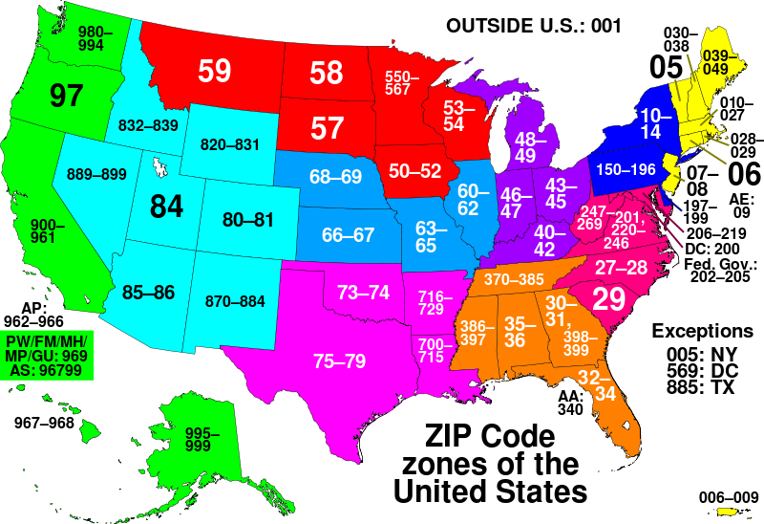
http://en.wikipedia.org/wiki/ZIP_code

Slide 6
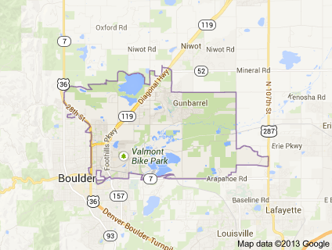
Google Maps

Slide 7
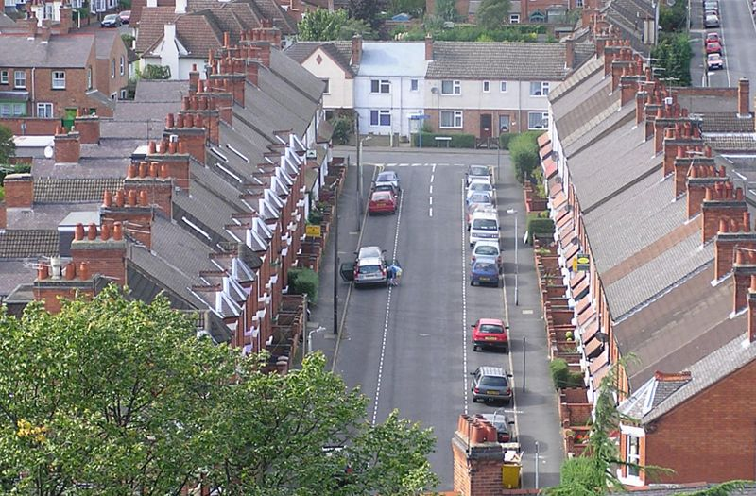
http://en.wikipedia.org/wiki/Terraced_house

Slide 8
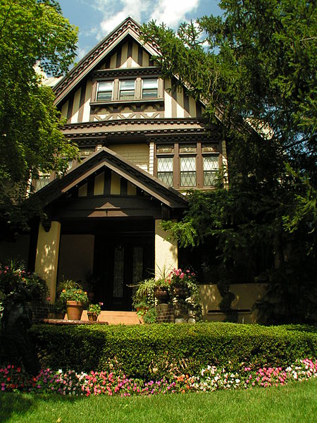
http://en.wikipedia.org/wiki/Single_family_house

Slide 9
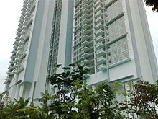
http://en.wikipedia.org/wiki/Condominium

Slide 10
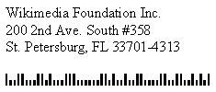
33701-4313-00-5-UNIT-358
Check digit (5) is not significant for walk sequence

Slide 11
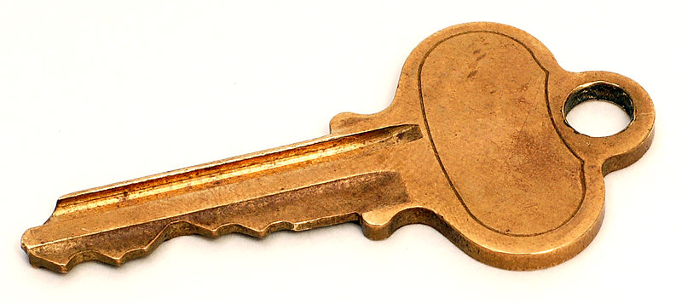
33701-4313-00-UNIT-358
Check digit (5) is not significant for walk sequence

Slide 12
Data Hygiene with Software
Coding Accuracy Support System (CASS)
The input of:
1 MICROWSOFT
REDMUND WA
Produces the output of:
1 MICROSOFT WAY
REDMOND WA 98052-8300
A List of CASS certified software vendors can be obtained from the US Postal Service
http://ribbs.usps.gov/files/vendors/cassn01d.TXT

Slide 13
Data Hygiene with CASS certified software
Create keys with zip5-zip4-dpbc-unit_type-unit_number
Use those keys for sorting, grouping, matching, etc.

Slide 14
Notes:
https://github.com/brianlong/street_address
I will be happy to process data for your open
Data project using my CASS software
(for free).
Q & A

