Slide 1
Working With Street Addresses
Brian Long
Twitter: @brianlong
GitHub: brianlong
Skype: brian.long.co
LinkedIn: http://www.linkedin.com/in/brianklong
#BOCC
Notes:
Let’s talk about street addresses.
My company crawls the web reading real estate for-sale advertisements and we process millions of street addresses each year. Our incoming data is very dirty with plenty of typos, spelling errors, or incomplete addresses.
Dealing with dirty data is difficult, but we use a little trick to help with sorting, grouping, and searching street addresses. Today, I would like to share this trick with you.

Slide 2
Common Problems
123 Main St S, Schenectady, NY 12345
123 S Main Street, Schenectady, NY
123 Main St South, Schenectady, NY 12345
123 South Main Street, Schenectady, NY 12345
123 Main St S, Schenectady, NY 12345
123 S Main St, Skanecktidy, NY 12346
Notes:
When processing and analyzing datasets with street addresses, we often see messy data like this. All of these entries are referring to the same address. However, the data formatting is inconsistent or has typographical errors. This inconsistency leads to problems with sorting, grouping, and searching.
One way to deal with this problem is to write your own code to standardize the addresses and hope that your sorting, grouping, and searching works out OK. It rarely does. Groan if you have tried this before.
Don’t’ worry, there is another way to work with street addresses that makes sorting, grouping, and searching quite easy. That story starts with this guy…

Slide 3

Cliff Clavin
http://en.wikipedia.org/wiki/Cliff_Clavin
Notes:
Most of us know Cliff. He is a great mail man, but he is no computer scientist. He doesn’t know about depth-first searches, breadth-first searches, or shortest-path algorithms. Although he can always find the shortest path to his next beer.
Yet, he somehow delivers the mail reliably every day. Fortunately, Cliff does work with some computer scientists and they created a special tool to help him…

Slide 4

Postal Barcode
ZIP Code
+4 Code
Delivery Point Code
http://en.wikipedia.org/wiki/ZIP_code, http://en.wikipedia.org/wiki/POSTNET
Notes:
It is this. A postal bar code. A postal bar code appears on every piece of mail delivered in the US. The barcode contains information related to the zip code and delivery point.
The ZIP code was introduced in the US in 1963 and the ZIP +4 was introduced in the 1980s.
Mr. ZIP promoted the use of ZIP codes for the post office during the 1960s and 1970s.
The POSTNET bar code shown here represents an 11 digit barcode, containing the ZIP Code, ZIP+4 Code, and the delivery point code. Versions of this bar code have been used for decades. There is also a new Intelligent Mail Bar Code that contains additional information about the mailer and the mail piece.
It is the information contained in the bar code that helps Cliff deliver the mail. It is also key to understand the bar code to efficiently analyze and process street addresses.
Let’s see how Zip Codes and bar codes work…

Slide 5
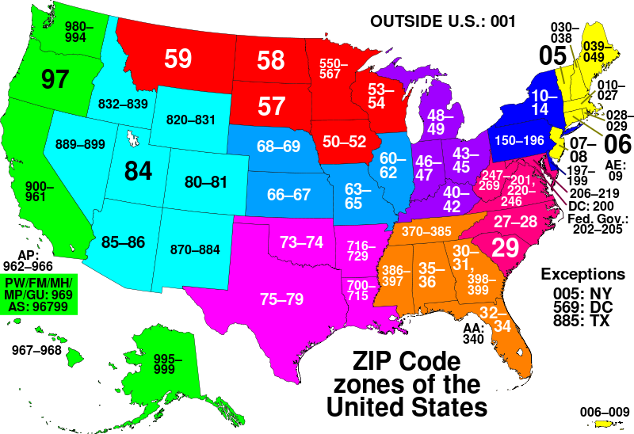
Zip Code Zones
Notes:
The US is split into zip code zones and these zones form the first 2 or 3 digits of a zip code. Here we can see that Colorado zip codes all start with 80 or 81.
The first 3 digits refer to a Sectional Control Facility (SCF) which will be contained within a zip code zone. So, ‘803’ will refer to a building that services all of the zip codes starting with 803.

Slide 6
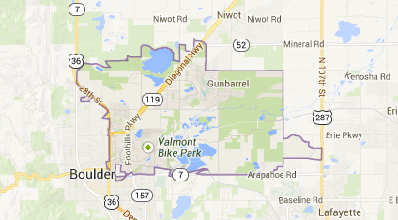
80301
Notes:
And here is a map showing an individual ZIP code in Boulder. You can even see that CU has been excluded from 80301. CU is large enough to have its own zip codes.

Slide 7
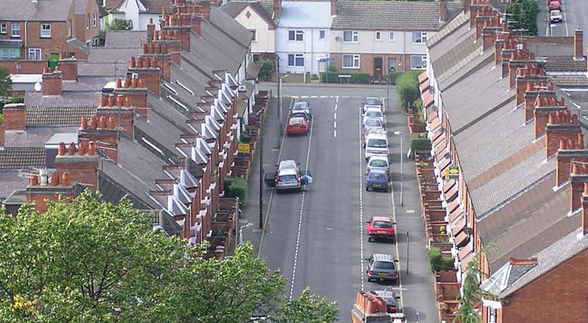
ZIP+4
http://en.wikipedia.org/wiki/Terraced_house
Notes:
9-digit ZIP codes were assigned in the 1980s by adding 4 digits to the ZIP. The post office has assigned a ZIP+4 code to small sections within a ZIP code. Typically, a +4 code is assigned to each side of the street on a particular block. So, in this photo, the homes on the left would share a 9-digit zip and the homes on the right would share a different 9-digit zip. There can be thousands of +4 codes within a single zip code.

Slide 8
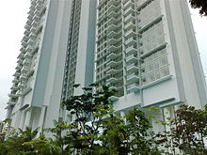
Highrise +4
http://en.wikipedia.org/wiki/Condominium
Notes:
In highrise buildings, the post office may assign different +4 codes for each floor. So, the residents on a given floor may share the same 9-digit zip code.

Slide 9
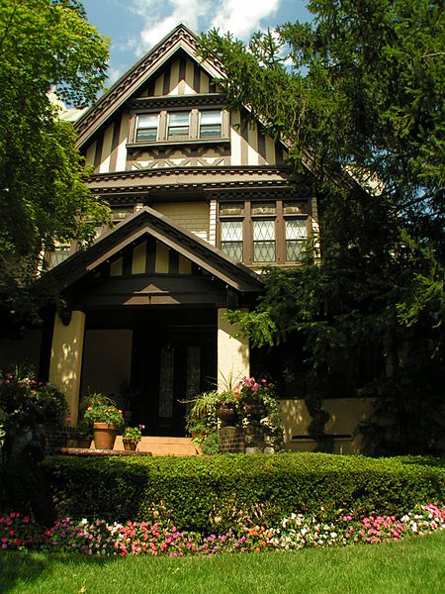
Delivery Point
http://en.wikipedia.org/wiki/Single_family_house
Notes:
Finally, to complete the bar code, the post office will add the last two digits of the house number to the Zip+4 code for a total of eleven digits. If this is 123 Main Street, the delivery point code will be ‘23’.
In a highrise building, the two digit delivery point code will usually be the same for all delivery points in the building and then the unit number is required for final delivery.

Slide 10
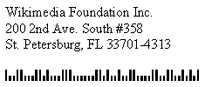
Final Delivery
33701-4313-00
UNIT-358
Notes:
Here is an example for Wikipedia.
33701 is the ZIP code, 4313 is the +4 code, and 00 is the delivery point code.
Inside the bar code, the post office also includes a check digit calculated with the sum modulo 10 of the bar code digits. This check digit is not important for our story. So I will ignore for the rest of this talk.
Since this is a highrise, we then add the unit information to complete the final walk sequence.
Thinking back to our friend Cliff, this is how he can deliver the mail so reliably. Every day, his mail is sorted into a walk sequence based on these codes. All he needs to do is pick up his mail for the day and follow the addresses in the order that they are sorted.
I previously mentioned that it was key to understand the bar code when working with street addresses. Well it turns out that this is a …

Slide 11
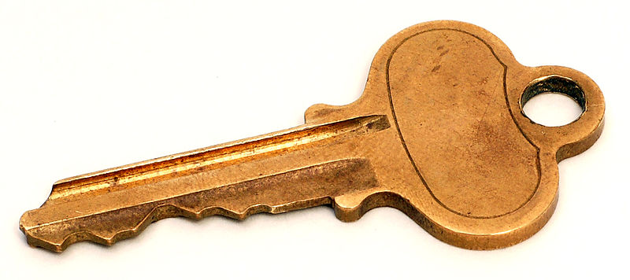
Unique Key
33701431300UNIT358
Notes:
Unique Key that we can use to create indexes for sorting, grouping, and search operations. Every deliverable address in the country has a unique code for sorting and delivering the mail.
Doesn’t it seem easier to work with this code than the mish-mash of street addresses that we saw in the first slide?
In my systems, I create an indexed database column for this key and use it for all of our sorting, grouping, and matching operations. It is an extremely fast and accurate way to process street addresses.
So, The last thing to talk about is how we get the information required to create the key.

Slide 12

Data Hygiene
Use 3rd Party Software to cleanup addresses:
1 Microwsoft Weigh, Redmund, WA => 1 Microsoft Way, Redmond, WA 98052-8300
[98052830099]
Coding Accuracy Support Software (CASS)
A list of CASS certified software vendors can be obtained from the USPS or by searching online.
http://ribbs.usps.gov/files/vendors/cassn01d.TXT
Notes:
Before processing data, we use 3rd party data hygiene software to standardize the address. In our case, the software is embedded into our systems. Stand-alone software and cloud services are also available.
All incoming data is scrubbed and the standardized address and bar code elements are returned.
For example, this incorrect address for Microsoft will be returned in the proper, standardized, format. The bar code data will be included too.
The post office certifies software vendors who create software that can clean up your data and prepare the addresses for mailing. The software is referred to as CASS certified or just CASS for short. You can find a list of CASS software providers from the post office or by searching online.
After this step, we then import the standardized data into our database and build the indexes.

Slide 13
Summary
Street addresses are messy data.
The post office provides a unique key that you can use for analysis.
Add a data hygiene step using third party CASS software.
Include the standardized data & bar code elements in your dataset.
Create an indexed key using the bar code data.
Search, sort, and group with ease.
Notes:
Street addresses are messy data.
Use third party CASS software for data hygiene.
Include the standardized address data & bar code elements in your dataset.
Create an indexed key using the bar code data.
See my GitHub account for this presentation and some miscellaneous Ruby code that may help you with your next project.

Slide 14
Questions?
What if a property doesn’t have a street address (e.g. vacant land)?
What if the address is incomplete?
Are there edge cases to be aware of?
Presentation & notes at https://github.com/brianlong/street_address
P.S. I will offer free CASS service for open data projects.

