Slide 1
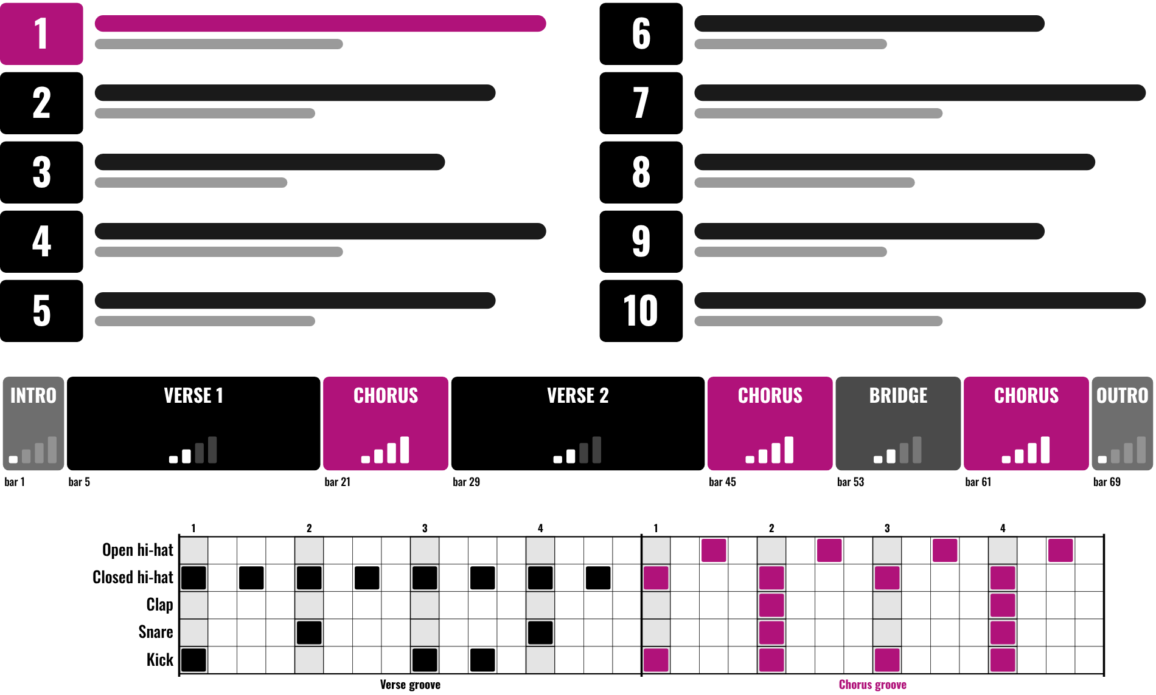
HUDSON BEAT
BILLBOARD TOP 10
Feat. this week’s Hot 100
DIGITAL MUSIC PRODUCTION 2 · CLASS 1 · SONG FORM AND DRUMS IN LOGIC PRO
Notes:
Class 1, the first minute. Have this week’s Billboard Hot 100 open on billboard.com, and the No. 1 song cued up on YouTube or Spotify from your own account; no audio, video or chart data are included in this deck. Open with my overview: your job is to pick one hit and recreate it in Logic Pro.

Slide 2
HUDSON BEAT
CLASS 1
LISTEN: THIS WEEK’S NO. 1
THIS WEEK’S BILLBOARD HOT 100
the No. 1 song
Teacher: open the chart; play the No. 1 from YouTube or Spotify.
How long until the first chorus?
What instruments can you hear?
Clap the beat: fast, medium or slow?
Billboard Top 10 · Intro deck · © 2026 Brian Lotze · Hudson Beat
2
Notes:
Play the first minute or so of the current No. 1 (preview it first: choose a clean version). The Hot 100 is published every week and has been since 1958; it ranks songs by streaming, sales and radio airplay. Take answers aloud. The point is my teacher note: listen analytically rather than passively.

Slide 3
HUDSON BEAT
CLASS 1
WHAT THE HECK IS EMULATION?
Recreating a track’s style and sound as closely as you can
Not just copying: reverse-engineering a hit
Same tempo, same form, your own drums
Then build your own version from scratch
Billboard Top 10 · Intro deck · © 2026 Brian Lotze · Hudson Beat
3
Notes:
Plain-English definition, from the project sheet vocabulary: emulation is recreating the style and sound of an existing track as closely as possible. From my overview: you are not just copying, you are reverse-engineering what makes a hit song work. The drum patterns must be self-created; percussion loops are okay as accents.

Slide 4
HUDSON BEAT
CLASS 1
SEVEN CLASSES
CLASS 1
Explore the Top 10 · Top 10 analysis · begin song form
CLASS 2
Finish the Song Form map · tempo and markers · drums
CLASS 3
Working day: build your foundation
CLASS 4
Working day: add layers
CLASS 5
Working day: refine the arrangement
CLASS 6
Mix and bounce · checklist · rubric · 3 questions
CLASS 7
Presentations with Padlet Q&A
Billboard Top 10 · Intro deck · © 2026 Brian Lotze · Hudson Beat
4
Notes:
The shape of the project, from my pacing guide. Class 1: explore the Top 10 and start the song form. Class 2: finish the map, then drums. Classes 3 to 5 are working days. Class 6: final mix and bounce, presentations prepared. Class 7: presentations with Padlet feedback. Hand out the project sheet now.

Slide 5
HUDSON BEAT
CLASS 1
STEP 1: EXPLORE THE TOP 10
1
Listen to all 10 songs
2
Fill in the Top 10 analysis
3
Pick one song with clear, easy-to-hear sections
4
Start counting bars: where does each section begin?
Billboard Top 10 · Intro deck · © 2026 Brian Lotze · Hudson Beat
5
Notes:
Students listen to all 10 songs with headphones and fill in the Top 10 analysis page. Steer them, as my notes say, away from heavily layered songs with 50 or more tracks and toward songs with clear, identifiable sections. Check song choices for school-appropriate content before they commit.

Slide 6
HUDSON BEAT
CLASS 1
SONG FORM: WHAT TO LISTEN FOR
Intro, verse, chorus, bridge, outro
Count the bars in every section
Write down when each section starts
Finish the Song Form map before Logic
Billboard Top 10 · Intro deck · © 2026 Brian Lotze · Hudson Beat
6
Notes:
Song form is the structure of a song: how sections like intro, verse, chorus and bridge are organized. Model counting bars aloud on the No. 1 from slide 2: count 1, 2, 3, 4 and say the bar number on each 1. Students begin their Song Form map today and finish it in Class 2, before they open Logic.

Slide 7
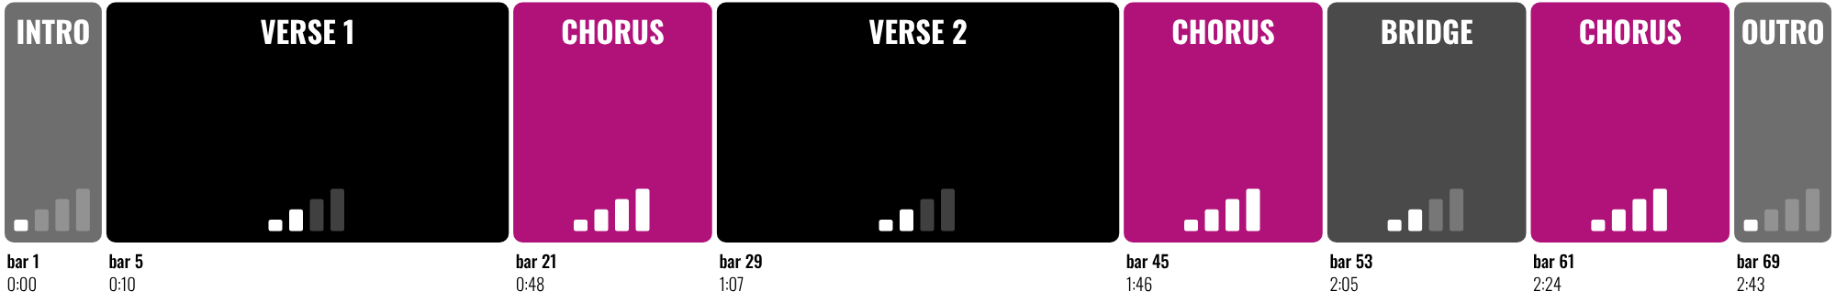
HUDSON BEAT
CLASS 2
WORKED EXAMPLE: A MAPPED SONG
72 bars at 100 BPM: 2:53
Count bars, not seconds
One Arrangement Marker per section
Verses 16 bars, choruses 8
Billboard Top 10 · Intro deck · © 2026 Brian Lotze · Hudson Beat
7
Notes:
Class 2. This is an original practice map, not a real song, so the numbers are easy to check: 72 bars at 100 BPM. One bar of 4/4 at 100 BPM lasts 2.4 seconds, so the second verse starts at bar 29, 67.2 seconds in (1:07), and the whole map runs 2:53. Students' maps come from their own song; check each one before they open Logic.

Slide 8
HUDSON BEAT
CLASS 2
WATCH ME: TEMPO AND MARKERS
1
Count the beats for 15 seconds, then × 4 = BPM
2
Set the project tempo to match
3
Metronome on (K): play the song alongside it
4
Global Tracks (G): one Arrangement Marker per section
5
Save as: Your Name – Billboard Top 10
Billboard Top 10 · Intro deck · © 2026 Brian Lotze · Hudson Beat
8
Notes:
A three-minute demo. Count beats for 15 seconds: 25 beats times 4 is 100 BPM. Set the project tempo, turn on the metronome and play the song next to it; if the click drifts, nudge the tempo by one. Then Global Tracks, Arrangement track: add one marker per section, sized to its bars, named as on the Song Form map. The requirement is to match the tempo exactly.

Slide 9
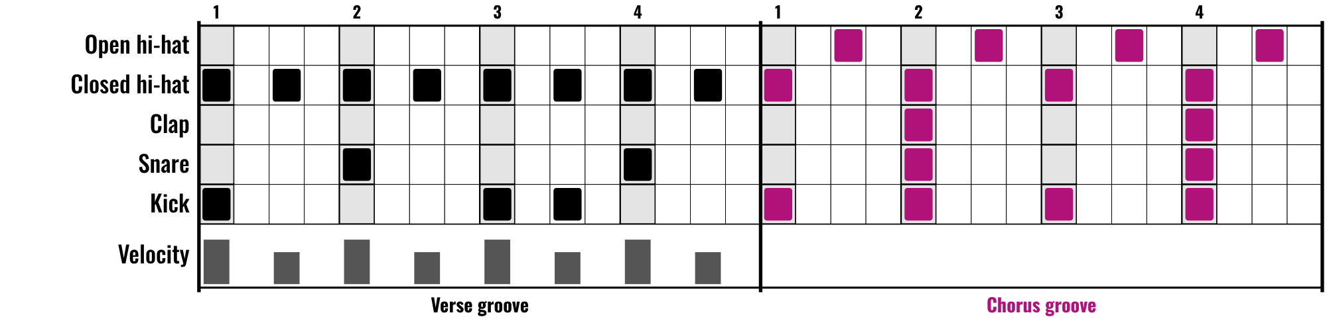
HUDSON BEAT
CLASS 2
WORKED EXAMPLE: BREAK DOWN THE DRUMS
Verse: hi-hat eighths, snare on 2 and 4
Chorus: kick on every beat, open hi-hats
A clap doubles the snare in the chorus
Velocity: louder on the beat, softer between
Billboard Top 10 · Intro deck · © 2026 Brian Lotze · Hudson Beat
9
Notes:
Break the beat into kick, snare and hi-hat, one sound at a time: listen for the hi-hat first, then the snare, then the kick. In this practice example the verse is laid back and the chorus pushes, with a kick on every beat. The velocity lane shows my tip against robotic drums: accents on the beat, softer hits between.

Slide 10
HUDSON BEAT
CLASS 2
WATCH ME: PROGRAM THE DRUMS
1
New track: an Electronic Drum Kit (Drum Machine Designer)
2
Pattern region at the first verse marker
3
Kick, snare, hi-hat first: copy what you hear
4
Vary the velocity so it doesn’t sound robotic
5
Copy it into every section that uses it
Billboard Top 10 · Intro deck · © 2026 Brian Lotze · Hudson Beat
10
Notes:
A short demo. An Electronic Drum Kit loads Drum Machine Designer. Control-click at the first verse marker, Create Pattern Region, double-click for the Step Sequencer. Program what you hear, then vary velocity and nudge a few notes for human feel. Drum patterns must be self-created; percussion loops only as accents.

Slide 11
HUDSON BEAT
CLASS 3
BUILD YOUR FOUNDATION
Bass, chords and core instruments
Match the original’s energy, section by section
Pick sounds that fit the genre
Your drums are the backbone
Billboard Top 10 · Intro deck · © 2026 Brian Lotze · Hudson Beat
11
Notes:
Class 3 is the first working day. Step 4 of the project sheet: lay down bass, chords and core instrumentation to match the original’s energy. Circulate with the song form maps in hand. My tip to repeat: your drums are the backbone; if the beat doesn’t feel right, the whole track will feel off.

Slide 12
HUDSON BEAT
CLASS 4
ADD LAYERS
Melodies, pads, FX and transitions
Match the fullness of the original
Capture the vibe, structure and energy
You don’t need every single sound
Billboard Top 10 · Intro deck · © 2026 Brian Lotze · Hudson Beat
12
Notes:
Class 4, a working day. Step 5: fill in melodies, pads, FX and transitions to match the fullness of the original. From my tips: don’t try to perfectly match every single sound; focus on capturing the vibe, structure and energy. Class 5 is a full working day with no new slide: refine the arrangement.

Slide 13
HUDSON BEAT
CLASS 6
MIX AND REFINE
EQ every track
Pan for width
Adjust levels
Add plug-ins for authenticity
Billboard Top 10 · Intro deck · © 2026 Brian Lotze · Hudson Beat
13
Notes:
Class 6, final mix and bounce. Step 6 of the sheet, word by word on the slide. My notes warn that students copy the arrangement but ignore the mix, and the EQ and panning step often gets skipped, so make it visible: ask every student to show you one EQ and one pan change before they bounce.

Slide 14
HUDSON BEAT
CLASS 6
WHAT YOU TURN IN
Top 10 analysis completed
Song form as Arrangement Markers in Logic
Bounced .mp3 or .wav uploaded
Zipped .logicx project uploaded
Named: Your Name – Billboard Top 10
Padlet post with your 3 questions
Answer 2 questions on classmates’ posts
Billboard Top 10 · Intro deck · © 2026 Brian Lotze · Hudson Beat
14
Notes:
The submission checklist from the project sheet, condensed. Export: File, Bounce, Project or Section, MP3 or WAV. Compress: in Finder, Control-click the .logicx project and choose Compress. Show where students upload (your class page) and where the Padlet board is.

Slide 15
HUDSON BEAT
CLASS 6
HOW IT’S SCORED
CREATIVITY & ORIGINALITY
5 = Exceptional creativity; innovative, bold, and expressive
/ 5
TECHNICAL SKILL / DAW USE
5 = Expert-level command of multiple Logic systems
/ 5
COMPOSITION & STRUCTURE
5 = Professional pacing, flow, and musical arc
/ 5
SOUND DESIGN & MIX QUALITY
5 = Exceptional sound design; professional-quality mix
/ 5
DOCUMENTATION & PRESENTATION
5 = Exceptional; thorough insight and polished delivery
/ 5
SCORED 1–5 · FINAL GRADE = AVERAGE OF YOUR SCORE AND MINE · / 25
Billboard Top 10 · Intro deck · © 2026 Brian Lotze · Hudson Beat
15
Notes:
My rubric: five categories, each scored 1 to 5, for a total out of 25. Students score themselves first; the final grade is the average of their score and mine. The slide reads the 5 column of each category aloud. Hand out the rubric page so students can self-score before they present.

Slide 16
HUDSON BEAT
CLASS 7
PRESENTATION DAY
Play your track for the class
Your Padlet post: 3 questions about your project
Answer at least 2 of each classmate’s 3
Listen like a producer: what made it work?
Billboard Top 10 · Intro deck · © 2026 Brian Lotze · Hudson Beat
16
Notes:
Class 7, presentations with Padlet Q and A. Each student plays their track and says which song they recreated. During classmates’ presentations, every student answers at least 2 of their 3 questions on their Padlet post. Keep the original song available in case the class wants to compare a section.

Slide 17
HUDSON BEAT
CLASS 7
ONE LAST THING…
You studied a hit.
You matched its tempo and form.
You built the drums yourself.
You listened like a producer.
Billboard Top 10 · Intro deck · © 2026 Brian Lotze · Hudson Beat
17
Notes:
Close with what my teacher notes say this project does: it teaches students to listen analytically rather than passively. They matched a real hit’s tempo, form and instrumentation with precision, and still made creative production choices of their own. That is how producers learn.

