Slide 1
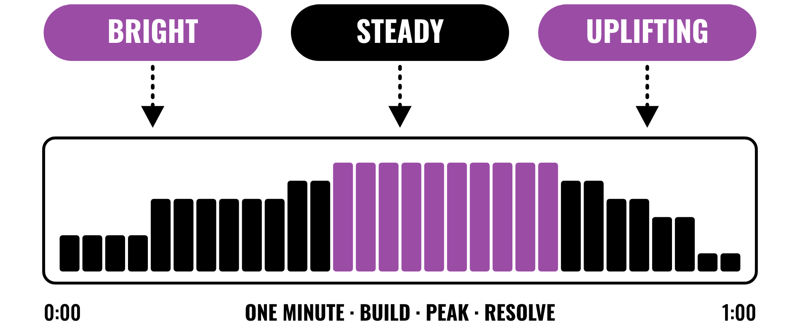
HUDSON BEAT
ROYALTY FREE
Music with a job to do.
DIGITAL MUSIC PRODUCTION 2 · CLASS 1 · MUSIC WITH A JOB TO DO
Notes:
Class 1, the first minute. No audio is included in this deck. Open with my overview: you are composing music for the real world. Create a 1-minute piece of royalty-free music that could score a video for the school district, anything from sports highlights to facilities tours, guided by 3 descriptive words you choose from a provided list.

Slide 2
HUDSON BEAT
CLASS 1
THINK: MUSIC WITH A JOB
THINK, THEN SHARE
Teacher: describe a 30-second video of a school sports highlight, first with no music and then with music. No audio is needed.
What does the music need to do for that video?
What changes if a calm piece plays under it instead?
Who must give permission to use a song?
Royalty Free · Intro deck · © 2026 Brian Lotze · Hudson Beat
2
Notes:
Ask the three questions aloud and take a few answers. Nothing is played from a speaker; describe a short video and let students imagine two kinds of music under it. No one else's music is included in this kit. This sets up my teacher note that students love knowing their music might actually get used, and my goal of understanding what makes music functional for media use.

Slide 3
HUDSON BEAT
CLASS 1
WHAT IS ROYALTY FREE?
Compose a 1-minute piece for media use
Guided by 3 descriptive words
No copyrighted samples; the arrangement is yours
Compose for a purpose, not just yourself
Royalty Free · Intro deck · © 2026 Brian Lotze · Hudson Beat
3
Notes:
My overview and goals, shortened to fit the slide. You are composing music for the real world: a 1-minute piece of royalty-free music that could score a video for the school district. Your sound and mood are guided by 3 descriptive words you choose from a provided list. My goals are to compose from keywords rather than personal preference, understand what makes music functional, practice efficient composition within a defined length and mood, and match musical choices to a visual or emotional context.

Slide 4
HUDSON BEAT
CLASS 1
SEVEN CLASSES
CLASS 1
Music with a job · five steps · four words · choose and plan
CLASS 2
Working day: words become sound, the brief
CLASS 3
Working day: compose, build-peak-resolve, worked example
CLASS 4
Working day: pick a vibe and commit
CLASS 5
Mix · reflection paragraph · bounce
CLASS 6
Checklist · rubric
CLASS 7
Presentations with Padlet Q&A
Royalty Free · Intro deck · © 2026 Brian Lotze · Hudson Beat
4
Notes:
The shape of the project, from my pacing guide. Class 1: introduction and word list; choose 3 words, brainstorm and begin composing. Classes 2 to 4 are working days: compose and refine your 1-minute piece. Class 5: mix and finalize, and write the reflection paragraph. Class 6: final bounce and prepare presentations. Class 7: presentations with Padlet Q and A peer feedback. Hand out the project sheet and the Word list now.

Slide 5
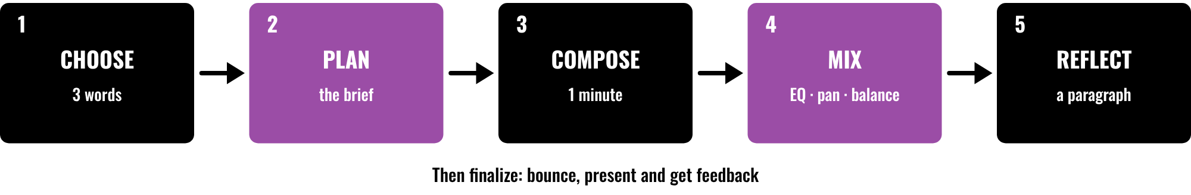
HUDSON BEAT
CLASS 1
FIVE STEPS, THEN FINISH
Choose 3 descriptive words
Plan how sound shows each word
Compose and mix one minute
Reflect, bounce and present
Royalty Free · Intro deck · © 2026 Brian Lotze · Hudson Beat
5
Notes:
Class 1. The first five steps of my project sheet, in order: choose your words, plan, compose, mix, and write the reflection paragraph. Then students finalize with a bounce and present with Padlet feedback. Point to each box and say roughly when it happens: choosing and planning today, composing on the working days, mixing and the paragraph in Class 5. The step names are mine; the picture and its short labels are the kit's own.

Slide 6
HUDSON BEAT
CLASS 1
FOUR WORDS TO KNOW
Royalty-Free: no ongoing fees, no copyrighted samples
Descriptive words: the mood of a piece
Scoring: music written to go with visuals
Apple Loops: allowed, but the arrangement is yours
Royalty Free · Intro deck · © 2026 Brian Lotze · Hudson Beat
6
Notes:
My four vocabulary terms, shortened to fit the slide. Royalty-Free: music that can be used without paying ongoing fees, with no copyrighted samples. Descriptive Words: adjectives that define the mood and character of a piece, for example upbeat or cinematic. Scoring: writing music specifically designed to accompany visual media. Apple Loops: pre-made loops in Logic, allowed here, but the arrangement must be your own. The full definitions are on the vocabulary page.

Slide 7
HUDSON BEAT
CLASS 1
STEPS 1 AND 2: CHOOSE, PLAN
1
Review the word list and pick 3 that define your mood
2
Brainstorm how instruments, rhythm and melody bring them to life
3
Write your 3 words at the top of your Creative brief
4
Name where your music would be used
Royalty Free · Intro deck · © 2026 Brian Lotze · Hudson Beat
7
Notes:
Steps 1 and 2 of the project sheet, shortened to fit the slide. Step 1, choose your words: review the word list and pick 3 that define your track's mood. Step 2, plan: brainstorm how instruments, rhythm and melody bring those words to life. The last two lines are the kit's own suggestions, not my steps: write the words at the top of the Creative brief, and name where the music would be used, which is my first tip. Hand out the Word list and the Creative brief.

Slide 8
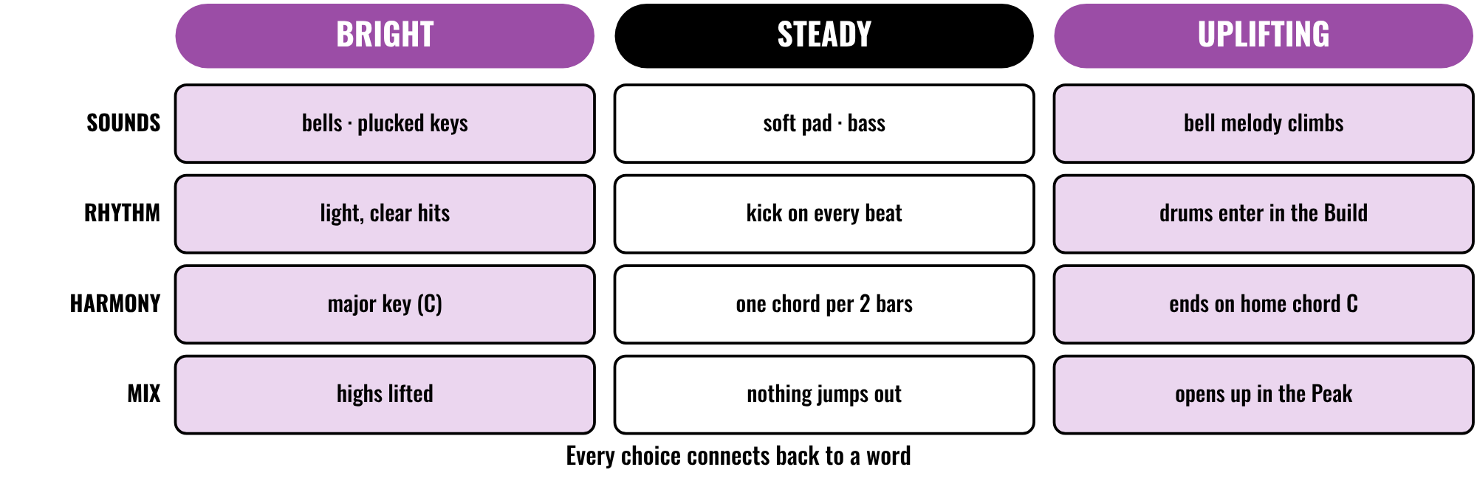
HUDSON BEAT
CLASS 2
WORDS BECOME SOUND
An invented brief on paper
Three words, four kinds of choice
Every choice points back to a word
Your words are your creative brief
Royalty Free · Intro deck · © 2026 Brian Lotze · Hudson Beat
8
Notes:
Class 2. A kit picture, not from my sheets: an invented brief on paper. Three words from the list, Bright, Steady and Uplifting, each turned into choices about sounds, rhythm, harmony and the mix. Ask students to pick one cell and say what they would hear. The Creative brief page lets them do the same for their own three words. Nothing here is audio.

Slide 9
HUDSON BEAT
CLASS 2
YOUR 3 WORDS ARE YOUR BRIEF
Every choice should connect back to them
Stuck? Ask which word a layer is for
Listen to a royalty-free piece and name its words
Keep the place it would be used in mind
Royalty Free · Intro deck · © 2026 Brian Lotze · Hudson Beat
9
Notes:
My third tip and my first struggle, shortened to fit the slide. Your 3 words are your creative brief, and every choice should connect back to them. Students sometimes ignore their words and just make what they want, so keep asking which word a layer is for. The second and third lines are the kit's own suggestions: the Listening log is a place to study a royalty-free piece the student chooses, and my first tip, keep the real use in mind, is the fourth line.

Slide 10
HUDSON BEAT
CLASS 3
STEP 3: COMPOSE
1
Build your 1-minute piece in Logic
2
Use layers that suit the style
3
Apple Loops are fine; the arrangement must be original
4
Log each layer as your own, a loop or both
Royalty Free · Intro deck · © 2026 Brian Lotze · Hudson Beat
10
Notes:
Step 3 of the project sheet and requirements 3 and 4, shortened to fit the slide. Step 3, compose: build your 1-minute piece in Logic. Requirement 3: your music must be royalty-free, with no copyrighted samples; Apple Loops are allowed but the arrangement must be original. Requirement 4: use layers appropriate to the style. The last line is the kit's own suggestion, not my step: the Layers and mix sheet asks students to say which layers they made, which are loops and what they changed, which answers my third struggle, over-reliance on Apple Loops.

Slide 11
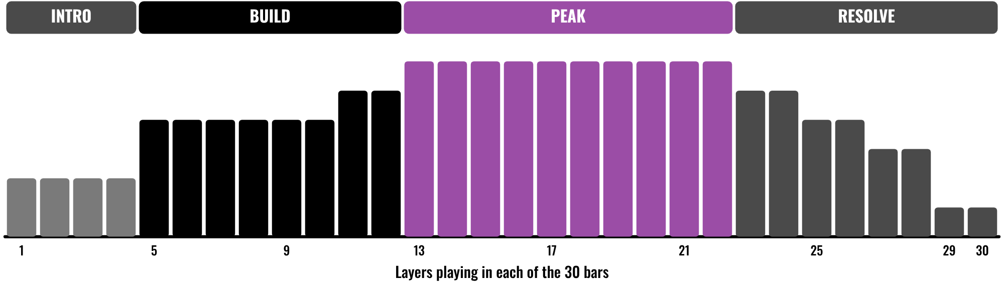
HUDSON BEAT
CLASS 3
BUILD, PEAK, RESOLVE
An invented piece, on paper
Fewer layers, then more, then fewer
The peak has the most layers
Build, peak, resolve
Royalty Free · Intro deck · © 2026 Brian Lotze · Hudson Beat
11
Notes:
Class 3, the first working day after the brief. A kit picture of an invented piece: how many layers play in each of 30 bars. It starts with two, grows through the build, has its most layers in the peak and thins out to a single pad at the end. My second struggle is that tracks feel incomplete at 1 minute, and my fix is a simple arc: build, peak, resolve. Students can plan their own on the Arrangement plan.

Slide 12
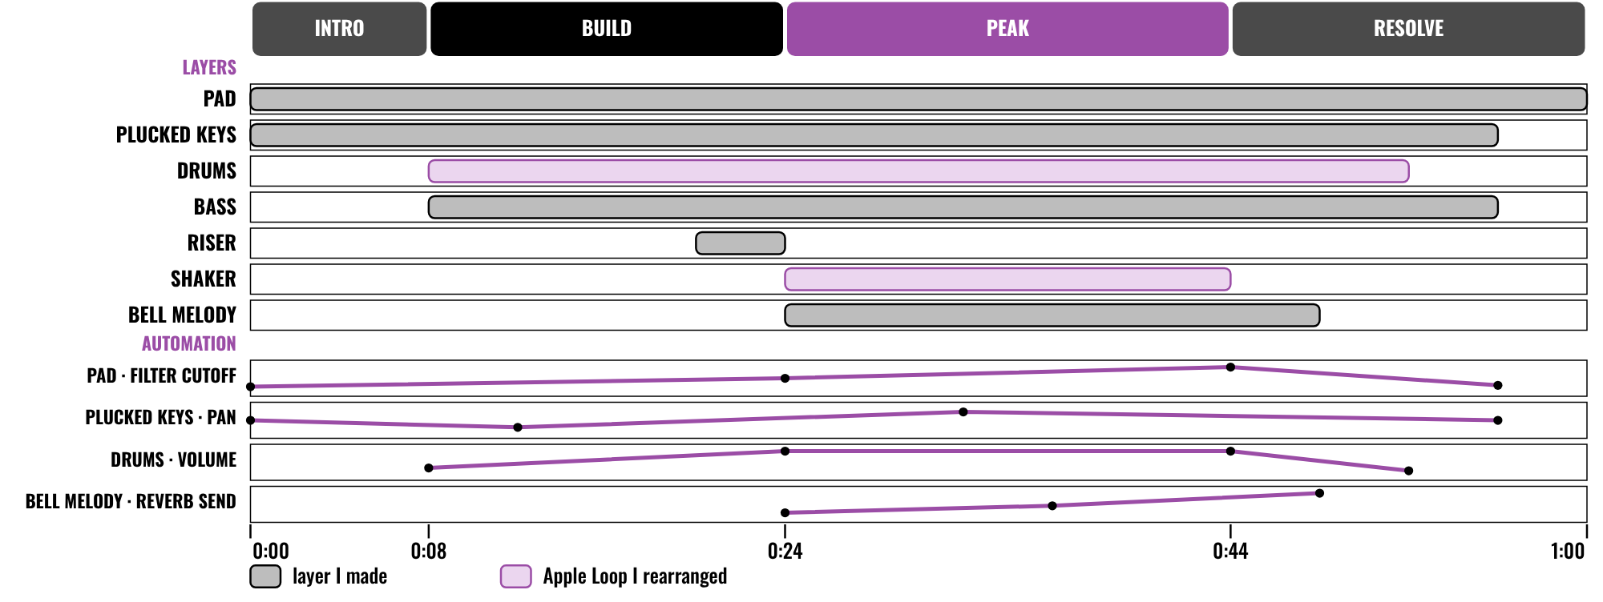
HUDSON BEAT
CLASS 3
WORKED EXAMPLE: 60 SECONDS
An invented 60-second piece
Four sections you can name
Seven layers, two are loops
Four automation lanes, none flat
Royalty Free · Intro deck · © 2026 Brian Lotze · Hudson Beat
12
Notes:
Class 3. An invented piece, Open Doors, described on paper for an invented video; nothing here is audio. It is 60 seconds, 30 bars at 120 BPM, in four sections: intro, build, peak and resolve. Seven layers join and leave, and two are Apple Loops that the student cut and rearranged. Below them are four automation lanes, and none is flat. The chords, the numbers and the weak and clear plans are on the worked example pages.

Slide 13
HUDSON BEAT
CLASS 4
ONE MINUTE GOES FAST
Pick a vibe and commit
Don’t cram too many ideas in
Give it a simple arc: build, peak, resolve
Check the length: 60 seconds, give or take
Royalty Free · Intro deck · © 2026 Brian Lotze · Hudson Beat
13
Notes:
My second tip and my second struggle, shortened to fit the slide. One minute goes fast, so do not cram too many ideas in; pick a vibe and commit. Tracks can feel incomplete at 1 minute, so encourage a simple arc: build, peak, resolve. The last line is the kit's own reminder: the length is 1 minute, give or take a few seconds, and bars times 240 divided by tempo gives seconds. Ask each student to play their first 20 seconds and say which of their words they hear.

Slide 14
HUDSON BEAT
CLASS 5
STEP 4: MIX
EQ, pan and balance your tracks
Apply EQ and plug-ins to shape your mix
Can you hear every layer?
Do your 3 words still come through?
Royalty Free · Intro deck · © 2026 Brian Lotze · Hudson Beat
14
Notes:
Step 4 and requirement 5, shortened to fit the slide. Mix: EQ, pan and balance your tracks, and apply EQ and plug-ins to shape your mix. The last two lines are the kit's own questions for the Layers and mix sheet: close your eyes and listen for each layer, then for each of the three words. Students fix the one thing that hides a word.

Slide 15
HUDSON BEAT
CLASS 5
STEPS 5 AND 6: REFLECT, BOUNCE
1
Write your reflection paragraph
2
Explain how the song reflects your 3 words
3
Bounce your track with the correct file name
4
Zip the .logicx project
Royalty Free · Intro deck · © 2026 Brian Lotze · Hudson Beat
15
Notes:
Class 5. Steps 5 and 6 of the project sheet, shortened to fit the slide. Write your reflection paragraph explaining your creative choices, and requirement 6, explain how your song reflects your 3 chosen words. Finalize: bounce your track with the correct file name format. My fourth struggle is that the paragraph is an afterthought, so students plan it on the Reflection page first. A reflection is a written or oral conversation about how they did and what they would do differently next time. The last line is the kit's own reminder to zip the project.

Slide 16
HUDSON BEAT
CLASS 6
WHAT YOU TURN IN
Bounced .mp3 or .wav
Zipped .logicx project
Named: Your Name – Royalty Free – Word, Word, Word
Reflection paragraph
Padlet post with 3 questions
Answer 2 questions on classmates’ posts
Royalty Free · Intro deck · © 2026 Brian Lotze · Hudson Beat
16
Notes:
The submission checklist from the project sheet, shortened to fit the slide. Show where students upload (your class page) and where the Padlet board is. The file name is Your Name, Royalty Free, then the three words, in that order. Check that every track is about 1 minute before students bounce.

Slide 17
HUDSON BEAT
CLASS 6
HOW IT’S SCORED
CREATIVITY & ORIGINALITY
5 = Exceptional creativity; innovative, bold, and expressive
/ 5
TECHNICAL SKILL / DAW USE
5 = Expert-level command of multiple Logic systems
/ 5
COMPOSITION & STRUCTURE
5 = Professional pacing, flow, and musical arc
/ 5
SOUND DESIGN & MIX QUALITY
5 = Exceptional sound design; professional-quality mix
/ 5
DOCUMENTATION & PRESENTATION
5 = Exceptional; thorough insight and polished delivery
/ 5
SCORED 1–5 · FINAL GRADE = AVERAGE OF YOUR SCORE AND MINE · / 25
Royalty Free · Intro deck · © 2026 Brian Lotze · Hudson Beat
17
Notes:
My rubric: five categories, each scored 1 to 5, for a total out of 25. Students score themselves first; the final grade is the average of their score and mine. The slide reads the 5 column of each category aloud. Hand out the rubric page so students can self-score before they present.

Slide 18
HUDSON BEAT
CLASS 7
PRESENTATION DAY
Play your track; say your 3 words
Say where each word shows up
Your Padlet post: 3 questions about your project
Answer at least 2 of each classmate’s 3
Royalty Free · Intro deck · © 2026 Brian Lotze · Hudson Beat
18
Notes:
Class 7, presentations with Padlet Q and A. Step 7 of the project sheet, shortened to fit the slide: create your own Padlet post with 3 questions you want classmates to answer, present to the class, and during classmates' presentations answer at least 2 of their 3 questions. The first two lines are the kit's own suggestions. Ask the class to name the three words before the presenter does.

Slide 19
HUDSON BEAT
CLASS 7
ONE LAST THING…
You got a brief.
You made your choices.
You kept it to a minute.
Now press play.
Royalty Free · Intro deck · © 2026 Brian Lotze · Hudson Beat
19
Notes:
Close with my teacher notes: this project pairs well with real district videos, and students love knowing their music might actually get used. Ask a few students which word they heard most in a classmate's track. Tell them the next project starts from the menu.

