Slide 1
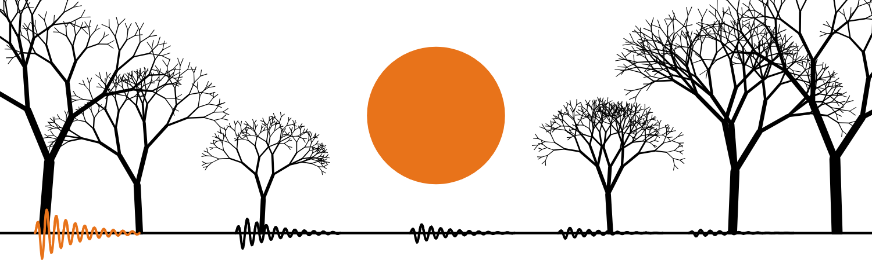
HUDSON BEAT
SPOOKY TUNES
Feat. the Halloween theme
DIGITAL MUSIC PRODUCTION · UNIT 6 · SCORING TO PICTURE IN LOGIC PRO
Notes:
Day 1, after you have played the woods video once with no comment. Tell students this is their first open-ended project: no chord progression, no song form, no right answer. Their brief is one minute of video and the job is to score it so the music makes the video feel the way it looks. Have the two listening examples cued up on YouTube or Spotify (your own account; no audio or video is included in this deck).

Slide 2
HUDSON BEAT
LISTEN FIRST
HALLOWEEN (MAIN TITLE)
John Carpenter
Teacher: play about 60 seconds from YouTube or Spotify.
What makes it scary?
What keeps repeating?
Does it feel bright or dark?
Spooky Tunes · Intro deck · © 2026 Brian Lotze · Hudson Beat
2
Notes:
Play roughly the first minute of the Halloween theme by John Carpenter. Ask the three questions and collect answers on the board, but do not confirm anything yet: feel it before you name it. Students usually notice the piano figure that keeps circling, that it never resolves, and that it is dark. Some will notice it is hard to count in 4: the piano pattern is famously counted in 5. Keep their words for slide 4.

Slide 3
HUDSON BEAT
LISTEN FOR THE SPACE
STRANGER THINGS (MAIN THEME)
Kyle Dixon & Michael Stein
Teacher: play about 60 seconds from YouTube or Spotify.
Does it sound close, or far away?
Can you hear echoes or a ‘room’ around the sound?
What would it sound like totally dry?
Spooky Tunes · Intro deck · © 2026 Brian Lotze · Hudson Beat
3
Notes:
Play the opening of the Stranger Things theme by Kyle Dixon and Michael Stein. This time the question is about space rather than notes: does the sound feel close or far away, is there a room or echo around it? Ask a student to describe what it would sound like with no space at all. That is the difference between dry and wet, which they will name on slide 5.

Slide 4
HUDSON BEAT
WHAT MAKES MUSIC SPOOKY?
Minor keys: darker than major
Half steps: two notes that rub
Space: reverb and delay make it feel big and far away
Silence: the sound after it feels enormous
Spooky Tunes · Intro deck · © 2026 Brian Lotze · Hudson Beat
4
Notes:
Connect their answers from the listening to four tools. Minor keys sound darker (they met major and minor earlier in the course; if not, the Minor Key Map covers it). Half steps are the smallest distance on the keyboard: play E and F together on the projector so they hear the rub. Space comes from reverb and delay. Silence is a sound too: a sound after silence feels enormous. These are tools, not rules: no key is required, and a score with no key at all is fine.

Slide 5
HUDSON BEAT
SPACE IS A SOUND
REVERB
DELAY
DRY
WET
a room, hall or cave around the sound
an echo that repeats
the original sound
the effect only
Spooky Tunes · Intro deck · © 2026 Brian Lotze · Hudson Beat
5
Notes:
Plain-English definitions. Reverb simulates a space; decay is how long the tail lasts. Delay repeats the sound after a set time; feedback is how many repeats. Dry is the untouched sound; wet is only the effect. If you can, play one short sound in Logic dry, then with heavy reverb, then with a long delay. The unit's mixing concept is reverb and delay via a bus, and its big idea is the line on this slide: space is a sound.

Slide 6
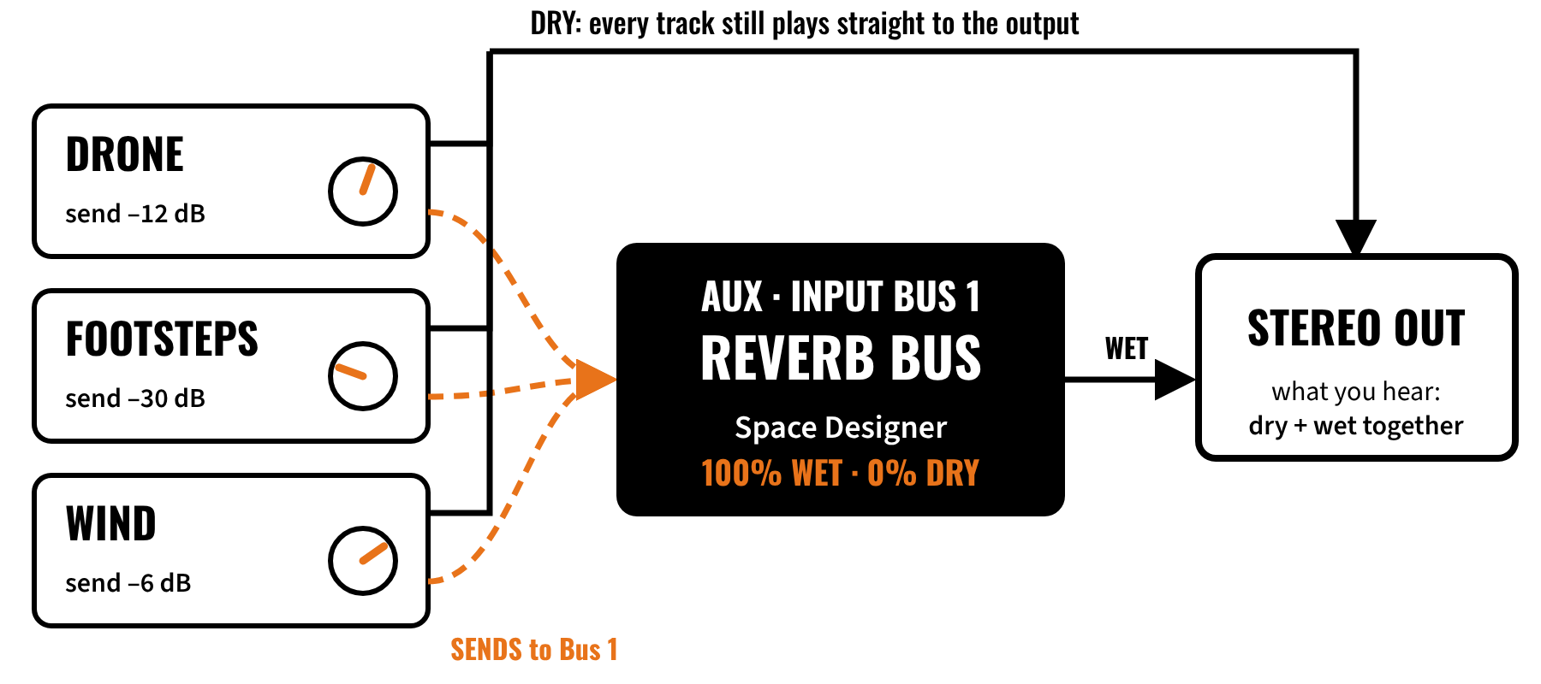
HUDSON BEAT
WHAT THE HECK IS A BUS?
Spooky Tunes · Intro deck · © 2026 Brian Lotze · Hudson Beat
6
Notes:
A bus is a shared channel. Instead of a reverb plugin on every track, you build one reverb on an Aux channel and each track sends some of its sound to it. Walk the diagram: each track still plays dry straight to the Stereo Out; the send knob decides how much of it also goes to Bus 1; the Aux adds only the wet reverb. Three reasons: consistency (one shared space), control (one fader for all the reverb) and efficiency (one plugin, less CPU).

Slide 7
HUDSON BEAT
NEAR OR FAR?
Same footstep: reverb send at –30 dB, then at –6 dB
Which one sounds closer?
Which one sounds farther away?
Why not just put the reverb on every track?
Spooky Tunes · Intro deck · © 2026 Brian Lotze · Hudson Beat
7
Notes:
Guided listening in Logic: play one footstep or tap with a low reverb send, then a high one. Students will say the low send sounds close and the high send sounds far away. That is the whole idea of depth in a mix: near things are dry, far things are wet. The last question sets up the demo: separate reverbs on every track can’t be controlled together and don’t sound like one shared space.

Slide 8
HUDSON BEAT
WATCH ME: THE REVERB BUS
1
Mixer (X): on a track, click an empty Send slot, choose Bus 1
2
Logic creates an Aux channel. Name it REVERB BUS
3
On the Aux insert: Reverb › Space Designer, a large-space preset
4
In Space Designer: Dry 0%, Wet 100%
5
Raise the track’s send (start around –15 dB), then send 2 more tracks
Spooky Tunes · Intro deck · © 2026 Brian Lotze · Hudson Beat
8
Notes:
This is the worked example in Logic; do it live while students watch with laptops closed for building (the full 8-step demo script is in the teacher notes). After step 5 play the project and ask what changed. Then give two other tracks different send levels and ask which sounds nearer. Finish by having one student rebuild the reverb bus from scratch on their own computer while the class watches.

Slide 9
HUDSON BEAT
THEN THE DELAY BUS
1
On a track, click an empty Send slot, choose Bus 2
2
On the new Aux: Delay › Tape Delay. Name it DELAY BUS
3
Tape Delay: Dry 0%, Wet 100%
4
Send lower than the reverb: try –20 to –25 dB
5
Long time (600–900 ms) + more feedback = eerie
Spooky Tunes · Intro deck · © 2026 Brian Lotze · Hudson Beat
9
Notes:
The second setup goes faster because students now understand the pattern. Point out that a track can have two sends, one to each bus. Suggest delay on only one or two sounds: selective delay draws the ear. Turning off tempo sync lets the echoes float freely, which often feels more unsettling. Students set up the delay bus at the start of Day 2.

Slide 10
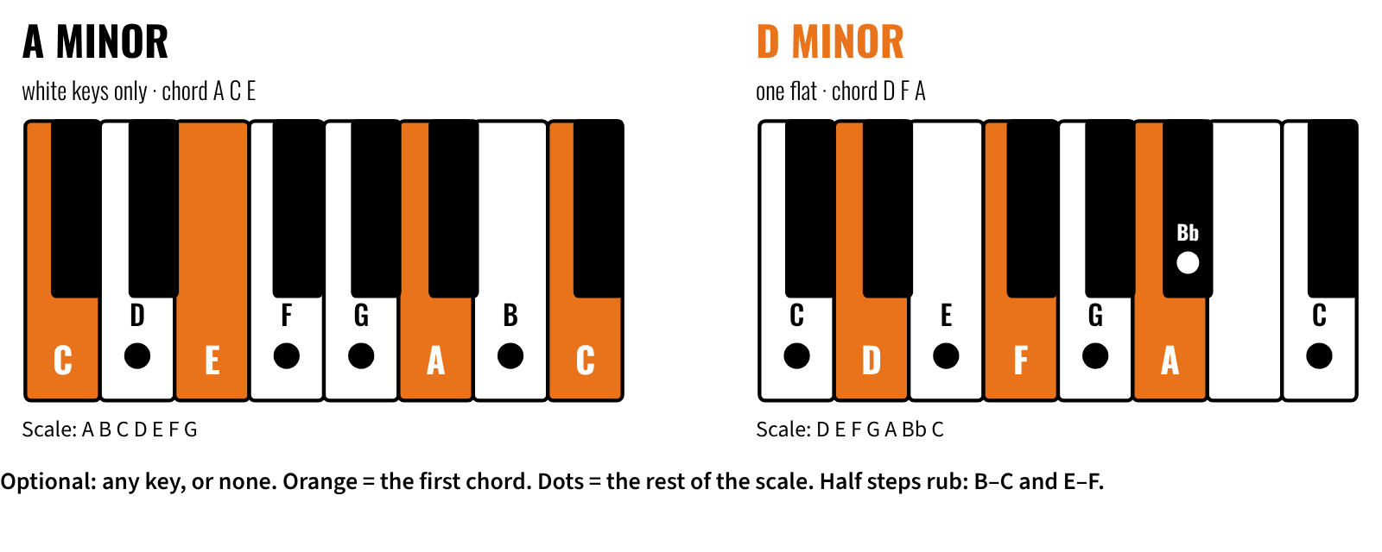
HUDSON BEAT
OPTIONAL: TRY A MINOR KEY
Spooky Tunes · Intro deck · © 2026 Brian Lotze · Hudson Beat
10
Notes:
Day 2. No key is required: students may work in any key, or in none, and atonal or sound-effect scores are fine. For anyone who wants a darker harmonic home, a minor key helps. The examples are A minor (white keys only) and D minor (one flat, B-flat). The orange keys are the first chord: root, third and fifth (A C E, D F A). The dots are the scale. The Minor Key Map and the reference card (eight minor keys) are optional reference pages. A student who changes key at a big moment should move the drone or bass too, or nobody hears the change.

Slide 11
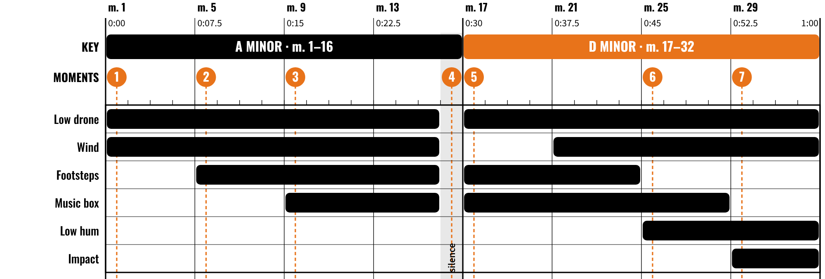
HUDSON BEAT
WORKED EXAMPLE: SCORING THE WOODS
32 measures at 128 BPM = 60 seconds. Every 4 measures = 7.5 seconds. Numbers = moments in the video.
Spooky Tunes · Intro deck · © 2026 Brian Lotze · Hudson Beat
11
Notes:
A score map for a 60-second clip at 128 BPM: 32 measures of 4/4 is exactly one minute, so every 4 measures is 7.5 seconds. Walk the numbered moments: the drone and wind fade in, close dry footsteps, a music-box melody with delay, a full measure of deliberate silence, then a visual cut at measure 17 where the drone moves (this example happens to change key there; that is a choice, not a rule), a swelling reverb send and one impact with a long tail. Your own clip’s moments will differ: that is what the cue sheet is for.

Slide 12
HUDSON BEAT
YOUR PROJECT: SPOOKY TUNES
Score a one-minute woods video
32 measures: any key, or none
A reverb bus and a delay bus
5+ sound sources: the Logic library, your own recording, a free download
Spooky Tunes · Intro deck · © 2026 Brian Lotze · Hudson Beat
12
Notes:
Hand out the project sheet and rubric. This is the brief: make it sound the way the video looks. Stress the three sound sources (at least one original microphone recording and one free download) and that both buses come before any composing. There is no chord progression, song form or key required: atonal and sound-effect scores are welcome.

Slide 13
HUDSON BEAT
THE STEPS
DAY 1
Bus demo · your reverb bus working
DAY 2
Delay bus · collect 5+ sounds · mark your moments
DAY 3
Import the video · markers · start scoring
DAY 4
Score the whole video · rough mix
DAY 5
Final mix · reflection · submit
DAY 6
Present with the video
Spooky Tunes · Intro deck · © 2026 Brian Lotze · Hudson Beat
13
Notes:
Walk the six days: Day 1 the bus demo and a working reverb bus; Day 2 the delay bus and collecting at least 5 sounds; Days 3 and 4 importing the video, placing markers and composing to the whole video; Day 5 mix, reflection and submit; Day 6 presentations with the video. Students who need more time on routing get it on Day 2.

Slide 14
HUDSON BEAT
WHAT YOU TURN IN
Reverb bus (Bus 1) and delay bus (Bus 2), both 100% wet
3+ tracks to reverb, 1+ to delay
Music for the whole video (32 measures)
5+ sources: 1+ recording, 1+ free download
MP3 + compressed .logicx, named Your Name – Spooky Tunes
Reflection + three feedback questions
Spooky Tunes · Intro deck · © 2026 Brian Lotze · Hudson Beat
14
Notes:
These are the deliverables from the submission checklist. Show where students submit (your class page) and where the feedback questions go (any class feedback board). Export: File › Bounce › Project or Section, MP3. Compress: in Finder, Control-click the .logicx project › Compress. The reflection names two specific techniques and why.

Slide 15
HUDSON BEAT
HOW IT’S SCORED
SOUND DESIGN & ATMOSPHERE
5 = Sounds from 5+ sources create an unsettling atmosphere that serves the video at every moment.
/ 5
COMPOSITION & PACING
5 = The music serves the picture: key moments are acknowledged and silence is a tool.
/ 5
TECHNICAL SKILL / DAW USE
5 = Both buses set up correctly and used with intention; send levels vary to create depth.
/ 5
REVERB & DELAY AS MIX
5 = Near sounds dry, far sounds wet: a convincing sense of physical space.
/ 5
DOCUMENTATION & PRESENTATION
5 = On time, named correctly, and a confident presentation that explains the sound choices.
/ 5
TOTAL / 25
Spooky Tunes · Intro deck · © 2026 Brian Lotze · Hudson Beat
15
Notes:
Five categories, each scored 2 to 5, for a total out of 25. Read the 5 column aloud so students know what great looks like: an atmosphere that serves the video at every moment, a score where key moments are acknowledged and silence is a tool, buses used with intention, near sounds dry and far sounds wet, and a confident presentation that explains the sound choices.

Slide 16
HUDSON BEAT
ONE LAST THING…
Space is a sound.
Silence is a tool.
Celebrate the strange ones.
Spooky Tunes · Intro deck · © 2026 Brian Lotze · Hudson Beat
16
Notes:
Close the launch with the unit’s big idea. This project gives students permission to be weird. The student who uses nothing but silence and a single pitch-bent note may be doing something more sophisticated than the student who layered eight spooky loops. Tell them that out loud.

