Slide 1
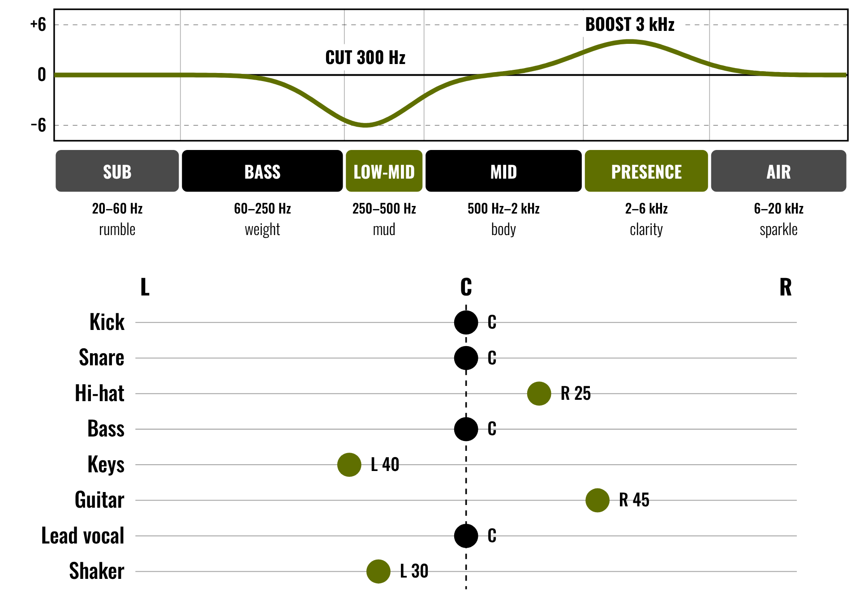
HUDSON BEAT
FX DEEP DIVE
Tone. Depth. Space.
DIGITAL MUSIC PRODUCTION 2 · CLASS 1 · EQ, PAN, REVERB AND DELAY IN LOGIC PRO
Notes:
Class 1, the first minute. Before class, take a short stretch of one of your own projects (or any track you may play in class) and mix it twice in Logic Pro: once dry, once with EQ, pan and effects. No audio is included in this deck. Open with my overview: level up your mixing by using at least 5 different effects creatively and intentionally.

Slide 2
HUDSON BEAT
CLASS 1
LISTEN: DRY, THEN MIXED
DRY, THEN MIXED
The same track, played twice
Teacher: play it with every effect bypassed, then with them on.
What changed between the two?
Which effect did you notice first?
Could you hear space, width or clarity?
FX Deep Dive · Intro deck · © 2026 Brian Lotze · Hudson Beat
2
Notes:
Play the dry version first with no comment, then the mixed one. Take answers aloud: louder, clearer, wider, deeper, smoother. Ask what each change might have been. This sets up the whole project: every effect should have a reason. Keep your mix simple so students can name what they hear.

Slide 3
HUDSON BEAT
CLASS 1
WHAT DO EFFECTS DO?
EQ shapes tone and clarity
Compression evens out loud and quiet
Reverb and delay add depth and space
Panning adds width and separation
Modulation adds movement
FX Deep Dive · Intro deck · © 2026 Brian Lotze · Hudson Beat
3
Notes:
A plain-English tour from the project sheet vocabulary: EQ adjusts the volume of specific frequencies; compression reduces the dynamic range; reverb simulates the reflections of a space; delay repeats a sound after a set time; panning places sounds left or right; modulation (chorus, phaser, flanger) adds movement. Students will add their own words on the vocabulary page.

Slide 4
HUDSON BEAT
CLASS 1
SEVEN CLASSES
CLASS 1
Dry and mixed · what effects do · choose a source · every effect needs a reason
CLASS 2
EQ demo · pan the band · reverb and delay · compression numbers
CLASS 3
Working day: EQ and pan every track
CLASS 4
Working day: effects with a reason
CLASS 5
Working day: refine the mix
CLASS 6
Refine and bounce · checklist · rubric · 3 questions
CLASS 7
Presentations with Padlet Q&A
FX Deep Dive · Intro deck · © 2026 Brian Lotze · Hudson Beat
4
Notes:
The shape of the project, from my pacing guide. Class 1: review the 11 FX from class notes, listen to examples, choose a source. Classes 2 to 5 are core working days: apply FX, EQ all tracks, set panning. Class 6: final adjustments, bounce, and prepare the presentation and three Padlet questions. Class 7: presentations with Padlet peer feedback. Hand out the project sheet now.

Slide 5
HUDSON BEAT
CLASS 1
STEPS 1 AND 2: REVIEW, CHOOSE
1
Review your notes on the 11 FX
2
Choose: your own project or a multitrack
3
A multitrack from Cambridge-MT: 8–16 tracks
4
Not a 40-track session
5
Fill in the Source log
FX Deep Dive · Intro deck · © 2026 Brian Lotze · Hudson Beat
5
Notes:
Steps 1 and 2 of the project sheet, shortened to fit the slide. Students revisit their notes on the 11 FX, then decide whether to remix their own earlier project or download a multitrack from Cambridge-MT. My tip: pick a song with 8 to 16 tracks, not a 40-track session. Pre-select the sessions yourself if you can (see the Source page in the resource).

Slide 6
HUDSON BEAT
CLASS 1
EVERY EFFECT NEEDS A REASON
What problem does this effect solve?
What do I hear when it is on?
Does it fit the genre?
Bypass it: is the mix better with it?
FX Deep Dive · Intro deck · © 2026 Brian Lotze · Hudson Beat
6
Notes:
My first common struggle: students apply FX randomly, without purpose. Push them to say why they use each effect. These four questions are the habit; they come back in the FX log and in the presentation. If a student breaks genre convention, my sheet says to be ready to explain the artistic reason. Less is more: a well-placed reverb or delay can transform a track.

Slide 7
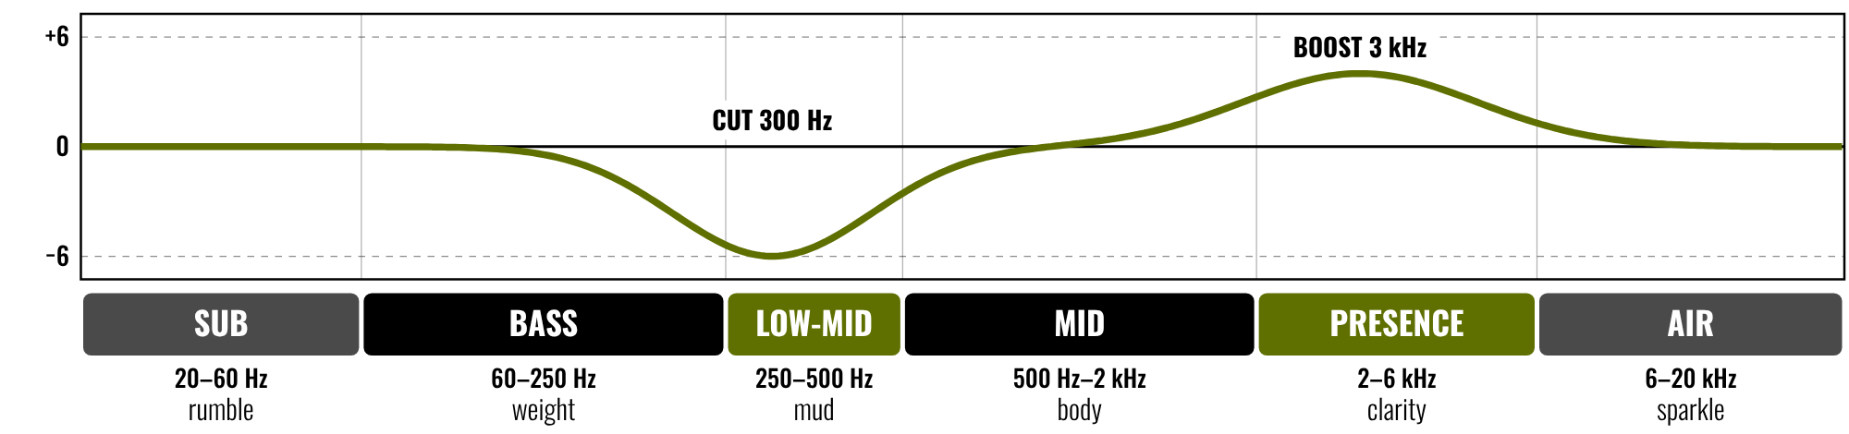
HUDSON BEAT
CLASS 2
WHERE SOUNDS LIVE
Cut where tracks crowd each other
Boost to bring out what you love
Muddy sounds often live near 300 Hz
Try a big move first, then back off
FX Deep Dive · Intro deck · © 2026 Brian Lotze · Hudson Beat
7
Notes:
Class 2. The frequency range in six bands on a log scale, with an example EQ curve: a cut near 300 Hz and a boost near 3 kHz. The names (rumble, weight, mud, body, clarity, sparkle) are common mixing words, not rules. Ask students which band their favorite instrument lives in. Then go straight to the live demo on the next slide.

Slide 8
HUDSON BEAT
CLASS 2
WATCH ME: EQ ON A SOLOED TRACK
1
Solo one track, open Channel EQ
2
Boost a narrow band and sweep it slowly
3
Now cut the same band: hear it vanish
4
Un-solo: is the whole mix clearer?
5
Bypass the EQ and compare (A/B)
FX Deep Dive · Intro deck · © 2026 Brian Lotze · Hudson Beat
8
Notes:
This is the live demo from my teacher notes: EQ feels invisible to beginners, so make dramatic cuts and boosts on a soloed track. Use a drum or bass track from your own project. Boost about 12 dB, sweep, then cut. Return to normal and ask what you fixed. EQ is the most powerful tool, so get it right before adding other effects.

Slide 9
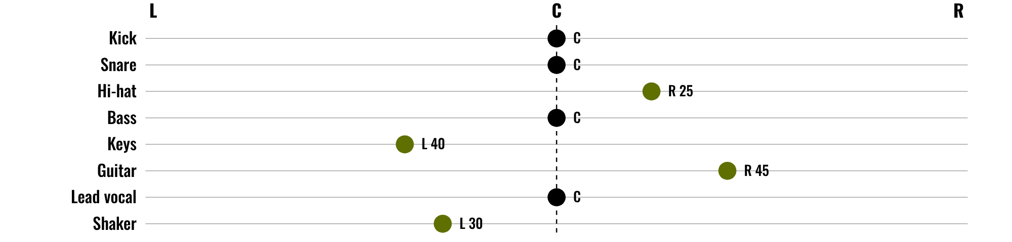
HUDSON BEAT
CLASS 2
WORKED EXAMPLE: PLACE THE BAND
Kick, snare, bass, vocal: center
Spread the rest, left and right
Left and right weigh the same
Width comes from panning
FX Deep Dive · Intro deck · © 2026 Brian Lotze · Hudson Beat
9
Notes:
An invented eight-track session, described on paper only; nothing here is a recording. Kick, snare, bass and lead vocal sit in the center. Hi-hat, keys, guitar and shaker are spread: keys 40 left, shaker 30 left, hi-hat 25 right, guitar 45 right, so left and right balance (70 each). My struggle: students leave everything center. Play a professional mix of your choice and point out the width.

Slide 10
HUDSON BEAT
CLASS 2
WATCH ME: REVERB AND DELAY
1
Click a Send slot, choose Bus 1 (an Aux appears)
2
Add one reverb to the Aux; send to taste
3
Delay time from tempo: 1/8 at 100 BPM = 300 ms
4
Turn it down until you only miss it when off
FX Deep Dive · Intro deck · © 2026 Brian Lotze · Hudson Beat
10
Notes:
A short demo of effects on a send. In the mixer, click an empty Send slot on a track and choose Bus 1; Logic makes an Aux channel. Put a reverb on the Aux and turn the send up on each track that needs it. For a delay, the time follows the tempo: at 100 BPM a quarter note is 600 ms, an eighth 300 ms and a dotted eighth 450 ms.

Slide 11
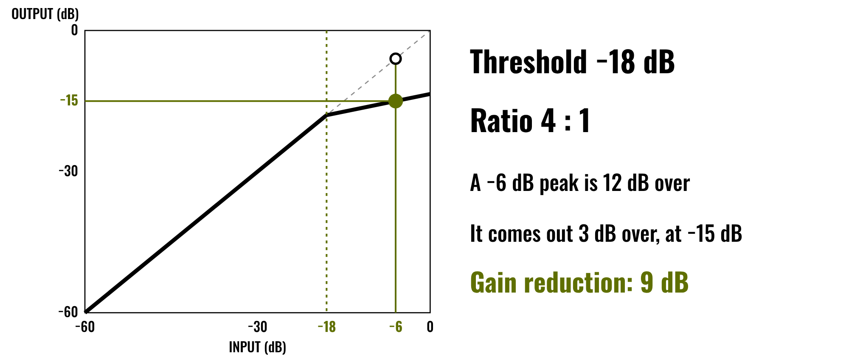
HUDSON BEAT
CLASS 2
WORKED EXAMPLE: COMPRESSION
Quiet sounds pass through unchanged
Only the part over the line is squeezed
A higher ratio squeezes harder
Make-up gain brings the level back
FX Deep Dive · Intro deck · © 2026 Brian Lotze · Hudson Beat
11
Notes:
Compression by the numbers, on an invented signal. Threshold is -18 dB and the ratio is 4:1. A peak at -6 dB is 12 dB over the threshold; the compressor lets only a quarter of that through, so it comes out 3 dB over, at -15 dB. The gain reduction is 9 dB. Real plug-ins add attack, release and make-up gain; students can explore those on their own.

Slide 12
HUDSON BEAT
CLASS 3
WORKING DAY: EQ AND PAN EVERY TRACK
EQ every track, one at a time
Pan each instrument into its own place
Fill in the Track map
Judge it in the whole mix, not only solo
FX Deep Dive · Intro deck · © 2026 Brian Lotze · Hudson Beat
12
Notes:
Class 3 is the first working day. Step 4 of the project sheet, shortened here: EQ and pan every track. The requirement is that every track is EQ'd and panned thoughtfully, so check the Track map for empty boxes. Circulate and ask each student to solo a track, make one EQ move, and say what problem it fixes.

Slide 13
HUDSON BEAT
CLASS 4
WORKING DAY: EFFECTS WITH A REASON
Use at least 5 different FX
Write the reason in your FX log
A/B every effect: bypass, listen, decide
Check on headphones and on speakers
FX Deep Dive · Intro deck · © 2026 Brian Lotze · Hudson Beat
13
Notes:
Class 4, a working day. Steps 3 and 5 of the project sheet, shortened here: plan and apply at least 5 different effects, then check the mix on headphones and speakers. Always A/B test: bypass the plug-in and listen with and without it. Class 5 is a full working day with no new slide: refine the mix.

Slide 14
HUDSON BEAT
CLASS 6
REFINE, BOUNCE, PREPARE
Final level and FX tweaks
Bounce a .mp3 or .wav
Zip the .logicx project
Write your 3 Padlet questions
FX Deep Dive · Intro deck · © 2026 Brian Lotze · Hudson Beat
14
Notes:
Class 6. Steps 5 and 6 of the project sheet, shortened to fit the slide: adjust levels and FX settings, then finalize by bouncing and preparing to walk the class through the FX choices. Bounce: File, Bounce, Project or Section. Zip: Control-click the .logicx in Finder, Compress. Students also write their three Padlet questions today.

Slide 15
HUDSON BEAT
CLASS 6
WHAT YOU TURN IN
Bounced .mp3 or .wav of the final mix
Zipped .logicx project
Named: Your Name – FX Deep Dive
At least 5 different FX, ready to discuss
All tracks EQ’d and panned
Padlet post with your 3 questions
Answer 2 questions on classmates’ posts
FX Deep Dive · Intro deck · © 2026 Brian Lotze · Hudson Beat
15
Notes:
The submission checklist from the project sheet, in short form. Show where students upload (your class page) and where the Padlet board is. Remind students that the FX log is theirs: it is what they will use to walk the class through their choices.

Slide 16
HUDSON BEAT
CLASS 6
HOW IT’S SCORED
CREATIVITY & ORIGINALITY
5 = Exceptional creativity; innovative, bold, and expressive
/ 5
TECHNICAL SKILL / DAW USE
5 = Expert-level command of multiple Logic systems
/ 5
COMPOSITION & STRUCTURE
5 = Professional pacing, flow, and musical arc
/ 5
SOUND DESIGN & MIX QUALITY
5 = Exceptional sound design; professional-quality mix
/ 5
DOCUMENTATION & PRESENTATION
5 = Exceptional; thorough insight and polished delivery
/ 5
SCORED 1–5 · FINAL GRADE = AVERAGE OF YOUR SCORE AND MINE · / 25
FX Deep Dive · Intro deck · © 2026 Brian Lotze · Hudson Beat
16
Notes:
My rubric: five categories, each scored 1 to 5, for a total out of 25. Students score themselves first; the final grade is the average of their score and mine. The slide reads the 5 column of each category aloud. Hand out the rubric page so students can self-score before they present.

Slide 17
HUDSON BEAT
CLASS 7
PRESENTATION DAY
Walk the class through your FX choices
Your Padlet post: 3 questions about your project
Answer at least 2 of each classmate’s 3
Listen like a mixer: what did they do, and why?
FX Deep Dive · Intro deck · © 2026 Brian Lotze · Hudson Beat
17
Notes:
Class 7, presentations with Padlet Q and A. Each student plays the final mix and explains the effects they chose and why. During classmates' presentations, every student answers at least 2 of their 3 questions on their Padlet post. If time allows, my mix critique idea fits here: play a volunteer mix on the main speakers.

Slide 18
HUDSON BEAT
CLASS 7
ONE LAST THING…
You started with a track.
You shaped tone and space.
Every effect had a reason.
Now it sounds like yours.
FX Deep Dive · Intro deck · © 2026 Brian Lotze · Hudson Beat
18
Notes:
Close with what my teacher notes say this project builds: the primary mixing skills, a shift in focus entirely to post-production. Every student left with a mix where each effect has a reason. Remind them that EQ, pan and a single well-placed reverb or delay already go a long way.

