Slide 1
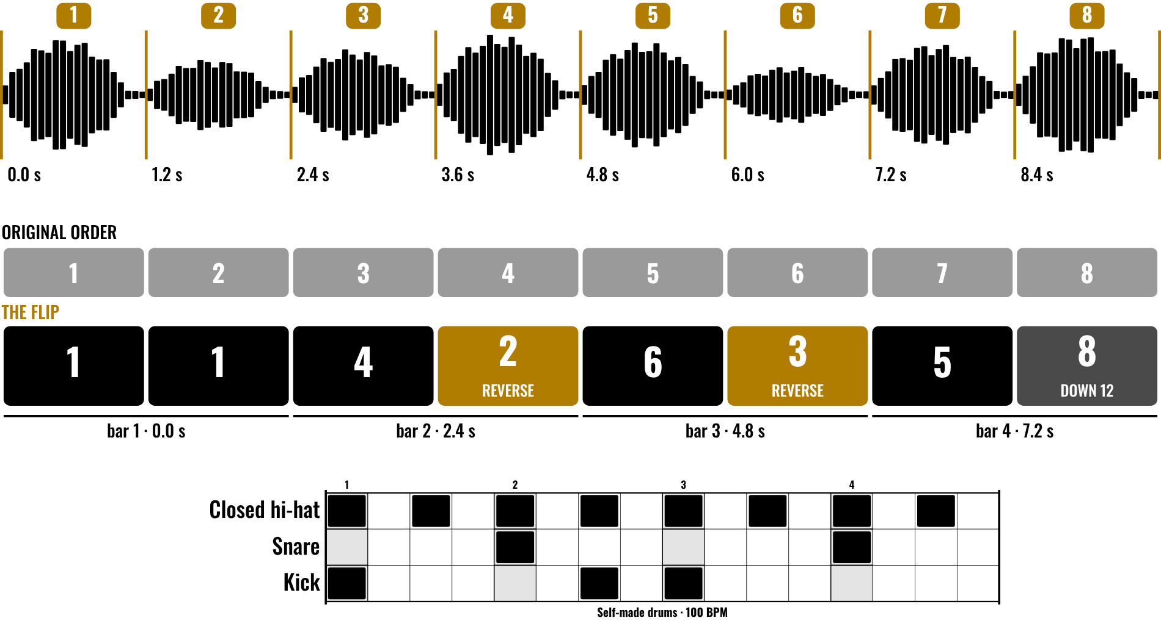
HUDSON BEAT
SAMPLE FLIPPING
Chop. Pitch. Flip.
DIGITAL MUSIC PRODUCTION 2 · CLASS 1 · CHOP, PITCH AND FLIP IN LOGIC PRO
Notes:
Class 1, the first minute. Before class, pick one cleared sample from your own set (page 4 of the resource shows how to build one) and make a 30-second flip of it in Logic Pro. No audio is included in this deck. Open with my overview: take one sample and flip it into something entirely your own.

Slide 2
HUDSON BEAT
CLASS 1
LISTEN: BEFORE AND AFTER
YOUR OWN CLEARED SAMPLE, PLAYED TWICE
Teacher: play the raw sample, then your 30-second flip.
What did I do to it?
Which tiny piece did I use again and again?
Could you hear the original inside the new track?
Sample Flipping · Intro deck · © 2026 Brian Lotze · Hudson Beat
2
Notes:
Play the raw sample first with no comment, then your flip. Take answers aloud: chopped, reversed, pitched, repeated, drums added. The point of the project is in my notes: students must actually chop, pitch or manipulate the sample, not just loop it. Keep your flip short and a bit rough on purpose.

Slide 3
HUDSON BEAT
CLASS 1
WHAT THE HECK IS FLIPPING?
Taking a sample and making something new from it
Chop it into pieces
Pitch it, reverse it, stretch it
Rearrange the pieces and build around them
Sample Flipping · Intro deck · © 2026 Brian Lotze · Hudson Beat
3
Notes:
Plain-English definition from the project sheet vocabulary: a sample is a recorded piece of audio used as raw material; flipping is transforming it through chopping, pitching or reversing; chopping is cutting it into smaller pieces to rearrange and replay. From my overview: this is how some of the biggest producers in hip-hop, R&B and electronic music work.

Slide 4
HUDSON BEAT
CLASS 1
SEVEN CLASSES
CLASS 1
Before and after · what flipping is · ethics · choose a sample
CLASS 2
Slice it · the three modes · flip it · drums that fit
CLASS 3
Working day: build your beat
CLASS 4
Working day: layer and arrange
CLASS 5
Working day: refine
CLASS 6
Mix and bounce · checklist · rubric · 3 questions
CLASS 7
Presentations with Padlet Q&A
Sample Flipping · Intro deck · © 2026 Brian Lotze · Hudson Beat
4
Notes:
The shape of the project, from my pacing guide. Class 1: introduction and Quick Sampler demo, select a sample. Class 2: deep dive into Quick Sampler, begin building. Classes 3 to 5 are working days. Class 6: final mix and bounce, presentations prepared. Class 7: presentations with Padlet feedback. Hand out the project sheet and the Sample log now.

Slide 5
HUDSON BEAT
CLASS 1
SAMPLING: ART AND ETHICS
Producers have always built new music from old sounds
Whose sound is it?
Is it cleared, public domain, or yours?
Our samples are cleared for this class
Write down where your sample came from
Sample Flipping · Intro deck · © 2026 Brian Lotze · Hudson Beat
5
Notes:
My teacher notes call this project a natural entry point for discussing sampling ethics and copyright. Use two or three of the discussion questions from the ethics page of the resource (page 5). Keep it short and honest: using someone else's recording generally needs their permission, which is why this class uses samples you have cleared. This is not legal advice.

Slide 6
HUDSON BEAT
CLASS 1
STEP 1: LISTEN AND CHOOSE
1
Browse the provided samples
2
Listen with headphones, more than once
3
Note the key and tempo from the file name
4
Pick one you can hear a use for
5
Fill in the Sample log
Sample Flipping · Intro deck · © 2026 Brian Lotze · Hudson Beat
6
Notes:
Students listen to the set with headphones and fill in the Sample log (page 12). File names that carry the key and tempo help, as in my guidelines: make sure the key fits the sample. My struggles list warns that students give up quickly if the sample does not sound cool at once, so tell them a plain sample can still become a great flip.

Slide 7
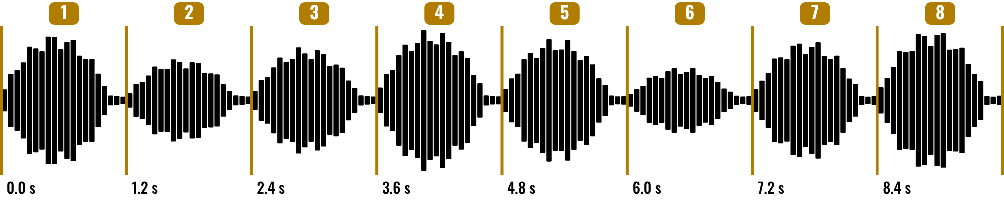
HUDSON BEAT
CLASS 2
WORKED EXAMPLE: SLICE A SAMPLE
8 slices of 1.2 s
9.6 s = 4 bars at 100 BPM
Each slice = 2 beats
Cut at the start of a sound
Sample Flipping · Intro deck · © 2026 Brian Lotze · Hudson Beat
7
Notes:
Class 2. This is an original practice sample, described on paper only; nothing here is a recording. It runs 9.6 seconds, which is 4 bars at 100 BPM (one bar is 2.4 seconds). Cut into 8 slices of 1.2 seconds, each slice is 2 beats and slice 4 starts at 3.6 seconds. Students' samples will differ; the arithmetic is the habit to teach.

Slide 8
HUDSON BEAT
CLASS 2
WATCH ME: THE THREE MODES
1
Classic: the sample plays across the keys, pitch follows the key
2
One Shot: a key plays the whole sample
3
Slice: the sample is cut up, one slice per key
4
Drop in a sample, try all three
5
Reverse, pitch, then play it
Sample Flipping · Intro deck · © 2026 Brian Lotze · Hudson Beat
8
Notes:
A three-minute demo, using your own cleared sample. Here the three modes are shortened from the longer descriptions on the reference page; the project sheet says to demo Classic, One Shot and Slice early because the modes confuse students. Drop in the sample, switch modes, and play each. Show Reverse and the pitch control. Menu names vary a little by Logic version.

Slide 9
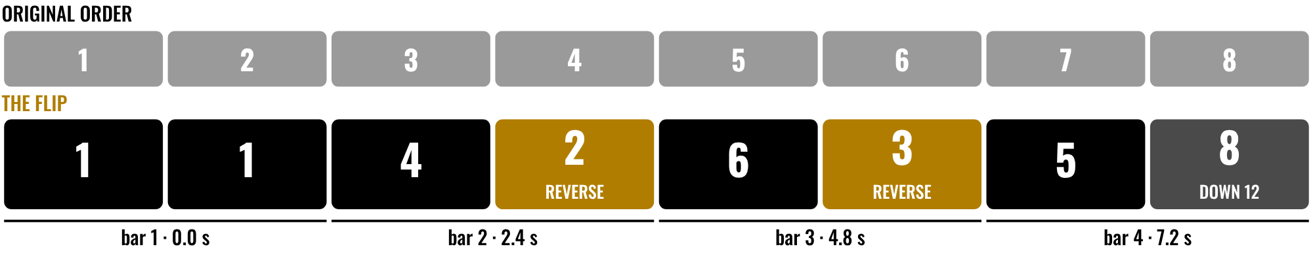
HUDSON BEAT
CLASS 2
WORKED EXAMPLE: FLIP IT
8 slots of 2 beats, 4 bars
Reverse slices 2 and 3
Slice 8 down an octave
Same slices, new order
Sample Flipping · Intro deck · © 2026 Brian Lotze · Hudson Beat
9
Notes:
The same 8 slices, rearranged into 8 slots of 2 beats: 4 bars, 9.6 seconds. Slice 1 repeats, slices 2 and 3 are reversed, and slice 8 drops an octave. In Classic mode, down 12 semitones doubles the length of a slice: 1.2 seconds becomes 2.4, exactly one bar. Ask students which move they would try first.

Slide 10
HUDSON BEAT
CLASS 2
WATCH ME: DRUMS THAT FIT
1
New track: an Electronic Drum Kit (Drum Machine Designer)
2
Pattern region, Step Sequencer
3
Kick, snare, hi-hat: leave space for the chops
4
Match the style the flip is heading toward
5
Vary the velocity
Sample Flipping · Intro deck · © 2026 Brian Lotze · Hudson Beat
10
Notes:
A short demo. An Electronic Drum Kit loads Drum Machine Designer. Control-click in the drum track, Create Pattern Region, double-click for the Step Sequencer. My tip: your drums set the tone, so match the style. Drum patterns must be self-created. Leave a gap where a chop lands so the two do not fight.

Slide 11
HUDSON BEAT
CLASS 3
BUILD YOUR BEAT
Program your own drum pattern
Match the style of your flip
Play the chops on the keys, record them
Keep the best take
Sample Flipping · Intro deck · © 2026 Brian Lotze · Hudson Beat
11
Notes:
Class 3 is the first working day. Step 3 of the project sheet, shortened here: build the beat. Students also record their chops by playing Quick Sampler from the keyboard or by drawing notes in the Piano Roll. Circulate and ask each student to play you the raw sample and then their loop; push anyone who is only looping the sample to chop or pitch it.

Slide 12
HUDSON BEAT
CLASS 4
LAYER AND ARRANGE
Bass, chords, melodies and extras
Keep it appropriate to the style
Give the track a beginning, a middle and an end
Put each sound on its own track
Sample Flipping · Intro deck · © 2026 Brian Lotze · Hudson Beat
12
Notes:
Class 4, a working day. Step 4, shortened here: add bass, chords, melodies and additional elements. From my guidelines, keep the layers appropriate to the style and put effects on different tracks so each can have its own volume and plug-ins. Class 5 is a full working day with no new slide: refine the track.

Slide 13
HUDSON BEAT
CLASS 6
MIX AND BOUNCE
EQ every track
Pan and balance everything
Bounce a .mp3 or .wav
Zip the .logicx project
Sample Flipping · Intro deck · © 2026 Brian Lotze · Hudson Beat
13
Notes:
Class 6, final mix and bounce. Steps 5 and 6 of the project sheet, shortened to fit the slide: mix with EQ, pan and balance, then finalize by bouncing and preparing the presentation. Ask every student to show you one EQ move and one pan move before they bounce. Bounce: File, Bounce, Project or Section. Zip: Control-click the .logicx in Finder, Compress.

Slide 14
HUDSON BEAT
CLASS 6
WHAT YOU TURN IN
Bounced .mp3 or .wav uploaded
Zipped .logicx project uploaded
Named: Your Name – Sample Flipping
Padlet post with your 3 questions
Answer 2 questions on classmates’ posts
Sample Flipping · Intro deck · © 2026 Brian Lotze · Hudson Beat
14
Notes:
The submission checklist from the project sheet, in short form. Show where students upload (your class page) and where the Padlet board is. Remind students that the Sample log (page 12) is theirs to keep: it records where the sample came from.

Slide 15
HUDSON BEAT
CLASS 6
HOW IT’S SCORED
CREATIVITY & ORIGINALITY
5 = Exceptional creativity; innovative, bold, and expressive
/ 5
TECHNICAL SKILL / DAW USE
5 = Expert-level command of multiple Logic systems
/ 5
COMPOSITION & STRUCTURE
5 = Professional pacing, flow, and musical arc
/ 5
SOUND DESIGN & MIX QUALITY
5 = Exceptional sound design; professional-quality mix
/ 5
DOCUMENTATION & PRESENTATION
5 = Exceptional; thorough insight and polished delivery
/ 5
SCORED 1–5 · FINAL GRADE = AVERAGE OF YOUR SCORE AND MINE · / 25
Sample Flipping · Intro deck · © 2026 Brian Lotze · Hudson Beat
15
Notes:
My rubric: five categories, each scored 1 to 5, for a total out of 25. Students score themselves first; the final grade is the average of their score and mine. The slide reads the 5 column of each category aloud. Hand out the rubric page so students can self-score before they present.

Slide 16
HUDSON BEAT
CLASS 7
PRESENTATION DAY
Play the raw sample, then your track
Your Padlet post: 3 questions about your project
Answer at least 2 of each classmate’s 3
Listen like a producer: what did they do to it?
Sample Flipping · Intro deck · © 2026 Brian Lotze · Hudson Beat
16
Notes:
Class 7, presentations with Padlet Q and A. Each student plays the raw sample and then the flip, so the class can hear the transformation. During classmates' presentations, every student answers at least 2 of their 3 questions on their Padlet post. Two minutes per student keeps the day moving.

Slide 17
HUDSON BEAT
CLASS 7
ONE LAST THING…
You started with one sample.
You chopped it and flipped it.
You built the drums yourself.
Now it’s yours.
REFLECTION · PAGE 21
Write it or talk it through: what went well, what was hard, what you would change.
Sample Flipping · Intro deck · © 2026 Brian Lotze · Hudson Beat
17
Notes:
Close with what my teacher notes say this project builds: Quick Sampler proficiency, drum programming and creative transformation, plus a first look at sampling ethics. Every student made a complete track from a single source. That is how producers work. Reflection: point students to the Reflection page. A reflection is a written or oral conversation about how they did on the project and what they would do differently next time; they choose to write it or to talk it through with you.

