Slide 1
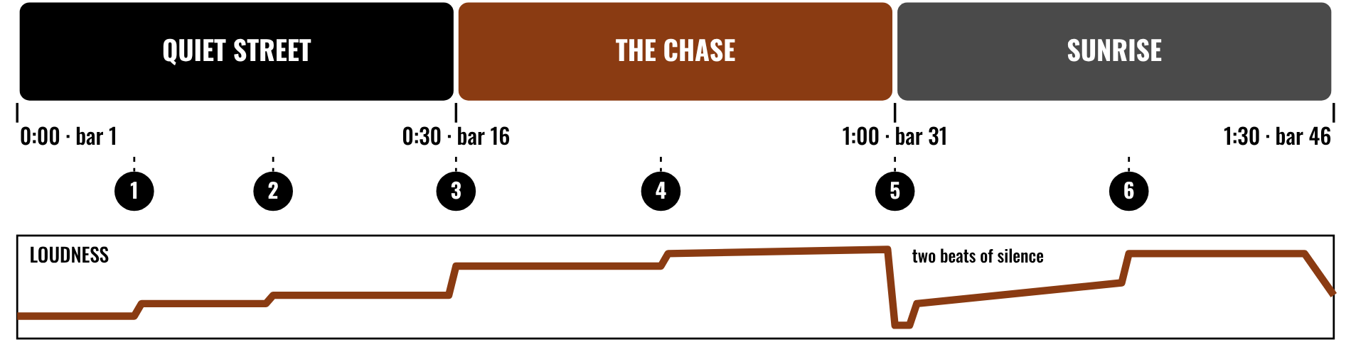
HUDSON BEAT
MUSIC FOR VISUAL MEDIA
Score the picture.
DIGITAL MUSIC PRODUCTION 2 · CLASS 1 · MOOD, TIMING AND HIT POINTS IN LOGIC PRO
Notes:
Class 1, the first minute. Before class, pick one short scene you are allowed to show (your own footage, or a clip your school may use) that has a clear mood and a few obvious moments. No video or audio is included in this deck. Open with my overview: choose a clip of 2 to 3 minutes and compose an original soundtrack in Logic Pro that matches its mood, pacing and emotional arc.

Slide 2
HUDSON BEAT
CLASS 1
WATCH: SOUND OFF, THEN SOUND ON
SOUND OFF, THEN ON
The same scene, played twice
Teacher: play the scene once with the sound off, then with a score.
What did the music tell you that the picture did not?
Where did the music change when the picture changed?
Was there a moment of silence?
Music for Visual Media · Intro deck · © 2026 Brian Lotze · Hudson Beat
2
Notes:
Play your scene with the sound off first, with no comment. Then play it with music. Take answers aloud: the feeling, the speed, the surprise. Ask where the music matched an action on screen. This sets up the whole project. If you want my before and after idea from the teacher notes, this is it: the same clip with and without music.

Slide 3
HUDSON BEAT
CLASS 1
WHAT DOES A SCORE DO?
Sets the mood: tense, joyful, mysterious
Matches the pacing of the cuts
Follows the emotional arc
Hits specific moments on screen
Knows when to be quiet
Music for Visual Media · Intro deck · © 2026 Brian Lotze · Hudson Beat
3
Notes:
A plain-English tour using the vocabulary on the project sheet. Scoring is writing music to accompany visual media. Mood is the emotional tone. Synchronization means aligning musical events with moments on screen, and a hit point is one such moment. Sound design is the effects. Students add their own words on the vocabulary page. Silence and space can be powerful.

Slide 4
HUDSON BEAT
CLASS 1
SEVEN CLASSES
CLASS 1
Sound off, then on · what a score does · choose a clip · study it
CLASS 2
Timeline · markers demo · bars and seconds · plan · dynamics
CLASS 3
Working day: compose the backbone
CLASS 4
Working day: sync and refine
CLASS 5
Working day: layer, sync, shape
CLASS 6
Finalize · checklist · rubric · 3 questions
CLASS 7
Presentations with Padlet Q&A
Music for Visual Media · Intro deck · © 2026 Brian Lotze · Hudson Beat
4
Notes:
The shape of the project, from my pacing guide. Class 1: introduction; students select and import their video and study it. Class 2: plan the score, marking key moments and deciding on mood and instrumentation. Classes 3 to 5 are working days: compose, layer and sync. Class 6: final mix, bounce, sync the audio to the video, prepare presentations. Class 7: presentations with Padlet peer feedback. Hand out the project sheet now.

Slide 5
HUDSON BEAT
CLASS 1
STEPS 1 AND 2: CHOOSE, STUDY
1
Find a clip of 2–3 minutes
2
Import it into Logic
3
Watch it at least 5 times
4
Note the mood, pacing and key moments
5
Fill in the Clip log and Watch notes
Music for Visual Media · Intro deck · © 2026 Brian Lotze · Hudson Beat
5
Notes:
Steps 1 and 2 of the project sheet, shortened to fit the slide. Students choose a clip of 2 to 3 minutes that inspires them and import it into Logic, then watch it multiple times, noting mood, pacing and key visual moments. My tip: watch it at least five times before composing. The Clip log is where they record where it came from.

Slide 6
HUDSON BEAT
CLASS 1
CHOOSE A CLIP YOU CAN USE
1–2 minutes of real scored content
Few scenes, clear moments
Your own footage, or a clip you may use
Know where it came from
Mute the clip’s own music
Music for Visual Media · Intro deck · © 2026 Brian Lotze · Hudson Beat
6
Notes:
My first common struggle: students pick clips that are too long or too complex. Encourage 1 to 2 minutes of actual scored content inside the 2 to 3 minute window. The project sheet allows your own clip or one from YouTube or Vimeo. Clips belong to their makers, so students record the source on the Clip log and check the site's terms before anyone posts a finished video.

Slide 7
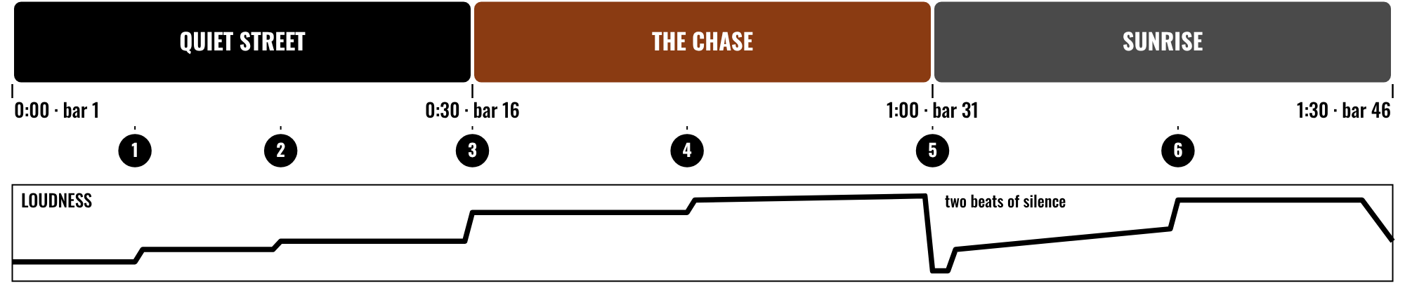
HUDSON BEAT
CLASS 2
WHERE THE MUSIC HITS
Three scenes, six hit points
The curve follows the picture
It gets quiet before the pop
Hit points sit on the timeline
Music for Visual Media · Intro deck · © 2026 Brian Lotze · Hudson Beat
7
Notes:
Class 2. An invented 90-second scene, described on paper only; nothing here is a video. Three scenes, six numbered hit points, and a loudness curve under them. Notice that the curve follows the picture: quiet, build, a drop to silence at the pop, then a release. Ask students where the hit points would be in their own clips. Then go straight to the Logic demo.

Slide 8
HUDSON BEAT
CLASS 2
WATCH ME: MARKERS IN LOGIC
1
File, Movie, Open Movie: the clip appears
2
Play it and stop on a key moment
3
Add a marker there and name it
4
Read the time in SMPTE: minutes, seconds, frames
5
Mark every moment you want to hit
Music for Visual Media · Intro deck · © 2026 Brian Lotze · Hudson Beat
8
Notes:
This is the demo from my teacher notes: synchronization is hard, so show how to use markers in Logic and count frames. Open a movie you may show, show the Marker track, and add three markers. Switch the display to SMPTE time and point out the frames. Use markers to flag key visual moments you want to hit, as my tips say.

Slide 9
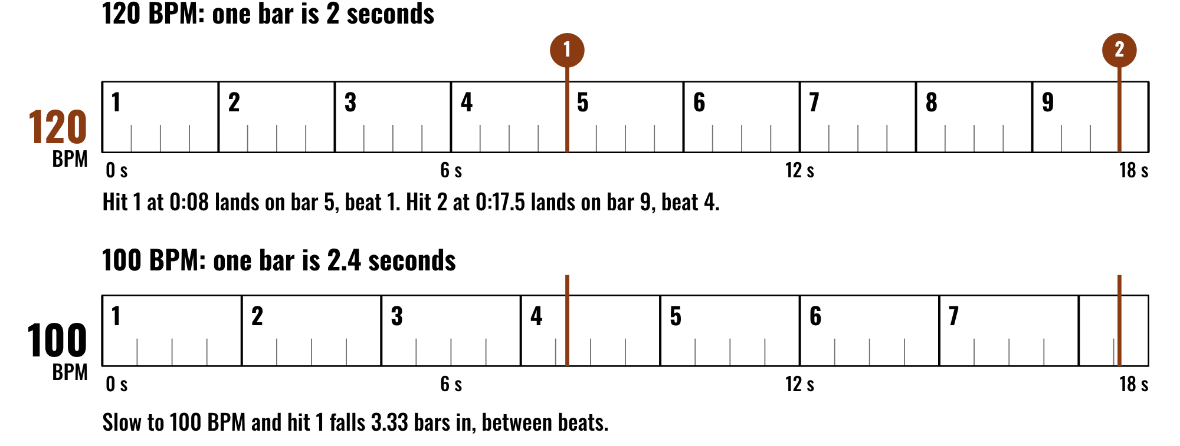
HUDSON BEAT
CLASS 2
WORKED EXAMPLE: BARS AND SECONDS
A bar is four beats
Seconds divided by bar length
Pick a tempo that lands the hits
Hits between beats feel loose
Music for Visual Media · Intro deck · © 2026 Brian Lotze · Hudson Beat
9
Notes:
At 120 BPM a beat is half a second and a bar of four beats is 2 seconds. A hit at 0:08 lands exactly on bar 5, beat 1. A hit at 0:17.5 lands on bar 9, beat 4. Slow the tempo to 100 BPM and a bar is 2.4 seconds, so the hit at 0:08 falls between beats. This is why some students set the tempo to fit their hit points. It is a trick, not a rule.

Slide 10
HUDSON BEAT
CLASS 2
PLAN YOUR SCORE
1
Where does the music build?
2
Where does it drop?
3
Where does it shift?
4
Where does it hit a cue?
5
Fill in the Score plan and Cue sheet
Music for Visual Media · Intro deck · © 2026 Brian Lotze · Hudson Beat
10
Notes:
Step 3 of the project sheet, shortened to fit the slide: decide where the music builds, drops, shifts and hits visual cues. Students use the Score plan for mood and instruments and the Cue sheet for the hit points with times. My pacing guide for Class 2 says: plan the score, mark key moments, decide on mood and instrumentation.

Slide 11
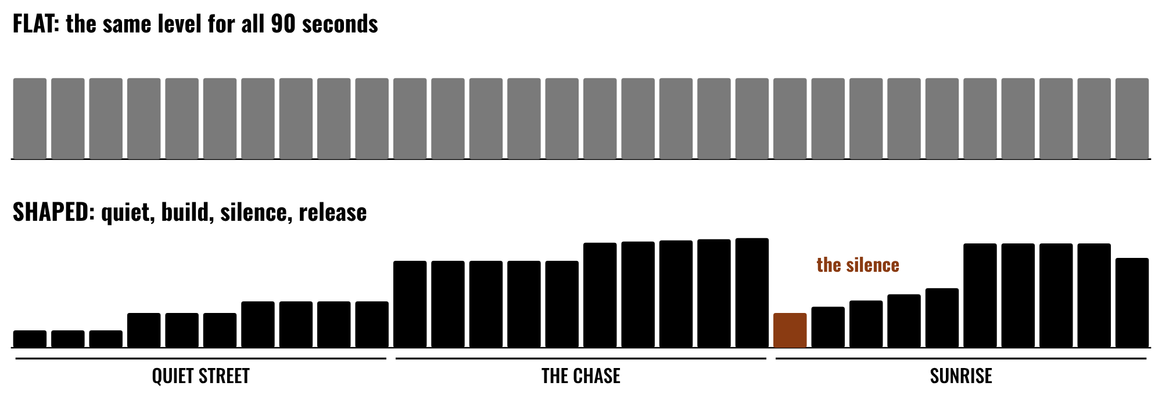
HUDSON BEAT
CLASS 2
SHAPE THE DYNAMICS
Flat means the same all the way
Shape follows the story
Silence is a choice
Loud means more after quiet
Music for Visual Media · Intro deck · © 2026 Brian Lotze · Hudson Beat
11
Notes:
My fourth common struggle: students forget about dynamic range, so everything is the same volume the whole time. The top row is flat; the bottom row follows the story, goes nearly silent at the pop, and then releases. Ask which one feels like it belongs to the picture. Show students volume automation as one tool and note that the music does not have to fill every second.

Slide 12
HUDSON BEAT
CLASS 3
WORKING DAY: COMPOSE
Start with the backbone
Layer in detail
Keep looking at the picture
Music you like is not the goal: music that fits is
Music for Visual Media · Intro deck · © 2026 Brian Lotze · Hudson Beat
12
Notes:
Class 3 is the first working day. Step 4 of the project sheet, shortened here: build your score in Logic, starting with the backbone and layering in detail. My second common struggle: students compose music they like instead of music that fits the video. Keep redirecting to the visuals. Circulate and ask each student what the picture is doing right now.

Slide 13
HUDSON BEAT
CLASS 4
WORKING DAY: SYNC AND REFINE
Check every hit point against the picture
Nudge by frames, not guesses
Add sound effects if you like
Leave space: silence is a choice
Music for Visual Media · Intro deck · © 2026 Brian Lotze · Hudson Beat
13
Notes:
Class 4, a working day. Step 5 of the project sheet, shortened here: fine-tune timing to the visuals and add sound effects if desired. Students use the Sync log to check each hit point. Class 5 is a full working day with no new slide: layer, sync and shape the dynamics. Ask each student to play you one hit point and tell you where it lands.

Slide 14
HUDSON BEAT
CLASS 6
FINALIZE AND BOUNCE
Final mix and levels
Bounce a .mp3 or .wav
Put your music on the video
Write your 3 Padlet questions
Music for Visual Media · Intro deck · © 2026 Brian Lotze · Hudson Beat
14
Notes:
Class 6. Step 6 of the project sheet, shortened to fit the slide: bounce the audio and prepare the video with your music for presentation. In Logic you can export the audio to the movie, or play the video and the bounce together. Zip the .logicx in Finder (Control-click, Compress). Students also write their three Padlet questions today.

Slide 15
HUDSON BEAT
CLASS 6
WHAT YOU TURN IN
Bounced .mp3 or .wav
Zipped .logicx project
Named: Your Name – Music for Visual Media
Video with synced audio ready
Padlet post with your 3 questions
Answer 2 questions on classmates’ posts
Music for Visual Media · Intro deck · © 2026 Brian Lotze · Hudson Beat
15
Notes:
The submission checklist from the project sheet, in short form. Show where students upload (your class page) and where the Padlet board is. Remind students to check that the finished video plays with sound before they present, and that the clip's original music is muted.

Slide 16
HUDSON BEAT
CLASS 6
HOW IT’S SCORED
CREATIVITY & ORIGINALITY
5 = Exceptional creativity; innovative, bold, and expressive
/ 5
TECHNICAL SKILL / DAW USE
5 = Expert-level command of multiple Logic systems
/ 5
COMPOSITION & STRUCTURE
5 = Professional pacing, flow, and musical arc
/ 5
SOUND DESIGN & MIX QUALITY
5 = Exceptional sound design; professional-quality mix
/ 5
DOCUMENTATION & PRESENTATION
5 = Exceptional; thorough insight and polished delivery
/ 5
SCORED 1–5 · FINAL GRADE = AVERAGE OF YOUR SCORE AND MINE · / 25
Music for Visual Media · Intro deck · © 2026 Brian Lotze · Hudson Beat
16
Notes:
My rubric: five categories, each scored 1 to 5, for a total out of 25. Students score themselves first; the final grade is the average of their score and mine. The slide reads the 5 column of each category aloud. Hand out the rubric page so students can self-score before they present.

Slide 17
HUDSON BEAT
CLASS 7
PRESENTATION DAY
Play your video with your score
Walk us through your choices
Your Padlet post: 3 questions about your project
Answer at least 2 of each classmate’s 3
Music for Visual Media · Intro deck · © 2026 Brian Lotze · Hudson Beat
17
Notes:
Class 7, presentations with Padlet Q and A. Each student plays the video with the score and explains the mood, the hit points and the creative choices. During classmates' presentations, every student answers at least 2 of their 3 questions on their Padlet post. If time allows, show one before and after: the same video with the music muted, then on.

Slide 18
HUDSON BEAT
CLASS 7
ONE LAST THING…
You started with silence.
You watched until you knew it.
You hit the moments.
Now it feels like one thing.
REFLECTION · PAGE 25
Write it or talk it through: what went well, what was hard, what you would change.
Music for Visual Media · Intro deck · © 2026 Brian Lotze · Hudson Beat
18
Notes:
Close with what my teacher notes say this project builds: synchronization skills, emotional storytelling through music, and arrangement for narrative purposes. It is one of the most rewarding projects when students nail the sync. Remind them that music does not have to fill every second. Reflection: point students to the Reflection page. A reflection is a written or oral conversation about how they did on the project and what they would do differently next time; they choose to write it or to talk it through with you.

