Slide 1
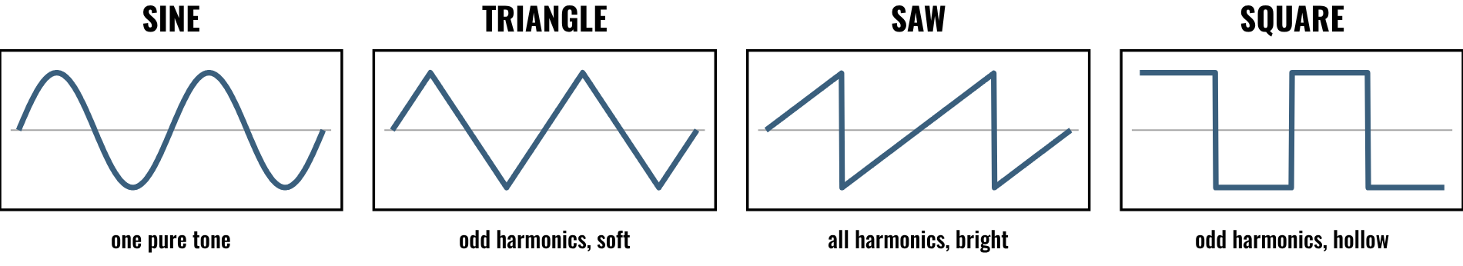
HUDSON BEAT
ALCHEMY ARCHITECT
Design the sound.
DIGITAL MUSIC PRODUCTION 2 · CLASS 1 · SYNTH SOUND DESIGN IN LOGIC PRO
Notes:
Class 1, the first minute. No audio is included in this deck. Before class, choose a short passage of electronic music with a bold synth sound, and find it yourself on a service your school allows; refer to it by title and artist only. Open with my overview: using Logic's Alchemy synthesizer, students design at least three custom patches from scratch, then compose a short original piece with them.

Slide 2
HUDSON BEAT
CLASS 1
LISTEN: WHO DESIGNED THIS SOUND?
EVERY SOUND WAS DESIGNED
Someone built that sound, knob by knob
Teacher: play a short passage you choose, one with a bold synth sound.
What does the sound make you think of?
Is it smooth or rough, bright or dark?
Does it change while the note plays?
Alchemy Architect · Intro deck · © 2026 Brian Lotze · Hudson Beat
2
Notes:
Play your passage twice. Take answers aloud about the feeling and the texture, then ask whether the sound changes from the start of the note to the end. This sets up my teacher notes' big idea: every sound in electronic music was designed by someone, and students can be that person. Do not name a song on the slide; say its title and artist aloud if you like.

Slide 3
HUDSON BEAT
CLASS 1
FOUR BUILDING BLOCKS
Oscillator: makes the raw wave
Filter: cuts or boosts frequencies
Envelope: shapes the sound over time
Modulation: makes it move
Alchemy Architect · Intro deck · © 2026 Brian Lotze · Hudson Beat
3
Notes:
A plain-English tour using the vocabulary on the project sheet. A synthesizer generates sound electronically using oscillators, filters and modulation. The oscillator is the sound source and makes the raw waveform. The filter shapes the tone by cutting or boosting frequencies. The envelope, ADSR, controls how the sound changes over time. Modulation uses one signal, like an LFO, to control another parameter. A patch is a saved set of settings. Students add their own words on the vocabulary page.

Slide 4
HUDSON BEAT
CLASS 1
SEVEN CLASSES
CLASS 1
Who designed this sound? · four building blocks · explore Alchemy
CLASS 2
Oscillator · filter · envelope · LFO · build Patch 1
CLASS 3
Working day: Patches 2 and 3
CLASS 4
Working day: compose with your patches
CLASS 5
Working day: compose and thicken
CLASS 6
Mix · bounce · checklist · rubric · 3 questions
CLASS 7
Presentations with Padlet Q&A
Alchemy Architect · Intro deck · © 2026 Brian Lotze · Hudson Beat
4
Notes:
The shape of the project, from my pacing guide. Class 1: introduction to Alchemy and guided exploration of the interface. Class 2: sound design basics, oscillators, filters and envelopes, and begin designing Patch 1. Classes 3 to 5 are working days: design the remaining patches and compose your track. Class 6: final mix and bounce, and prepare presentations. Class 7: presentations with Padlet peer feedback. Hand out the project sheet now.

Slide 5
HUDSON BEAT
CLASS 1
STEPS 1 AND 2: EXPLORE, LEARN
1
Open Alchemy and try the interface
2
Play the sound sources and presets
3
Learn oscillators, filters, envelopes
4
Learn modulation routing
5
Fill in the Explore sheet
Alchemy Architect · Intro deck · © 2026 Brian Lotze · Hudson Beat
5
Notes:
Steps 1 and 2 of the project sheet, shortened to fit the slide. Students open Alchemy and experiment with the interface, sound sources and presets, then work on understanding oscillators, filters, envelopes and modulation routing. The Explore sheet gives them small tasks so Class 1 is play with a purpose. Headphones on.

Slide 6
HUDSON BEAT
CLASS 1
START SIMPLE, SAVE OFTEN
Simple view before Advanced
Change one thing at a time
Save your patch as you go
Design first, compose second
Alchemy Architect · Intro deck · © 2026 Brian Lotze · Hudson Beat
6
Notes:
My common struggles, as a promise for the whole project. Alchemy is overwhelming at first, so start with the Simple view before opening Advanced. Students tweak endlessly without saving, so enforce a save-as-you-go habit; a numbered name such as Tide 1, Tide 2 works well. And students struggle to compose with unfamiliar sounds, so design first and compose second.

Slide 7
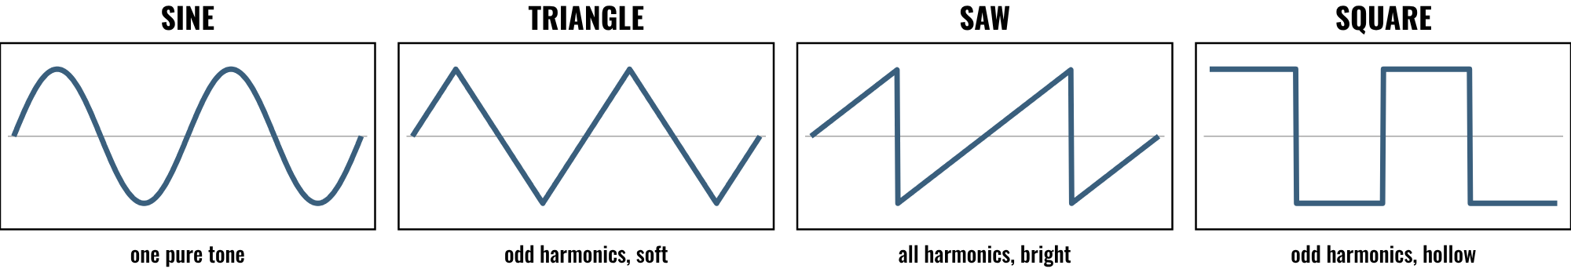
HUDSON BEAT
CLASS 2
THE OSCILLATOR: THE RAW SOUND
Each wave has its own sound
Saw is bright, sine is pure
Square sounds hollow
Start with one and shape it
Alchemy Architect · Intro deck · © 2026 Brian Lotze · Hudson Beat
7
Notes:
Class 2. Four classic waveforms, drawn on paper; nothing here is audio. A sine is one pure tone. A triangle has only odd harmonics and sounds soft. A saw has every harmonic and sounds bright. A square has odd harmonics and sounds hollow. Play each in Alchemy for the class. My tip: start with a simple waveform and shape it.

Slide 8
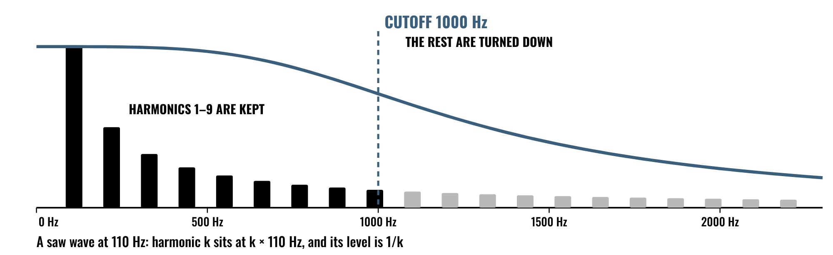
HUDSON BEAT
CLASS 2
THE FILTER: SHAPING THE TONE
The filter turns harmonics down
Low cutoff means a darker sound
Open the cutoff to brighten it
Move it while you hold a note
Alchemy Architect · Intro deck · © 2026 Brian Lotze · Hudson Beat
8
Notes:
A saw wave at 110 Hz has a harmonic at every multiple of 110, each one quieter: 110, 220, 330, and so on, at 1, 1/2, 1/3 of the level. A low-pass filter with its cutoff at 1000 Hz keeps the first nine and turns the rest down; the curve shows how it fades rather than stops. Lower the cutoff and the sound gets darker. Demo it live by moving the cutoff while holding a note.

Slide 9
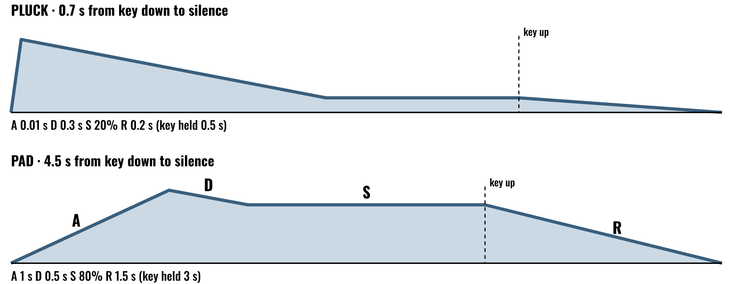
HUDSON BEAT
CLASS 2
THE ENVELOPE: SHAPE OVER TIME
Short attack, a pluck
Long attack, a pad
Release is the tail after you let go
Sustain is a level, not a time
Alchemy Architect · Intro deck · © 2026 Brian Lotze · Hudson Beat
9
Notes:
ADSR is Attack, Decay, Sustain, Release. The pluck: attack 0.01 seconds, decay 0.3, sustain 20 percent, release 0.2. The pad: attack 1 second, decay 0.5, sustain 80 percent, release 1.5. Sustain is a level, not a time; the other three are times. Ask: which one would you use for a bass, a bell, a pad? Then play with the envelope in Alchemy.

Slide 10
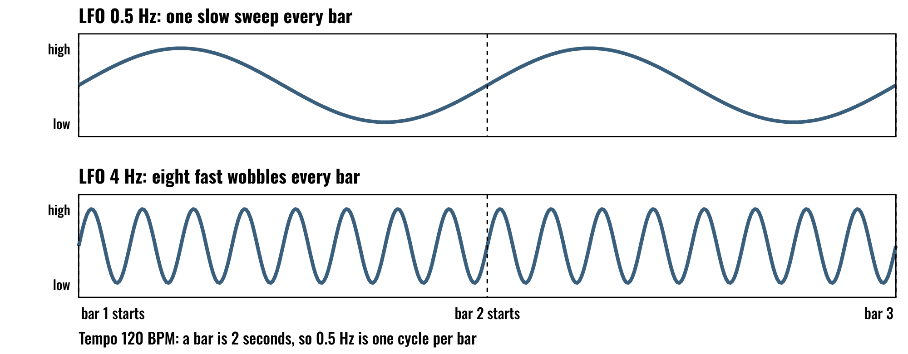
HUDSON BEAT
CLASS 2
MODULATION: MAKE IT MOVE
An LFO is a slow wave that moves a knob
Rate sets how fast it moves
Amount sets how far it moves
Match the rate to the bar
Alchemy Architect · Intro deck · © 2026 Brian Lotze · Hudson Beat
10
Notes:
An LFO is a low-frequency oscillator: a slow wave that moves another knob, here the filter cutoff. At 120 BPM a bar is 2 seconds, so an LFO at 0.5 Hz makes one sweep each bar and an LFO at 4 Hz makes eight wobbles each bar. Rate is how fast, amount is how far. My advanced variation asks for advanced modulation routing; this is the gentle start.

Slide 11
HUDSON BEAT
CLASS 2
WATCH ME: BUILD PATCH 1
1
Start with one simple waveform
2
Open the filter: move the cutoff
3
Shape it with the envelope
4
Add one slow LFO to the cutoff
5
Save it: give the patch a name
Alchemy Architect · Intro deck · © 2026 Brian Lotze · Hudson Beat
11
Notes:
Step 3 of the project sheet, shortened to fit the slide: create your first original sound from scratch, and save it. Build one patch live in about ten minutes using exactly these five moves, saving after each one. Then students begin their own Patch 1 on the Patch card. My easier variation is a guided walkthrough of one patch as a class; this demo can be that.

Slide 12
HUDSON BEAT
CLASS 3
WORKING DAY: PATCHES 2 AND 3
Build two more sounds from scratch
Make each one different: bass, pad, lead
Change one setting at a time
Save as you go
Alchemy Architect · Intro deck · © 2026 Brian Lotze · Hudson Beat
12
Notes:
Class 3 is the first working day. Step 4 of the project sheet, shortened here: build two more distinct sounds and aim for variety. A pad, a bass and a bell make a good set. Students fill in a Patch card for each. Circulate and ask each student to play you the patch alone and tell you its job.

Slide 13
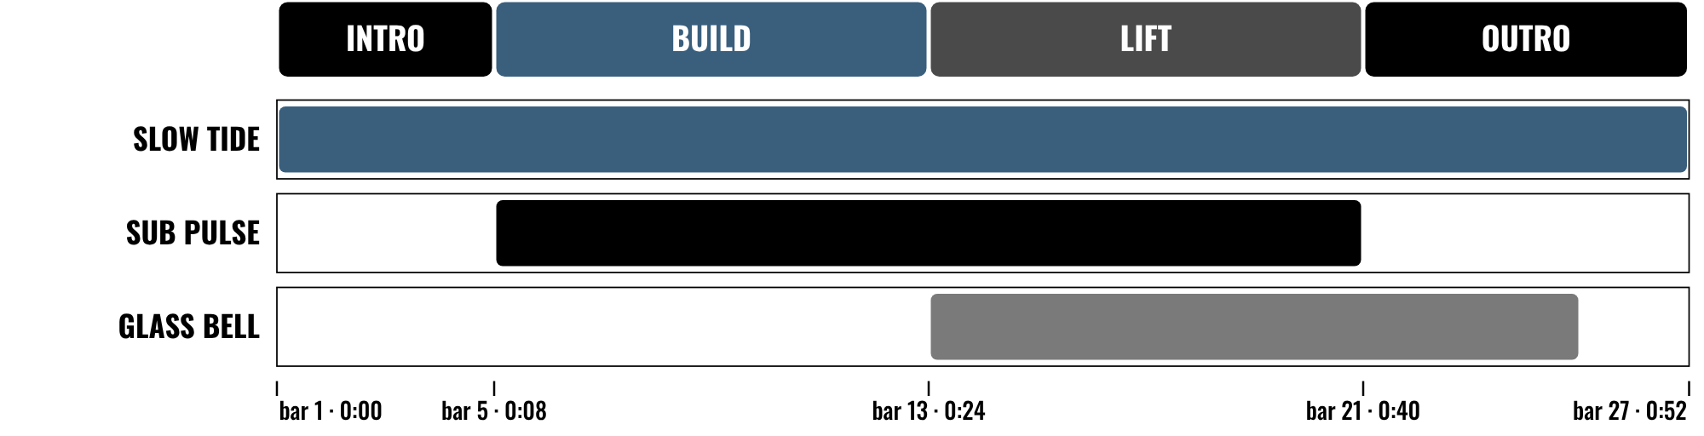
HUDSON BEAT
CLASS 4
WORKING DAY: COMPOSE
Design first, compose second
Give each patch a job
Bring patches in and out
Plan 45–60 seconds
Alchemy Architect · Intro deck · © 2026 Brian Lotze · Hudson Beat
13
Notes:
Class 4. Step 5 of the project sheet, shortened here: use your three patches to build a 45 to 60 second track. The picture is an invented 26-bar plan at 120 BPM, which is 52 seconds, with three patches coming in and out. Students fill in the Track plan first. My third struggle: custom patches can sound thin, so show layering and effects to thicken them. Class 5 is a full working day.

Slide 14
HUDSON BEAT
CLASS 6
MIX, EFFECTS AND BOUNCE
Add effects, automation, EQ and panning
Balance the levels
Bounce a .mp3 or .wav
Zip the .logicx project
Write your 3 Padlet questions
Alchemy Architect · Intro deck · © 2026 Brian Lotze · Hudson Beat
14
Notes:
Class 6. Step 6 of the project sheet, shortened to fit the slide: apply effects, automation, EQ and panning, and bounce your track. Students use the Mix check. Zip the .logicx in Finder (Control-click, Compress). Students also write their three Padlet questions today.

Slide 15
HUDSON BEAT
CLASS 6
WHAT YOU TURN IN
Bounced .mp3 or .wav
Zipped .logicx project
Named: Your Name – Alchemy Architect
3 custom Alchemy patches made and used
Padlet post with your 3 questions
Answer 2 questions on classmates’ posts
Alchemy Architect · Intro deck · © 2026 Brian Lotze · Hudson Beat
15
Notes:
The submission checklist from the project sheet, in short form. Show where students upload (your class page) and where the Padlet board is. Remind students that three custom patches must be created and used, so the track should feature all of them.

Slide 16
HUDSON BEAT
CLASS 6
HOW IT’S SCORED
CREATIVITY & ORIGINALITY
5 = Exceptional creativity; innovative, bold, and expressive
/ 5
TECHNICAL SKILL / DAW USE
5 = Expert-level command of multiple Logic systems
/ 5
COMPOSITION & STRUCTURE
5 = Professional pacing, flow, and musical arc
/ 5
SOUND DESIGN & MIX QUALITY
5 = Exceptional sound design; professional-quality mix
/ 5
DOCUMENTATION & PRESENTATION
5 = Exceptional; thorough insight and polished delivery
/ 5
SCORED 1–5 · FINAL GRADE = AVERAGE OF YOUR SCORE AND MINE · / 25
Alchemy Architect · Intro deck · © 2026 Brian Lotze · Hudson Beat
16
Notes:
My rubric: five categories, each scored 1 to 5, for a total out of 25. Students score themselves first; the final grade is the average of their score and mine. The slide reads the 5 column of each category aloud. Hand out the rubric page so students can self-score before they present.

Slide 17
HUDSON BEAT
CLASS 7
PRESENTATION DAY
Play your track
Show us your 3 patches
Your Padlet post: 3 questions about your project
Answer at least 2 of each classmate’s 3
Alchemy Architect · Intro deck · © 2026 Brian Lotze · Hudson Beat
17
Notes:
Class 7, presentations with Padlet Q and A. Each student plays the track and shows or describes the three patches, then explains the creative choices. During classmates' presentations, every student answers at least 2 of their 3 questions on their Padlet post. My teacher notes suggest students name their patches creatively and share them as a class sound library.

Slide 18
HUDSON BEAT
CLASS 7
ONE LAST THING…
You started with a blank patch.
You shaped the tone.
You gave it motion.
Now the sound is yours.
REFLECTION · PAGE 23
Write it or talk it through: what went well, what was hard, what you would change.
Alchemy Architect · Intro deck · © 2026 Brian Lotze · Hudson Beat
18
Notes:
Close with what my teacher notes say this project introduces: sound synthesis fundamentals. Every sound in electronic music was designed by someone, and now they know how to be that person. Invite students to keep saving patches and building their own sound library. Reflection: point students to the Reflection page. A reflection is a written or oral conversation about how they did on the project and what they would do differently next time; they choose to write it or to talk it through with you.

