Slide 1
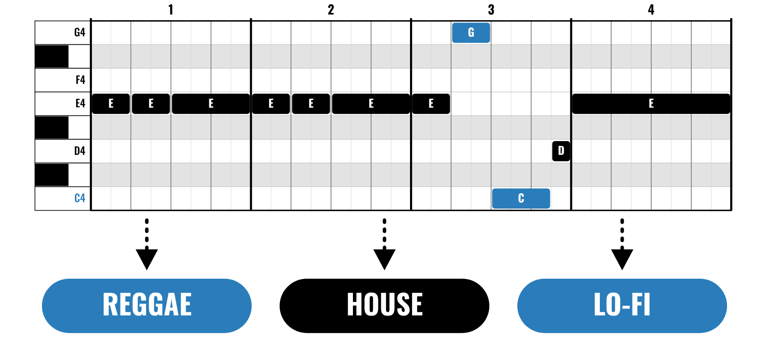
HUDSON BEAT
CAROL FLIP
Same tune, new genre.
LOGIC PRO PROJECT · CLASS 1 · SAME TUNE, NEW GENRE
Notes:
Class 1, the first minute. No audio is included in this deck. Open with the idea: you are going to take a carol everyone knows and flip it into a new genre in Logic Pro. The three melodies are public domain and arrive as note charts, so every student can enter them without reading staff notation.

Slide 2
HUDSON BEAT
CLASS 1
THINK: WHAT STAYS THE SAME?
THINK, THEN SHARE
Teacher: say or hum the first line of Jingle Bells slowly and sadly, then fast and bouncy.
What stayed the same?
What changed?
How much can you change before it stops being the tune?
Carol Flip · Intro deck · © 2026 Brian Lotze · Hudson Beat
2
Notes:
Ask the three questions aloud and take a few answers. Nothing is played from a speaker: you say or hum the line yourself, first slow and sad and then quick and bouncy. Students notice that the notes stayed and the feel changed. That is the whole project: keep the melody, change the genre around it.

Slide 3
HUDSON BEAT
CLASS 1
WHAT IS CAROL FLIP?
Choose a public-domain carol
Enter its melody in Logic Pro
Flip it into any genre
Finish with 60 to 90 seconds
Carol Flip · Intro deck · © 2026 Brian Lotze · Hudson Beat
3
Notes:
The project in four lines. Students choose Jingle Bells, Deck the Halls or Silent Night; all three are public domain, so anyone may use the melody. They enter the melody from a piano-roll chart, then flip the tempo, drums, bass, chords and sounds into a genre of their choice. The finished remix is 60 to 90 seconds. Jingle Bells and Deck the Halls are winter songs; Silent Night is a Christmas carol. If a student would rather not use a carol, a teacher-approved public-domain melody works.

Slide 4
HUDSON BEAT
CLASS 1
FOUR CLASSES
CLASS 1
Same tune, new genre · five moves · reading a piano roll
CLASS 2
Enter the melody · one flip · genre is in the drums
CLASS 3
Worked example, 75 seconds · mix and keep the tune
CLASS 4
Checklist · rubric · presentations
Carol Flip · Intro deck · © 2026 Brian Lotze · Hudson Beat
4
Notes:
The shape of the project. Class 1: hook, choose a carol and a genre, fill in the Flip plan and begin entering the melody. Class 2: enter and check the melody, then build the drums and bass of the genre. Class 3: add chords and sounds, plan the form, build the arrangement and mix. Class 4: bounce, hand in, present and reflect. Hand out the project sheet, the charts and the genre cards now.

Slide 5
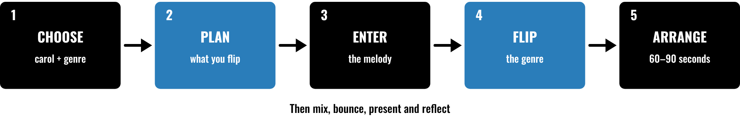
HUDSON BEAT
CLASS 1
FIVE MOVES, THEN FINISH
Choose a carol and a genre
Plan what you will flip
Enter the melody from the chart
Flip it, arrange it, mix it
Carol Flip · Intro deck · © 2026 Brian Lotze · Hudson Beat
5
Notes:
Class 1. The five moves in order: choose, plan, enter, flip and arrange. After that students mix, bounce, present and reflect. Point to each box and say roughly when it happens: choosing and planning today, entering and flipping on Class 2, arranging on Class 3. The picture and its short labels are drawn for this kit.

Slide 6
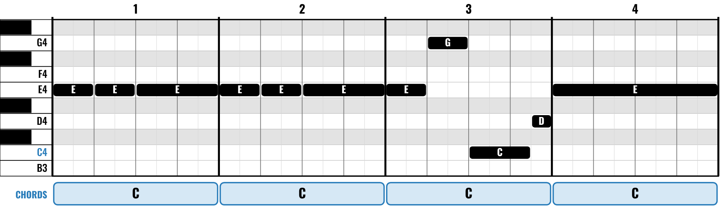
HUDSON BEAT
CLASS 1
READING A PIANO ROLL
Higher bar means higher pitch
Longer bar means a longer note
Left to right is time, bar by bar
The chords are one idea that fits
Carol Flip · Intro deck · © 2026 Brian Lotze · Hudson Beat
6
Notes:
Class 1. This is the Piano Roll view of the first four bars of the Jingle Bells chorus, drawn the same way as the charts on students' pages. A higher bar is a higher pitch, a longer bar is a longer note, and time runs left to right. The chord boxes underneath are one set of chords that fit; other chords can work. Ask a student to read bar 3 aloud: E, G, a long C, a short D.

Slide 7
HUDSON BEAT
CLASS 2
ENTER THE MELODY
1
Set the tempo and the time signature (6/8 for Silent Night)
2
Make a Software Instrument track and a MIDI region
3
Open the Piano Roll and set the grid to sixteenth notes
4
Draw each note from the chart, bar by bar
5
Play it back and fix any wrong note
Carol Flip · Intro deck · © 2026 Brian Lotze · Hudson Beat
7
Notes:
Class 2. Demonstrate on the projector: set the tempo and, for Silent Night, the 6/8 time signature; create a Software Instrument track and a MIDI region; open the Piano Roll; set the grid so notes land on sixteenth notes; draw the notes from the chart. Students then listen for wrong notes. Menu names move between Logic versions; the Logic quick reference lists where things live.

Slide 8
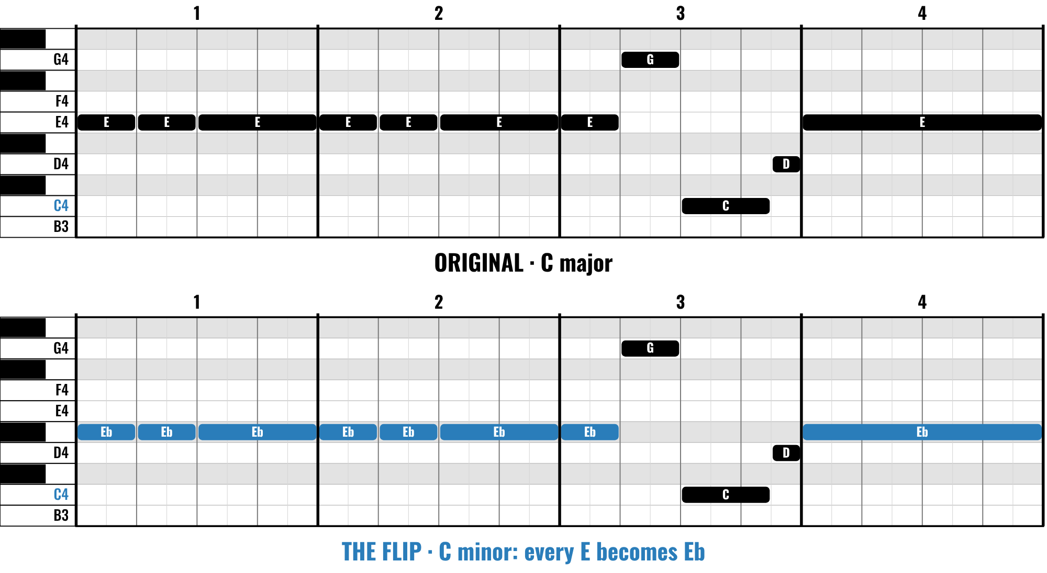
HUDSON BEAT
CLASS 2
ONE FLIP: MAJOR TO MINOR
Same notes, same lengths
Only the E’s move, down a half step
Major sounds bright, minor darker
One flip of the three you need
Carol Flip · Intro deck · © 2026 Brian Lotze · Hudson Beat
8
Notes:
Class 2. A flip students can try in seconds: keep every note and every length, but lower each E by a half step to Eb, so the tune moves from C major to C minor. The notes keep their order and rhythm, so the carol is still recognizable. This is the flip used in the worked example. Students can do it by selecting the E notes in the Piano Roll and moving them down one row.

Slide 9
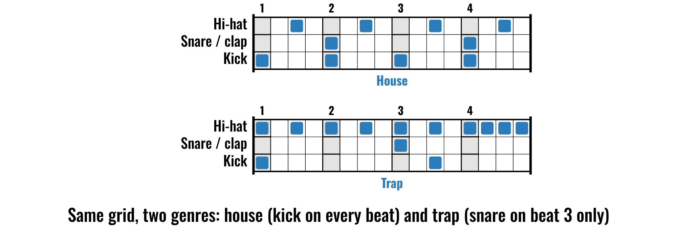
HUDSON BEAT
CLASS 2
GENRE IS IN THE DRUMS
Carol Flip · Intro deck · © 2026 Brian Lotze · Hudson Beat
9
Notes:
Class 2. The same 16-step grid in two genres. In house the kick plays on every beat and the claps on 2 and 4. In trap the snare plays only on beat 3 and the hats are busy, so it feels half as fast. Students copy a pattern from a genre card into the Step Sequencer or use a Drummer track. Ask: which flip is this, tempo, drums or sounds?

Slide 10
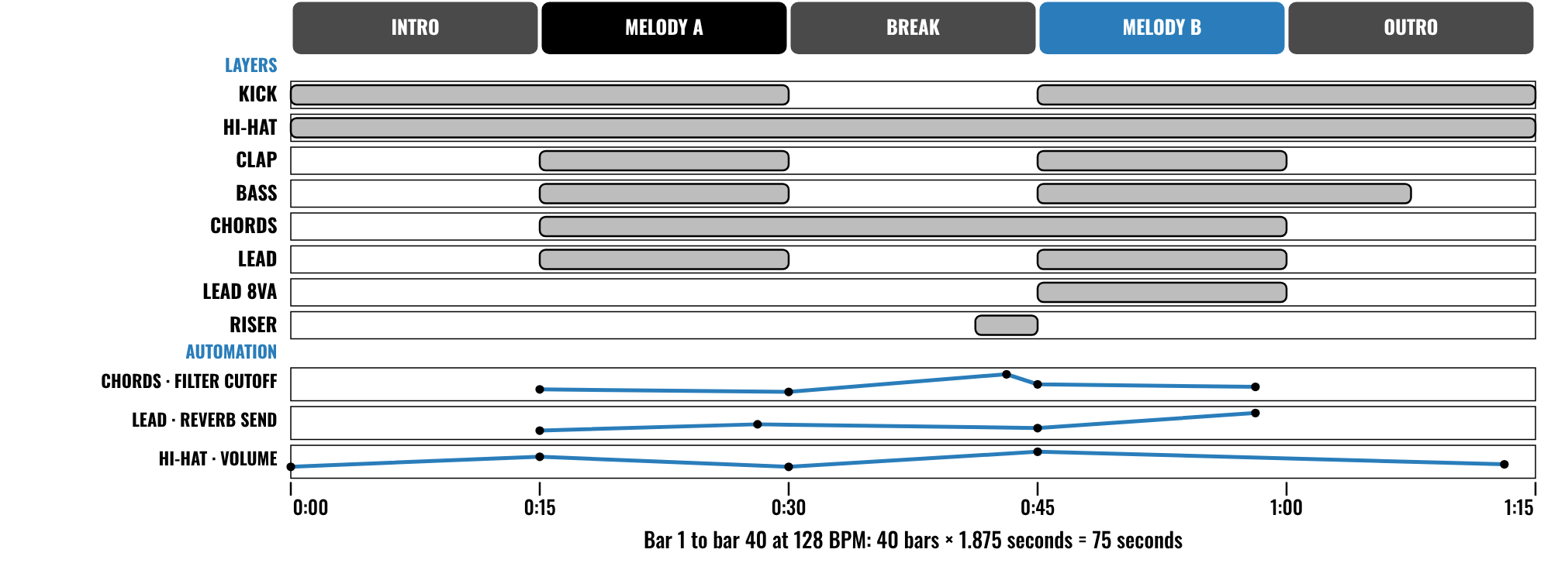
HUDSON BEAT
CLASS 3
WORKED EXAMPLE: 75 SECONDS
An invented 75-second remix
Five sections of eight bars
Eight layers, three automation lanes
Melody B has the most layers
Carol Flip · Intro deck · © 2026 Brian Lotze · Hudson Beat
10
Notes:
Class 3. An invented remix described on paper, nothing here is audio: Jingle Bells in C minor as house music at 128 BPM. Forty bars at 1.875 seconds a bar is 75 seconds, in five sections of eight bars. Eight layers join and leave, and Melody B has the most. Three automation lanes keep the sound moving. Students plan their own on the Arrangement plan.

Slide 11
HUDSON BEAT
CLASS 3
MIX IT, KEEP THE TUNE
Can you name the carol in ten seconds?
Turn the backing down, not the melody up
Can you hear every layer?
Add one effect that fits the genre
Carol Flip · Intro deck · © 2026 Brian Lotze · Hudson Beat
11
Notes:
Class 3. Mixing in one idea: the melody is the star. Ask students to play their first 20 seconds and say whether a listener could name the carol. If the drums or bass bury it, turn the backing down or EQ the melody up. Then check that every layer can be heard, and add one effect that suits the genre, such as a reverb, a filter or a tape-style delay.

Slide 12
HUDSON BEAT
CLASS 4
WHAT YOU TURN IN
Bounced .mp3 or .wav
Zipped .logicx project
Named: Your Name – Carol Flip – Carol, Genre
Flip plan, Arrangement plan, Reflection
Rubric self-score
Three questions for classmates
Carol Flip · Intro deck · © 2026 Brian Lotze · Hudson Beat
12
Notes:
Class 4. The submission checklist, shortened to fit the slide. Show where students hand in. The file name is Your Name, Carol Flip, then the carol and the genre, in that order. Check that every remix is between 60 and 90 seconds before students bounce.

Slide 13
HUDSON BEAT
CLASS 4
HOW IT’S SCORED
MELODY ACCURACY
5 = Exact, and any planned change (octave, mode) is done correctly and on purpose
/ 5
THE FLIP
5 = A confident, original take: every choice says the genre and the carol is unmistakable
/ 5
GENRE CRAFT
5 = Sounds like the genre: groove, bass, chords and effects all line up
/ 5
ARRANGEMENT & MIX
5 = A form that builds and resolves; every layer audible, melody on top
/ 5
PLAN & REFLECTION
5 = Insightful reflection and a polished, confident presentation
/ 5
SCORED 1–5 · FINAL GRADE = AVERAGE OF YOUR SCORE AND MINE · / 25
Carol Flip · Intro deck · © 2026 Brian Lotze · Hudson Beat
13
Notes:
The rubric: five categories, each scored 1 to 5, for a total out of 25. Students score themselves first; the final grade is the average of their score and yours. The slide reads the 5 column of each category aloud. Hand out the rubric page so students can self-score before they present.

Slide 14
HUDSON BEAT
CLASS 4
PRESENTATION DAY
Play your remix, then name the carol
Say the three things you flipped
Your three questions for classmates
Answer at least 2 of each classmate’s
Carol Flip · Intro deck · © 2026 Brian Lotze · Hudson Beat
14
Notes:
Class 4, presentations. Each student plays their remix, says which carol it is and names the three things they flipped, then takes questions. Students write three questions they want classmates to answer, and answer at least two of each classmate's. Ask the class to name the carol before the presenter does.

Slide 15
HUDSON BEAT
CLASS 4
ONE LAST THING…
You picked a carol.
You flipped it.
The tune still shines.
Now press play.
REFLECTION · PAGE 25
Write it or talk it through: what went well, what was hard, what you would change.
Carol Flip · Intro deck · © 2026 Brian Lotze · Hudson Beat
15
Notes:
Close with the listening day: play the finished flips without saying the title and let the class name each carol. A melody that people name quickly is a flip that worked. Ask a few students which of their flips changed the feel most. No audio is included in this kit; the sounds are the students' own. Reflection: point students to the Reflection page. A reflection is a written or oral conversation about how they did on the project and what they would do differently next time; they choose to write it or to talk it through with you.

