Slide 1
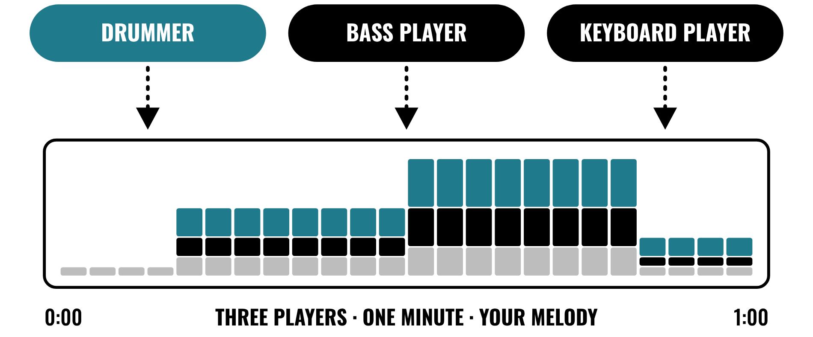
HUDSON BEAT
SESSION PLAYER’S STUDIO
Build a band without the band.
DIGITAL MUSIC PRODUCTION 2 · CLASS 1 · BUILD A BAND WITHOUT THE BAND
Notes:
Class 1, the first minute. No audio is included in this deck. Open with my overview: build a band without the band. Use Logic’s Session Players, Drummer, Bass Player, and Keyboard Player, to create a realistic live-style arrangement. Customize their style, groove, and complexity, then add your own melody on top.

Slide 2
HUDSON BEAT
CLASS 1
THINK: WHAT DOES A BAND DO?
THINK, THEN SHARE
Teacher: describe a band playing the same slow song twice, first quietly and simply, then loud and busy. No audio is needed.
What did the drummer change?
What stayed the same?
Who wrote the melody?
Session Player’s Studio · Intro deck · © 2026 Brian Lotze · Hudson Beat
2
Notes:
Ask the three questions aloud and take a few answers. Nothing is played from a speaker; describe one band and one song in two ways and let students imagine them. This sets up my goal that students adjust style, groove and complexity to create a realistic performance, and my teacher note that this project suits students who are less confident playing but have strong arrangement ideas.

Slide 3
HUDSON BEAT
CLASS 1
WHAT IS SESSION PLAYER’S STUDIO?
Build a band without the band
Drummer, Bass Player and Keyboard Player
Customize style, groove and complexity
Add your own melody on top
Session Player’s Studio · Intro deck · © 2026 Brian Lotze · Hudson Beat
3
Notes:
My overview and goals, shortened to fit the slide. Build a band without the band: use Logic's Session Players, Drummer, Bass Player and Keyboard Player, to create a realistic live-style arrangement, customize their style, groove and complexity, then add your own melody on top. My goals are to learn to use the Session Players, adjust style, groove and complexity to create a realistic performance, arrange a short piece with an intro, groove and ending, and add an original melody and mix for a polished final product.

Slide 4
HUDSON BEAT
CLASS 1
SEVEN CLASSES
CLASS 1
Build a band · five steps · five words · set up and choose chords
CLASS 2
Customize style, groove and complexity
CLASS 3
Working day: arrange, energy, worked example
CLASS 4
Working day: add your melody
CLASS 5
Working day: refine and mix
CLASS 6
Checklist · rubric
CLASS 7
Presentations with Padlet Q&A
Session Player’s Studio · Intro deck · © 2026 Brian Lotze · Hudson Beat
4
Notes:
The shape of the project, from my pacing guide. Class 1: introduction, demo Session Players, and students set up and choose chord progressions. Class 2: customize the session players and begin arranging sections. Classes 3 to 5 are working days: arrange, add melody, refine. Class 6: final mix, bounce and prepare presentations. Class 7: presentations with Padlet Q and A peer feedback.

Slide 5
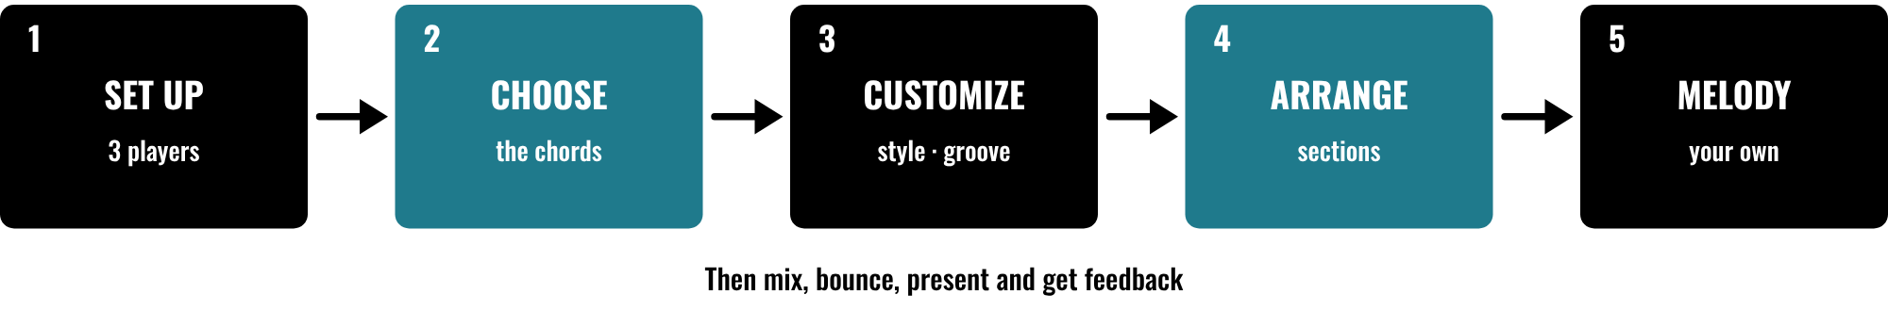
HUDSON BEAT
CLASS 1
FIVE STEPS, THEN FINISH
Load three Session Players
Choose a chord progression
Customize, then arrange
Add your melody, mix, present
Session Player’s Studio · Intro deck · © 2026 Brian Lotze · Hudson Beat
5
Notes:
Class 1. The first five steps of my project sheet, in order: set up, choose a chord progression, customize, arrange and add your melody. Then students mix and finalize, and present with Padlet feedback. Point to each box and say roughly when it happens: set up and chords today, customizing tomorrow, arranging and the melody on the working days. The step names are mine; the picture and its short labels are the kit's own.

Slide 6
HUDSON BEAT
CLASS 1
FIVE WORDS TO KNOW
Session Player: a virtual musician that plays for you
Groove: how tight, loose or swinging it feels
Complexity: how busy or simple a part is
Chord progression: the chords under a piece
Arrangement: how sections and instruments are laid out
Session Player’s Studio · Intro deck · © 2026 Brian Lotze · Hudson Beat
6
Notes:
My five vocabulary terms, shortened to fit the slide. Session Player: a Logic Pro virtual musician that generates realistic performances based on your settings. Groove: the rhythmic feel of a performance, how tight, loose or swinging it feels. Complexity: how busy or simple a session player's part is. Chord progression: a sequence of chords that provides the harmonic foundation of a piece. Arrangement: how different sections and instruments are organized across the timeline. The full definitions are on the vocabulary page.

Slide 7
HUDSON BEAT
CLASS 1
STEPS 1 AND 2: SET UP, CHOOSE CHORDS
1
Load Drummer, Bass Player and Keyboard Player
2
Borrow a chord progression or make your own
3
Stuck? Start from the Chord cheat sheet
4
Write your chords on the Arrangement plan
Session Player’s Studio · Intro deck · © 2026 Brian Lotze · Hudson Beat
7
Notes:
Steps 1 and 2 of the project sheet, shortened to fit the slide. Step 1, set up: load Drummer, Bass Player, and Keyboard Player into your project. Step 2: choose a chord progression, borrow one from a song you like or create your own. The last two lines are the kit's own suggestions, not my steps: the Chord cheat sheet answers my fourth struggle, that chord progressions intimidate some students, and the Arrangement plan has a row for the chords. Demo loading all three players live.

Slide 8
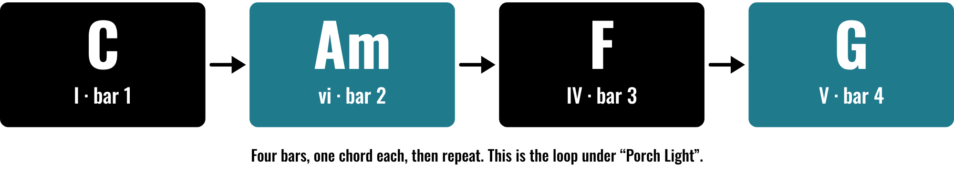
HUDSON BEAT
CLASS 1
A FOUR-BAR CHORD LOOP
An invented loop, on paper
One chord for each bar
Repeat it under every section
Change it in the B-section
Session Player’s Studio · Intro deck · © 2026 Brian Lotze · Hudson Beat
8
Notes:
Class 1. A kit picture, not from my sheets: the four chords under the invented worked example, C, A minor, F and G, one chord for each bar, then repeat. The Roman numerals I, vi, IV and V are on the Chord cheat sheet in five keys. Ask students to say the chords aloud with you, one a bar, and then show them how to type the chords into the project. Nothing here is audio.

Slide 9
HUDSON BEAT
CLASS 2
STEP 3: CUSTOMIZE
1
Adjust each player’s style, groove and complexity
2
You can change the instrument a player uses
3
The player makes the notes; you choose the sound
4
Write your settings on the Players sheet
Session Player’s Studio · Intro deck · © 2026 Brian Lotze · Hudson Beat
9
Notes:
Step 3 of the project sheet and tip 1, shortened to fit the slide. Customize: adjust each session player's style, groove, and complexity settings. My first tip: don't be afraid to change the instrument a session player is using, because it creates the notes and you choose the sound. My first struggle is students who leave everything on default, so push them to customize. The last line is the kit's own suggestion: the Players sheet is where they record what they set.

Slide 10
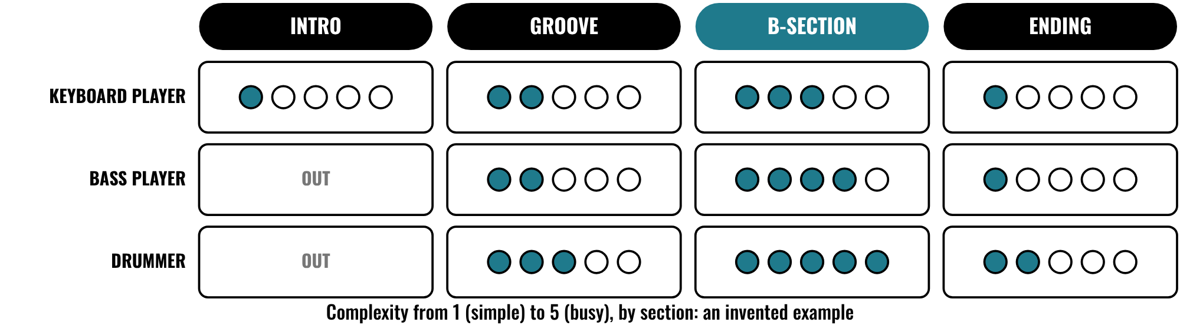
HUDSON BEAT
CLASS 2
SAME PLAYERS, DIFFERENT SETTINGS
Same players in every section
The settings are what change
Keys are simple in the intro
The B-section is the busiest
Session Player’s Studio · Intro deck · © 2026 Brian Lotze · Hudson Beat
10
Notes:
Class 2. A kit picture of an invented piece: the same three Session Players in four sections, each with a different complexity from 1, simple, to 5, busy. The Keyboard Player is alone and simple in the intro, and the Drummer is at 5 in the B-section. Ask students which section would feel biggest and why. The scale from 1 to 5 is the kit's own, so that settings can be talked about; Logic shows them with its own controls. Nothing here is audio.

Slide 11
HUDSON BEAT
CLASS 3
STEP 4: ARRANGE
1
Build an intro, main groove and ending
2
Vary the energy between sections
3
Change Drummer patterns and Bass complexity per section
4
Plan it on the Arrangement plan
Session Player’s Studio · Intro deck · © 2026 Brian Lotze · Hudson Beat
11
Notes:
Step 4 of the project sheet and my third struggle, shortened to fit the slide. Arrange: build an intro, main groove, and ending, and vary the energy between sections. My third struggle is students who don't vary sections, so the whole track sounds the same; show them how to change Drummer patterns and Bass complexity per section. The last line is the kit's own suggestion: the Arrangement plan is where they decide it on paper first.

Slide 12
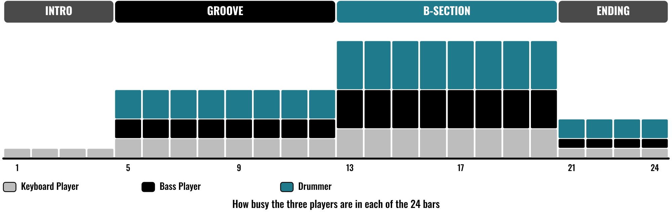
HUDSON BEAT
CLASS 3
ENERGY OVER ONE MINUTE
An invented piece, on paper
Small intro, bigger groove
The B-section is the peak
The ending thins out
Session Player’s Studio · Intro deck · © 2026 Brian Lotze · Hudson Beat
12
Notes:
Class 3, the first working day after the settings. A kit picture of an invented piece: how busy the three players are in each of 24 bars. The intro is small, the groove is bigger, the B-section is the peak and the ending thins out. My tip 3 is to vary the complexity between sections so the intro feels different from the peak. Students can plan their own on the Arrangement plan.

Slide 13
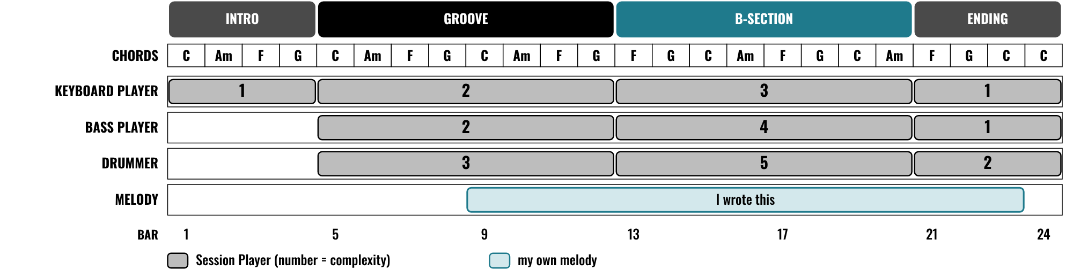
HUDSON BEAT
CLASS 3
WORKED EXAMPLE: 60 SECONDS
An invented 60-second piece
Four sections you can name
A chord for every bar
Your melody sits on top
Session Player’s Studio · Intro deck · © 2026 Brian Lotze · Hudson Beat
13
Notes:
Class 3. An invented piece, Porch Light, described on paper; nothing here is audio. It is 24 bars at 96 BPM, which is 60 seconds, in four sections. Three Session Players come in and out with different complexity, there is a chord for every bar, and an original melody comes in at bar 9. The numbers, the settings and the weak and clear plans are on the worked example pages.

Slide 14
HUDSON BEAT
CLASS 4
STEP 5: ADD YOUR MELODY
Record or program an original melody
The melody is what makes this yours
Spend real time on it
Use chord tones on the strong beats
Session Player’s Studio · Intro deck · © 2026 Brian Lotze · Hudson Beat
14
Notes:
Step 5 and tip 4, shortened to fit the slide. Add your melody: record or program an original melody over the top. My fourth tip: the melody is what makes this yours, so spend real time on it. My second struggle is that the melody is an afterthought, so dedicate this class to melody writing. The last line is the kit's own suggestion; the Melody planner lists the chord tones.

Slide 15
HUDSON BEAT
CLASS 5
STEP 6: MIX AND FINALIZE
Balance levels
Apply EQ and effects
Bounce your track
Can you hear your melody over the band?
Session Player’s Studio · Intro deck · © 2026 Brian Lotze · Hudson Beat
15
Notes:
Step 6, shortened to fit the slide: mix and finalize. Balance levels, apply EQ and effects, and bounce your track. The last line is the kit's own question for the Mix sheet: close your eyes and listen for the melody. Ask each student to play their intro and then their peak, and say what changed.

Slide 16
HUDSON BEAT
CLASS 6
WHAT YOU TURN IN
Bounced .mp3 or .wav
Zipped .logicx project
Named: Your Name – Session Player’s Studio
At least 3 Session Players with custom settings
Padlet post with 3 questions
Answer 2 questions on classmates’ posts
Session Player’s Studio · Intro deck · © 2026 Brian Lotze · Hudson Beat
16
Notes:
The submission checklist from the project sheet, shortened to fit the slide. Show where students upload (your class page) and where the Padlet board is. The file name is Your Name, then Session Player's Studio. Check that every student has at least three Session Players with custom settings before they bounce.

Slide 17
HUDSON BEAT
CLASS 6
HOW IT’S SCORED
CREATIVITY & ORIGINALITY
5 = Exceptional creativity; innovative, bold, and expressive
/ 5
TECHNICAL SKILL / DAW USE
5 = Expert-level command of multiple Logic systems
/ 5
COMPOSITION & STRUCTURE
5 = Professional pacing, flow, and musical arc
/ 5
SOUND DESIGN & MIX QUALITY
5 = Exceptional sound design; professional-quality mix
/ 5
DOCUMENTATION & PRESENTATION
5 = Exceptional; thorough insight and polished delivery
/ 5
SCORED 1–5 · FINAL GRADE = AVERAGE OF YOUR SCORE AND MINE · / 25
Session Player’s Studio · Intro deck · © 2026 Brian Lotze · Hudson Beat
17
Notes:
My rubric: five categories, each scored 1 to 5, for a total out of 25. Students score themselves first; the final grade is the average of their score and mine. The slide reads the 5 column of each category aloud. Hand out the rubric page so students can self-score before they present.

Slide 18
HUDSON BEAT
CLASS 7
PRESENTATION DAY
Play your track; name your three players
Say what you changed in the intro and the peak
Your Padlet post: 3 questions about your project
Answer at least 2 of each classmate’s 3
Session Player’s Studio · Intro deck · © 2026 Brian Lotze · Hudson Beat
18
Notes:
Class 7, presentations with Padlet Q and A. Step 7 of the project sheet, shortened to fit the slide: create your own Padlet post with 3 questions you want classmates to answer, present to the class, and during classmates' presentations answer at least 2 of their 3 questions. The first two lines are the kit's own suggestions. Ask the class to name the chord progression before the presenter does.

Slide 19
HUDSON BEAT
CLASS 7
ONE LAST THING…
You built a band.
You shaped every part.
You wrote the melody.
Now press play.
REFLECTION · PAGE 24
Write it or talk it through: what went well, what was hard, what you would change.
Session Player’s Studio · Intro deck · © 2026 Brian Lotze · Hudson Beat
19
Notes:
Close with my teacher note: this is a great project for students who are less confident with playing but have strong arrangement ideas. Ask a few students which player they changed the most. Tell them the next project starts from the menu. Reflection: point students to the Reflection page. A reflection is a written or oral conversation about how they did on the project and what they would do differently next time; they choose to write it or to talk it through with you.

