Slide 1
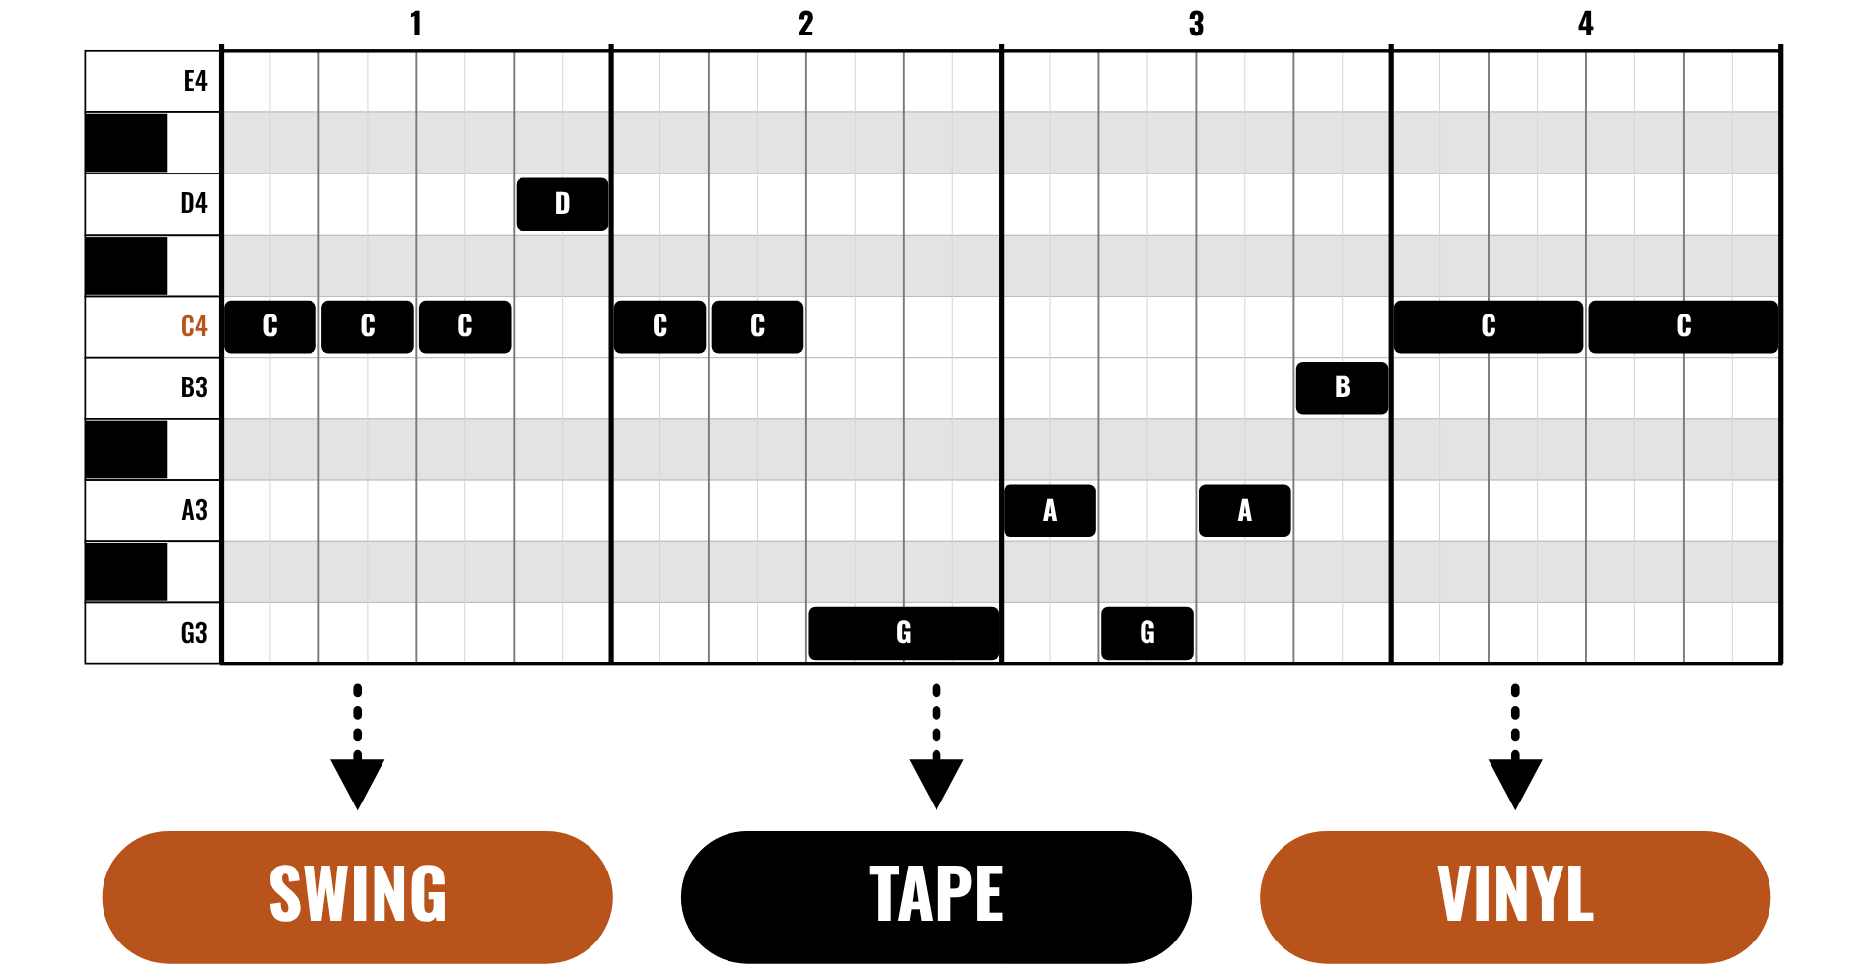
HUDSON BEAT
LO-FI HOLIDAY BEAT
A carol, slowed down and dusted off.
LOGIC PRO PROJECT · CLASS 1 · A CAROL, REWOUND
Notes:
Class 1, the first minute. No audio is included in this deck. Open with the idea: you are going to turn a carol everyone knows into a lo-fi hip-hop beat in Logic Pro, with swing, tape wobble, a Bitcrusher and vinyl noise. The three melodies are public domain and arrive as note charts, so every student can enter them without reading staff notation.

Slide 2
HUDSON BEAT
CLASS 1
THINK: WHAT MAKES MUSIC SOUND LO-FI?
THINK, THEN SHARE
Teacher: say or hum the first line of Good King Wenceslas, first bright and crisp, then slow, soft and a little behind the beat.
What changed?
What would make it sound warm or old?
Which sounds would you add?
Lo-Fi Holiday Beat · Intro deck · © 2026 Brian Lotze · Hudson Beat
2
Notes:
Ask the three questions aloud and take a few answers. Nothing is played from a speaker: you say or hum the first line yourself, first bright and crisp and then slow, soft and a little late. Students will say slower, quieter and bouncier and, if they know the style, crackle and warmth. Write their words on the board; the project turns each one into a tool.

Slide 3
HUDSON BEAT
CLASS 1
WHAT IS LO-FI HOLIDAY BEAT?
Choose a public-domain carol
Enter its melody and chords in Logic Pro
Make it lo-fi: swing, tape, bitcrush, vinyl noise
Finish a 60 to 90 second beat
Lo-Fi Holiday Beat · Intro deck · © 2026 Brian Lotze · Hudson Beat
3
Notes:
The project in four lines. Students choose Good King Wenceslas, God Rest Ye Merry, Gentlemen or O Tannenbaum; all three melodies are public domain, so anyone may use them. They enter the melody and chords from a piano-roll chart, then build a slow, swung beat and make it sound lo-fi. The finished beat is 60 to 90 seconds. If a student would rather use another carol, a teacher-approved public-domain melody works, and a blank piano roll is provided.

Slide 4
HUDSON BEAT
CLASS 1
FOUR CLASSES
CLASS 1
A carol, rewound · five moves · reading a piano roll
CLASS 2
Build the beat · straight or swung · three drum patterns
CLASS 3
Worked example, 84 seconds · make it lo-fi, keep the tune
CLASS 4
Checklist · rubric · presentations
Lo-Fi Holiday Beat · Intro deck · © 2026 Brian Lotze · Hudson Beat
4
Notes:
The shape of the project. Class 1: hook, choose a carol, fill in the Beat plan and enter the melody and chords. Class 2: build the beat, with drums, swing and a bass line. Class 3: make it lo-fi with tape, a Bitcrusher, a low-pass filter and vinyl noise, then plan the form, arrange and mix. Class 4: bounce, hand in, present and reflect. Hand out the project sheet, the charts and the Beat plan now.

Slide 5
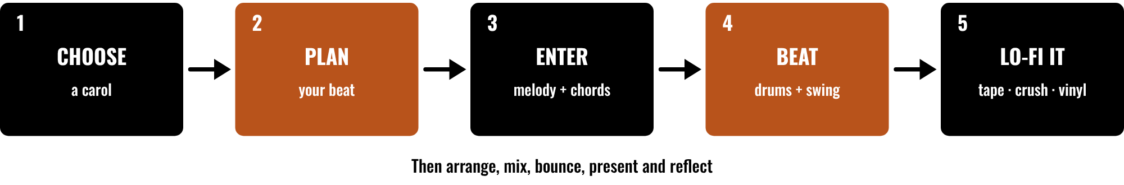
HUDSON BEAT
CLASS 1
FIVE MOVES, THEN FINISH
Choose a carol and a tempo
Plan your beat and lo-fi moves
Enter the melody and chords
Beat first, then lo-fi it, then arrange
Lo-Fi Holiday Beat · Intro deck · © 2026 Brian Lotze · Hudson Beat
5
Notes:
Class 1. The five moves in order: choose, plan, enter, beat and lo-fi it. After that students arrange, mix, bounce, present and reflect. Point to each box and say roughly when it happens: choosing and planning today, entering and the beat on Class 2, lo-fi sound and arranging on Class 3. The picture and its short labels are drawn for this kit.

Slide 6
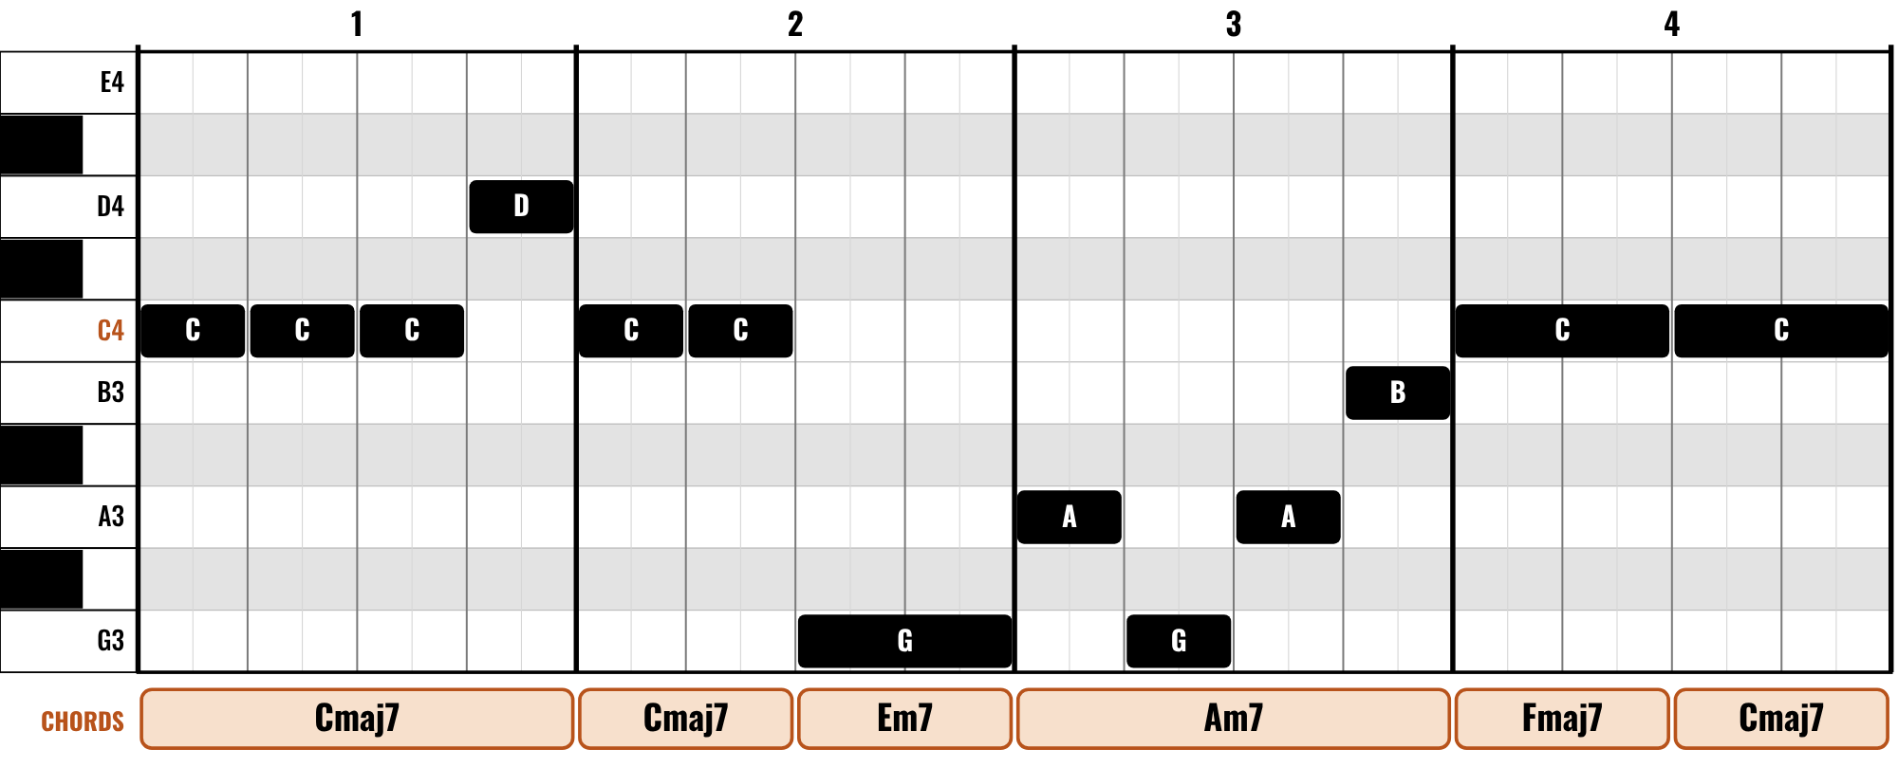
HUDSON BEAT
CLASS 1
READING A PIANO ROLL
Higher bar means higher pitch
Longer bar means a longer note
Left to right is time, bar by bar
The chords are one idea that fits
Lo-Fi Holiday Beat · Intro deck · © 2026 Brian Lotze · Hudson Beat
6
Notes:
Class 1. This is the Piano Roll view of the four-bar Good King Wenceslas loop, drawn the same way as the charts on students' pages. A higher bar is a higher pitch, a longer bar is a longer note, and time runs left to right. The chord boxes underneath are the loop's chords; other chords can work. Ask a student to read bar 2 aloud: C, C, then a long G.

Slide 7
HUDSON BEAT
CLASS 2
BUILD THE BEAT
1
Set the tempo, 70 to 90 BPM
2
Pick a drum pattern: kick, snare, hats
3
Enter it in the Step Sequencer, or start from a Drummer track
4
Swing it: Quantize 1/16, then Q-Swing
5
Add a soft bass on the chord roots
Lo-Fi Holiday Beat · Intro deck · © 2026 Brian Lotze · Hudson Beat
7
Notes:
Class 2. Demonstrate on the projector: set the tempo between 70 and 90 BPM, make a Drum Machine Designer track and open the Step Sequencer, or make a Drummer track in a hip-hop style. Click in pattern A from page 15. Then select the region, set Quantize to 1/16 and raise Q-Swing until the hats bounce. Add a soft bass playing one long note on each chord root. Menu names move between Logic versions.

Slide 8
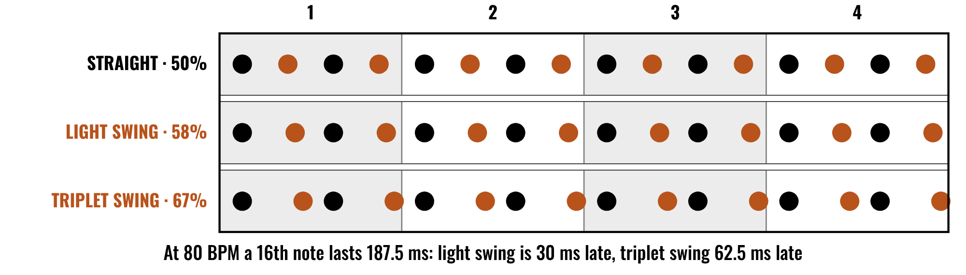
HUDSON BEAT
CLASS 2
STRAIGHT OR SWUNG?
Black dots stay on the grid
Orange dots land later and later
Straight marches, swing bounces
Q-Swing in the Region inspector
Lo-Fi Holiday Beat · Intro deck · © 2026 Brian Lotze · Hudson Beat
8
Notes:
Class 2. One bar of sixteenth-note hi-hats three times. The black dots are on the grid in all three rows; the orange dots are the off-beat sixteenths, and each row moves them later. At 80 BPM a sixteenth lasts 187.5 milliseconds, so light swing is 30 ms late and triplet swing is 62.5 ms late. Logic's Q-Swing slider has its own scale, so students compare by ear.

Slide 9
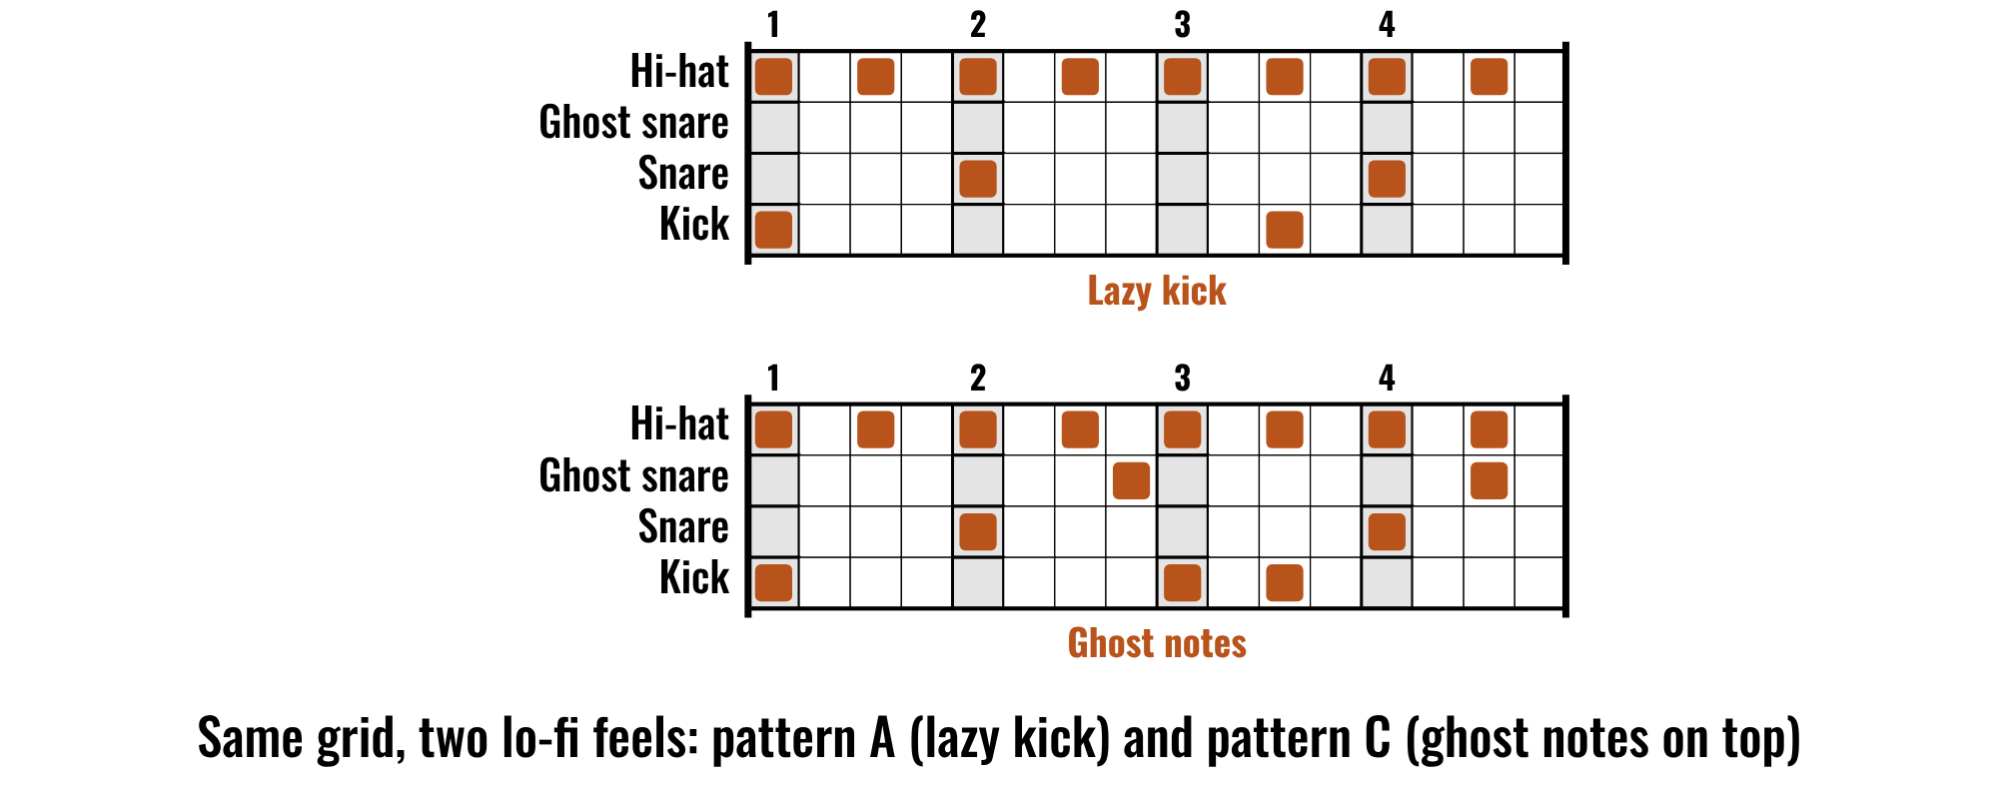
HUDSON BEAT
CLASS 2
THREE LO-FI DRUM PATTERNS
Lo-Fi Holiday Beat · Intro deck · © 2026 Brian Lotze · Hudson Beat
9
Notes:
Class 2. The same 16-step grid in two lo-fi feels. Pattern A is the lazy kick: kick on beat 1 and just after beat 3, snare on 2 and 4. Pattern C adds very quiet ghost snare hits between the backbeats. Students copy a pattern from page 15 into the Step Sequencer. Ask: which of your lo-fi moves is this, swing, drums or sound? O Tannenbaum needs pattern D, the 3/4 waltz.

Slide 10
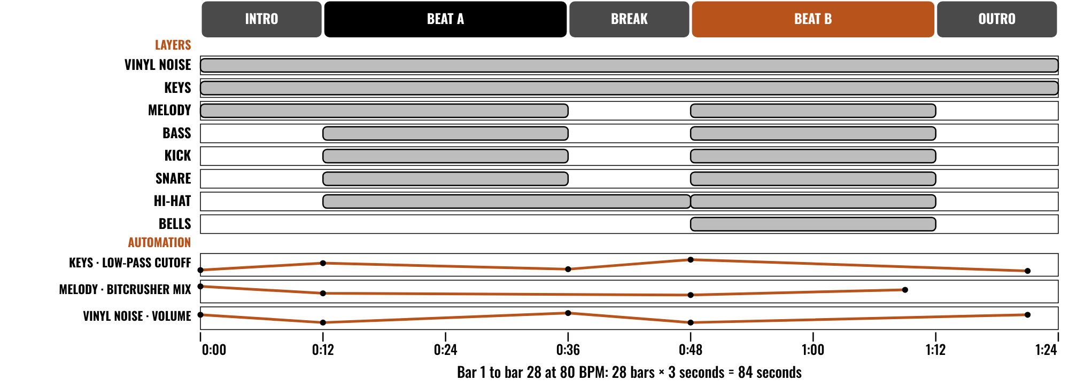
HUDSON BEAT
CLASS 3
WORKED EXAMPLE: 84 SECONDS
An invented 84-second beat
Five sections: 4, 8, 4, 8, 4 bars
Eight layers, three automation lanes
Beat B has the most layers
Lo-Fi Holiday Beat · Intro deck · © 2026 Brian Lotze · Hudson Beat
10
Notes:
Class 3. An invented beat described on paper, nothing here is audio: Good King Wenceslas at 80 BPM. Twenty-eight bars at 3 seconds a bar is 84 seconds, in five sections of 4, 8, 4, 8 and 4 bars. Eight layers join and leave, and Beat B has the most. Three automation lanes keep the sound moving. Students plan their own on the Arrangement plan.

Slide 11
HUDSON BEAT
CLASS 3
MAKE IT LO-FI, KEEP THE TUNE
Low-pass the keys: soften the highs
Tape: a little wobble and echo
Bitcrusher on one sound, not everything
Vinyl noise: so quiet you miss it when it stops
Lo-Fi Holiday Beat · Intro deck · © 2026 Brian Lotze · Hudson Beat
11
Notes:
Class 3. The four sound moves in one idea: each one is small, and the melody stays the star. Close the High Cut filter in Channel EQ on the keys; add a little Scanner Vibrato and a Tape Delay with low feedback; put a Bitcrusher on one sound only; and place a very quiet noise track under everything. Ask each student to play their first 20 seconds and say whether a listener could name the carol.

Slide 12
HUDSON BEAT
CLASS 4
WHAT YOU TURN IN
Bounced .mp3 or .wav
Zipped .logicx project
Named: Your Name – Lo-Fi Holiday Beat – Carol
Beat plan, Arrangement plan, Reflection
Rubric self-score
Three questions for classmates
Lo-Fi Holiday Beat · Intro deck · © 2026 Brian Lotze · Hudson Beat
12
Notes:
Class 4. The submission checklist, shortened to fit the slide. Show where students hand in. The file name is Your Name, Lo-Fi Holiday Beat, then the carol, in that order. Check that every beat is between 60 and 90 seconds before students bounce.

Slide 13
HUDSON BEAT
CLASS 4
HOW IT’S SCORED
MELODY & CHORDS
5 = Exact, with chords and a bass line that support the melody; the carol is unmistakable
/ 5
LO-FI BEAT
5 = A relaxed, bouncing groove: swing, drums and bass lock together
/ 5
LO-FI SOUND
5 = Every effect is used on purpose, with automation, and the carol is still clear
/ 5
ARRANGEMENT & MIX
5 = A form that builds and resolves; every layer audible, melody on top, noise quiet
/ 5
PLAN & REFLECTION
5 = Insightful reflection and a polished, confident presentation
/ 5
SCORED 1–5 · FINAL GRADE = AVERAGE OF YOUR SCORE AND MINE · / 25
Lo-Fi Holiday Beat · Intro deck · © 2026 Brian Lotze · Hudson Beat
13
Notes:
The rubric: five categories, each scored 1 to 5, for a total out of 25. Students score themselves first; the final grade is the average of their score and yours. The slide reads the 5 column of each category aloud. Hand out the rubric page so students can self-score before they present.

Slide 14
HUDSON BEAT
CLASS 4
PRESENTATION DAY
Play your beat, then name the carol
Say which lo-fi moves you used
Your three questions for classmates
Answer at least 2 of each classmate’s
Lo-Fi Holiday Beat · Intro deck · © 2026 Brian Lotze · Hudson Beat
14
Notes:
Class 4, presentations. Each student plays their beat, says which carol it is and names the lo-fi moves they used, then takes questions. Students write three questions they want classmates to answer, and answer at least two of each classmate's. Ask the class to name the carol before the presenter does.

Slide 15
HUDSON BEAT
CLASS 4
ONE LAST THING…
You picked a carol.
You slowed it down.
You added the dust.
Now press play.
REFLECTION · PAGE 26
Write it or talk it through: what went well, what was hard, what you would change.
Lo-Fi Holiday Beat · Intro deck · © 2026 Brian Lotze · Hudson Beat
15
Notes:
Close with the listening day: play the finished beats without saying the title and let the class name each carol. A melody that people name quickly is a beat that kept the tune. Ask a few students which lo-fi move changed the mood most. No audio is included in this kit; the sounds are the students' own. Reflection: point students to the Reflection page. A reflection is a written or oral conversation about how they did on the project and what they would do differently next time; they choose to write it or to talk it through with you.

