Slide 1
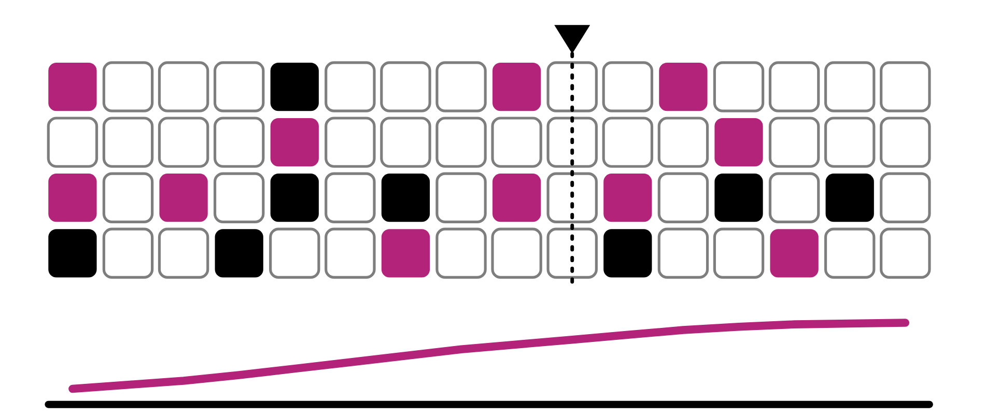
HUDSON BEAT
PATTERN PRODIGY
Program a groove that evolves.
DIGITAL MUSIC PRODUCTION 2 · CLASS 1 · PROGRAM A GROOVE THAT EVOLVES
Notes:
Class 1, the first minute. No audio is included in this deck. Open with my overview: become a pattern master. Use Logic's Step Sequencer and Pattern Regions to craft an original groove-driven composition, a 30 to 60 second piece that evolves over time through layering, automation and creative use of sequencer features like probability and velocity.

Slide 2
HUDSON BEAT
CLASS 1
THINK: A BEAT THAT CHANGES
TAP IT OUT
Think, then share
Teacher: tap a simple beat on a desk, then change one tap each time round. No audio is needed.
What makes a groove feel like a groove?
What happens if a machine plays the exact same bar forever?
How could a machine sound as if a person is playing?
Pattern Prodigy · Intro deck · © 2026 Brian Lotze · Hudson Beat
2
Notes:
Ask the three questions aloud and take a few answers. Nothing is played from a speaker; tap a beat on a desk and change one tap each time round, so students hear that small changes keep a loop alive. No one else's music is included in this kit. This sets up my tips: probability is your friend, and do not just stack patterns.

Slide 3
HUDSON BEAT
CLASS 1
WHAT IS PATTERN PRODIGY?
Build an original loop-based groove
Step Sequencer and Pattern Regions
Probability, velocity and automation
30–60 seconds that evolves over time
Pattern Prodigy · Intro deck · © 2026 Brian Lotze · Hudson Beat
3
Notes:
My overview and goals, shortened to fit the slide. Become a pattern master: use Logic's Step Sequencer and Pattern Regions to craft an original groove-driven composition of 30 to 60 seconds that evolves over time through layering, automation and creative use of sequencer features like probability and velocity. My goals add EQ, panning and plug-ins for a polished sound, and texture and form through pattern layering. Slide 6 introduces the five vocabulary terms.

Slide 4
HUDSON BEAT
CLASS 1
SEVEN CLASSES
CLASS 1
A beat that changes · the steps · five words · explore and build rhythms
CLASS 2
Read a grid · not only drums · add melodic layers
CLASS 3
Working day: four ways to evolve, worked example
CLASS 4
Working day: probability, mix, refine
CLASS 5
Working day: explore automation, probability, variation
CLASS 6
Bounce · checklist · rubric
CLASS 7
Presentations with Padlet Q&A
Pattern Prodigy · Intro deck · © 2026 Brian Lotze · Hudson Beat
4
Notes:
The shape of the project, from my pacing guide. Class 1: introduction to the Step Sequencer and Pattern Regions, with guided exploration. Class 2: build drum and percussion patterns and begin adding melodic layers. Classes 3 to 5 are working days: explore automation, probability and variation. Class 6: final mix and bounce, and prepare presentations. Class 7: presentations with Padlet Q and A peer feedback. Hand out the project sheet now.

Slide 5
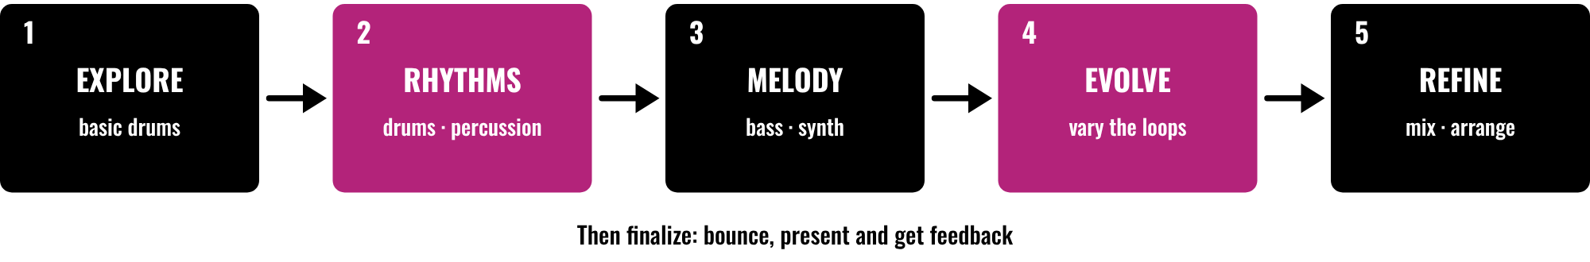
HUDSON BEAT
CLASS 1
FIVE STEPS, THEN FINISH
Explore basic drum patterns
Build drum and percussion patterns
Add bass and synth patterns
Evolve them, then mix and refine
Pattern Prodigy · Intro deck · © 2026 Brian Lotze · Hudson Beat
5
Notes:
Class 1. The first five steps of my project sheet, in order: explore, build rhythms, add melodic layers, automate and vary, mix and refine. Then students finalize with a bounce and present with Padlet feedback. Point to each box and say roughly when it happens: exploring and rhythms now, melodic layers in Class 2, variation and refining on the working days. The step names are mine; the picture and its short labels are the kit's own.

Slide 6
HUDSON BEAT
CLASS 1
FIVE WORDS TO KNOW
Step Sequencer: toggle steps on a grid
Pattern Region: holds sequencer data
Probability: a chance a step plays
Velocity: how hard a note is played
Automation: a parameter changing over time
Pattern Prodigy · Intro deck · © 2026 Brian Lotze · Hudson Beat
6
Notes:
My five vocabulary terms, shortened to fit the slide. Step Sequencer: a Logic tool that lets you program rhythms and melodies by toggling steps on a grid. Pattern Region: a region in Logic that contains step sequencer data. Probability: a feature that gives each step a chance of playing or not, adding randomness. Velocity: how hard a note is played; higher velocity is louder and often brighter. Automation: changing a parameter, such as volume, filter or pan, over time to create movement. The full definitions are on the vocabulary page.

Slide 7
HUDSON BEAT
CLASS 1
STEPS 1 AND 2: EXPLORE, BUILD
1
Open the Step Sequencer; try basic drum patterns
2
Click steps on and off, listen, change one thing at a time
3
Create your core drum and percussion patterns
4
Make a groove that feels good first
Pattern Prodigy · Intro deck · © 2026 Brian Lotze · Hudson Beat
7
Notes:
Steps 1 and 2 of the project sheet, shortened to fit the slide. Step 1, explore: open the Step Sequencer and experiment with basic drum patterns. Step 2, build rhythms: create your core drum and percussion patterns. The second and fourth lines are the kit's own suggestions, not my steps: change one thing at a time so students hear what each change does, and get a groove that feels good before adding anything, which is my first tip. Guide the class through a first pattern; none is included as audio.

Slide 8
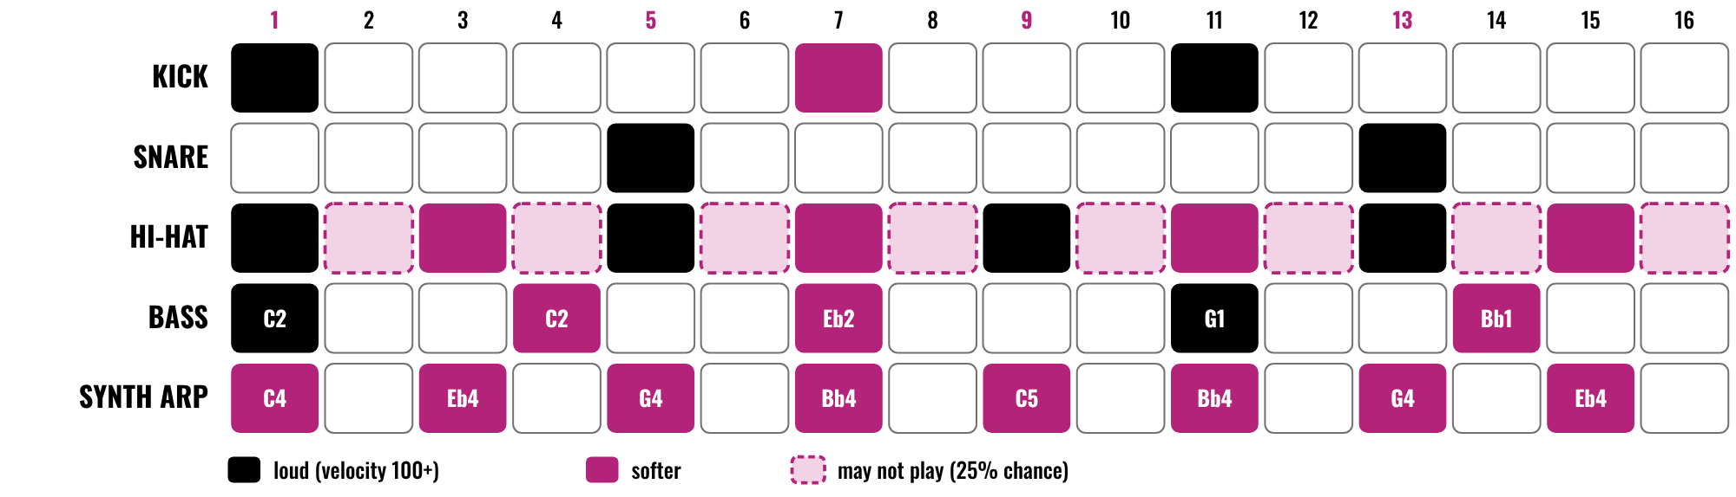
HUDSON BEAT
CLASS 2
READING A PATTERN GRID
One bar, 16 steps
Darker means louder
Dashed steps may not play
Drums, bass and a synth arp
Pattern Prodigy · Intro deck · © 2026 Brian Lotze · Hudson Beat
8
Notes:
Class 2. A kit picture, not from my sheets: one bar of an invented groove on a 16-step grid, with kick, snare, hi-hat, bass and a synth arp. Darker steps are louder, which is velocity; a dashed step may not play, which is probability. Ask students to find where the kick and snare fall and which steps are the hi-hat's ghost steps. The Pattern grids page lets them plan their own.

Slide 9
HUDSON BEAT
CLASS 2
NOT ONLY DRUMS
The Step Sequencer works for bass and synths too
Demo a melodic pattern early
Start with your drums; the rest follows
Ask: what else could be a row?
Pattern Prodigy · Intro deck · © 2026 Brian Lotze · Hudson Beat
9
Notes:
My first struggle and first tip, shortened to fit the slide. Students only use the Step Sequencer for drums, so demo melodic patterns early. Start with your drums: once you have a groove that feels good, everything else falls into place. The last line is the kit's own question: a bass line, a chord arp or a small effect can each be a row.

Slide 10
HUDSON BEAT
CLASS 2
STEP 3: ADD MELODIC LAYERS
1
Program bass and synth patterns that complement your groove
2
Include a drum kit, a bass or synth, and one more element
3
Let the bass follow the kick
4
Add one pattern at a time, and listen
Pattern Prodigy · Intro deck · © 2026 Brian Lotze · Hudson Beat
10
Notes:
Step 3 of the project sheet and requirement 3, shortened to fit the slide. Step 3, add melodic layers: program bass and synth patterns that complement your groove. Requirement 3: include at least one drum kit, one bass or synth, and one additional element. The last two lines are the kit's own suggestions, not my steps: let the bass follow the kick, and add one pattern at a time and listen before adding the next. Hand out the Feature tracker.

Slide 11
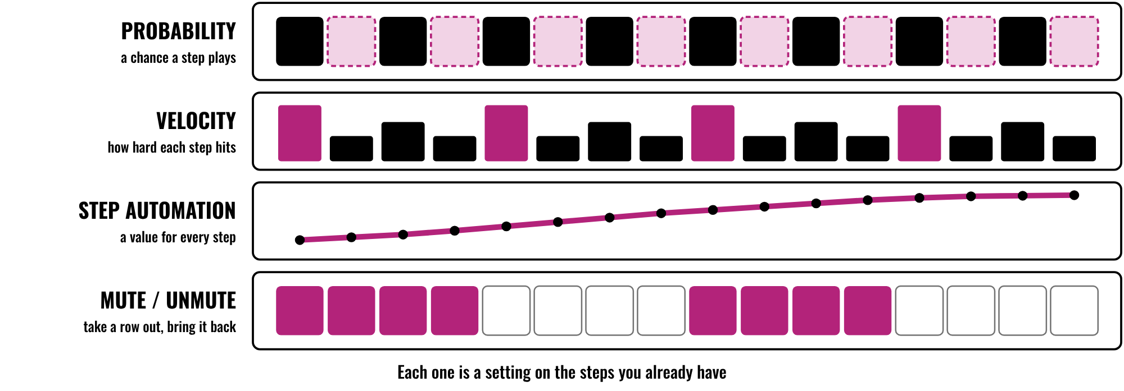
HUDSON BEAT
CLASS 3
FOUR WAYS TO EVOLVE
Probability: a chance to play
Velocity: how hard
Step automation: a value per step
Mute / unmute: arrangement changes
Pattern Prodigy · Intro deck · © 2026 Brian Lotze · Hudson Beat
11
Notes:
Class 3, the first working day. A kit picture of four Step Sequencer settings on the steps students already have. Probability gives a step a chance of playing. Velocity changes how hard each step hits. Step automation gives every step its own value, for example a filter cutoff. Mute and unmute takes a row out and brings it back, which my fourth tip uses for arrangement changes. Students use at least three of these or others they find; the sheet says at least 3 different Step Sequencer features.

Slide 12
HUDSON BEAT
CLASS 3
STEP 4: AUTOMATE AND VARY
Use probability, velocity and automation
Patterns should evolve, not repeat exactly
Use at least 3 Step Sequencer features
Count your features on the tracker
Pattern Prodigy · Intro deck · © 2026 Brian Lotze · Hudson Beat
12
Notes:
Step 4 and requirement 2, shortened to fit the slide. Step 4, automate and vary: use probability, velocity and automation to make patterns evolve. Requirement 2: use at least 3 different Step Sequencer features. My second struggle is that patterns sound static, so push automation and probability. The last line is the kit's own: students list their features on the Feature tracker.

Slide 13
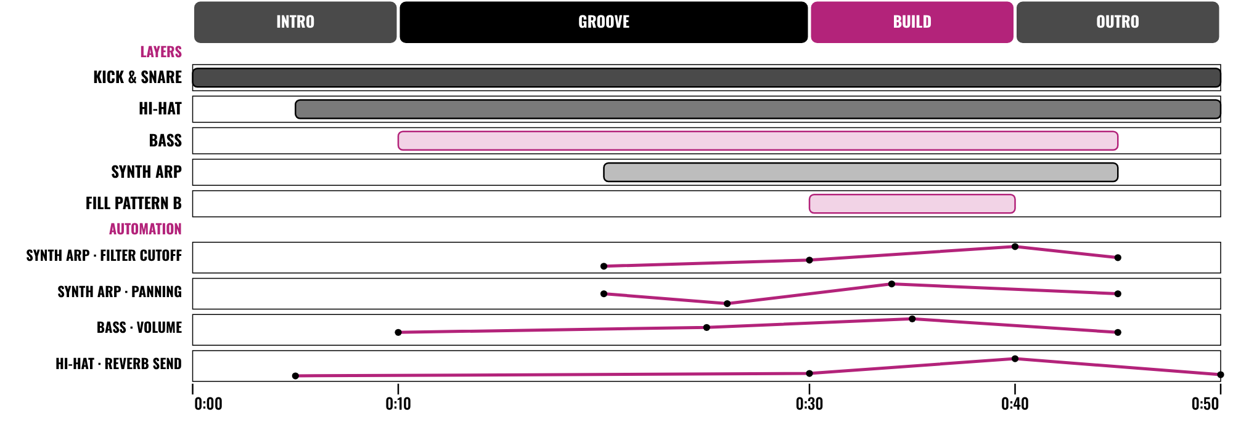
HUDSON BEAT
CLASS 3
WORKED EXAMPLE: 50 SECONDS
An invented 50-second piece, on paper
Four sections you can name
Five layers that join and leave
Four automation lanes, none flat
Pattern Prodigy · Intro deck · © 2026 Brian Lotze · Hudson Beat
13
Notes:
Class 3. An invented piece, Night Shift, described on paper; nothing here is audio. It is 50 seconds long, 20 bars at 96 BPM, in four sections: intro, groove, build and outro. Five layers join and leave: kick and snare, hi-hat, bass, a synth arp and a second drum pattern. Below them are four automation lanes, and none is flat. The patterns, the five features and the arithmetic are on the worked example pages.

Slide 14
HUDSON BEAT
CLASS 4
PROBABILITY IS YOUR FRIEND
Even a small chance makes patterns feel human
Do not just stack patterns: build and evolve
Static? Push automation and probability
Try it live on a hi-hat
Pattern Prodigy · Intro deck · © 2026 Brian Lotze · Hudson Beat
14
Notes:
My tips 2 and 3 and my second and third struggles, shortened to fit the slide. Probability is your friend: even a small percentage of randomness makes patterns feel more human. Do not just stack patterns; think about how your piece builds and evolves. Patterns that sound static need automation and probability. Students do not always understand probability, so show a live example on a hi-hat: give a few steps a 25 percent chance and loop it. Ask students to try it now.

Slide 15
HUDSON BEAT
CLASS 4
STEP 5: MIX AND REFINE
Apply EQ, panning and plug-ins
Arrange into a cohesive piece
Use mute/unmute to change the arrangement
Harder option: 90 seconds, alternates, 2 step automations
Pattern Prodigy · Intro deck · © 2026 Brian Lotze · Hudson Beat
15
Notes:
Step 5, tip 4 and my Harder variation, shortened to fit the slide. Mix and refine: apply EQ, panning and plug-ins, and arrange into a cohesive piece. Use mute and unmute in the Step Sequencer to create arrangement changes. My Harder variation extends the piece to 90 seconds and requires pattern alternates and two types of step automation; offer it to students who are ready. Hand out the Listen-back sheet.

Slide 16
HUDSON BEAT
CLASS 6
STEPS 6 AND 7: BOUNCE, PRESENT
1
Bounce your track
2
Zip the .logicx project
3
Create your Padlet post with 3 questions
4
Prepare to present
Pattern Prodigy · Intro deck · © 2026 Brian Lotze · Hudson Beat
16
Notes:
Class 6. Steps 6 and 7 of the project sheet, shortened to fit the slide. Finalize: bounce your track and prepare your presentation. Present and get feedback: create your own Padlet post with three questions you want classmates to answer. The second line is the kit's own reminder about the submission: zip the .logicx in Finder (Control-click, Compress). Check that every track is between 30 and 60 seconds before students bounce, because the short length makes students rush.

Slide 17
HUDSON BEAT
CLASS 6
WHAT YOU TURN IN
Bounced .mp3 or .wav
Zipped .logicx project
Named: Your Name – Pattern Prodigy
At least 3 Step Sequencer features
Padlet post with 3 questions
Answer 2 questions on classmates’ posts
Pattern Prodigy · Intro deck · © 2026 Brian Lotze · Hudson Beat
17
Notes:
The submission checklist from the project sheet, shortened to fit the slide. Show where students upload (your class page) and where the Padlet board is. Remind students that the checklist includes using at least three Step Sequencer features: they can show them from their Feature tracker. A bounced file of the wrong length is the quickest thing to fix: check it is 30 to 60 seconds.

Slide 18
HUDSON BEAT
CLASS 6
HOW IT’S SCORED
CREATIVITY & ORIGINALITY
5 = Exceptional creativity; innovative, bold, and expressive
/ 5
TECHNICAL SKILL / DAW USE
5 = Expert-level command of multiple Logic systems
/ 5
COMPOSITION & STRUCTURE
5 = Professional pacing, flow, and musical arc
/ 5
SOUND DESIGN & MIX QUALITY
5 = Exceptional sound design; professional-quality mix
/ 5
DOCUMENTATION & PRESENTATION
5 = Exceptional; thorough insight and polished delivery
/ 5
SCORED 1–5 · FINAL GRADE = AVERAGE OF YOUR SCORE AND MINE · / 25
Pattern Prodigy · Intro deck · © 2026 Brian Lotze · Hudson Beat
18
Notes:
My rubric: five categories, each scored 1 to 5, for a total out of 25. Students score themselves first; the final grade is the average of their score and mine. The slide reads the 5 column of each category aloud. Hand out the rubric page so students can self-score before they present.

Slide 19
HUDSON BEAT
CLASS 7
PRESENTATION DAY
Play your track
Say which features you used and where
Your Padlet post: 3 questions about your project
Answer at least 2 of each classmate’s 3
Pattern Prodigy · Intro deck · © 2026 Brian Lotze · Hudson Beat
19
Notes:
Class 7, presentations with Padlet Q and A. Step 7 of the project sheet, shortened to fit the slide: create your own Padlet post with 3 questions you want classmates to answer, present to the class, and during classmates' presentations answer at least 2 of their 3 questions. The second line is the kit's own suggestion. Ask the class to listen for one thing that changes in each piece.

Slide 20
HUDSON BEAT
CLASS 7
ONE LAST THING…
You built the pattern.
You made it breathe.
You let it evolve.
Now press play.
REFLECTION · PAGE 23
Write it or talk it through: what went well, what was hard, what you would change.
Pattern Prodigy · Intro deck · © 2026 Brian Lotze · Hudson Beat
20
Notes:
Close with my teacher notes: this project works well for students drawn to electronic, lo-fi or beat-driven music. Ask a few students what they noticed changing in a classmate's groove. Tell them the next project starts from the menu. Reflection: point students to the Reflection page. A reflection is a written or oral conversation about how they did on the project and what they would do differently next time; they choose to write it or to talk it through with you.

