Slide 1
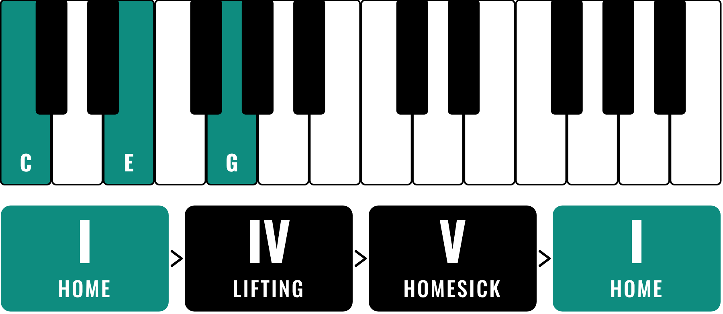
HUDSON BEAT
CHORDS BY EAR
Feat. Twist and Shout
DIGITAL MUSIC PRODUCTION · UNIT 3 · DAY 1 · CHORDS AND ROMAN NUMERALS IN LOGIC PRO
Notes:
Day 1, the first minute. Today is an ear day: no worksheets, no Roman numerals. Have Twist and Shout (The Beatles) and, for Day 4, Let It Be (The Beatles) cued up on YouTube or Spotify from your own account; no audio or video is included in this deck. Open Logic with a piano sound on the class speakers. Open with a question: why do some songs feel finished at the end and others feel like they are waiting?

Slide 2
HUDSON BEAT
DAY 1
WHAT THE HECK IS A CHORD?
Three or more notes played at the same time
Notes from the scale, stacked together
Major sounds bright. Minor sounds dark.
Today: no names. Just your ears.
Chords by Ear · Intro deck · © 2026 Brian Lotze · Hudson Beat
2
Notes:
Plain-English definition, kept short on purpose. The unit's principle is feel it before you name it: students play and describe chords before they see a single Roman numeral. Tell them the only thing you want today is their honest words. There are no wrong answers.

Slide 3
HUDSON BEAT
DAY 1
LISTEN: ONE NOTE, THEN A CHORD
C › C–E–G › A–C–E
teacher plays on a piano sound
Play a single C. Then C major. Then A minor.
What does one note feel like?
What changed when it became a chord?
What is different about the third one?
Chords by Ear · Intro deck · © 2026 Brian Lotze · Hudson Beat
3
Notes:
The opening activity from the teacher notes, steps 2 to 4. Play a single C: what does that feel like? (Empty. Waiting.) Play C-E-G: what changed? Let them answer freely: happy, full, finished. Play A-C-E: what is different? Dark, heavy, sad. Write their words on the board and keep them for Day 4.

Slide 4
HUDSON BEAT
DAY 1
LISTEN: FOUR CHORDS IN A ROW
C–E–G › F–A–C › G–B–D › C–E–G
slowly, then on a loop
Play the four chords slowly, then loop them.
What happened at the end?
Which chord wanted to go somewhere?
Why does the last one feel finished?
Chords by Ear · Intro deck · © 2026 Brian Lotze · Hudson Beat
4
Notes:
Step 5 of the opening activity: play I-IV-V-I slowly, but do not say I-IV-V-I yet. Ask what happened at the end. Most will say it resolved. Ask why. Then say step 6: the packet gives names to everything you just felt. That is all music theory is.

Slide 5
HUDSON BEAT
DAY 1
LISTEN: A REAL SONG
TWIST AND SHOUT
The Beatles
Teacher: play the first minute from YouTube or Spotify.
How many different chords do you hear?
Which one feels like home?
When does it want to go back?
Chords by Ear · Intro deck · © 2026 Brian Lotze · Hudson Beat
5
Notes:
About eight minutes. Twist and Shout by The Beatles goes round three chords over and over: they are the same three as the loop they just heard (I, IV and V, in a different key), but do not name them yet. Students usually hear that one chord is home and another one pulls back to it. Play it twice if they need it.

Slide 6
HUDSON BEAT
DAY 1
YOUR TURN: PLAY AND DESCRIBE
Play each one on a piano sound. Write what it feels like in your own words. Bright or dark?
C–E–G
F–A–C
G–B–D
A–C–E
Chord 1 · feels like…
Chord 2 · feels like…
Chord 3 · feels like…
Chord 4 · feels like…
D–F–A
E–G–B
B–D–F
Chord 5 · feels like…
Chord 6 · feels like…
Chord 7 · feels like…
Chords by Ear · Intro deck · © 2026 Brian Lotze · Hudson Beat
6
Notes:
Students open Logic, load a piano sound and play the seven chords on the Chord Feel Log one at a time (MPK Mini or Musical Typing), writing what each one feels like in their own words and ticking bright or dark. The chords are given by their notes only, all white keys. Circulate and ask: say more. Sad how? Waiting for what?

Slide 7
HUDSON BEAT
DAY 1
SAME CHORDS, A DIFFERENT HOME
LOOP 1
C–E–G
F–A–C
G–B–D
C–E–G
Home: the first and last chord
on a loop
on a loop
on a loop
on a loop
LOOP 2
A–C–E
F–A–C
C–E–G
G–B–D
Where is home now?
on a loop
on a loop
on a loop
on a loop
Same white keys, nearly the same chords. A different home.
Chords by Ear · Intro deck · © 2026 Brian Lotze · Hudson Beat
7
Notes:
Second half of the log. Students loop the two four-chord progressions. Loop 1 lands on C-E-G; loop 2 starts and feels at home on A-C-E. Same white keys, nearly the same chords, a different home. Ask: where is home now, and how does it feel compared with loop 1? This is C major against A minor, but keep the names for later.

Slide 8
HUDSON BEAT
DAY 1
YOUR WORDS ARE MUSIC THEORY
“That one sounds like something good is about to happen.”
“That one sounds unfinished.”
Write the class’s words on the board
On Day 4 they get shorter names
Chords by Ear · Intro deck · © 2026 Brian Lotze · Hudson Beat
8
Notes:
The share-out. Collect the best words for each chord and keep them visible (a photo of the board works). These descriptions are music theory. On Day 4 the Roman numerals simply give them shorter names: home, lifting, homesick, tender.

Slide 9
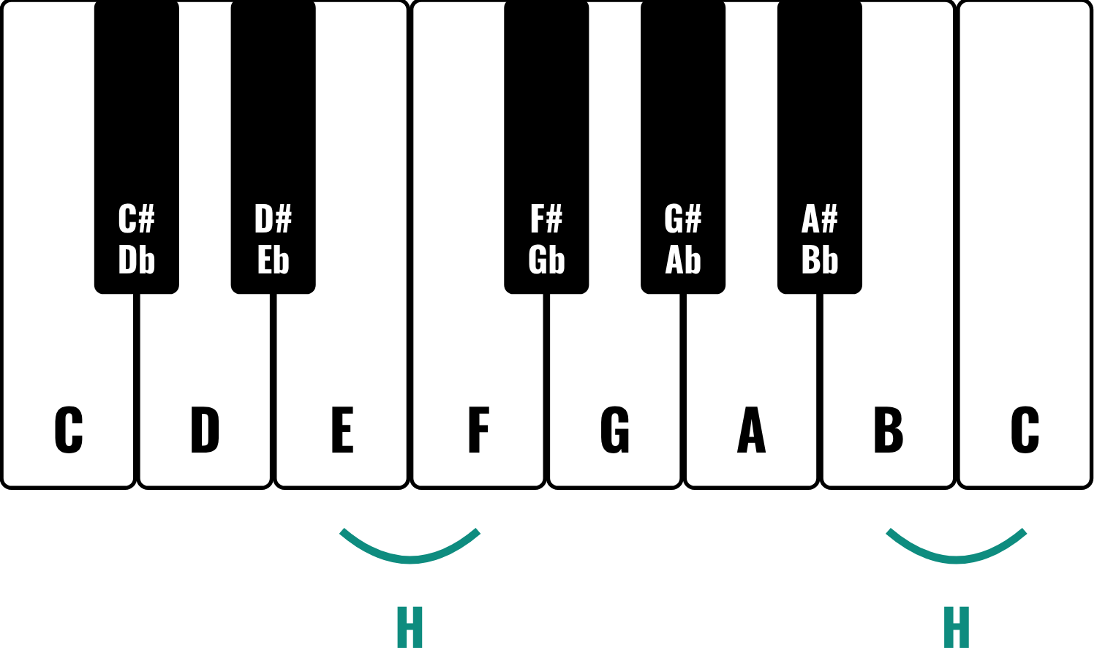
HUDSON BEAT
DAY 2
THE KEYBOARD
HALF STEP (H)
One key in either direction, black keys included. E to F and B to C are the only white-key half steps.
WHOLE STEP (W)
Two half steps: skip one key. C to D, D to E, G to A.
Find C: just left of every group of 2 black keys.
Chords by Ear · Intro deck · © 2026 Brian Lotze · Hudson Beat
9
Notes:
Day 2 opens with the C major and A natural minor scales played for the class: which sounds brighter? Then this slide. The keyboard repeats 7 white keys and 5 black keys. Find C just to the left of every group of 2 black keys. E to F and B to C are the only white-key half steps. Students then do Part 1 of the packet.

Slide 10
HUDSON BEAT
DAY 2
SCALES: THE INGREDIENT LIST
C MAJOR · W - W - H - W - W - W - H
C
D
E
F
G
A
B
C
W
W
H
W
W
W
H
A NATURAL MINOR · W - H - W - W - H - W - W
A
B
C
D
E
F
G
A
W
H
W
W
H
W
W
Same seven white keys, a different starting note, a different feel.
Chords by Ear · Intro deck · © 2026 Brian Lotze · Hudson Beat
10
Notes:
A scale is the ingredient list for a key: it tells you which notes will always sound right together. Walk the C major formula on the keyboard, then A natural minor. Same seven white keys, a different starting note, a different feel. Students do Part 2 of the packet and play each scale as they go.

Slide 11
HUDSON BEAT
DAY 3
YOUR PROJECT: CHORDS & ROMAN NUMERALS
DAY 1
CHORDS BY EAR: JUST LISTEN
Play seven chords and describe them in your own words; hear I–IV–V–I come home
DAY 2
THE KEYBOARD AND SCALES
Name every key; half steps and whole steps; build the C major and A minor scales
DAY 3
BUILD CHORDS FROM FORMULAS · PROJECT
Build major, minor and diminished chords from formulas; enter them in the piano roll
DAY 4
ROMAN NUMERALS + REFERENCE CARD · PROJECT
Roman numerals = names for feelings; KCSRN + Reference Card; chords over the bassline
DAY 5
BALANCE, FINISH, PRESENT · PROJECT
Balance the chords under the bass; finish, submit and present
Chords by Ear · Intro deck · © 2026 Brian Lotze · Hudson Beat
11
Notes:
Day 3 starts with C major and A minor played again: now that you know notes, can you figure out what notes those are? Then hand out the project sheet. The project runs Days 3 to 5: build the chords, name them with Roman numerals, build them over the bassline in Logic, fill in the chord function table, present.

Slide 12
HUDSON BEAT
DAY 3
WHAT YOU TURN IN
Chord pages + Roman numeral section of the packet
Reference Card for your key
4 chords in Logic, one per measure
Each region labeled with its Roman numeral
Chord function table filled in
MP3 + .zip, named Your Name — Building Blocks Part 3
Chords by Ear · Intro deck · © 2026 Brian Lotze · Hudson Beat
12
Notes:
The submission checklist. Show where students submit (your class page). Export: File › Bounce › Project or Section, MP3. Compress: in Finder, Control-click the .logicx project and choose Compress. The file name follows the project sheet.

Slide 13
HUDSON BEAT
DAY 3
HOW IT’S SCORED
CHORD CONSTRUCTION
5 = All chords correct, well-voiced and labeled with Roman numerals.
/ 5
HARMONIC UNDERSTANDING
5 = Specific, accurate descriptions; knows why each chord was chosen.
/ 5
DOCUMENTATION & PRESENTATION
5 = Named correctly, on time; explains choices in Roman numeral language.
/ 5
SCORED 2 TO 5 · TOTAL / 15
Chords by Ear · Intro deck · © 2026 Brian Lotze · Hudson Beat
13
Notes:
Three categories, each scored 2 to 5, for a total out of 15. Read the 5 column aloud: every chord correct, well-voiced and labeled; specific, accurate descriptions of how each chord feels and why it was chosen; on time, named correctly, and chord choices explained in Roman numeral language.

Slide 14
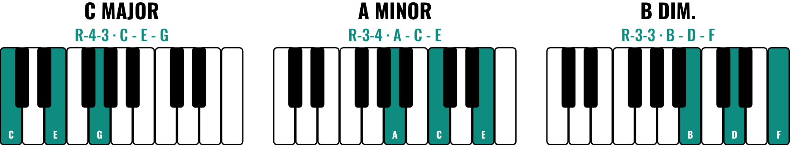
HUDSON BEAT
DAY 3
BUILD A CHORD: COUNT HALF STEPS
MAJOR: R - 4 - 3
MINOR: R - 3 - 4
DIMINISHED: R - 3 - 3
bright and stable
darker and more emotional
tense and unstable
Do not count the root: for C, C# is 1. C-E-G = 4 up, then 3 up.
Chords by Ear · Intro deck · © 2026 Brian Lotze · Hudson Beat
14
Notes:
Model counting on the keyboard. The root is not step 1: for C major, C# is 1, D 2, D# 3, E 4; then from E, F is 1, F# 2, G 3. C-E-G. Minor flips it: 3 then 4. Diminished is 3 and 3. Ask every student to count their first chord out loud before writing it. Then Part 3 of the packet.

Slide 15
HUDSON BEAT
DAY 3
WATCH ME: A CHORD IN THE PIANO ROLL
1
New software instrument track, a piano sound
2
Draw an empty MIDI region, one measure long
3
Open the piano roll and add C, E and G
4
Same start, same length: stacked, not a melody
5
Play it. Name the region.
Chords by Ear · Intro deck · © 2026 Brian Lotze · Hudson Beat
15
Notes:
The worked example in Logic, about 3 minutes, then students build every chord from their packet as a region. Point at the piano roll: all three notes start at the same position and last the same length. Anything that looks like a melody line is wrong. Steps and shortcuts are on the Logic quick reference page.

Slide 16
HUDSON BEAT
DAY 4
ROMAN NUMERALS = NAMES FOR FEELINGS
I – IV – V – I = HOME, AWAY, VERY AWAY, HOME
I
IV
V
vi
Home. Settled. Complete.
Lifting. Hopeful. Away from home.
Homesick. Wants to resolve to I.
Tender. Melancholy. Emotional.
Uppercase = major · lowercase = minor · ° = diminished. A letter name tells you the notes; a Roman numeral tells you the job.
Chords by Ear · Intro deck · © 2026 Brian Lotze · Hudson Beat
16
Notes:
Day 4. Play I-IV-V-I and say it: home, away, very away, home. Then play i-VI-III-VII: how is that different? Name the feelings before naming the numerals. Then match the class's Day 1 words to these tiles. A chord's letter name tells you its notes; its Roman numeral tells you how it functions. The I chord feels like home in every key.

Slide 17
HUDSON BEAT
DAY 4
LISTEN: FIND THE TENDER CHORD
LET IT BE
The Beatles
Teacher: play the first minute from YouTube or Spotify.
Four chords: I, V, vi, IV
Which one is home?
Which one feels tender?
Chords by Ear · Intro deck · © 2026 Brian Lotze · Hudson Beat
17
Notes:
Let It Be by The Beatles uses I, V, vi and IV in C major: C, G, A minor, F. Students now have names, so ask them to raise a hand on the tender one (vi, A minor). Point out that vi is the same chord as the A minor home from Day 1: a chord's job depends on the key.

Slide 18
HUDSON BEAT
DAY 4
YOUR REFERENCE CARD
C MAJOR — W - W - H - W - W - W - H
RN
CHORD
NOTES
FEELS LIKE…
I
C Major
C - E - G
Home. Settled. Complete.
ii
D Minor
D - F - A
Gentle tension. Moving somewhere.
iii
E Minor
E - G - B
Wistful. In between.
IV
F Major
F - A - C
Lifting. Hopeful. Away from home.
V
G Major
G - B - D
Homesick. Wants to resolve to I.
vi
A Minor
A - C - E
Tender. Melancholy. Emotional.
vii°
B Dim.
B - D - F
Tense. Unstable. Rarely used alone.
Chords by Ear · Intro deck · © 2026 Brian Lotze · Hudson Beat
18
Notes:
This is the finished C major card. Students fill in their own on the blank card (and the KCSRN worksheet for their key) after the Roman numeral section of the packet. It is a living document: they will use it in the next unit, in the EDM project and beyond, so filling it in carefully now is an investment. Check spellings as you circulate.

Slide 19
HUDSON BEAT
DAY 4
WORKED EXAMPLE: CHORDS OVER THE BASSLINE
I
vi
IV
V
C Major
A Minor
F Major
G Major
G
E
C
D
CHORDS
E
C
A
B
C
A
F
G
BASS
C
A
F
G
Measure 1
Measure 2
Measure 3
Measure 4
Teal: the chords you build (3 notes stacked). Black: the bassline in the file. Every chord’s root = the bass note.
Chords by Ear · Intro deck · © 2026 Brian Lotze · Hudson Beat
19
Notes:
One possible answer for a C major file: the bass plays C, A, F, G, one note per measure, and the chords above it are I, vi, IV and V, each labeled with its Roman numeral. Every chord's root is the bass note. Students listen to their bassline twice, work out the chords from the roots, then build and label them. The A minor version is in the kit.

Slide 20
HUDSON BEAT
DAY 5
MIXING MOMENT: BALANCE
Solo the chords, then the bass, then both
Which one should the listener follow?
Turn the chords down until the bass is clear
Turning down is a musical decision
Chords by Ear · Intro deck · © 2026 Brian Lotze · Hudson Beat
20
Notes:
Day 5 opens with the unit's mixing concept. When you layer parts, the ones in the background have to step back. When chords and melody are the same volume, the melody disappears; today it is the chords and the bass. Turning the chords down is not a mixing trick, it is a musical decision about what the listener should focus on.

Slide 21
HUDSON BEAT
DAY 5
ONE LAST THING…
Point to your I chord.
Play it. Does it feel like home?
That is the test.
Chords by Ear · Intro deck · © 2026 Brian Lotze · Hudson Beat
21
Notes:
The last three minutes, after the presentations. Close the way the teacher notes do: point to your I chord, play it, does it feel like home? Name what students did this week: they felt the chords first and named them second. The bassline unit comes next.

