Slide 1
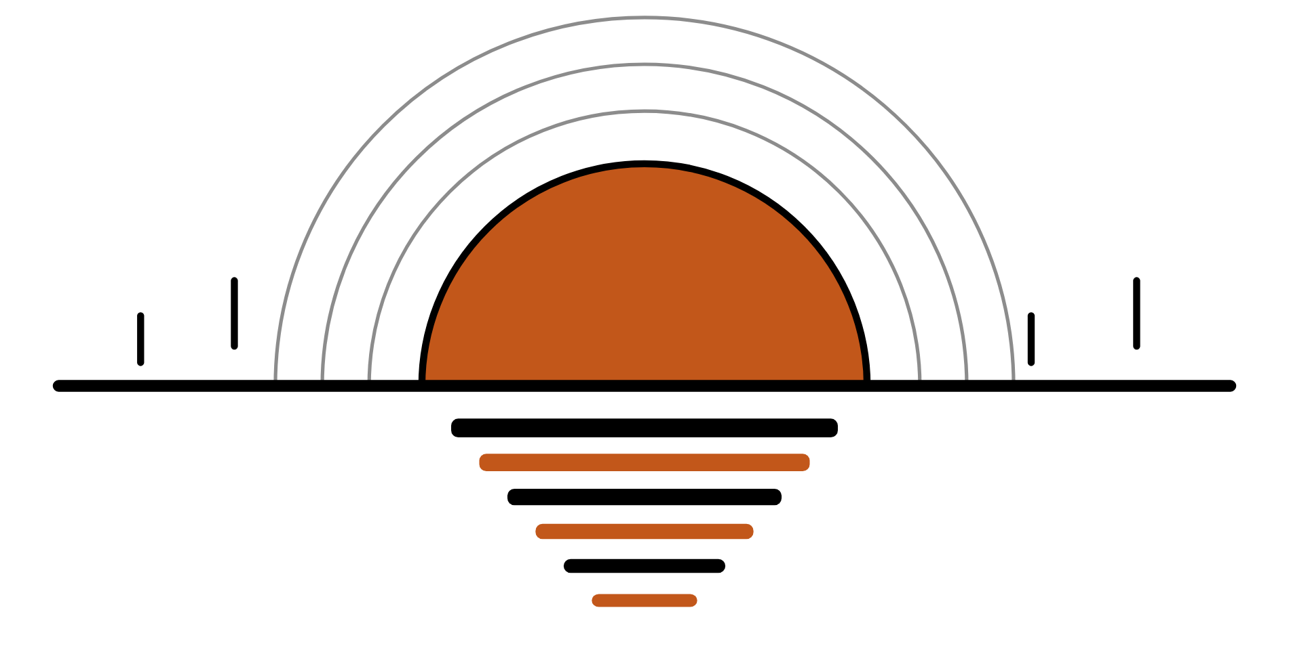
HUDSON BEAT
INFINITE HORIZON
Make a sound that never sits still.
DIGITAL MUSIC PRODUCTION 2 · CLASS 1 · MAKE A SOUNDSCAPE THAT NEVER SITS STILL
Notes:
Class 1, the first minute. No audio is included in this deck. Open with my overview: create a soundscape that never sits still. Design an evolving ambient piece that continuously transforms through automation, modulation and layering. Say that there is no traditional rhythm or song structure: this project is about motion, texture and space.

Slide 2
HUDSON BEAT
CLASS 1
THINK: MUSIC WITH NO BEAT
CLOSE YOUR EYES
Think, then share
Teacher: no audio is needed. You may play a short ambient piece you choose; none is included.
Can music have no beat and still go somewhere?
What is a sound that slowly changes, like wind or a hum?
How would you make a sound feel like it is moving?
Infinite Horizon · Intro deck · © 2026 Brian Lotze · Hudson Beat
2
Notes:
Ask the three questions aloud and take a few answers. Nothing is played from a speaker unless you choose to, and no one else's music is included in this kit. If you do play a short ambient piece of your own choosing, ask students to close their eyes and say what changed. This sets up my first struggle: students default to adding beats, so say early that this project is about texture and motion, not rhythm.

Slide 3
HUDSON BEAT
CLASS 1
WHAT IS INFINITE HORIZON?
A soundscape that never sits still
An evolving ambient piece
Automation, modulation and layering
No traditional rhythm or song structure
Infinite Horizon · Intro deck · © 2026 Brian Lotze · Hudson Beat
3
Notes:
My overview and goals, shortened to fit the slide. Create a soundscape that never sits still: an evolving ambient piece that continuously transforms through automation, modulation and layering. No traditional rhythm or song structure; this is about motion, texture and space. Goal four is a 60 to 90 second soundscape that sustains listener interest. Students write the five vocabulary terms in their own words on the vocabulary page; slide 6 introduces them.

Slide 4
HUDSON BEAT
CLASS 1
SEVEN CLASSES
CLASS 1
A sound with no beat · the steps · five words · listen, then build a drone
CLASS 2
Opening, evolution, climax, fade · texture, not rhythm · layer
CLASS 3
Working day: automate, worked example
CLASS 4
Working day: patience, refine, eyes closed
CLASS 5
Working day: automate, refine, evolve
CLASS 6
Mix for depth · bounce · checklist · rubric
CLASS 7
Presentations with Padlet Q&A
Infinite Horizon · Intro deck · © 2026 Brian Lotze · Hudson Beat
4
Notes:
The shape of the project, from my pacing guide. Class 1: introduction, listen to ambient examples and begin building a drone or pad foundation. Class 2: layer additional textures and atmospheric elements. Classes 3 to 5 are working days: automate, refine and evolve the soundscape. Class 6: final mix and bounce, and prepare presentations. Class 7: presentations with Padlet Q and A peer feedback. Hand out the project sheet now.

Slide 5
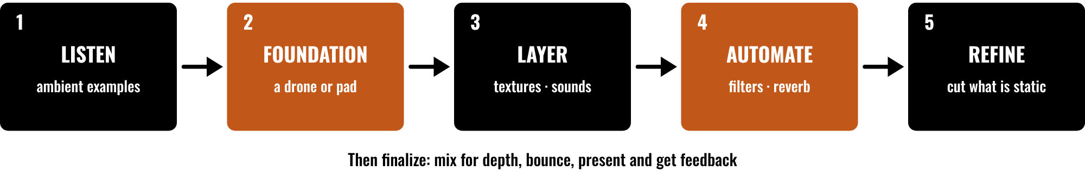
HUDSON BEAT
CLASS 1
FIVE STEPS, THEN FINISH
Listen to ambient examples
Build a drone or pad base
Layer, then automate
Refine: cut what is static
Infinite Horizon · Intro deck · © 2026 Brian Lotze · Hudson Beat
5
Notes:
Class 1. The first five steps of my project sheet, in order: listen, build your foundation, layer, automate, refine. Then students finalize with a mix and a bounce, and present with Padlet feedback. Point to each box and say roughly when it happens: listening and the foundation today, layers in Class 2, automation and refining on the working days. The step names are mine; the picture and its short labels are the kit's own.

Slide 6
HUDSON BEAT
CLASS 1
FIVE WORDS TO KNOW
Soundscape: texture and atmosphere, not melody or rhythm
Drone: a sustained tone or chord
Automation: changing a parameter over time
Modulation: one signal controlling another
Ambient: tone, atmosphere and texture
Infinite Horizon · Intro deck · © 2026 Brian Lotze · Hudson Beat
6
Notes:
My five vocabulary terms, shortened to fit the slide. Soundscape: an ambient composition focused on texture and atmosphere rather than melody or rhythm. Drone: a sustained tone or chord that creates a foundation for ambient music. Automation: changing a parameter over time to create movement and evolution. Modulation: using one signal to control another, adding variation and life to a sound. Ambient: music focused on tone, atmosphere and texture rather than traditional song structure. The full definitions are on the vocabulary page.

Slide 7
HUDSON BEAT
CLASS 1
STEPS 1 AND 2: LISTEN, BUILD
1
Study examples of ambient and soundscape music
2
Write what you hear on the Listening log
3
Create a drone or pad as your base texture
4
Make it long and steady, so layers can sit on it
Infinite Horizon · Intro deck · © 2026 Brian Lotze · Hudson Beat
7
Notes:
Steps 1 and 2 of the project sheet, shortened to fit the slide. Step 1, listen: study examples of ambient and soundscape music for inspiration. Step 2, build your foundation: create a drone or pad layer as your base texture. The second and fourth lines are the kit's own suggestions, not my steps: students write what they hear on the Listening log, and the drone should be steady enough for layers to sit on. You choose the listening examples; none is included.

Slide 8
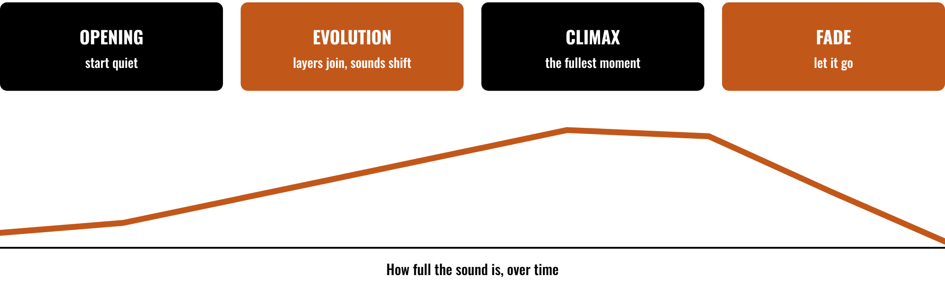
HUDSON BEAT
CLASS 2
THINK IN FOUR PHASES
Opening: start quiet
Evolution: layers join and shift
Climax: the fullest moment
Fade: let it go
Infinite Horizon · Intro deck · © 2026 Brian Lotze · Hudson Beat
8
Notes:
Class 2. A kit picture, not from my sheets, built from my third struggle: students struggle without traditional structure to guide them, so suggest thinking in phases: opening, evolution, climax, fade. The curve shows how full the sound is over time. Ask students to place their own piece on it: where does it start, where does it peak, how does it end? The Phase plan has room for the layers in each phase.

Slide 9
HUDSON BEAT
CLASS 2
TEXTURE, NOT RHYTHM
Avoid traditional rhythm and song structure
Focus on motion and space
Students often add a beat: take it out
Ask: what changes while it plays?
Infinite Horizon · Intro deck · © 2026 Brian Lotze · Hudson Beat
9
Notes:
My fifth requirement and first struggle, shortened to fit the slide. Avoid traditional rhythm or song structure and focus on motion and space. Students default to adding beats; remind them this is about texture and motion, not rhythm. The last line is the kit's own question for the working days: if nothing changes, there is nothing to hear yet.

Slide 10
HUDSON BEAT
CLASS 2
STEP 3: LAYER
1
Add textures, sounds and atmospheric elements
2
Use synths, samples and FX
3
Keep the drone underneath
4
Add one layer at a time, and listen
Infinite Horizon · Intro deck · © 2026 Brian Lotze · Hudson Beat
10
Notes:
Step 3 of the project sheet and requirement 2, shortened to fit the slide. Step 3, layer: add additional textures, sounds and atmospheric elements. Requirement 2: layer ambient textures and drones using synths, samples and FX. The last line is the kit's own suggestion, not my step: add one layer at a time and listen before adding the next. Hand out the Phase plan so students can say which layers belong in which phase.

Slide 11
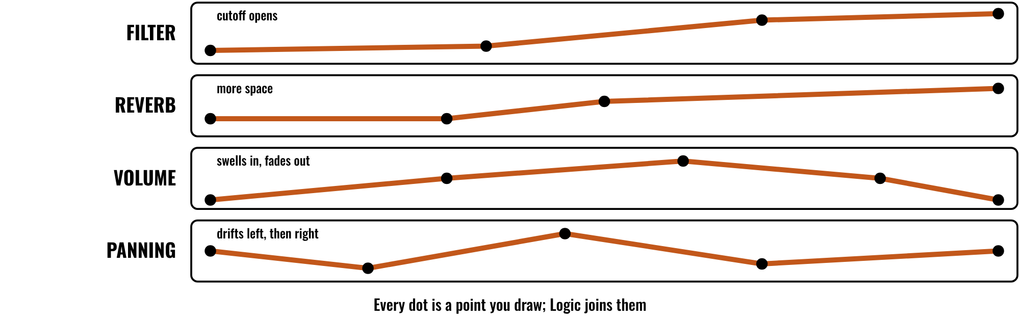
HUDSON BEAT
CLASS 3
AUTOMATE EVERYTHING
Infinite Horizon · Intro deck · © 2026 Brian Lotze · Hudson Beat
11
Notes:
Class 3, the first working day. A kit picture of what automation looks like: a line drawn on a lane, one lane for each parameter. From my third tip: automate everything, because if a parameter stays the same the whole time the soundscape will feel flat. The four lanes are the ones my step 4 names: filters, reverb, volume and panning. In Logic, press A to show automation and choose the parameter to draw.

Slide 12
HUDSON BEAT
CLASS 3
STEP 4: AUTOMATE
Draw automation on filters, reverb, volume and panning
Change parameters over time
Make every transition gradual
Count your lanes on the Automation plan
Infinite Horizon · Intro deck · © 2026 Brian Lotze · Hudson Beat
12
Notes:
Step 4 and requirements 3 and 4, shortened to fit the slide. Step 4, automate: draw automation on filters, reverb, volume and panning to create evolution. Use automation to change parameters over time, and incorporate gradual transitions and evolving movement. My second struggle is that soundscapes feel static because students do not automate enough parameters; require a minimum number of automation lanes. The last line is the kit's own: students list their lanes on the Automation plan.

Slide 13
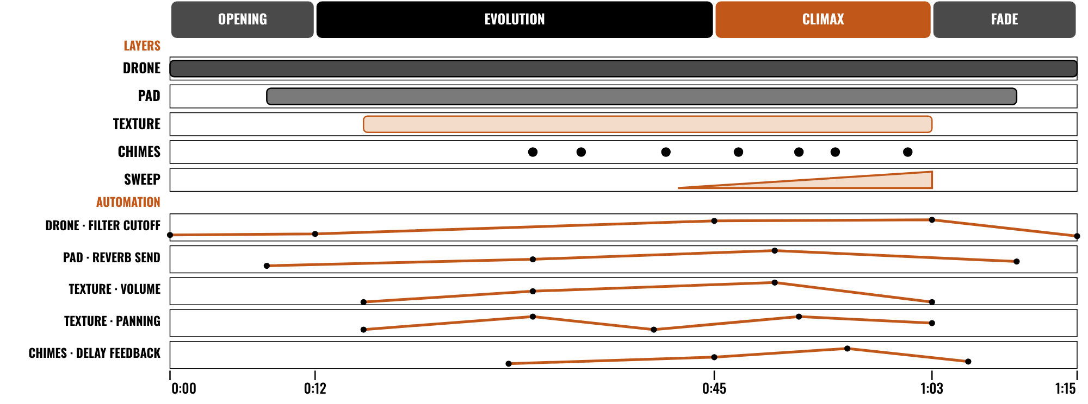
HUDSON BEAT
CLASS 3
WORKED EXAMPLE: 75 SECONDS
An invented 75-second piece, on paper
Four phases you can name
Five layers that join and leave
Five automation lanes, none flat
Infinite Horizon · Intro deck · © 2026 Brian Lotze · Hudson Beat
13
Notes:
Class 3. An invented piece, Slow Tide, described on paper; nothing here is audio. It is 75 seconds long, in four phases: opening, evolution, climax and fade. Five layers join and leave: a drone, a pad, a texture, a few chimes and a sweep. Below them are five automation lanes, and none of them is flat: the drone's filter, the pad's reverb, the texture's volume and panning, and the chimes' delay. The numbers are on the worked example page.

Slide 14
HUDSON BEAT
CLASS 4
BE PATIENT
Let sounds evolve slowly
Do not rush changes
Reverb and delay create a sense of space
If a parameter never moves, it sounds flat
Infinite Horizon · Intro deck · © 2026 Brian Lotze · Hudson Beat
14
Notes:
My tips 1 to 3, shortened to fit the slide. This project is about patience: let sounds evolve slowly and do not rush changes. Reverb and delay are your best friends here; use them to create a sense of space. Automate everything: if a parameter stays the same the whole time, your soundscape will feel flat. Ask students to stretch the slowest change in their piece, then listen again.

Slide 15
HUDSON BEAT
CLASS 4
STEP 5: REFINE
Listen for flow and pacing
Remove anything that feels static or repetitive
Close your eyes: does it take you somewhere?
Harder option: 5+ automation lanes and Alchemy
Infinite Horizon · Intro deck · © 2026 Brian Lotze · Hudson Beat
15
Notes:
Step 5, tip 4 and my Harder variation, shortened to fit the slide. Refine: listen for flow and pacing, and remove anything that feels static or repetitive. Close your eyes while listening to your piece: does it take you somewhere? That is the goal. My Harder variation extends the piece to two minutes or more, requires at least five automation lanes and use of Alchemy for custom ambient patches; offer it to students who are ready. Hand out the Listen-back sheet.

Slide 16
HUDSON BEAT
CLASS 6
STEPS 6 AND 7: MIX, BOUNCE
1
Mix for depth and space
2
Bounce your soundscape
3
Zip the .logicx project
4
Create your Padlet post with 3 questions
5
Prepare to present
Infinite Horizon · Intro deck · © 2026 Brian Lotze · Hudson Beat
16
Notes:
Class 6. Steps 6 and 7 of the project sheet, shortened to fit the slide. Finalize: mix for depth and space and bounce your soundscape. Present and get feedback: create your own Padlet post with three questions you want classmates to answer. The third line is the kit's own reminder about the submission: zip the .logicx in Finder (Control-click, Compress). Check that every soundscape is between 60 and 90 seconds before students bounce.

Slide 17
HUDSON BEAT
CLASS 6
WHAT YOU TURN IN
Bounced .mp3 or .wav
Zipped .logicx project
Named: Your Name – Infinite Horizon
Padlet post with your 3 questions
Answer 2 questions on classmates’ posts
Infinite Horizon · Intro deck · © 2026 Brian Lotze · Hudson Beat
17
Notes:
The submission checklist from the project sheet, shortened to fit the slide. Show where students upload (your class page) and where the Padlet board is. Remind students that a bounced file with the wrong length is the quickest thing to fix: check it is 60 to 90 seconds.

Slide 18
HUDSON BEAT
CLASS 6
HOW IT’S SCORED
CREATIVITY & ORIGINALITY
5 = Exceptional creativity; innovative, bold, and expressive
/ 5
TECHNICAL SKILL / DAW USE
5 = Expert-level command of multiple Logic systems
/ 5
COMPOSITION & STRUCTURE
5 = Professional pacing, flow, and musical arc
/ 5
SOUND DESIGN & MIX QUALITY
5 = Exceptional sound design; professional-quality mix
/ 5
DOCUMENTATION & PRESENTATION
5 = Exceptional; thorough insight and polished delivery
/ 5
SCORED 1–5 · FINAL GRADE = AVERAGE OF YOUR SCORE AND MINE · / 25
Infinite Horizon · Intro deck · © 2026 Brian Lotze · Hudson Beat
18
Notes:
My rubric: five categories, each scored 1 to 5, for a total out of 25. Students score themselves first; the final grade is the average of their score and mine. The slide reads the 5 column of each category aloud. Hand out the rubric page so students can self-score before they present.

Slide 19
HUDSON BEAT
CLASS 7
PRESENTATION DAY
Play your soundscape
Say what you wanted it to feel like
Your Padlet post: 3 questions about your project
Answer at least 2 of each classmate’s 3
Infinite Horizon · Intro deck · © 2026 Brian Lotze · Hudson Beat
19
Notes:
Class 7, presentations with Padlet Q and A. Step 7 of the project sheet, shortened to fit the slide: create your own Padlet post with 3 questions you want classmates to answer, present to the class, and during classmates' presentations answer at least 2 of their 3 questions. The second line is the kit's own suggestion. Ask the class to close their eyes during each piece.

Slide 20
HUDSON BEAT
CLASS 7
ONE LAST THING…
You made it move.
You gave it space.
You let it evolve.
Now listen.
REFLECTION · PAGE 22
Write it or talk it through: what went well, what was hard, what you would change.
Infinite Horizon · Intro deck · © 2026 Brian Lotze · Hudson Beat
20
Notes:
Close with my teacher notes: this project stretches students' definition of what music can be. Ask a few students what they noticed in a classmate's piece with their eyes closed. My notes suggest pairing the project with a brief discussion of ambient and experimental music history; the kit leaves that to you. Tell them the next project starts from the menu. Reflection: point students to the Reflection page. A reflection is a written or oral conversation about how they did on the project and what they would do differently next time; they choose to write it or to talk it through with you.

