Slide 1
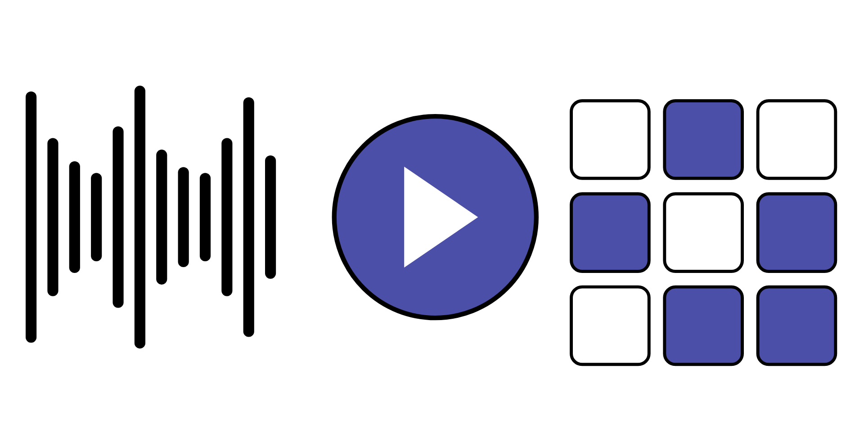
HUDSON BEAT
FREE PLAY
Make whatever you want. Finish it.
DIGITAL MUSIC PRODUCTION 2 · CLASS 1 · MAKE WHATEVER YOU WANT IN LOGIC PRO
Notes:
Class 1, the first minute. No audio is included in this deck. Open with my overview: this is your chance to make whatever you want. Use Logic Pro to explore any style, technique or idea that excites you. The only rule is to have a plan and follow through. Say that the project is about finding a creative voice and showing you can manage a project from start to finish.

Slide 2
HUDSON BEAT
CLASS 1
THINK: WHAT WOULD YOU MAKE?
IF ANYTHING WERE ALLOWED
Think, then share
Teacher: no audio is needed. Ask the questions aloud and take a few answers.
If nobody could say no, what would you make?
What style or sound do you keep coming back to?
What is one thing you want to try in Logic?
Free Play · Intro deck · © 2026 Brian Lotze · Hudson Beat
2
Notes:
Ask the three questions aloud and take a few answers. Nothing is played from a speaker and no one else's music is used. The point is that Free Play only works if students pick something they care about, and that is harder than it sounds: the freedom is the challenge. This sets up my first struggle, analysis paralysis, which comes up on slide 7.

Slide 3
HUDSON BEAT
CLASS 1
WHAT IS FREE PLAY?
Any style, technique or idea that excites you
One rule: have a plan and follow through
Show you can manage a project from start to finish
Goal: build confidence in your own creative decisions
Free Play · Intro deck · © 2026 Brian Lotze · Hudson Beat
3
Notes:
My overview and fourth goal, shortened to fit the slide. Use Logic Pro to explore any style, technique or idea that excites you. The only rule: have a plan and follow through. The project is about finding your creative voice and showing that you can manage a project from start to finish. Goal four: build confidence in making creative decisions independently. Students write the four vocabulary terms in their own words on the vocabulary page: DAW, bounce or export, arrangement and project proposal.

Slide 4
HUDSON BEAT
CLASS 1
SEVEN CLASSES
CLASS 1
What would you make? · production cycle · explore · commit early
CLASS 2
Three parts of a proposal · vague or clear · before you submit
CLASS 3
Working day: build, develop, worked example
CLASS 4
Working day: keep building, protect your mix time
CLASS 5
Working day: compose, build, refine
CLASS 6
Mix · bounce · checklist · rubric
CLASS 7
Presentations with Padlet Q&A
Free Play · Intro deck · © 2026 Brian Lotze · Hudson Beat
4
Notes:
The shape of the project, from my pacing guide. Class 1: introduction, project overview, explore Logic, brainstorm ideas. Class 2: write and submit project proposals on your class page. Classes 3 to 5 are working days: compose, build, refine. Class 6: final mix, bounce, and prepare presentations, and students write their three Padlet feedback questions. Class 7: presentations with Padlet Q and A peer feedback. Hand out the project sheet now.

Slide 5
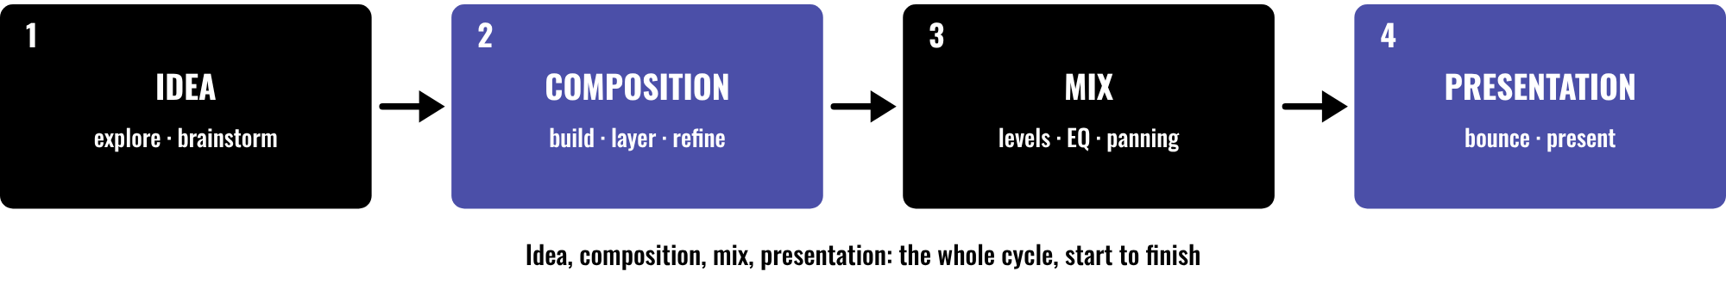
HUDSON BEAT
CLASS 1
THE PRODUCTION CYCLE
Idea: explore and brainstorm
Composition: build and refine
Mix: balance every track
Present and get feedback
Free Play · Intro deck · © 2026 Brian Lotze · Hudson Beat
5
Notes:
Class 1. My third goal is to practice the full production cycle: idea, composition, mix, presentation. Every project in this course follows it, and this is the first time students run it with no rules about what to make. Point to each box and say when it happens: the idea today and Class 2, composition on the working days, the mix and bounce in Class 6, the presentation in Class 7.

Slide 6
HUDSON BEAT
CLASS 1
STEP 1: EXPLORE
1
Open Logic and experiment with sounds
2
Brainstorm ideas
3
Write down two or three, not just one
4
Pick one before the end of class
5
Fill in the Idea sketchpad
Free Play · Intro deck · © 2026 Brian Lotze · Hudson Beat
6
Notes:
Step 1 of the project sheet, shortened to fit the slide: explore. Open Logic, experiment with sounds and brainstorm ideas. The last three lines on the slide are the kit's own suggestions, not my steps: write down two or three ideas, pick one before the end of class, and use the Idea sketchpad. If a student cannot pick, offer the Idea starters page; my Easier variation is a short list of prompts to choose from.

Slide 7
HUDSON BEAT
CLASS 1
COMMIT EARLY
Get something down early, then refine as you go
Don't spend 3 days picking sounds
Ideas can shift while you work
Stuck? Listen to music that inspires you
Free Play · Intro deck · © 2026 Brian Lotze · Hudson Beat
7
Notes:
My tips 1, 2 and 3, shortened to fit the slide. Tip 1: start with a clear idea, but let it evolve; some of the best projects shift direction. Tip 2: do not spend three days picking sounds; get something down early and refine as you go. Tip 3: if you get stuck, listen to music that inspires you and notice what they did. This answers my first struggle, analysis paralysis: encourage students to commit to an idea early and iterate.

Slide 8
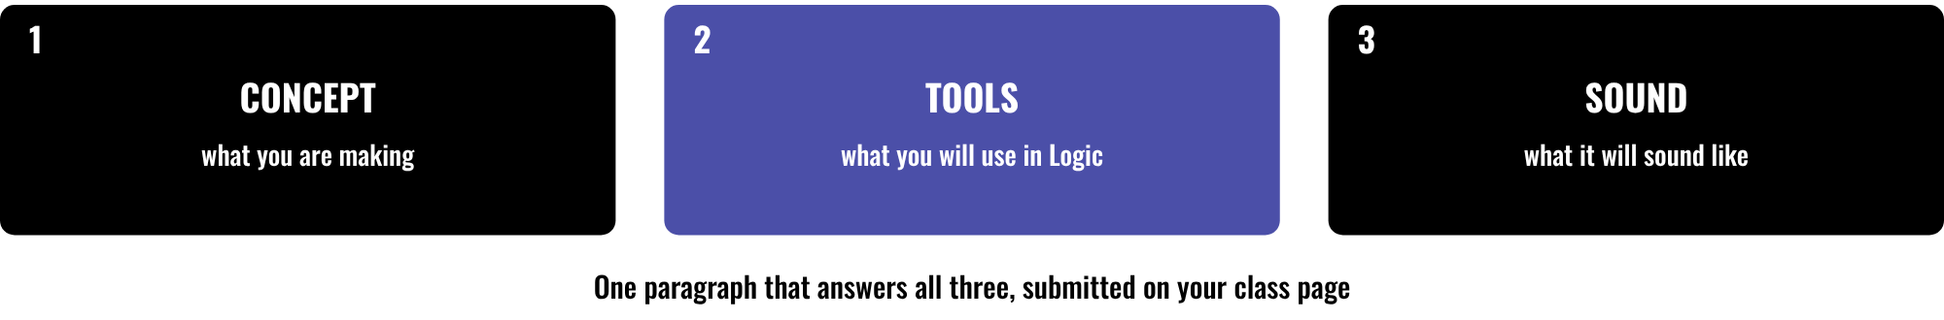
HUDSON BEAT
CLASS 2
A PROPOSAL HAS THREE PARTS
Concept: what it is
Tools: what you will use
Sound: what it will be like
More than one sentence
Free Play · Intro deck · © 2026 Brian Lotze · Hudson Beat
8
Notes:
Class 2. Step 2 of the project sheet, shortened here: write a paragraph describing your concept, your tools, and what the final product will sound like, and submit it on your class page. Those are the three boxes. My second struggle is weak proposals: some students write one vague sentence, so push them to describe what the track will sound like and which tools they will use. The Proposal planner has a sentence frame for each part.

Slide 9
HUDSON BEAT
CLASS 2
VAGUE OR CLEAR?
Vague: “I will make a chill beat.”
Clear: what it is, which tools, what it sounds like
Say the tempo, the mood and the instruments
Name the Logic tools you will use
Free Play · Intro deck · © 2026 Brian Lotze · Hudson Beat
9
Notes:
A quick contrast; the vague example is the kit's own, not mine. Read it aloud, then ask what it would sound like: nobody can say. Then read the clear version from the worked example page, an invented piece on paper. A clear proposal gives the concept, the tools and the sound. My second struggle, shortened: a one-sentence proposal needs to be pushed to say what the track will sound like and which tools it will use.

Slide 10
HUDSON BEAT
CLASS 2
BEFORE YOU SUBMIT
A concept: what you are making
Tools: what you will use in Logic
What it will sound like
A paragraph, not one sentence
Submitted on your class page
Free Play · Intro deck · © 2026 Brian Lotze · Hudson Beat
10
Notes:
The checklist is the kit's own, built from step 2 and my second struggle; step 2 is shortened here. Students tick each line on the Proposal planner before they submit. Read every proposal before the student starts building, and send a vague one back with a question rather than a grade. The proposal also becomes evidence for the Documentation and Presentation row of my rubric.

Slide 11
HUDSON BEAT
CLASS 3
STEPS 3 AND 4: BUILD, DEVELOP
Lay down the foundation: drums, chords, bass
Begin shaping the arrangement
Add layers, melodies, FX and transitions
Refine your sound and structure
Free Play · Intro deck · © 2026 Brian Lotze · Hudson Beat
11
Notes:
Class 3 is the first working day, and Classes 4 and 5 continue it. Steps 3 and 4 of the project sheet, shortened to fit the slide. Step 3, build: lay down your foundation of drums, chords and bass and begin shaping your arrangement. Step 4, develop: add layers, melodies, FX and transitions, and refine your sound and structure. Hand out the Work plan so students can say what they will finish each class.

Slide 12
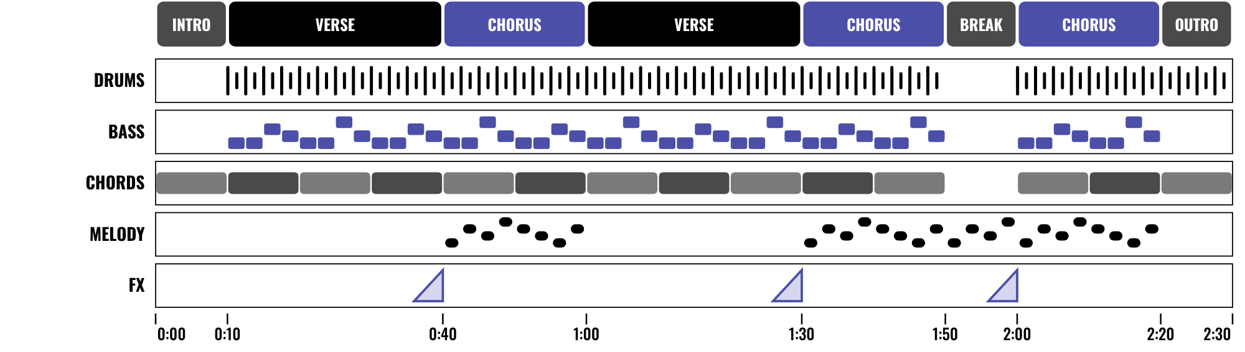
HUDSON BEAT
CLASS 3
WORKED EXAMPLE: 2:30 ON PAPER
An invented 2:30 piece on paper
Sections you can name
Layers that come and go
Plan it, then follow through
Free Play · Intro deck · © 2026 Brian Lotze · Hudson Beat
12
Notes:
Class 3. An invented piece, Late Bus Home, described on paper; nothing here is audio. It is 96 beats per minute and 60 bars of 4/4, which is two minutes thirty. Read the sections across the top: intro, verse, chorus, verse, chorus, a short break, a last chorus and an outro. The lanes show drums, bass and chords entering after the intro, the melody in the choruses and the break, and short risers before each chorus. The full proposal, the arrangement numbers and a mix plan are on the worked example page.

Slide 13
HUDSON BEAT
CLASS 4
KEEP BUILDING
Check your track against your proposal
Add one new thing every class
Try a transition between sections
Save a new version before big changes
Free Play · Intro deck · © 2026 Brian Lotze · Hudson Beat
13
Notes:
Class 4, a working day. These four lines are the kit's own suggestions for the middle of the project, not my steps. Ask each student to read their proposal and say whether the track still matches it; it can change, but they should know it has. A transition between sections, a riser or a drop out, is a quick way to make a loop feel like a piece. Saving a new version first means a bad experiment costs nothing.

Slide 14
HUDSON BEAT
CLASS 4
MIX TIME IS NOT OPTIONAL
Leave at least one full class for the final mix
Balance levels, EQ and panning on all tracks
Listen on headphones AND speakers
Mixing takes longer than you think
Free Play · Intro deck · © 2026 Brian Lotze · Hudson Beat
14
Notes:
My third struggle, shortened: students underestimate how long mixing takes, so remind them to leave at least one full class for final mixing and bounce. Requirement 3, shortened: apply basic mixing (EQ, panning and volume balancing) on all tracks. Tip 4, shortened: listen to your track on headphones and speakers before you call it done. Ask students to say which class they will start mixing on and write it on the Work plan.

Slide 15
HUDSON BEAT
CLASS 6
STEPS 5 AND 6: MIX, FINALIZE
1
Balance levels, apply EQ and panning
2
Clean up your project
3
Bounce your final track
4
Prepare your presentation
5
Write your 3 Padlet questions
Free Play · Intro deck · © 2026 Brian Lotze · Hudson Beat
15
Notes:
Class 6. Steps 5 and 6 of the project sheet, shortened to fit the slide. Step 5: mix, balancing your levels, applying EQ and panning and cleaning up your project. Step 6: finalize, bouncing your final track and preparing your presentation. The last line is from my pacing guide: students write their three Padlet feedback questions today. Zip the .logicx in Finder (Control-click, Compress).

Slide 16
HUDSON BEAT
CLASS 6
WHAT YOU TURN IN
Proposal paragraph on your class page
Bounced .mp3 or .wav
Zipped .logicx project
Named: Your Name – Free Play
Padlet post with your 3 questions
Answer 2 questions on classmates’ posts
Free Play · Intro deck · © 2026 Brian Lotze · Hudson Beat
16
Notes:
The submission checklist from the project sheet, shortened to fit the slide. Show where students upload (your class page) and where the Padlet board is. The proposal should already be in from Class 2; if it is not, this is the last chance.

Slide 17
HUDSON BEAT
CLASS 6
HOW IT’S SCORED
CREATIVITY & ORIGINALITY
5 = Exceptional creativity; innovative, bold, and expressive
/ 5
TECHNICAL SKILL / DAW USE
5 = Expert-level command of multiple Logic systems
/ 5
COMPOSITION & STRUCTURE
5 = Professional pacing, flow, and musical arc
/ 5
SOUND DESIGN & MIX QUALITY
5 = Exceptional sound design; professional-quality mix
/ 5
DOCUMENTATION & PRESENTATION
5 = Exceptional; thorough insight and polished delivery
/ 5
SCORED 1–5 · FINAL GRADE = AVERAGE OF YOUR SCORE AND MINE · / 25
Free Play · Intro deck · © 2026 Brian Lotze · Hudson Beat
17
Notes:
My rubric: five categories, each scored 1 to 5, for a total out of 25. Students score themselves first; the final grade is the average of their score and mine. The slide reads the 5 column of each category aloud. Hand out the rubric page so students can self-score before they present.

Slide 18
HUDSON BEAT
CLASS 7
PRESENTATION DAY
Play your track
Say what you set out to make, and what changed
Your Padlet post: 3 questions about your project
Answer at least 2 of each classmate’s 3
Free Play · Intro deck · © 2026 Brian Lotze · Hudson Beat
18
Notes:
Class 7, presentations with Padlet Q and A. Step 7 of the project sheet, shortened to fit the slide: create your own Padlet post with 3 questions you want classmates to answer, present to the class, and during classmates' presentations answer at least 2 of their 3 questions. Remind the class that thoughtful questions lead to better feedback, my fourth struggle. Ask each student to say what they set out to make before they play it.

Slide 19
HUDSON BEAT
CLASS 7
ONE LAST THING…
You had a plan.
You followed through.
You made it your way.
Now play it.
REFLECTION · PAGE 21
Write it or talk it through: what went well, what was hard, what you would change.
Free Play · Intro deck · © 2026 Brian Lotze · Hudson Beat
19
Notes:
Close with what my teacher notes say this project does: it is a diagnostic project as much as a creative one, and it sets up the proposal and Padlet Q and A workflow students will use all semester. Tell them the next project starts from a menu, and they will write another proposal. Reflection: point students to the Reflection page. A reflection is a written or oral conversation about how they did on the project and what they would do differently next time; they choose to write it or to talk it through with you.

