Slide 1
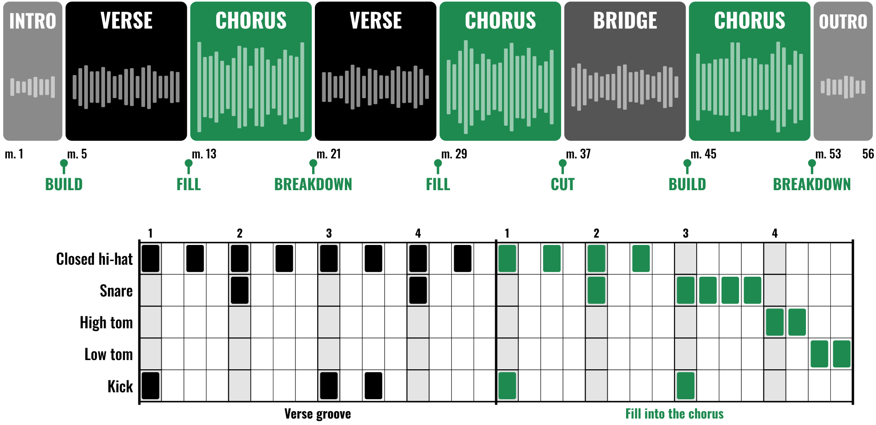
HUDSON BEAT
STEMS & GROOVES
Feat. In the Air Tonight
DIGITAL MUSIC PRODUCTION · UNIT 2 · DAY 1 · DRUMS OVER STEMS IN LOGIC PRO
Notes:
Day 1, the first minute. Have your Foundation stem open in Logic on the class speakers, and In the Air Tonight (Phil Collins) cued up on YouTube or Spotify from your own account; no audio or video is included in this deck. Stems are not included either: see the stems pages of the kit to find or make them. Open with: today you write drums for music that already exists.

Slide 2
HUDSON BEAT
DAY 1
LISTEN: MUSIC WITH NO DRUMS
YOUR FOUNDATION STEM
teacher plays 60 seconds
No drums yet: that part is your job.
What is this music doing?
Where does the energy change?
Where does a new section feel like it starts?
Stems & Grooves · Intro deck · © 2026 Brian Lotze · Hudson Beat
2
Notes:
From my teacher notes, minutes 0 to 5: play 60 seconds of one of the stem tracks without the drums. Ask what the music is doing and where the energy changes. Do not give answers yet. The point is to hear before naming anything; students answer again after they have mapped their own stem.

Slide 3
HUDSON BEAT
DAY 1
WHAT THE HECK IS A STEM?
One instrument or group, pulled out of a recording
Your stem: everything except the drums
Your job: write drums that belong
Listen first, then respond
Stems & Grooves · Intro deck · © 2026 Brian Lotze · Hudson Beat
3
Notes:
Plain-English definition, from the project sheet vocabulary: a stem track is a single isolated instrument or group from a real recording; in this project, everything except the drums. The unit's principle from my course plan is listen first, then respond. Drums that belong to the music, not just on top of it.

Slide 4
HUDSON BEAT
DAY 1
SIX DAYS, TWO PARTS
DAY 1
LEARNING + FOUNDATION START · FOUNDATION
Listen to the stem; the four transitions; map the sections; start the A pattern
DAY 2
WORKING: FOUNDATION · FOUNDATION
Finish A, build a contrasting B, place both; gain staging
DAY 3
TRANSITION WORKSHOP + FULL SONG START · FULL SONG
Transition workshop; map every section change; build transitions in 64 steps
DAY 4
WORKING: FULL SONG · FULL SONG
Finish every transition; play it through; optional reverb bus
DAY 5
SUBMISSION + PRESENTATION PREP · SUBMIT
Checklists and rubric; submit; write three feedback questions
DAY 6
PRESENTING · PRESENT
Play it with the stem; why that transition? You mixed a song
Stems & Grooves · Intro deck · © 2026 Brian Lotze · Hudson Beat
4
Notes:
The shape of the unit. Part 1, Foundation: two contrasting patterns, A and B, placed where the sections change in a 16-measure stem. Part 2, Full Song: a new, longer stem, and a deliberate transition at every section change. Day 5 is for finishing and submitting, Day 6 for presenting. Hand out the project sheet now.

Slide 5
HUDSON BEAT
DAY 1
LISTEN: A FAMOUS DRUM ENTRANCE
IN THE AIR TONIGHT
Phil Collins
Teacher: play from about 3:00 to 4:00 from YouTube or Spotify.
What keeps time before the big drums arrive?
What happens right before they come in?
Why does it hit so hard?
Stems & Grooves · Intro deck · © 2026 Brian Lotze · Hudson Beat
5
Notes:
About three minutes. For most of In the Air Tonight a quiet drum machine keeps time and the big drums are held back; they finally crash in with a famous tom fill near 3:40. That fill is a transition: it announces the new section. It hits hard because of the space before it. Keep it brief, as my notes say: students understand transitions better once they have built patterns.

Slide 6
HUDSON BEAT
DAY 1
FOUR WAYS TO ANNOUNCE A CHANGE
1 · Drum fill
2 · Breakdown
a rhythmic variation in the last 1–2 measures that signals a change is coming
strip to one element (kick only, hi-hat only) before the new section hits
3 · Cut
4 · Build
complete silence for 1–2 beats before the next section drops
add elements progressively in the last measure to increase energy into the change
You will use these in Part 2. Every section change gets one.
Stems & Grooves · Intro deck · © 2026 Brian Lotze · Hudson Beat
6
Notes:
The four transition types, word for word from the Day 1 post. Play each of the four examples you programmed from the worked transitions page, once each today; Day 3 is the full workshop. Students use these in Part 2, Full Song, so today is just a first hearing.

Slide 7
HUDSON BEAT
DAY 1
LISTEN BEFORE YOU BUILD
1
Download one stem from the Foundation folder
2
Play all 16 measures twice: touch nothing
3
Where does the energy change? Count measures
4
Arrangement markers: A or B, 4 measures each
5
Only then open Drum Machine Designer
Stems & Grooves · Intro deck · © 2026 Brian Lotze · Hudson Beat
7
Notes:
Minutes 15 to 25. Students download their stem and listen twice before touching Logic. Circulate and ask every student: where are your sections? They should be able to tell you. Students who struggle can use the section map worksheet, or you can pre-label the markers for them.

Slide 8
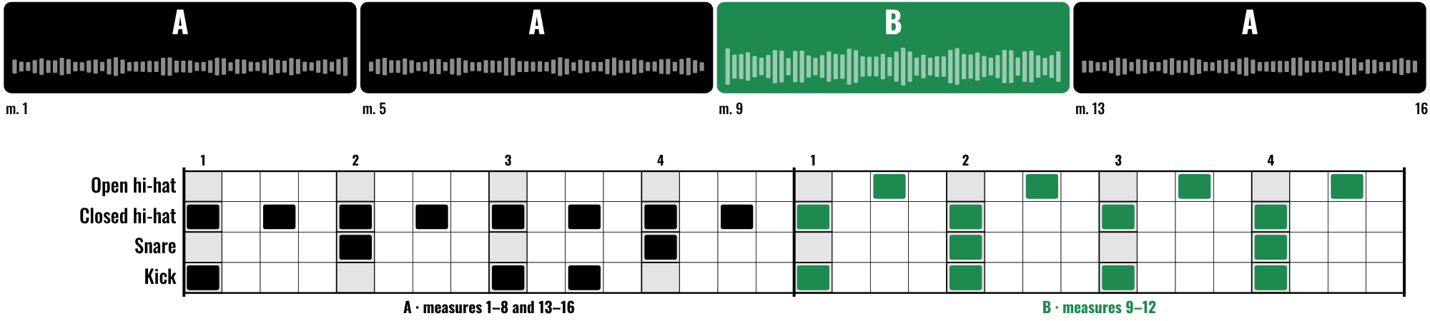
HUDSON BEAT
DAY 1
WORKED EXAMPLE: A AND B OVER THE STEM
A: laid back, closed hi-hat eighths
B: kick on every beat, open hi-hats
Placed A, A, B, A: it follows the stem
Tell them apart without looking
Stems & Grooves · Intro deck · © 2026 Brian Lotze · Hudson Beat
8
Notes:
One possible answer over the Foundation stem from the recipe: 16 measures, four sections of 4. Pattern A is laid back with closed hi-hat eighths; pattern B pushes energy with a kick on every beat and open hi-hats off the beat. Placed A, A, B, A to follow the stem. You can tell them apart without looking at the screen.

Slide 9
HUDSON BEAT
DAY 1
WATCH ME: BUILD YOUR A PATTERN
1
New track: Software Instrument, an Electronic Drum Kit
2
Control-click at the first A: Create Pattern Region
3
Kick, snare, closed hi-hat first
4
Play it with the stem: does it fit?
5
Save it: Your Name - Foundation
Stems & Grooves · Intro deck · © 2026 Brian Lotze · Hudson Beat
9
Notes:
A three-minute demo. An Electronic Drum Kit loads Drum Machine Designer. Control-click in the track at the first A marker, Create Pattern Region, double-click to open the Step Sequencer. Start with kick, snare and closed hi-hat, aim for 3 to 5 layers, and keep playing it with the stem.

Slide 10
HUDSON BEAT
DAY 2
DOES IT FIT?
Two volunteers: A pattern with the stem
Does the groove fit the feel of the section?
Do the drums follow the music?
Or does the music follow the drums?
Stems & Grooves · Intro deck · © 2026 Brian Lotze · Hudson Beat
10
Notes:
Day 2, minutes 0 to 5, from my notes: ask two students to play their A pattern alongside the stem. Does it fit? The whole class listens and responds briefly. The project sheet's question: do my drums follow the music, or does the music follow my drums? It should always be the former.

Slide 11
HUDSON BEAT
DAY 2
PLAY A, THEN PLAY B
Can you feel the difference without looking?
If A is busy, B might be stripped back
If A is laid back, B might add energy
Then copy both across every section
Stems & Grooves · Intro deck · © 2026 Brian Lotze · Hudson Beat
11
Notes:
Minutes 5 to 45: students finish A, build B and place both across the full stem. The key prompt from my notes: play A, then immediately play B. If they have to look at the screen to tell them apart, they are not different enough. Push back on the student who changed one hi-hat hit and called it B.

Slide 12
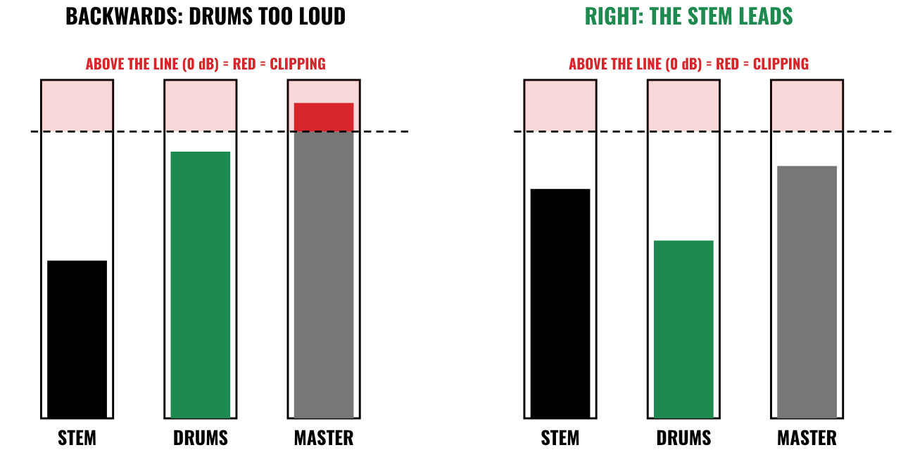
HUDSON BEAT
DAY 2
MIXING MOMENT: GAIN STAGING
Never into the red
Turn other things down
The stem leads
Drums support it
Every element audible
Stems & Grooves · Intro deck · © 2026 Brian Lotze · Hudson Beat
12
Notes:
The mixing concept for this unit, minutes 45 to 53. Students adjust volumes so nothing clips. Say the rule from my tutorial: never push anything into the red; it is almost always better to turn other things down. Play a project with the drums too loud, pull the drums down until the stem leads, and ask which sounds more like a real song.

Slide 13
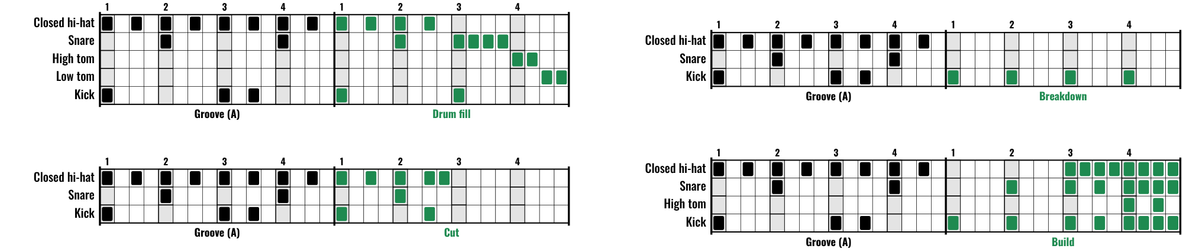
HUDSON BEAT
DAY 3
TRANSITION WORKSHOP
Fill: the groove breaks into snare, then toms
Breakdown: one element left (the kick)
Cut: two beats of complete silence
Build: a sound joins on every beat
Stems & Grooves · Intro deck · © 2026 Brian Lotze · Hudson Beat
13
Notes:
Day 3, the most important instructional moment of the unit. Play each of the four examples twice, programmed in Logic from the worked transitions page, and ask what it does to the energy. Fill: the groove breaks into snare and toms. Breakdown: only the kick is left. Cut: two beats of silence. Build: a sound joins on every beat.

Slide 14
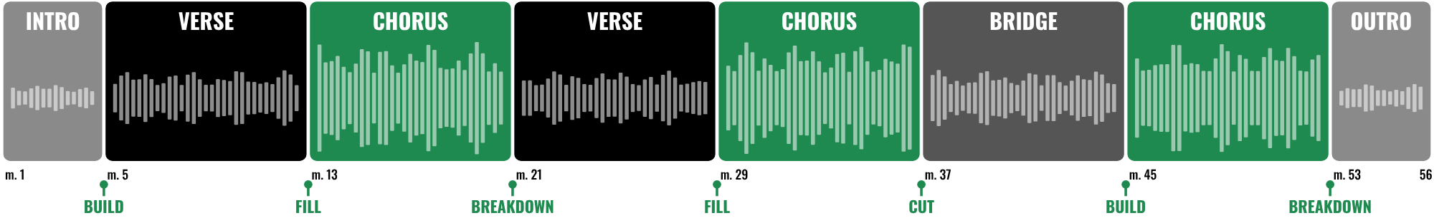
HUDSON BEAT
DAY 3
WORKED EXAMPLE: MAP EVERY CHANGE
8 sections, 7 changes, 7 transitions
Four types, each for its moment
A cut before the quieter bridge
A build before the big last chorus
Stems & Grooves · Intro deck · © 2026 Brian Lotze · Hudson Beat
14
Notes:
One possible map of the Full Song stem from the recipe: 56 measures, eight sections, so seven section changes and seven transitions. Four types are used, each chosen for its moment: a cut before the quieter bridge, a build before the big last chorus, as the project sheet says. Students map their own stem before they write a single transition.

Slide 15
HUDSON BEAT
DAY 3
WATCH ME: A TRANSITION IN 64 STEPS
1
Copy the groove into the measures before the change
2
Step Sequencer: set the pattern length to 64 steps
3
Change only the last measure (or two)
4
Play into the new section: does it announce it?
5
Listen, then move to the next change
Stems & Grooves · Intro deck · © 2026 Brian Lotze · Hudson Beat
15
Notes:
A short demo. A 64-step pattern covers four measures, so the transition sits in the same region as the groove. Change only the last one or two measures. Listen after each transition before moving to the next, and ask the key question at every one: why this type for this moment?

Slide 16
HUDSON BEAT
DAY 4
PLAY IT ALL THE WAY THROUGH
Every section change should feel intentional
If a transition adds nothing, rework it
A cut only works if the music earns it
The stem is the star: drums support it
Stems & Grooves · Intro deck · © 2026 Brian Lotze · Hudson Beat
16
Notes:
Day 4 is a full working day. The common prompt from my notes: play the full track from beginning to end without stopping. Every section change should feel like it was meant to happen. If anything feels accidental, it needs work. Remind students of the cut tip: silence only works if the music earns it.

Slide 17
HUDSON BEAT
DAY 4
OPTIONAL: A REVERB BUS
1
Mixer (X): on the drums, click a Send slot, choose a bus
2
Logic adds an Aux channel strip
3
On the Aux: an Audio FX slot, then ChromaVerb
4
Turn the Send knob up slowly
5
Not graded: the full lesson is in Unit 6
Stems & Grooves · Intro deck · © 2026 Brian Lotze · Hudson Beat
17
Notes:
Optional, for early finishers, and not graded: my course plan mentions reverb for the full song, and the bus and send workflow is taught properly in Unit 6, Spooky Tunes. A little shared reverb can glue the drums to the stem. Less is more: the drums should not sound far away.

Slide 18
HUDSON BEAT
DAY 5
FOUNDATION: WHAT YOU TURN IN
A and B written and placed across all sections
At least 3 layers per pattern
Nothing clipping, everything audible
Named as on your project sheet
MP3 + .zip, submitted before presenting
Stems & Grooves · Intro deck · © 2026 Brian Lotze · Hudson Beat
18
Notes:
Day 5. The Foundation part of the submission checklist, condensed. Show where students submit (your class page). Export: File, Bounce, Project or Section, MP3. Compress: in Finder, Control-click the .logicx project and choose Compress. Check the project name you want on the project sheet.

Slide 19
HUDSON BEAT
DAY 5
FULL SONG: WHAT YOU TURN IN
Every section change labeled, with a transition
At least two transition types
Each transition fits the music
Mix: the drums serve the stem
Named; MP3 + .zip submitted
Three Padlet feedback questions posted
Stems & Grooves · Intro deck · © 2026 Brian Lotze · Hudson Beat
19
Notes:
The Full Song part of the checklist, plus the three feedback questions every student posts before presenting. Students who are done write their questions now; students who are not yet done finish and submit. All projects are submitted before Day 6.

Slide 20
HUDSON BEAT
DAY 5
HOW IT’S SCORED
FOUNDATIONS
5 = A and B have distinct personalities; placement precise and intentional.
/ 5
FULL SONG
5 = Every transition feels inevitable: the right type for each moment.
/ 5
TECHNICAL SKILL / DAW USE
5 = 64-step mode for transition detail; clean, confident workflow.
/ 5
GAIN STAGING & MIX
5 = Drums sit perfectly with the stem; nothing clips; one cohesive piece.
/ 5
DOCUMENTATION & PRESENTATION
5 = Named, on time, confident, three thoughtful Padlet questions.
/ 5
SCORED 2 TO 5 · TOTAL / 25
Stems & Grooves · Intro deck · © 2026 Brian Lotze · Hudson Beat
20
Notes:
Five categories, each scored 2 to 5, for a total out of 25. Read the 5 column aloud: distinct A and B patterns placed precisely; every transition feels inevitable; 64-step mode used for transition detail; drums that sit perfectly with the stem with nothing clipping; on time, confident, three thoughtful Padlet questions.

Slide 21
HUDSON BEAT
DAY 6
PRESENTATION DAY
Play your full drum track with the stem
Point to each transition: why that type?
Respond to at least 2 projects
You responded to music that already existed
Stems & Grooves · Intro deck · © 2026 Brian Lotze · Hudson Beat
21
Notes:
Day 6. Each student plays their full drum track alongside the stem. Classmates respond to at least 2 projects. Ask about one transition: why did you choose this type for this moment? Name what students just did: they adjusted volumes and panned instruments around a real song.

Slide 22
HUDSON BEAT
DAY 6
ONE LAST THING…
You listened first.
You wrote drums that belong.
You announced every change.
You mixed a song.
Stems & Grooves · Intro deck · © 2026 Brian Lotze · Hudson Beat
22
Notes:
Close with the observation from my teacher notes: your drums were written in response to music that already existed. That is what session musicians do. That is a professional skill. And from my course plan, name it: you mixed a song. Next unit, Chords by Ear.

