Slide 1
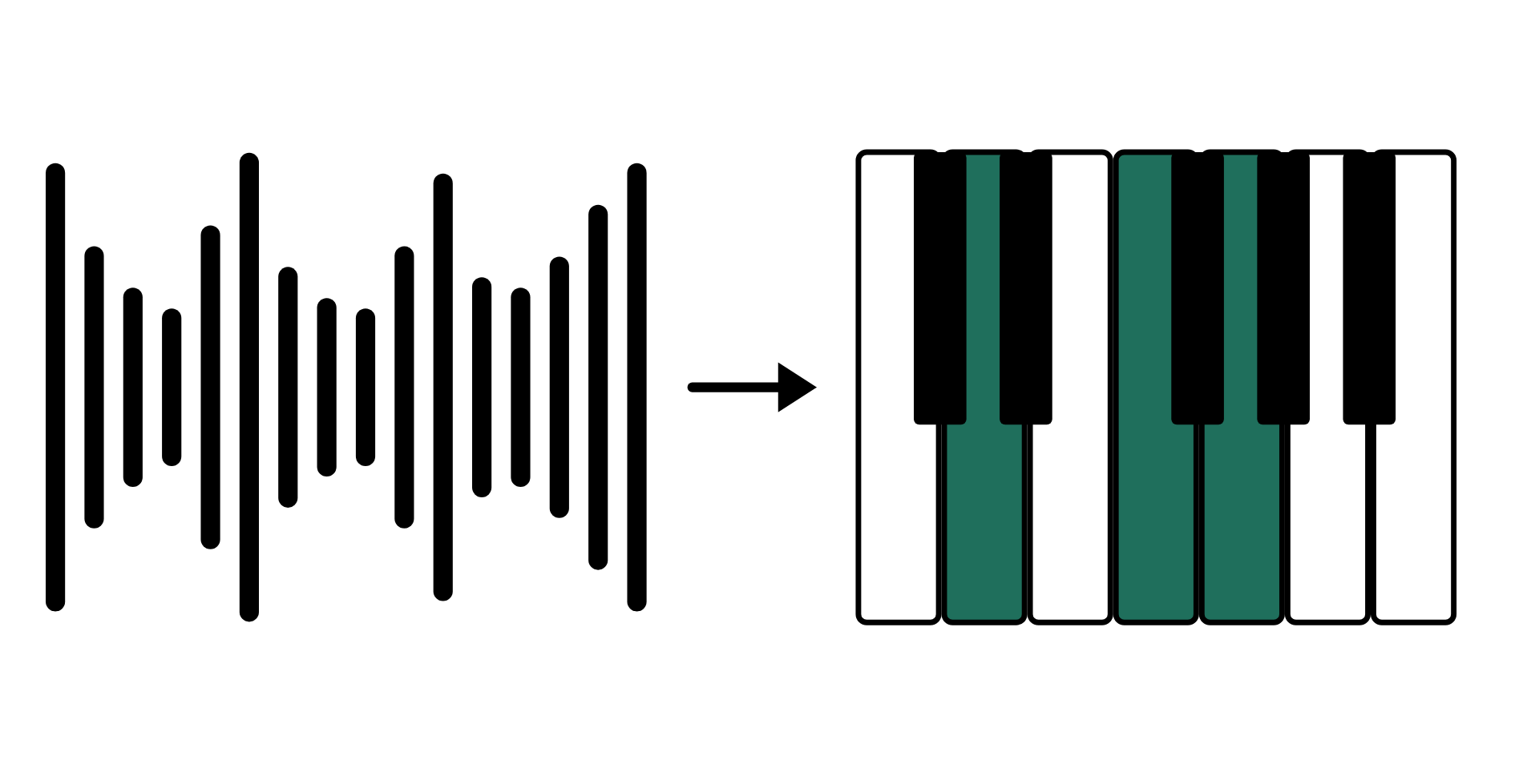
HUDSON BEAT
FOUND SOUND
Turn everyday sounds into instruments.
DIGITAL MUSIC PRODUCTION 2 · CLASS 1 · TURN EVERYDAY SOUNDS INTO INSTRUMENTS IN LOGIC PRO
Notes:
Class 1, the first minute. No audio is included in this deck. Open with my overview: become a sound designer, record everyday sounds from your phone, the microphone at your station, or anywhere around you, and transform them into musical instruments using Logic's Quick Sampler. Then compose a short piece built entirely from your found sounds, 30 to 60 seconds long.

Slide 2
HUDSON BEAT
CLASS 1
LISTEN: NAME THAT SOUND
WHAT WAS THAT?
Guess, then explain how you know
Teacher: make a short everyday sound out of view (a zip, a drawer, a pen click).
What do you think made it?
What does it remind you of?
Could it be a drum, a bass or a pad?
Found Sound · Intro deck · © 2026 Brian Lotze · Hudson Beat
2
Notes:
Make a short sound yourself, out of the students' view: a zipper, a drawer, a stapler, a pen click. Nothing needs to be played from a speaker, and no recording from anyone else is used. Take guesses aloud. The point is that every sound can be heard two ways: what made it, and what it could become. That is the idea behind the whole project, and it sets up my line that music can come from anywhere, not just preset libraries.

Slide 3
HUDSON BEAT
CLASS 1
WHAT IS FOUND SOUND?
Any real-world sound used as raw material for music
Quick Sampler turns any audio into a playable instrument
Sound design: shaping sounds for a purpose
Found Sound · Intro deck · © 2026 Brian Lotze · Hudson Beat
3
Notes:
My vocabulary terms, shortened to fit the slide. Found sound: any sound from the real world used as raw material for music. Quick Sampler: Logic's tool for turning any audio into a playable instrument. Sound design: the process of creating, manipulating and shaping sounds for a specific purpose. Students write the five terms in their own words on the vocabulary page; normalize and layering come up on later days.

Slide 4
HUDSON BEAT
CLASS 1
SEVEN CLASSES
CLASS 1
Name that sound · found sound · sound to song · live demo
CLASS 2
Classic · One Shot · Slice · demo · go weird
CLASS 3
Working day: compose and layer
CLASS 4
Working day: the worked example, check your layers
CLASS 5
Working day: compose, layer, mix
CLASS 6
Mix · bounce · checklist · rubric
CLASS 7
Presentations with Padlet Q&A
Found Sound · Intro deck · © 2026 Brian Lotze · Hudson Beat
4
Notes:
The shape of the project, from my pacing guide. Class 1: introduction, a Quick Sampler demo with a live recording, students begin collecting sounds. Class 2: edit and prep recordings, begin building instruments in Quick Sampler. Classes 3 to 5 are working days: compose, layer and mix. Class 6: final mix and bounce, prepare presentations. Class 7: presentations with Padlet Q and A peer feedback. Hand out the project sheet now.

Slide 5
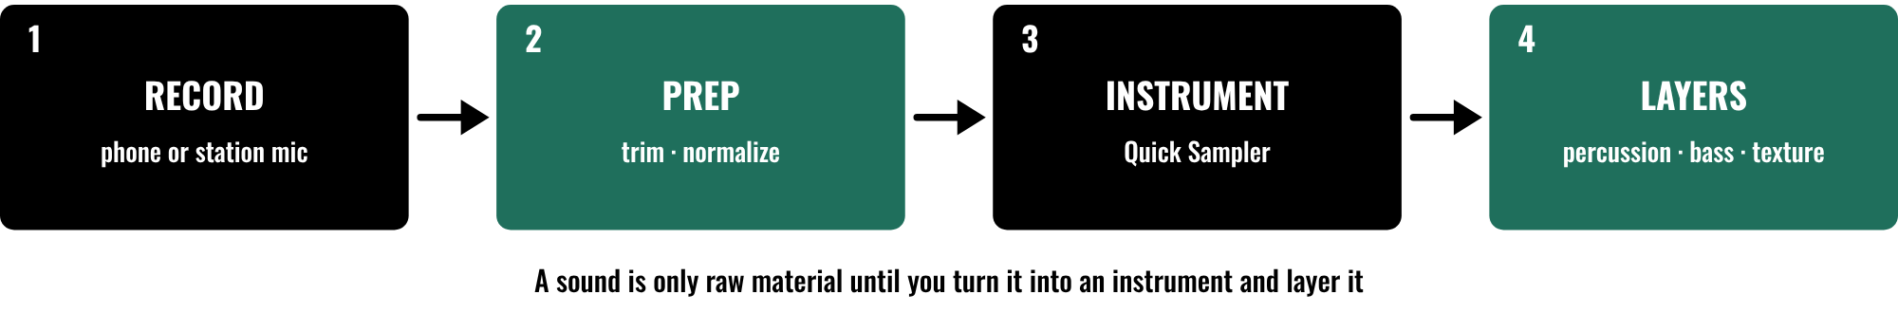
HUDSON BEAT
CLASS 1
FROM SOUND TO SONG
Record clean sounds
Trim and normalize them
Build instruments in Quick Sampler
Layer them into a piece
Found Sound · Intro deck · © 2026 Brian Lotze · Hudson Beat
5
Notes:
Class 1. The path of the project in four moves. Record a sound with your phone or the microphone at your station. Prep it: trim, normalize and clean it up in Logic. Build an instrument from it in Quick Sampler. Then layer your instruments into a piece with at least three distinct layers, for example percussion, bass and texture. Requirement 4 asks for exactly that; a single found sound as a melody is thin, so stack textures underneath it.

Slide 6
HUDSON BEAT
CLASS 1
WATCH ME: SOUND TO INSTRUMENT
1
Record one short everyday sound
2
Trim it and normalize it in Logic
3
Drag it into Quick Sampler
4
Play it on the keyboard
5
Name it and save the project
Found Sound · Intro deck · © 2026 Brian Lotze · Hudson Beat
6
Notes:
My Class 1 plan is to demo Quick Sampler with a live recording. The five lines are the kit's own outline of that demo, not my steps. Record a sound in front of the class: a pen click, a book closing, your keys. Trim it, normalize it, drag it into Quick Sampler and play it on the keys so students hear an everyday noise become an instrument. Keep it to about ten minutes and save the project when you finish. Menu names are on the Logic quick reference; check the labels on your version.

Slide 7
HUDSON BEAT
CLASS 1
STEPS 1 AND 2: COLLECT, PREP
1
Record at least 5 sounds
2
Use your phone or the microphone at your station
3
Get clean recordings: close, quiet, no wind
4
Trim, normalize and clean up in Logic
5
Fill in the Sound log
Found Sound · Intro deck · © 2026 Brian Lotze · Hudson Beat
7
Notes:
Steps 1 and 2 of the project sheet, shortened to fit the slide. Step 1: record at least 5 sounds using your phone or the microphone at your station. Step 2: trim, normalize and clean up your recordings in Logic. My first struggle, shortened here: students record low-quality audio, so show them how to get clean recordings from a phone or the condenser mic. The tips on the slide are the kit's suggestions, not mine: get close to the sound, record in a quiet spot, keep wind off the microphone.

Slide 8
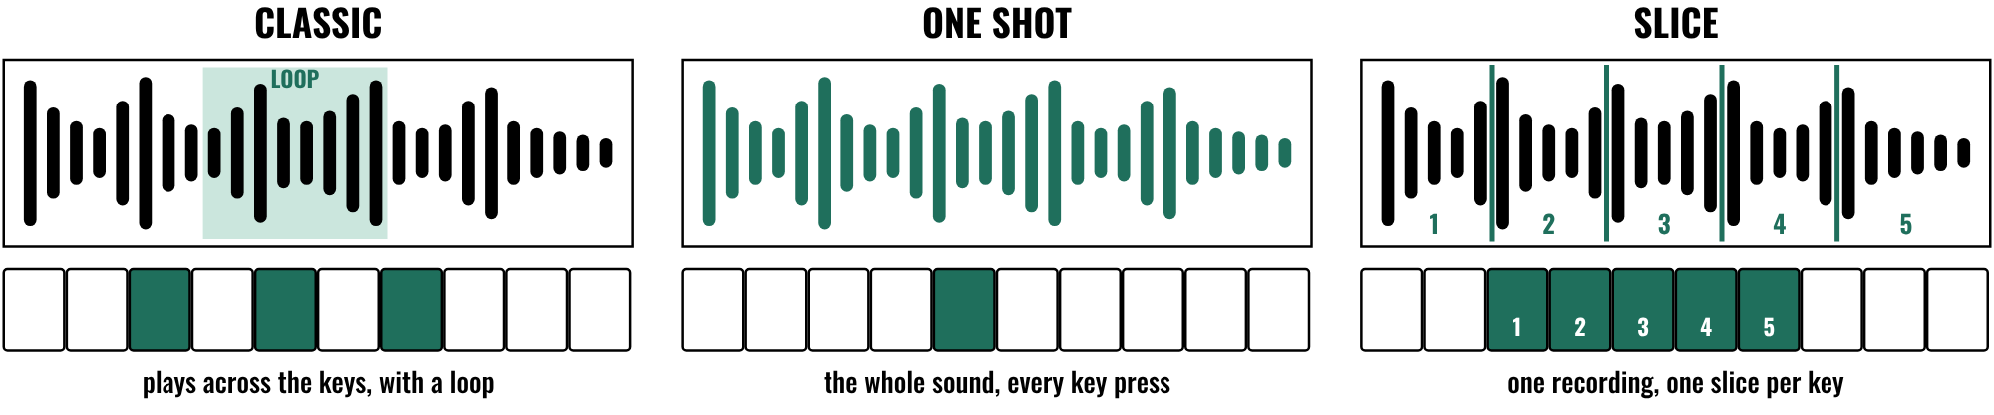
HUDSON BEAT
CLASS 2
THREE QUICK SAMPLER MODES
Classic: across the keys, with a loop
One Shot: the whole sound each time
Slice: one recording, a whole kit
Pick the mode that fits the job
Found Sound · Intro deck · © 2026 Brian Lotze · Hudson Beat
8
Notes:
Class 2. Quick Sampler has three modes: Classic, One Shot and Slice. Classic plays the sound across the keys like an instrument and lets you set a loop. One Shot plays the whole sound each time a key is pressed. Slice cuts a recording at its loud moments and puts each slice on its own key, so one recording becomes a whole kit. My second struggle is that Quick Sampler is confusing at first, so demo all three modes with a real sound. Check the labels on your version.

Slide 9
HUDSON BEAT
CLASS 2
WATCH ME: ALL THREE MODES
1
Take one recording with several hits
2
Play it in Classic, with a loop
3
Switch to One Shot
4
Switch to Slice and play the kit
5
Which mode fits which job?
Found Sound · Intro deck · © 2026 Brian Lotze · Hudson Beat
9
Notes:
A live demo of about ten minutes; the five lines are the kit's own outline, not my steps. Use one recording with several loud moments, such as a drawer, a stapler or a locker. Play it in Classic with a loop, switch to One Shot, then Slice and play the slices across the keys. Ask students which mode suits percussion, which suits bass and which suits texture, and let them argue. My tip 2 says Slice turns one recording into a whole kit.

Slide 10
HUDSON BEAT
CLASS 2
GO WEIRD
The weirder the source, the better the instrument
Don't just record the obvious
Try Slice on one recording
Transformation is the goal
Found Sound · Intro deck · © 2026 Brian Lotze · Hudson Beat
10
Notes:
My tips 1, 2 and 4, shortened to fit the slide. Tip 1: the weirder the source sound, the more interesting your instruments will be, so do not just record obvious things. Tip 2: experiment with Slice mode, which turns one recording into a whole kit. Tip 4: the goal is transformation; if your audience cannot tell where the sounds came from, you are doing it right. Students begin the Instrument builder today.

Slide 11
HUDSON BEAT
CLASS 3
WORKING DAYS: COMPOSE
Use your custom instruments to build the piece
Stop auditioning, start playing
Aim for at least 3 layers
Save versions as you go
Found Sound · Intro deck · © 2026 Brian Lotze · Hudson Beat
11
Notes:
Class 3 is the first working day, and Classes 4 and 5 continue it. Step 4 of the project sheet, shortened here: use your custom instruments to build a short piece with at least 3 layers. My third struggle, shortened: students create instruments but do not compose with them, they just audition sounds endlessly. Set a rule: an instrument that has no place on the Layer plan gets a job or goes. Students use the Layer plan.

Slide 12
HUDSON BEAT
CLASS 3
THREE LAYERS, NOT ONE
Percussion · bass · texture
A single found sound as a melody is thin
Stack textures underneath
Density matters more than length
Found Sound · Intro deck · © 2026 Brian Lotze · Hudson Beat
12
Notes:
Goal 3 and requirement 4, shortened: design at least three distinct sound layers, for example percussion, bass and texture. My tip 3 says a single found sound as a melody is thin, so stack textures underneath it. My fourth struggle, shortened: the 30 to 60 second length feels limiting, so remind students that density matters more than length. Circulate and ask each student to play you their three layers one at a time.

Slide 13
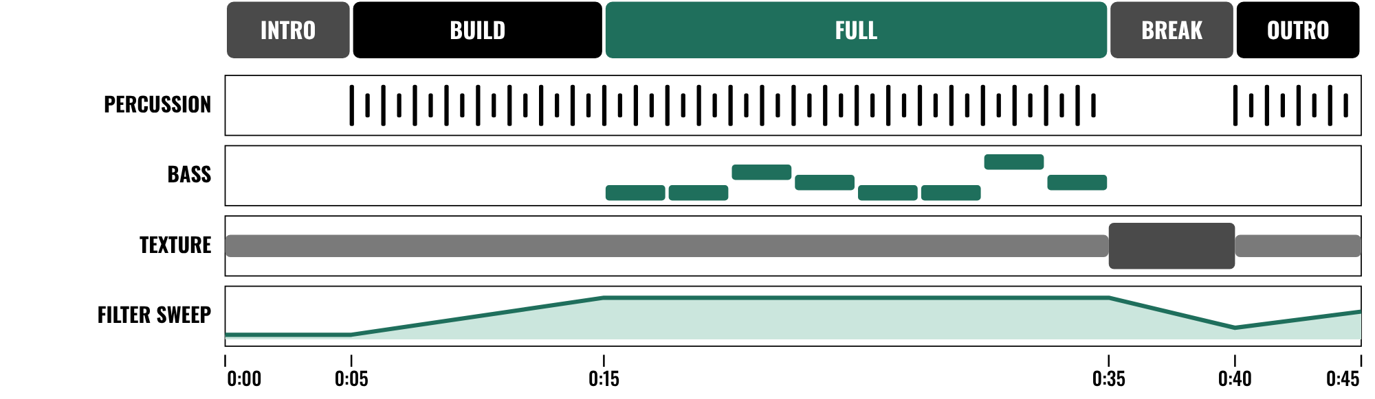
HUDSON BEAT
CLASS 4
WORKED EXAMPLE: 45 SECONDS ON PAPER
Three layers, all playing at once
Texture, then percussion, then bass
A filter sweep keeps it moving
Plan 30–60 seconds
Found Sound · Intro deck · © 2026 Brian Lotze · Hudson Beat
13
Notes:
Class 4. An invented piece, Passing Period, described on paper; nothing here is audio. It is 96 beats per minute, 18 bars of 4/4, which is 45 seconds, inside my 30 to 60 second requirement. A vending-machine hum sets the texture from the start, a pencil tap and a locker slam sliced across the keys enter as percussion at 5 seconds, and a door thud pitched down joins as bass at 15 seconds. A filter sweep opens the texture, a short break strips back to the hum, and the outro closes. The full plan is on the worked example page.

Slide 14
HUDSON BEAT
CLASS 4
CHECK YOUR LAYERS
Can you name the sound behind each layer?
Do you have at least 3 layers at once?
Does something change every few bars?
Would a stranger guess the source?
Found Sound · Intro deck · © 2026 Brian Lotze · Hudson Beat
14
Notes:
A check students can use on each other's work. These are the kit's own questions, drawn from my goals and my fourth tip: three distinct layers, effects and automation for interest, and transformation. If a student cannot name the sound behind a layer, send them back to the Sound log. Class 5 is a full working day with no new slide.

Slide 15
HUDSON BEAT
CLASS 6
STEPS 5 AND 6: MIX, FINALIZE
1
Apply EQ, effects and automation
2
Balance levels and add polish
3
Bounce your track
4
Prepare your presentation
Found Sound · Intro deck · © 2026 Brian Lotze · Hudson Beat
15
Notes:
Class 6. Steps 5 and 6 of the project sheet, shortened to fit the slide. Step 5: mix, applying EQ, effects and automation, balancing levels and adding polish. Step 6: finalize, bounce your track and prepare your presentation. A found sound can be harsh or boomy until it is EQed, so listen layer by layer. Zip the .logicx in Finder (Control-click, Compress). Students also write their three Padlet questions today.

Slide 16
HUDSON BEAT
CLASS 6
WHAT YOU TURN IN
Bounced .mp3 or .wav
Zipped .logicx project
Named: Your Name – Found Sound
At least 5 source sounds used
Padlet post with your 3 questions
Answer 2 questions on classmates’ posts
Found Sound · Intro deck · © 2026 Brian Lotze · Hudson Beat
16
Notes:
The submission checklist from the project sheet, shortened to fit the slide. Show where students upload (your class page) and where the Padlet board is. Check that the Sound log shows at least five source sounds recorded and used.

Slide 17
HUDSON BEAT
CLASS 6
HOW IT’S SCORED
CREATIVITY & ORIGINALITY
5 = Exceptional creativity; innovative, bold, and expressive
/ 5
TECHNICAL SKILL / DAW USE
5 = Expert-level command of multiple Logic systems
/ 5
COMPOSITION & STRUCTURE
5 = Professional pacing, flow, and musical arc
/ 5
SOUND DESIGN & MIX QUALITY
5 = Exceptional sound design; professional-quality mix
/ 5
DOCUMENTATION & PRESENTATION
5 = Exceptional; thorough insight and polished delivery
/ 5
SCORED 1–5 · FINAL GRADE = AVERAGE OF YOUR SCORE AND MINE · / 25
Found Sound · Intro deck · © 2026 Brian Lotze · Hudson Beat
17
Notes:
My rubric: five categories, each scored 1 to 5, for a total out of 25. Students score themselves first; the final grade is the average of their score and mine. The slide reads the 5 column of each category aloud. Hand out the rubric page so students can self-score before they present.

Slide 18
HUDSON BEAT
CLASS 7
PRESENTATION DAY
Play your piece
Name the sounds you started with
Your Padlet post: 3 questions about your project
Answer at least 2 of each classmate’s 3
Found Sound · Intro deck · © 2026 Brian Lotze · Hudson Beat
18
Notes:
Class 7, presentations with Padlet Q and A. Step 7 of the project sheet, shortened to fit the slide: create your own Padlet post with 3 questions you want classmates to answer, present to the class, and during classmates' presentations answer at least 2 of their 3 questions. Ask each student to name the sounds they started with before they play the piece, then let the class guess.

Slide 19
HUDSON BEAT
CLASS 7
ONE LAST THING…
You listened closely.
You recorded the world.
You built instruments from it.
Now it plays.
REFLECTION · PAGE 21
Write it or talk it through: what went well, what was hard, what you would change.
Found Sound · Intro deck · © 2026 Brian Lotze · Hudson Beat
19
Notes:
Close with what my teacher notes say this project does: it builds recording skills, Quick Sampler proficiency and sound design thinking, and it teaches students that music can come from anywhere, not just preset libraries. Reflection: point students to the Reflection page. A reflection is a written or oral conversation about how they did on the project and what they would do differently next time; they choose to write it or to talk it through with you.

