Slide 1

HUDSON BEAT
ANTI-MUSIC MANIFESTO
Break the rules on purpose.
DIGITAL MUSIC PRODUCTION 2 · CLASS 1 · BREAK THE RULES ON PURPOSE IN LOGIC PRO
Notes:
Class 1, the first minute. No audio is included in this deck. Open with my overview: break the rules on purpose and create an intentional piece of anti-music, a work that deliberately defies traditional structure, tonality or rhythm while still expressing a clear artistic concept. Then my line: this is not random noise, it is noise with a vision. Students make one 45 to 60 second piece in Logic and write a one-paragraph artist statement.

Slide 2
HUDSON BEAT
CLASS 1
LISTEN: IS THIS MUSIC?
IS IT MUSIC?
Decide, then defend your answer
Teacher: play a short passage you choose, one that breaks a rule.
What rule does it seem to break?
Does it feel planned or accidental?
Would you call it music?
Anti-Music Manifesto · Intro deck · © 2026 Brian Lotze · Hudson Beat
2
Notes:
My teacher notes suggest a brief listening session of experimental music before starting. Choose one or two short passages yourself, preview them at a low volume, and find them on a service your school allows; say the title and the artist aloud if you like, and do not put them on the slide. Take answers aloud. The point is that the same sounds can feel planned or accidental, which sets up the idea that the difference between anti-music and random noise is intention.

Slide 3
HUDSON BEAT
CLASS 1
WHAT IS ANTI-MUSIC?
Art that breaks the rules on purpose
It keeps an artistic purpose
Not random noise
Noise with a vision
Anti-Music Manifesto · Intro deck · © 2026 Brian Lotze · Hudson Beat
3
Notes:
My vocabulary term: anti-music is art that intentionally breaks traditional musical rules while maintaining artistic purpose; the slide shortens that definition. The last line is from my overview. Students write the term in their own words on the vocabulary page. Atonality, dissonance and deconstruction, the other terms on the sheet, come up as the rules get chosen.

Slide 4
HUDSON BEAT
CLASS 1
SEVEN CLASSES
CLASS 1
Is this music? · what is anti-music? · pick a rule to break
CLASS 2
Source · transform · effects · automation · demo
CLASS 3
Working day: build and shape
CLASS 4
Working day: the worked example, is it on purpose?
CLASS 5
Working day: refine
CLASS 6
Artist statement · mix · bounce · checklist · rubric
CLASS 7
Presentations with Padlet Q&A
Anti-Music Manifesto · Intro deck · © 2026 Brian Lotze · Hudson Beat
4
Notes:
The shape of the project, from my pacing guide. Class 1: introduction, what anti-music means, brainstorm concepts. Class 2: gather sounds, begin building, write initial concept notes. Classes 3 to 5 are working days: build, shape, refine. Class 6: write the artist statement, final mix and bounce, prepare presentations. Class 7: presentations with Padlet Q and A peer feedback. Hand out the project sheet now.

Slide 5
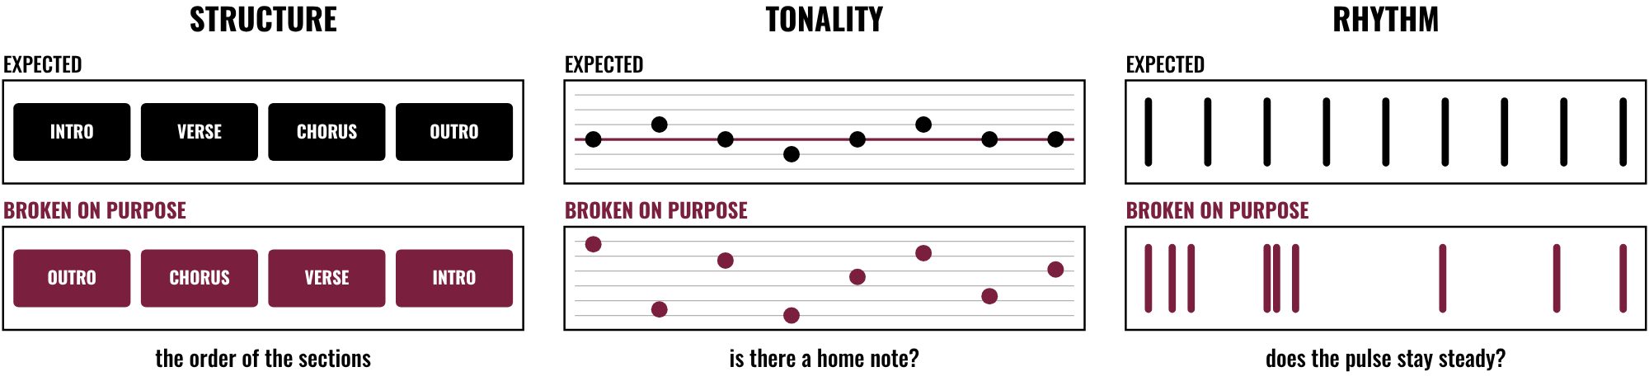
HUDSON BEAT
CLASS 1
PICK A RULE TO BREAK
Pick one rule, or more
Structure, tonality or rhythm
Know why you are breaking it
Break it on purpose
Anti-Music Manifesto · Intro deck · © 2026 Brian Lotze · Hudson Beat
5
Notes:
Requirement 2 is to intentionally break at least one major musical convention: structure, tonality, rhythm, and so on. The picture shows each one holding, then broken on purpose. Structure: the sections come in an expected order, and here the order is reversed. Tonality: a melody keeps returning to a home note, and here no note feels like home. Rhythm: a steady pulse, and here it falls apart. Rule cards for students who want a starting point are on the Rules page.

Slide 6
HUDSON BEAT
CLASS 1
STEPS 1 AND 2: CONCEPT, SOUNDS
1
Define your concept
2
What rule are you breaking, and why?
3
Record or create unconventional sounds
4
Fill in the Concept sheet
5
Keep a Sound log
Anti-Music Manifesto · Intro deck · © 2026 Brian Lotze · Hudson Beat
6
Notes:
Steps 1 and 2 of the project sheet, shortened to fit the slide. Step 1: brainstorm what anti-music means to you, and decide what rule you are breaking and why. Step 2: record or create unconventional sound sources. The Concept sheet and the Sound log hold the thinking. Nobody opens a Logic session until the Concept sheet names a rule and a reason.

Slide 7
HUDSON BEAT
CLASS 1
INTENTION, NOT ACCIDENT
Define your concept before you build
Name the specific rule you break
Know why you are breaking it
Uncomfortable is allowed
Anti-Music Manifesto · Intro deck · © 2026 Brian Lotze · Hudson Beat
7
Notes:
My first common struggle, shortened here: students make random noise and call it anti-music, so push them to define their concept before they start building. Require the specific rule and the reason. My third struggle: some students are uncomfortable making bad music on purpose, so frame it as artistic exploration, not failure. My tip 3 says it too: that might be the point.

Slide 8
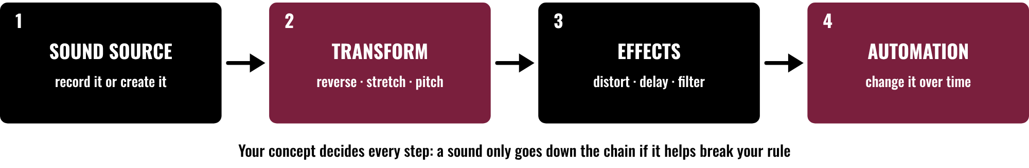
HUDSON BEAT
CLASS 2
THE SOUND CHAIN
Record or create a sound
Transform it until it is strange
Distort and deconstruct with effects
Automate so it keeps changing
Anti-Music Manifesto · Intro deck · © 2026 Brian Lotze · Hudson Beat
8
Notes:
Class 2. A sound source, here recorded or created, goes through transformation, effects and automation. Requirements 3 and 4 ask students to use Logic's effects and automation to distort or deconstruct sounds, and to record or create unconventional sound sources. My fourth struggle is students who just bang on a keyboard, so encourage effects, automation and sound manipulation.

Slide 9
HUDSON BEAT
CLASS 2
GATHER UNUSUAL SOUNDS
Record everyday objects and spaces
Create sounds inside Logic
Keep every file, name it, log it
Keep recordings school-appropriate and kind
Anti-Music Manifesto · Intro deck · © 2026 Brian Lotze · Hudson Beat
9
Notes:
Step 2: record or create unconventional sound sources. These are suggestions from the kit, not mine: objects and rooms around the school, sounds students make in Logic, and everything named and noted in the Sound log so nothing gets lost. Remind students to get permission before recording other people, and to keep the headphone volume moderate, because distorted and noisy sounds can be much louder than they seem.

Slide 10
HUDSON BEAT
CLASS 2
WATCH ME: TURN A SOUND INSIDE OUT
1
Record one short everyday sound
2
Reverse it or change its speed and pitch
3
Add distortion or delay
4
Automate one effect knob
5
Save it and note what you did
Anti-Music Manifesto · Intro deck · © 2026 Brian Lotze · Hudson Beat
10
Notes:
A live demo of about ten minutes, which is also the kit's own suggestion for Class 2, not one of my steps. Record a short sound, a drawer or a pen click, then reverse it, change its speed or pitch, add distortion or delay, and draw automation on one effect knob so the change happens over time. Save after each move and write what you did in the Sound log. Menu names are on the Logic quick reference; check the labels on your version.

Slide 11
HUDSON BEAT
CLASS 3
WORKING DAYS: BUILD AND SHAPE
Build with effects, automation and distortion
Lean into the rule you chose
Shape it: intentional, not accidental
Save versions as you go
Anti-Music Manifesto · Intro deck · © 2026 Brian Lotze · Hudson Beat
11
Notes:
Class 3 is the first working day, and Classes 4 and 5 continue it. Steps 3 and 4 of the project sheet, shortened here: use Logic to construct your piece and lean into effects, automation and distortion; even though you are breaking rules, the piece should feel intentional, not accidental. Students use the Build plan. Circulate and ask each student to play you the moment the rule breaks.

Slide 12
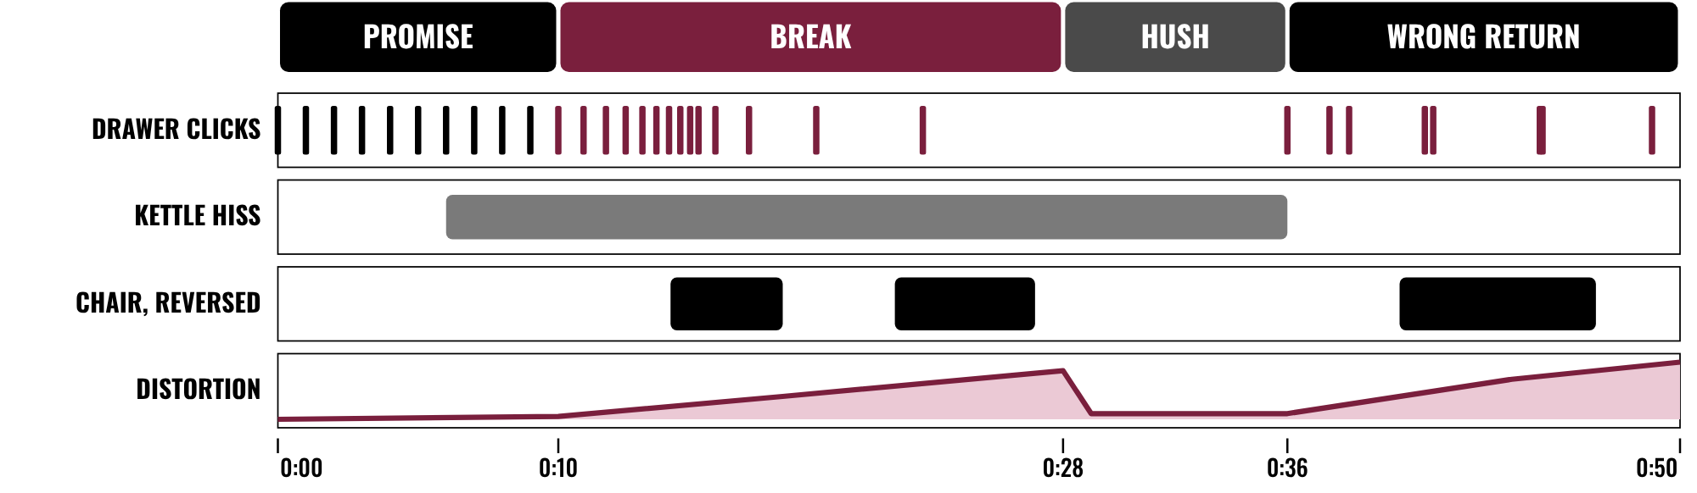
HUDSON BEAT
CLASS 4
WORKED EXAMPLE: 50 SECONDS ON PAPER
The rule is a steady pulse
It breaks, hushes, returns wrong
Every sound has a job
Plan 45–60 seconds
Anti-Music Manifesto · Intro deck · © 2026 Brian Lotze · Hudson Beat
12
Notes:
Class 4. An invented piece, Kitchen Table, described on paper; nothing here is audio. The rule is a steady pulse. Promise: ten drawer clicks, one a second. Break: the clicks speed up, stretch out and fall apart as the distortion rises. Hush: only a kettle hiss. Wrong return: the clicks come back, uneven. It is 50 seconds, inside my 45 to 60 second requirement. The full plan and a sample artist statement are on the worked example page.

Slide 13
HUDSON BEAT
CLASS 4
IS IT ON PURPOSE?
Could a listener tell which rule you broke?
Does every sound have a job?
Does it change over its 45 to 60 seconds?
Can you explain every choice?
Anti-Music Manifesto · Intro deck · © 2026 Brian Lotze · Hudson Beat
13
Notes:
A check students can use on each other's work. These are the kit's own questions, drawn from my line that the difference between anti-music and random noise is intention. If a student cannot answer the first question, send them back to the Concept sheet. Class 5 is a full working day with no new slide.

Slide 14
HUDSON BEAT
CLASS 6
STEP 5: THE ARTIST STATEMENT
1
One paragraph
2
Name the specific rule you broke
3
Explain your reasoning
4
Say what to listen for
Anti-Music Manifesto · Intro deck · © 2026 Brian Lotze · Hudson Beat
14
Notes:
Class 6. Step 5 of the project sheet, shortened to fit the slide: write your artist statement, explaining what you did and why. My second struggle is vague statements, so require the specific rule and the reasoning. Tip 4: the statement is just as important as the music, because it tells your audience what to listen for. Students plan it on the Statement planner.

Slide 15
HUDSON BEAT
CLASS 6
FINAL MIX AND BOUNCE
Mix: balance on purpose
Bounce a .mp3 or .wav
Zip the .logicx project
Write your 3 Padlet questions
Anti-Music Manifesto · Intro deck · © 2026 Brian Lotze · Hudson Beat
15
Notes:
Step 6 of the project sheet, shortened to fit the slide: mix, bounce, and prepare to present your concept to the class. A harsh sound can still be balanced against the others; levels are a choice. Zip the .logicx in Finder (Control-click, Compress). Students also write their three Padlet questions today.

Slide 16
HUDSON BEAT
CLASS 6
WHAT YOU TURN IN
Bounced .mp3 or .wav
Zipped .logicx project
Named: Your Name – Anti-Music Manifesto
Artist statement submitted
Padlet post with your 3 questions
Answer 2 questions on classmates’ posts
Anti-Music Manifesto · Intro deck · © 2026 Brian Lotze · Hudson Beat
16
Notes:
The submission checklist from the project sheet, shortened to fit the slide. Show where students upload (your class page) and where the Padlet board is. Remind students that the artist statement is submitted as well as the music.

Slide 17
HUDSON BEAT
CLASS 6
HOW IT’S SCORED
CREATIVITY & ORIGINALITY
5 = Exceptional creativity; innovative, bold, and expressive
/ 5
TECHNICAL SKILL / DAW USE
5 = Expert-level command of multiple Logic systems
/ 5
COMPOSITION & STRUCTURE
5 = Professional pacing, flow, and musical arc
/ 5
SOUND DESIGN & MIX QUALITY
5 = Exceptional sound design; professional-quality mix
/ 5
DOCUMENTATION & PRESENTATION
5 = Exceptional; thorough insight and polished delivery
/ 5
SCORED 1–5 · FINAL GRADE = AVERAGE OF YOUR SCORE AND MINE · / 25
Anti-Music Manifesto · Intro deck · © 2026 Brian Lotze · Hudson Beat
17
Notes:
My rubric: five categories, each scored 1 to 5, for a total out of 25. Students score themselves first; the final grade is the average of their score and mine. The slide reads the 5 column of each category aloud. Hand out the rubric page so students can self-score before they present.

Slide 18
HUDSON BEAT
CLASS 7
PRESENTATION DAY
Play your piece
Say the rule you broke, and why
Your Padlet post: 3 questions about your project
Answer at least 2 of each classmate’s 3
Anti-Music Manifesto · Intro deck · © 2026 Brian Lotze · Hudson Beat
18
Notes:
Class 7, presentations with Padlet Q and A. Each student plays the piece and presents the concept, then during classmates' presentations every student answers at least 2 of their 3 questions on their Padlet post. Read the artist statement aloud or let students do it. My notes say this project sparks great class discussions; leave time for them.

Slide 19
HUDSON BEAT
CLASS 7
ONE LAST THING…
You picked a rule.
You broke it on purpose.
You said why.
Now the noise has a vision.
REFLECTION · PAGE 22
Write it or talk it through: what went well, what was hard, what you would change.
Anti-Music Manifesto · Intro deck · © 2026 Brian Lotze · Hudson Beat
19
Notes:
Close with what my teacher notes say this project does: it pushes creative boundaries and critical thinking about what music is, and it makes students articulate artistic intent, which strengthens their ability to talk about creative work. Reflection: point students to the Reflection page. A reflection is a written or oral conversation about how they did on the project and what they would do differently next time; they choose to write it or to talk it through with you.

