Slide 1
HUDSON BEAT
1
1.2
1.3
1.4
2
2.2
2.3
2.4
3
3.2
3.3
3.4
4
4.2
4.3
4.4
Hi-hat
Clap
Snare
Kick
BEAT FROM NOTHING
Feat. Billie Jean
DIGITAL MUSIC PRODUCTION · UNIT 1 · DRUM PROGRAMMING IN LOGIC PRO
Notes:
Day 1, before anything else. Welcome students to their first project: by the end of the week every one of them will have built an original drum beat from scratch in Logic. No loops, no pre-made grooves. Tell them today is about listening and naming; nobody touches Logic until tomorrow. Have Billie Jean by Michael Jackson cued up on YouTube or Spotify (your own account; no audio is included in this deck).

Slide 2
HUDSON BEAT
LISTEN FIRST
BILLIE JEAN · MICHAEL JACKSON
Teacher: play about 60 seconds from YouTube or Spotify.
What do you hear?
What’s repeating?
What enters, and when?
Beat From Nothing · Intro deck · © 2026 Brian Lotze · Hudson Beat
2
Notes:
Play roughly the first minute. Ask the three questions and collect answers on the board, but do not confirm anything yet: this is ‘feel it before you name it’. Students usually say ‘the drums start alone’, ‘the bass comes in’, ‘it keeps going round’. Keep their words; you will name them on the next slides.

Slide 3
HUDSON BEAT
WHAT THE HECK IS A LOOP?
A repeated musical idea
Simple or complex!
Builds on previous material
Beat From Nothing · Intro deck · © 2026 Brian Lotze · Hudson Beat
3
Notes:
Plain-English definition: a loop is a musical idea that repeats. It can be one drum hit or a whole groove. Each new loop builds on what came before. Point back to their answers: ‘it keeps going round’ is exactly this. Ask: where else have you heard loops? (Almost every song they know.)

Slide 4
HUDSON BEAT
WHICH INSTRUMENTS LOOP?
DRUMS
PERCUSSION
BASS
SYNTH
hi-hat
snare
kick
shaker
the lowest sound
chords and color
Beat From Nothing · Intro deck · © 2026 Brian Lotze · Hudson Beat
4
Notes:
Replay the opening of Billie Jean and have students raise a hand each time they hear a new looping layer. Reveal the list: drums (hi-hat, snare, kick), shaker, bass, synth. Point out that the drum part alone is just three sounds: kick, snare and hi-hat. That is what they will build this week.

Slide 5
HUDSON BEAT
HOW LONG IS EACH LOOP?
Clap along to the pulse: each clap is a BEAT
Most of the time there are 4 beats in a MEASURE (bar)
How many beats do the drums play by themselves?
How many measures is that?
Beat From Nothing · Intro deck · © 2026 Brian Lotze · Hudson Beat
5
Notes:
Play Billie Jean again and have the class clap the pulse. Each clap is a beat; four beats make a measure. Then ask how long the drums play alone before the bass enters, and have students count it in measures while it plays. Let them count it themselves rather than giving the number; replay as many times as needed. Counting in measures is the skill they need for AABA later in the week.

Slide 6
HUDSON BEAT
MAPPING AN INTRO, LAYER BY LAYER
1
5
9
13
DRUMS
4 measures
4 measures
4 measures
4 measures
BASS
4 measures
4 measures
4 measures
SHAKER
4 measures
4 measures
SYNTH
4 measures
Each layer enters at the start of a 4-measure block and keeps looping. In Logic, every block is a region.
Beat From Nothing · Intro deck · © 2026 Brian Lotze · Hudson Beat
6
Notes:
This is the worked example of how a song intro is built from loops. Walk through it like a timeline: the drums start alone, then each new layer enters at the start of a 4-measure block and keeps looping. In Logic, each block would be a region on its own track. Ask: what would it sound like if everything entered at once? (No build, nothing to look forward to.) This chart is a model, not a transcription: it shows the idea of staggered entrances.

Slide 7
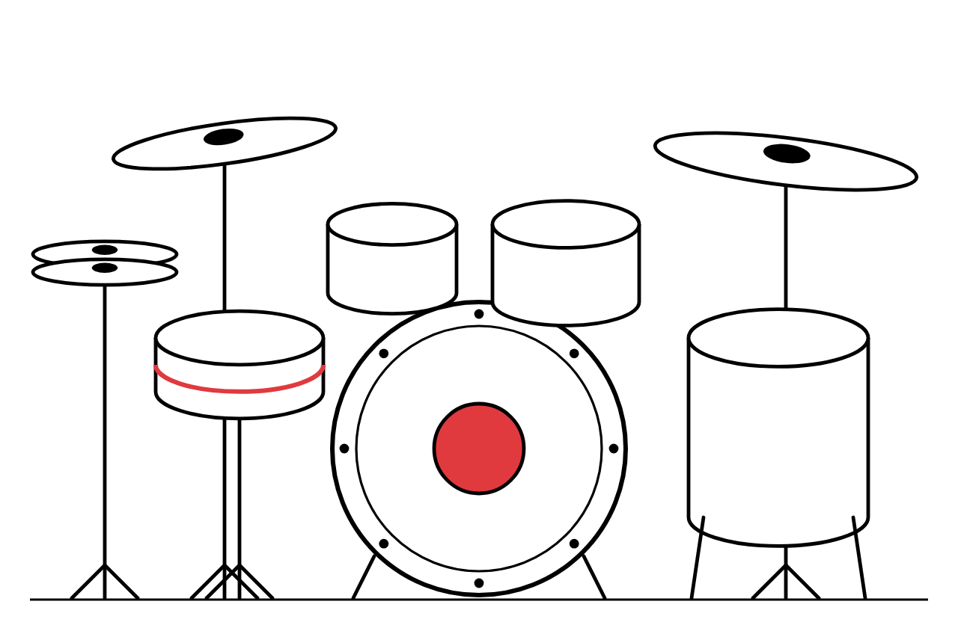
HUDSON BEAT
MEET THE KIT
KICK
the lowest, heaviest hit; usually beats 1 and 3
SNARE
the sharp crack; usually beats 2 and 4
HI-HAT
two cymbals that keep a steady pulse; closed (tight) or open (ringing)
Beat From Nothing · Intro deck · © 2026 Brian Lotze · Hudson Beat
7
Notes:
Pairs with the Parts of the Drum Set worksheet. Focus on the three building blocks and their jobs: the kick grounds the beat, the snare drives it, the hi-hat makes it breathe. Mention the toms, crash and ride exist too; students can use them as their extra element.

Slide 8
HUDSON BEAT
READ THE GRID
1
1.2
1.3
1.4
2
2.2
2.3
2.4
3
3.2
3.3
3.4
4
4.2
4.3
4.4
Eighths
Sixteenths
16 squares = 1 measure of sixteenth notes
Every other square = eighth notes (the default groove)
Every square = sixteenth notes (busier, more energy)
Beat From Nothing · Intro deck · © 2026 Brian Lotze · Hudson Beat
8
Notes:
Day 1 close or Day 2 launch. This is the same grid students used on the listening sheet and the one they will see in Logic’s Step Sequencer. The shaded squares are the four beats. Have students clap the hi-hat row (eighths), then sixteenths, and feel the energy change.

Slide 9
HUDSON BEAT
WORKED EXAMPLE: BILLIE JEAN’S DRUMS
1
1.2
1.3
1.4
2
2.2
2.3
2.4
3
3.2
3.3
3.4
4
4.2
4.3
4.4
Hi-hat
Snare
Kick
BILLIE JEAN · MICHAEL JACKSON · 116 BPM
Hi-hat in eighth notes · snare on 2 and 4 · kick on 1 and 3
Teacher: play the song from YouTube or Spotify and compare.
Beat From Nothing · Intro deck · © 2026 Brian Lotze · Hudson Beat
9
Notes:
Day 2. This is the pattern from the Famous Drum Patterns page: hi-hat in eighth notes, snare on 2 and 4, kick on 1 and 3, at 116 BPM. Copying it is not busywork: it trains the ear to recognize what ‘correct’ feels like with a specific kick-snare-hi-hat relationship. Build it live in Logic while students watch, then play the song again (YouTube or Spotify) and compare.

Slide 10
HUDSON BEAT
IN LOGIC
1
Create a Software Instrument track and choose any Electronic Drum Kit (this loads Drum Machine Designer)
2
Control-click (right-click) in the track at bar 1, then choose Create Pattern Region
3
Double-click the region to open the Step Sequencer
4
Click squares to place hits; press C to Cycle the measure
5
Set the tempo in the control bar (116 for Billie Jean)
Beat From Nothing · Intro deck · © 2026 Brian Lotze · Hudson Beat
10
Notes:
Demonstrate each step on the projector while students follow. Watch for the most common Day 2 error: double-clicking a blank space opens an empty piano roll. The correct move is Control-click, Create Pattern Region. After the demo, students mess around with no requirements, then copy ONE famous pattern exactly and call you over. Use that check-in to show them how to change the tempo.

Slide 11
HUDSON BEAT
YOUR PROJECT: BEAT FROM NOTHING
An original drum beat, built from nothing
No loops, no pre-made grooves
Kick, snare, closed hi-hat + at least one extra sound
16 measures in AABA form, mixed with volume and panning
Beat From Nothing · Intro deck · © 2026 Brian Lotze · Hudson Beat
11
Notes:
Launch the project at the end of Day 2. Hand out the project sheet and rubric. Hold the line on ‘no loops’: some students will be frustrated they can’t just drag a loop. By the end of the unit they will feel more pride in four bars they built than in four minutes they assembled.

Slide 12
HUDSON BEAT
THE STEPS
DAY 1
Name the kit · loops · listening
DAY 2
Copy a famous pattern
DAY 3
Build A · build B · arrange AABA · mix · submit
DAY 4
Present + feedback
A
A
B
A
measures 1–4
measures 5–8
measures 9–12
measures 13–16
B = A with one change: remove one element, add one sound, or change the hi-hat rhythm.
Beat From Nothing · Intro deck · © 2026 Brian Lotze · Hudson Beat
12
Notes:
Walk through the plan: Day 3 they build an A section (start from kick 1 and 3, snare 2 and 4, hi-hat in eighths, then make it theirs), a B section (one change: remove one element, add one sound, or change the hi-hat rhythm), arrange A A B A at 4 measures each, and mix. Day 4 they present. The best B sections are about 80% the same as A.

Slide 13
HUDSON BEAT
WHAT YOU TURN IN
Beat built in Drum Machine Designer, no Apple Loops
Volume set on every track, nothing at default
Panning on at least 2 tracks
Named: Your Name – Beat From Nothing
MP3 + compressed .logicx, submitted before presenting
Three feedback questions posted before presenting
Beat From Nothing · Intro deck · © 2026 Brian Lotze · Hudson Beat
13
Notes:
These are the deliverables from the submission checklist. Show where students submit (your class page) and where the feedback questions go (Padlet or any class feedback board). Export: File > Bounce > Project or Section, MP3. Compress: in Finder, Control-click the .logicx file > Compress.

Slide 14
HUDSON BEAT
HOW IT’S SCORED
CREATIVITY & ORIGINALITY
5 = Beat has a distinct feel and personality. B section creates meaningful contrast. Goes beyond the obvious.
/ 5
TECHNICAL SKILL / DAW USE
5 = Drum Machine Designer used confidently. Pattern regions, 64-step, or note repeat used with control.
/ 5
COMPOSITION & STRUCTURE
5 = AABA structure is clear and musically satisfying. Beat locks in and feels complete.
/ 5
VOLUME & BALANCE
5 = All elements are balanced with intention. Each drum sound has its own space. Panning adds width without distraction.
/ 5
DOCUMENTATION & PRESENTATION
5 = Project correctly named, submitted on time. Confident presentation. Three thoughtful feedback questions posted.
/ 5
TOTAL / 25
Beat From Nothing · Intro deck · © 2026 Brian Lotze · Hudson Beat
14
Notes:
Five categories, each scored 2 to 5, for a total out of 25. Read the 5 column aloud for each category so students know what great looks like: distinct feel, confident use of Drum Machine Designer, a clear AABA that locks in, every sound with its own space, and a confident presentation with three thoughtful questions.

Slide 15
HUDSON BEAT
ONE LAST THING…
Can you nod your head to it?
If not, what one thing would you change?
1
1.2
1.3
1.4
2
2.2
2.3
2.4
3
3.2
3.3
3.4
4
4.2
4.3
4.4
Closed hi-hat
Open hi-hat
Snare
Kick
Clap
Beat From Nothing · Intro deck · © 2026 Brian Lotze · Hudson Beat
15
Notes:
Close the launch with the one question you will ask all week while circulating. It works for every student at every level, and it is the heart of the rubric’s Composition & Structure row. Then: turn things down, not up.

