Slide 1
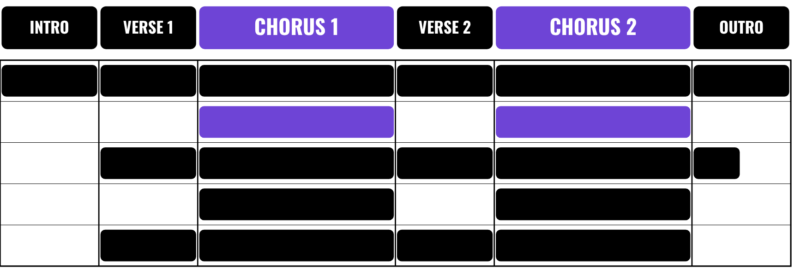
HUDSON BEAT
SONG FORM
Feat. Blinding Lights
DIGITAL MUSIC PRODUCTION · UNIT 5 · DAY 1 · SONG STRUCTURE IN LOGIC PRO
Notes:
Day 1, the first two minutes. Today is a listening day: nobody builds anything in Logic. Have Crazy (Gnarls Barkley) and Blinding Lights (The Weeknd) cued up on YouTube or Spotify from your own account; no audio or video is included in this deck. Open with a question: you always know when the chorus is coming, even in a song you have never heard. How?

Slide 2
HUDSON BEAT
DAY 1
WHAT THE HECK IS SONG FORM?
The overall structure of a song
How its sections are organized, beginning to end
Intro · verse · chorus · bridge · outro
Sections feel different because of what is playing
Song Form · Intro deck · © 2026 Brian Lotze · Hudson Beat
2
Notes:
Plain-English definition, then the central insight of the unit, the line to land by the end of the week: sections feel different because of what is playing, not just because of a label. A chorus is not called a chorus because someone decided to call it that. It is called a chorus because it is texturally fuller, emotionally bigger and more memorable than the verse. That is a compositional decision, not a naming decision.

Slide 3
HUDSON BEAT
DAY 1
LISTEN: FEEL THE CHANGE
CRAZY
Gnarls Barkley
Teacher: play the first 2–3 minutes from YouTube or Spotify.
Raise your hand when the section changes
What came in? What dropped out?
Count the measures: what number keeps showing up?
Song Form · Intro deck · © 2026 Brian Lotze · Hudson Beat
3
Notes:
Class example 1, about 10 to 12 minutes. First listen, about 90 seconds: play without stopping; students raise a hand when they feel the section change. Do not define, just listen. Second listen: pause at each change and ask what came in or dropped out; label it on the board. Third listen: count the measures together out loud. Students usually discover on their own that sections land in multiples of 4.

Slide 4
HUDSON BEAT
DAY 1
WHAT EACH SECTION DOES
INTRO
VERSE
PRE-CHORUS
Earns attention. Starts sparse and builds.
The setup. Sparser than the chorus.
Optional. Builds tension before the chorus.
CHORUS
BRIDGE
OUTRO
The peak. Fuller, louder, same every time.
Breaks the pattern once, before the last chorus.
Brings it home. Strips back. Ends cleanly.
Song Form · Intro deck · © 2026 Brian Lotze · Hudson Beat
4
Notes:
One minute, between the two class examples. A section is not just a label: it has a job, and the job tells you how to build it. Point back to Crazy: where was the setup, where was the payoff? Mention that not every song has a pre-chorus or a bridge; students will hunt for them in their independent songs. The full descriptions are on the project sheet.

Slide 5
HUDSON BEAT
DAY 1
LISTEN: SONG 2
BLINDING LIGHTS
The Weeknd
Teacher: play the first 2–3 minutes from YouTube or Spotify.
You lead the labeling this time
Same structure as Crazy? What is different?
Why does the chorus feel bigger?
Song Form · Intro deck · © 2026 Brian Lotze · Hudson Beat
5
Notes:
Class example 2, same process at a faster pace, with students leading more of the labeling. The verse is sparse and unsettled; the chorus erupts with full synth pad and drums, so the section change is physically felt. Push for musical answers to the last question (what came in, what got thicker), not just ‘it sounds louder’.

Slide 6
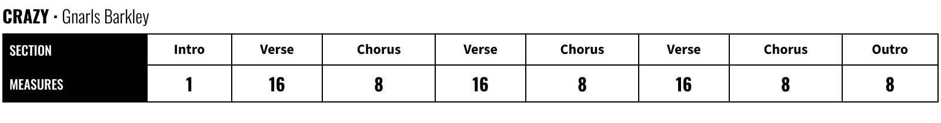
HUDSON BEAT
DAY 1
YOUR TURN: TWO SONGS ON YOUR OWN
A finished table looks like this (class example). Now pick two of these. Find them on YouTube or Spotify:
ANTI-HERO
Taylor Swift
GOOD 4 U
Olivia Rodrigo
LEVITATING
Dua Lipa
UPTOWN FUNK
Bruno Mars
Song Form · Intro deck · © 2026 Brian Lotze · Hudson Beat
6
Notes:
Independent analysis, about 20 minutes. Each student picks two of the four songs and completes a Song Form table for each: label every section, count the measures, note what is playing. Students play the songs from YouTube or Spotify on their own headphones. The image shows how a finished row looks, using the class example. Circulate and check that sections are labeled and measures counted.

Slide 7
HUDSON BEAT
DAY 1
WHAT SHOWED UP EVERY TIME?
Sections are almost always 4 or 8 bars
The chorus is fuller than the verse
Intros build in; outros strip back
Write it down: your written response
Song Form · Intro deck · © 2026 Brian Lotze · Hudson Beat
7
Notes:
The share-out at the end of Day 1 is important. Ask: what patterns did you notice across all four songs? Let students get there before you show the bullets. These are the principles they will apply the next day. Students finish with the written response, two or three sentences, on the Compare the Forms page.

Slide 8
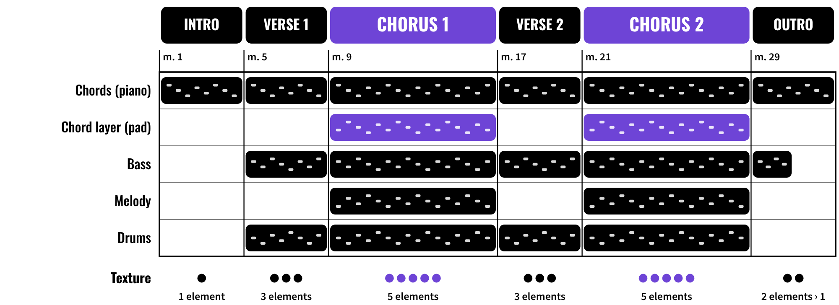
HUDSON BEAT
DAY 2
ARRANGEMENT = WHAT PLAYS WHERE
The worked example: one lane per element, one column per section. Violet = the chord layer.
Song Form · Intro deck · © 2026 Brian Lotze · Hudson Beat
8
Notes:
Day 2 opens here. Arrangement is the decisions about which elements play in which sections: what comes in, what drops out, and when. Walk the picture left to right: the intro is one element, the verse adds bass and drums, the chorus adds the chord layer and the melody, the outro strips back. Count the black bars in each column: that count is the texture. The unit’s mixing concept is arrangement as mix.

Slide 9
HUDSON BEAT
DAY 2
WATCH ME: THE CHORD LAYER
1
Option-drag a chord region onto a new track below
2
Change the instrument: a pad, a Rhodes, a slow-attack synth
3
Play both together: thicker, same notes
4
Mute the second track in the verse, unmute it in the chorus
5
Play it all: can you hear the chorus get bigger?
Song Form · Intro deck · © 2026 Brian Lotze · Hudson Beat
9
Notes:
The worked example in Logic, a 5-minute whole-class demo. Do it live with one student’s chords or your own. After step 3 ask what changed; the notes did not, the texture did. After step 5 ask: can you hear the chorus get bigger? That is arrangement as mix. Students will repeat this on Day 3.

Slide 10
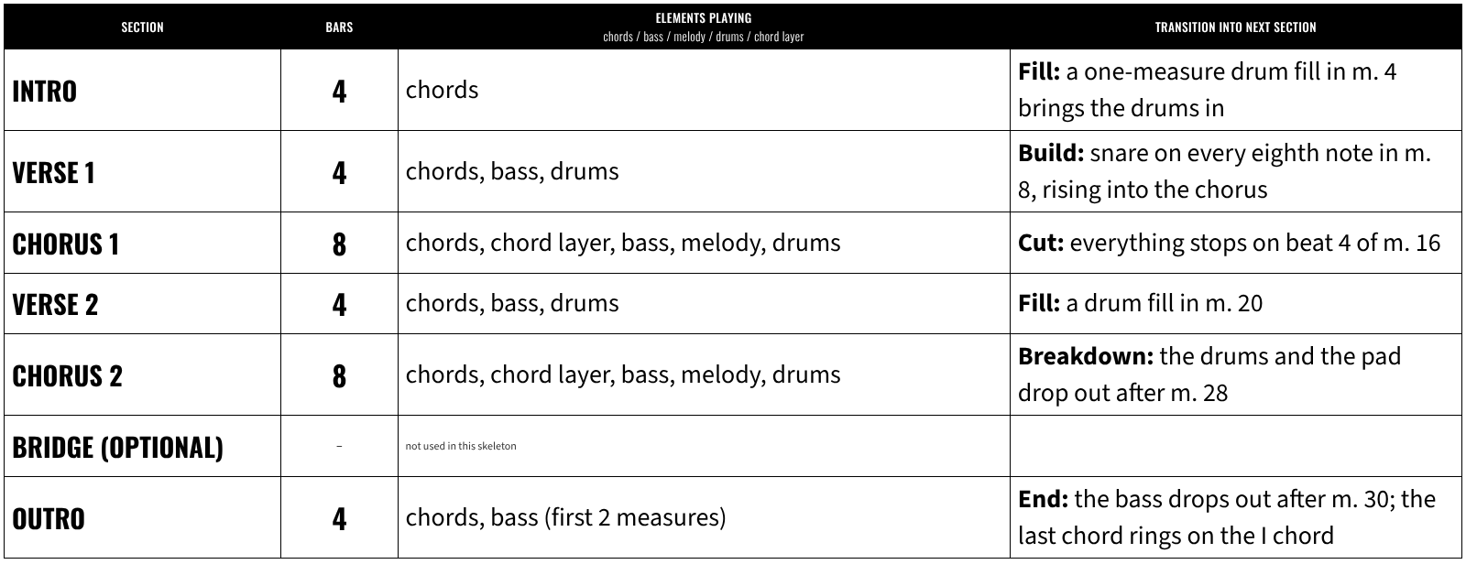
HUDSON BEAT
DAY 2
WORKED EXAMPLE: A 32-MEASURE SKELETON
Song Form · Intro deck · © 2026 Brian Lotze · Hudson Beat
10
Notes:
A filled-in planning table for a short song in C major, I–V–vi–IV (C G Am F). Six sections, 32 measures, every section 4 or 8 bars. Read down the elements column: the intro has one element, the verses three, the choruses five, the outro two and then one. Every row names its transition. Compare it to Crazy: same 4s and 8s, chorus fullest, but shorter verses because this is a skeleton.

Slide 11
HUDSON BEAT
DAY 2
PLAN BEFORE YOU BUILD
Every section needs a name and a length
…a list of what is playing
…and a transition into the next one
Fill in the planning table on paper first
No arrangement work in Logic until your plan is checked
Song Form · Intro deck · © 2026 Brian Lotze · Hudson Beat
11
Notes:
Enforce the planning table: do not let anyone open the arrangement view until the plan is filled in. Walk around and check: the chorus has more elements than the verse, the intro starts with fewer than the verse, every section change has a transition written down, and sections have real names, not Part 1 and Part 2.

Slide 12
HUDSON BEAT
DAY 2
FOUR WAYS TO CHANGE SECTIONS
1
2
3
4
FILL
BREAKDOWN
CUT
BUILD
a short drum pattern that leads into the next section
elements drop out so the next section hits harder
everything stops for a beat, then the new section starts
energy rises (snare roll, rising notes) into the next section
Song Form · Intro deck · © 2026 Brian Lotze · Hudson Beat
12
Notes:
The four transition types from earlier units are the vocabulary for every section change: fill, breakdown, cut and build. Ask students to name which type they will use at each change and why. A section change with no acknowledgment sounds like a loop. If you can, tap each one on a drum track so students hear the difference.

Slide 13
HUDSON BEAT
DAY 2
YOUR PROJECT: SONG FORM
Four songs on the Song Form sheet + a written response
Plan 4+ sections, each 4+ measures
Build it in Logic with arrangement markers
Make the chorus feel bigger than the verse
Song Form · Intro deck · © 2026 Brian Lotze · Hudson Beat
13
Notes:
Hand out the project sheet and rubric. Students arrange their own chords, bass and melody into a song. Intro, verse and chorus are required; bridge and outro are encouraged. Sections are at least 4 measures each. The test for the whole project: can you hear which section you are in without looking at the screen?

Slide 14
HUDSON BEAT
DAY 2
THE STEPS
DAY 1
SONG FORM ANALYSIS: A LISTENING DAY
Listen to 4 songs and map their form on the Song Form sheet; write what you noticed
DAY 2
PLAN + BUILD THE SKELETON
Add your melody, fill in the planning table, build the skeleton with arrangement markers
DAY 3
DIFFERENTIATE THE SECTIONS
Chord layer, melody only where it belongs, a drum transition at every change
DAY 4
FINISH, SUBMIT, PRESENT
Finish the mix, export and submit, present: point to your chorus
Song Form · Intro deck · © 2026 Brian Lotze · Hudson Beat
14
Notes:
Walk the four days: Day 1 the listening and the Song Form sheet, Day 2 the plan, the melody and the skeleton, Day 3 the chord layer, melody placement and drum transitions, Day 4 finish, submit and present. The six steps on the project sheet follow the same order.

Slide 15
HUDSON BEAT
DAY 2
WHAT YOU TURN IN
Song Form sheet: 4 songs + written response
Planning table, filled in before building
4+ sections with arrangement markers, 4+ measures each
Chord layer on a second instrument + a transition at every change
MP3 + compressed .logicx, named Your Name – Song Form
Three feedback questions before presenting
Song Form · Intro deck · © 2026 Brian Lotze · Hudson Beat
15
Notes:
These are the deliverables from the submission checklist. Show where students submit (your class page) and where the feedback questions go (any class feedback board). Export: File › Bounce › Project or Section, MP3. Compress: in Finder, Control-click the .logicx project › Compress.

Slide 16
HUDSON BEAT
DAY 2
HOW IT’S SCORED
SONG FORM ANALYSIS
5 = All four sheets accurate; the written response shows real insight into song structure.
/ 5
SONG FORM STRUCTURE
5 = A clearly planned, complete song with a beginning, middle and end.
/ 5
SECTION DIFFERENTIATION
5 = Distinct textures: a listener can name the section by ear.
/ 5
ARRANGEMENT AS MIX
5 = Arrangement and mix work as one; nothing is clipping.
/ 5
DOCUMENTATION & PRESENTATION
5 = On time, named correctly; explains form choices section by section; three feedback questions.
/ 5
TOTAL / 25
Song Form · Intro deck · © 2026 Brian Lotze · Hudson Beat
16
Notes:
Five categories, each scored 2 to 5, for a total out of 25. Read the 5 column aloud so students know what great looks like: accurate sheets and real insight, a complete song with a beginning, middle and end, sections you can identify by ear, a mix that follows the arrangement, and a presentation that explains the choices section by section.

Slide 17
HUDSON BEAT
DAY 4
ONE LAST THING…
Sections feel different because of what is playing.
Write once, arrange many times.
You built the form yourself.
Song Form · Intro deck · © 2026 Brian Lotze · Hudson Beat
17
Notes:
Day 4, the last three minutes, after the presentations. Close with this line: what you just heard (intro, verse, chorus, verse, chorus) is the structure of almost every pop song ever released. You did not just copy that structure. You understood it well enough to build it yourself.

