Slide 1

HUDSON BEAT
GENRE EXPLORATION
Step outside your comfort zone.
DIGITAL MUSIC PRODUCTION 2 · CLASS 1 · MAKE A TRACK IN A GENRE YOU DO NOT KNOW
Notes:
Class 1, the first minute. No audio is included in this deck. Open with my overview: step outside your comfort zone. Pick a musical genre you are unfamiliar with, research what defines it, and produce a track that captures its signature sound. Say that the project pushes students to listen deeper, experiment with new sounds, and grow as producers.

Slide 2
HUDSON BEAT
CLASS 1
THINK: A GENRE YOU WOULD SKIP
THINK, THEN SHARE
Teacher: no audio is needed. Ask the questions aloud and take a few answers.
Which genre would you never choose to listen to?
What do you think it sounds like, and how do you know?
What would you need to find out to make it?
Genre Exploration · Intro deck · © 2026 Brian Lotze · Hudson Beat
2
Notes:
Ask the three questions aloud and take a few answers. Nothing is played from a speaker and no one else's music is used. The point is my closing note: students often surprise themselves by enjoying genres they thought they would hate. Do not name a genre for them; let them say what they would skip. It sets up my first struggle, picking a genre too close to what they already make.

Slide 3
HUDSON BEAT
CLASS 1
WHAT IS GENRE EXPLORATION?
Pick a genre you are unfamiliar with
Research what defines it
Produce a track that captures its signature sound
Goal: listen deeper and grow as a producer
Genre Exploration · Intro deck · © 2026 Brian Lotze · Hudson Beat
3
Notes:
My overview and first goals, shortened to fit the slide. Pick a musical genre you are unfamiliar with, research what defines it, and produce a track that captures its signature sound. The project pushes you to listen deeper, experiment with new sounds, and grow as a producer. Students write the four vocabulary terms in their own words on the vocabulary page; slide 6 introduces them.

Slide 4
HUDSON BEAT
CLASS 1
SEVEN CLASSES
CLASS 1
What genre would you skip? · five steps · four words · research
CLASS 2
Genre fingerprint · production, not just instruments · before you compose
CLASS 3
Working day: sketch, compose, worked example
CLASS 4
Working day: compare to references, mix like the genre
CLASS 5
Working day: expand, refine, mix
CLASS 6
Mix · reflect · bounce · checklist · rubric
CLASS 7
Presentations with Padlet Q&A
Genre Exploration · Intro deck · © 2026 Brian Lotze · Hudson Beat
4
Notes:
The shape of the project, from my pacing guide. Class 1: introduction, select a genre and begin the Google Form research. Class 2: finish research and begin sketching an 8 to 16 bar loop. Classes 3 to 5 are working days: expand the composition, refine the arrangement and mix. Class 6: final mix, bounce, write the reflection, and prepare presentations. Class 7: presentations with Padlet Q and A peer feedback. Hand out the project sheet now.

Slide 5
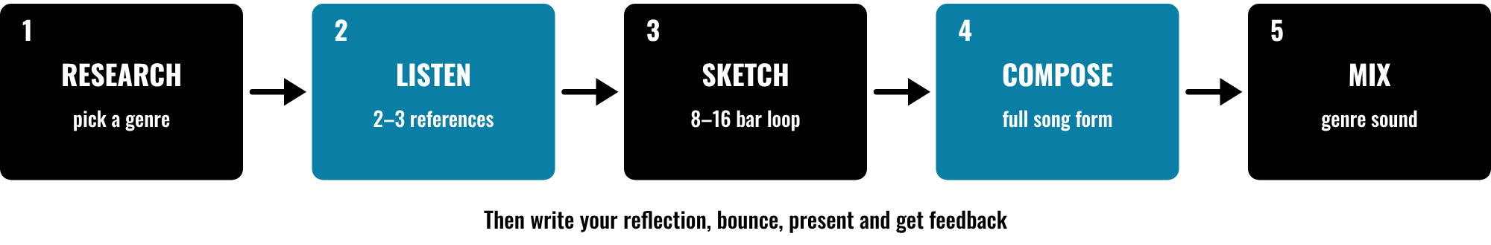
HUDSON BEAT
CLASS 1
FIVE STEPS, RESEARCH TO MIX
Research: pick and analyze a genre
Listen: study 2–3 references
Sketch, then compose the full form
Mix to match the genre’s sound
Genre Exploration · Intro deck · © 2026 Brian Lotze · Hudson Beat
5
Notes:
Class 1. The first five steps of my project sheet, in order: research, listen, sketch, compose, mix. Then students write their reflection, finalize the bounce, and present with Padlet feedback. Point to each box and say roughly when it happens: research today and in Class 2, the sketch in Class 2, composing on the working days, the mix in Classes 4 to 6. The step names are mine; the picture and its short labels are the kit's own.

Slide 6
HUDSON BEAT
CLASS 1
FOUR WORDS TO KNOW
Genre: a category defined by shared traits
Reference track: a song you study as your guide
Instrumentation: the instruments and sounds used
Song form: how a song is structured
Genre Exploration · Intro deck · © 2026 Brian Lotze · Hudson Beat
6
Notes:
My four vocabulary terms, shortened to fit the slide. Genre: a category of music defined by shared characteristics like rhythm, instrumentation and structure. Reference track: a professionally produced song you study and use as a guide for your own production. Instrumentation: the specific instruments and sounds used in a piece of music. Song form: how a song is structured, verse, chorus, bridge and so on. The full definitions are on the vocabulary page.

Slide 7
HUDSON BEAT
CLASS 1
STEPS 1 AND 2: RESEARCH, LISTEN
1
Select a genre you do not already make
2
Complete the Google Form on its key characteristics
3
Study 2–3 reference tracks
4
Break down their elements
5
Write what you hear on the log
Genre Exploration · Intro deck · © 2026 Brian Lotze · Hudson Beat
7
Notes:
Steps 1 and 2 of the project sheet, shortened to fit the slide. Step 1, research: select your genre and complete the Google Form analyzing its key characteristics. Step 2, listen: study 2 to 3 reference tracks and break down their elements. The last line is the kit's own suggestion, not my step: students write what they hear on the Reference track log. My resources encourage Spotify, YouTube or Apple Music for reference tracks; students choose their own tracks. Approve each genre before they leave.

Slide 8

HUDSON BEAT
CLASS 2
A GENRE HAS A FINGERPRINT
Rhythm: the groove
Sound: instruments and synths
Form: how the song is built
Production: how it is mixed
Genre Exploration · Intro deck · © 2026 Brian Lotze · Hudson Beat
8
Notes:
Class 2. A kit picture, not from my sheets, built from my definition of a genre: shared characteristics like rhythm, instrumentation and structure, plus the production techniques my requirement 5 names. Ask students to find all four in their reference tracks: the rhythm, the sound, the form and the production. My second struggle is shallow research, so require specific reference tracks and concrete elements, not a vague impression.

Slide 9
HUDSON BEAT
CLASS 2
INSTRUMENTS ARE NOT ENOUGH
Commit fully, not just one instrument
Use sounds that belong to the genre
Apply genre-appropriate mixing and production
Compare your mix to your references
Genre Exploration · Intro deck · © 2026 Brian Lotze · Hudson Beat
9
Notes:
Requirements 4 and 5 and my first tip, shortened to fit the slide. Commit to the genre fully; do not just add one instrument that sounds kind of like it. Use instruments, synths or samples authentic to the genre. Apply genre-appropriate mixing and production techniques. This answers my third struggle, students who nail the instruments but miss the production style. The fourth line comes from my second tip: pull your references into Logic and compare your mix.

Slide 10
HUDSON BEAT
CLASS 2
BEFORE YOU COMPOSE
A genre I am not comfortable producing in
Google Form research completed
2–3 reference tracks studied
Rhythm, sound, form and production noted
My teacher has seen my genre
Genre Exploration · Intro deck · © 2026 Brian Lotze · Hudson Beat
10
Notes:
The checklist is the kit's own, built from requirements 1 and 2, step 2 (shortened here) and my first two struggles. Students tick each line on the Genre research sheet and the Reference track log before they start composing. Send a student back who has picked a genre close to what they already make, with a question, and send back research that names no concrete elements.

Slide 11
HUDSON BEAT
CLASS 3
STEPS 3 AND 4: SKETCH, COMPOSE
1
Build an 8–16 bar loop that captures the genre’s essence
2
Develop the full song structure
3
Layer instrumentation and refine
4
Follow typical song forms of the genre
Genre Exploration · Intro deck · © 2026 Brian Lotze · Hudson Beat
11
Notes:
Class 3 is the first working day, and Classes 4 and 5 continue it. Steps 3 and 4 of the project sheet, shortened to fit the slide. Step 3, sketch: build an 8 to 16 bar loop that captures the genre's essence. Step 4, compose: develop the full song structure, layer instrumentation and refine. The last line comes from requirement 3. Hand out the Work plan.

Slide 12
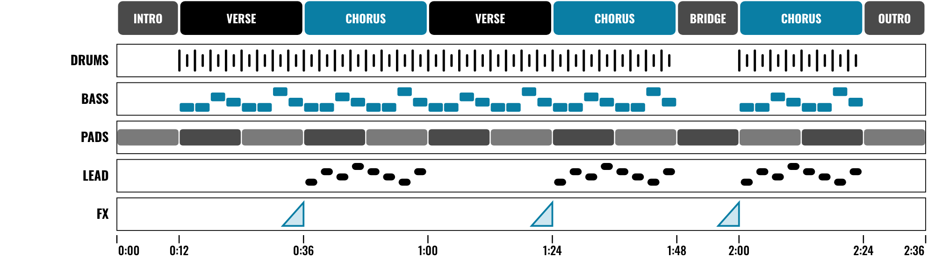
HUDSON BEAT
CLASS 3
WORKED EXAMPLE: INVENTED GENRE
An invented genre, on paper
Sections you can name
Layers that come and go
Space is part of the genre
Genre Exploration · Intro deck · © 2026 Brian Lotze · Hudson Beat
12
Notes:
Class 3. An invented genre, Harbor Drift, described on paper; nothing here is audio and no real genre is named. It is 80 beats per minute and 52 bars of 4/4, which is two minutes thirty-six. Read the sections across the top: intro, verse, chorus, verse, chorus, a short bridge, a last chorus and an outro. The lanes show drums and bass entering after the intro, pads all the way through, the lead in the choruses, and risers before each chorus. The genre card, three invented reference tracks and the numbers are on the worked example page.

Slide 13
HUDSON BEAT
CLASS 4
USE YOUR REFERENCES CONSTANTLY
Pull a reference into Logic and compare your mix
Listen: does yours feel the same?
Don’t be afraid to sound weird to yourself
Your Google Form research will save you time
Genre Exploration · Intro deck · © 2026 Brian Lotze · Hudson Beat
13
Notes:
My tips 2, 3 and 4, shortened to fit the slide. Use reference tracks constantly: pull them into Logic and compare your mix. Do not be afraid to sound weird to yourself; that is the point. Your Google Form research will save you time later. The kit suggests that a reference sits on its own muted track and is removed before bouncing, so only the student's own track is handed in.

Slide 14
HUDSON BEAT
CLASS 4
MIX LIKE THE GENRE
Step 5: apply genre-appropriate mixing techniques
Polish the track
Harder option: name 2 genre-specific mixing techniques
Leave a full class for the final mix
Genre Exploration · Intro deck · © 2026 Brian Lotze · Hudson Beat
14
Notes:
Step 5 of the project sheet and my Harder variation, shortened to fit the slide. Mix: apply genre-appropriate mixing techniques and polish the track. My Harder variation adds a requirement for two genre-specific mixing techniques; offer it to students who are ready. The last line is the kit's own suggestion, not my step: protect one full class for the final mix. The worked example page shows two techniques for the invented genre.

Slide 15
HUDSON BEAT
CLASS 6
MIX, REFLECT, BOUNCE
1
Mix: apply genre-appropriate techniques, polish
2
Write your reflection, 1 paragraph minimum
3
Finalize your bounce
4
Create your Padlet post with 3 questions
5
Prepare to present
Genre Exploration · Intro deck · © 2026 Brian Lotze · Hudson Beat
15
Notes:
Class 6. Steps 5, 6 and 7 of the project sheet, shortened to fit the slide. Mix and polish. Write your reflection and finalize your bounce. Create your own Padlet post with three questions for classmates and prepare to present. Remind students that my fourth struggle is thin reflections, so they use the prompts on the Reflection page. A reflection is a written or oral conversation about how they did and what they would do differently next time; my sheet asks for the written paragraph.

Slide 16
HUDSON BEAT
CLASS 6
WHAT YOU TURN IN
Genre Research Google Form
Bounced .mp3 or .wav
Zipped .logicx project
Named: Your Name – Genre Exploration
Written reflection on your class page
Padlet post with your 3 questions
Answer 2 questions on classmates’ posts
Genre Exploration · Intro deck · © 2026 Brian Lotze · Hudson Beat
16
Notes:
The submission checklist from the project sheet, shortened to fit the slide. Show where students upload (your class page) and where the Padlet board is. Zip the .logicx in Finder (Control-click, Compress). The Google Form should already be complete from Classes 1 and 2; if it is not, this is the last chance.

Slide 17
HUDSON BEAT
CLASS 6
HOW IT’S SCORED
CREATIVITY & ORIGINALITY
5 = Exceptional creativity; innovative, bold, and expressive
/ 5
TECHNICAL SKILL / DAW USE
5 = Expert-level command of multiple Logic systems
/ 5
COMPOSITION & STRUCTURE
5 = Professional pacing, flow, and musical arc
/ 5
SOUND DESIGN & MIX QUALITY
5 = Exceptional sound design; professional-quality mix
/ 5
DOCUMENTATION & PRESENTATION
5 = Exceptional; thorough insight and polished delivery
/ 5
SCORED 1–5 · FINAL GRADE = AVERAGE OF YOUR SCORE AND MINE · / 25
Genre Exploration · Intro deck · © 2026 Brian Lotze · Hudson Beat
17
Notes:
My rubric: five categories, each scored 1 to 5, for a total out of 25. Students score themselves first; the final grade is the average of their score and mine. The slide reads the 5 column of each category aloud. Hand out the rubric page so students can self-score before they present.

Slide 18
HUDSON BEAT
CLASS 7
PRESENTATION DAY
Play your track
Say which genre you chose and what defines it
Your Padlet post: 3 questions about your project
Answer at least 2 of each classmate’s 3
Genre Exploration · Intro deck · © 2026 Brian Lotze · Hudson Beat
18
Notes:
Class 7, presentations with Padlet Q and A. Step 7 of the project sheet, shortened to fit the slide: create your own Padlet post with 3 questions you want classmates to answer, present to the class, and during classmates' presentations answer at least 2 of their 3 questions. The second line is the kit's own suggestion. No one plays a reference track; the project is the student's own.

Slide 19
HUDSON BEAT
CLASS 7
ONE LAST THING…
You left your comfort zone.
You studied the genre.
You made it sound right.
Now play it.
Genre Exploration · Intro deck · © 2026 Brian Lotze · Hudson Beat
19
Notes:
Close with my closing note: students often surprise themselves by enjoying genres they thought they would hate. Ask a few students whether that happened to them. Reflection: point students to the Reflection page for the prompts; it follows my definition, a written or oral conversation about how they did and what they would do differently next time, and my sheet asks for the written paragraph. Tell them the next project starts from the menu.

