Slide 1
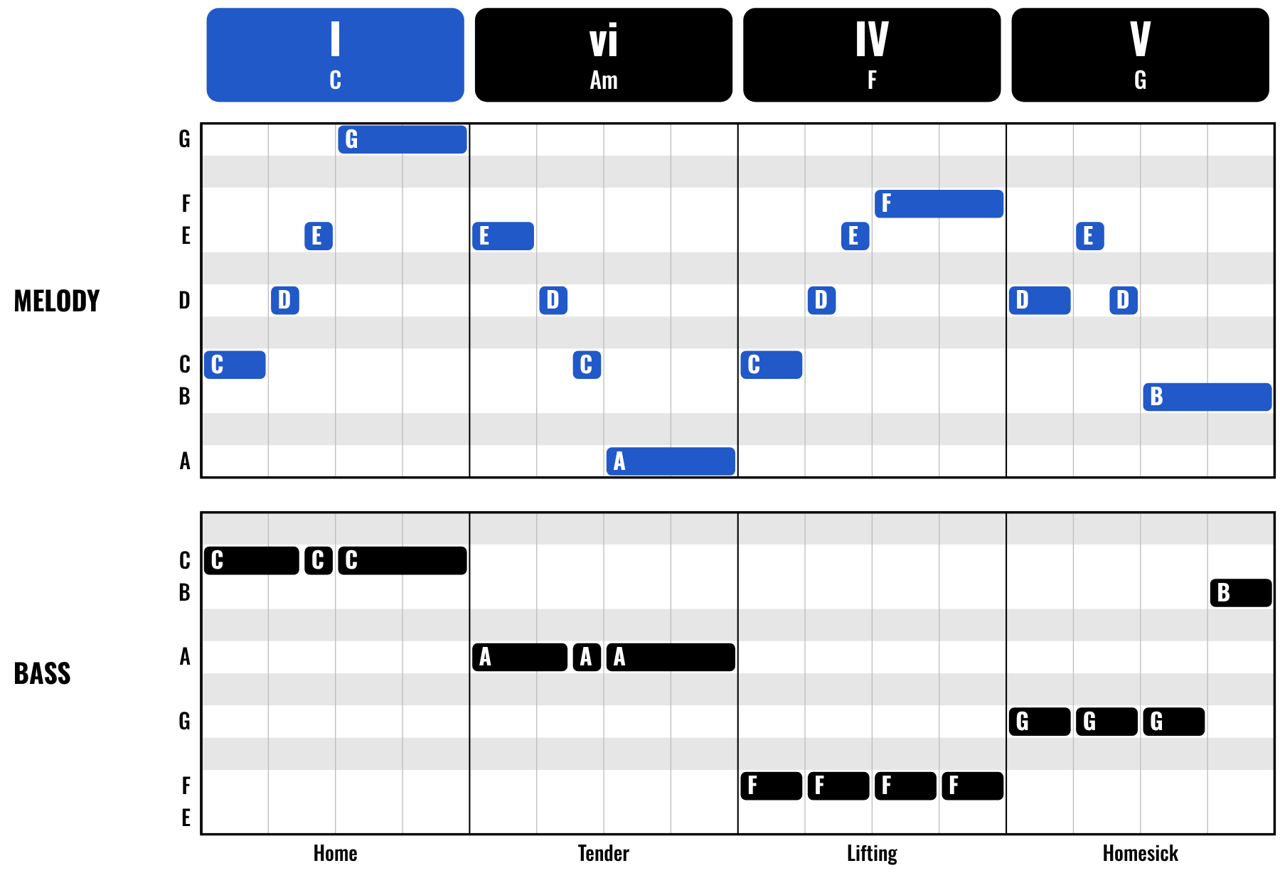
HUDSON BEAT
BASS & MELODY WRITING
Feat. Seven Nation Army
DIGITAL MUSIC PRODUCTION · UNIT 4 · DAY 1 · BASSLINES AND MELODIES IN LOGIC PRO
Notes:
Day 1, the first minute. Have Seven Nation Army (The White Stripes) and, for Day 2, Stand by Me (Ben E. King) cued up on YouTube or Spotify from your own account; no audio or video is included in this deck. Open Logic with the chords-and-bassline file on the class speakers. Open with a question: what is the part of a song you hum in the shower?

Slide 2
HUDSON BEAT
DAY 1
WHAT THE HECK IS A MELODY?
The tune you hum after the song ends
One note at a time, on top of the chords
Short, repetitive and singable
Simple and repetitive wins
Bass & Melody Writing · Intro deck · © 2026 Brian Lotze · Hudson Beat
2
Notes:
Plain-English definition, kept short. Say the line from my course plan now and keep saying it all week: Simple and repetitive will always beat complicated and forgettable. The bass is the other half of this unit: it anchors the bottom while the melody defines the top.

Slide 3
HUDSON BEAT
DAY 1
LISTEN: A MELODY A STADIUM CAN SING
SEVEN NATION ARMY
The White Stripes
Teacher: play the first 30 seconds from YouTube or Spotify.
How many different notes do you hear?
How many times does it repeat?
Could you hum it after one listen?
Bass & Melody Writing · Intro deck · © 2026 Brian Lotze · Hudson Beat
3
Notes:
About five minutes. The famous riff of Seven Nation Army is seven notes long and uses only five different notes, all from one scale, and whole stadiums sing it back. Students usually guess far more notes. Point out: short, repetitive, singable. That is the target for their own melody.

Slide 4
HUDSON BEAT
DAY 1
BRIGHT OR DARK?
C MAJOR SCALE › A NATURAL MINOR SCALE
teacher plays on a piano sound
Same seven white keys, two starting notes.
Which one sounds brighter?
Which one sounds darker?
What changed?
Bass & Melody Writing · Intro deck · © 2026 Brian Lotze · Hudson Beat
4
Notes:
From my Part 2 teacher notes: play the C major scale and the A natural minor scale for the class. Ask which sounds brighter and which darker. Do not explain yet. Most students hear C major as bright and A minor as darker, even though both use only white keys: the home note changed.

Slide 5
HUDSON BEAT
DAY 1
A SCALE IS YOUR INGREDIENT LIST
C MAJOR · W - W - H - W - W - W - H
C
D
E
F
G
A
B
C
W
W
H
W
W
W
H
A NATURAL MINOR · W - H - W - W - H - W - W
A
B
C
D
E
F
G
A
W
H
W
W
H
W
W
Every white key is a safe note. Start or end on the root: C or A.
Bass & Melody Writing · Intro deck · © 2026 Brian Lotze · Hudson Beat
5
Notes:
The key insight from my teacher notes: a scale is not an exercise. It is the ingredient list for a key. Every note in a melody should come from the scale; if it does, it will sound like it belongs. Students who built these scales in Unit 3 check them against the Reference Card and play them; others complete Part 2 of the packet now.

Slide 6
HUDSON BEAT
DAY 1
FOUR DAYS, TWO SHORT PROJECTS
DAY 1
SCALES + MELODY START · MELODY
A melody is short, repetitive and singable; scales; four ways to write it; start your melody
DAY 2
FINISH THE MELODY, MEET THE BASS RULE · MELODY + THE BASS RULE
Finish the melody; frequency separation; look hard at a bassline and find the rule
DAY 3
PLAN + BUILD THE BASSLINE · BASSLINE
Plan four chords with Roman numerals; roots first, then rhythm; build the bassline
DAY 4
PRESENTATIONS · PRESENT
Play it, explain it: what key, what Roman numerals, what did you want it to feel like?
Bass & Melody Writing · Intro deck · © 2026 Brian Lotze · Hudson Beat
6
Notes:
The shape of the unit. Days 1 and 2: a short melody over the chords and bassline you already have. End of Day 2: look hard at a bassline and discover its rule. Day 3: choose your own four chords and write a bassline that follows them. Day 4: present both. Hand out the melody project sheet now.

Slide 7
HUDSON BEAT
DAY 1
FOUR WAYS TO WRITE A MELODY
1 · Play it in
2 · Draw a rhythm first
Good when you can already hear an idea in your head.
Good when you have a groove but no tune yet.
3 · Click one note, move it
4 · Use the step sequencer
Good when you want to build slowly, one decision at a time.
Good when you want a short, repeating, rhythmic hook.
Whichever way: 2 or 4 measures, notes from your scale, start or end on the root.
Bass & Melody Writing · Intro deck · © 2026 Brian Lotze · Hudson Beat
7
Notes:
The four methods from my course plan. None is more correct than another; students should try at least two today. Play it in suits students who can already hear an idea; drawing a rhythm first and clicking one note at a time suit students who freeze at the keyboard; the step sequencer suits short rhythmic hooks. Quantize is not cheating: it fixes timing, not notes.

Slide 8
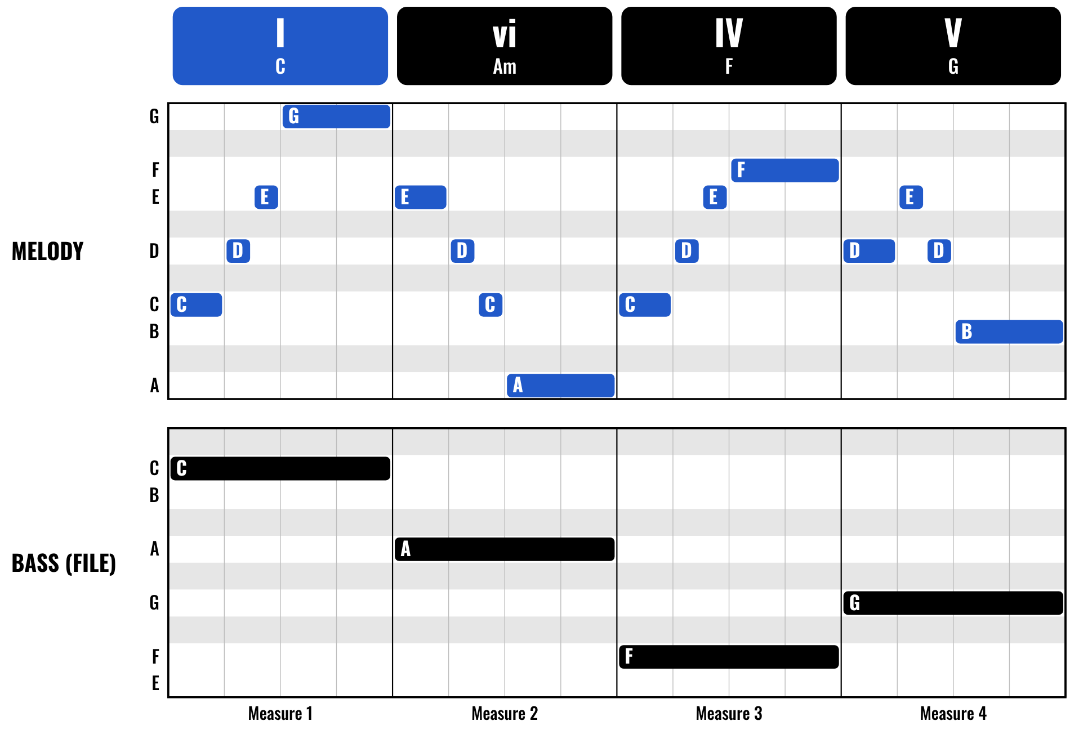
HUDSON BEAT
DAY 1
WORKED EXAMPLE: A MELODY OVER THE CHORDS
Blue: your melody, one note at a time
Black: the bassline already in the file
Each measure starts on a note of its chord
Same rhythm every measure: easy to remember
Bass & Melody Writing · Intro deck · © 2026 Brian Lotze · Hudson Beat
8
Notes:
One possible answer in a C major file, over the chords and bassline from Unit 3: one measure per chord, the same rhythm in every measure, starting on the root C, going up then down. Every note is a white key from the C major scale, and each measure starts on a note of its chord, so it sounds like it belongs. The A minor version is in the kit.

Slide 9
HUDSON BEAT
DAY 1
WATCH ME: RECORD, QUANTIZE, COPY
1
Open the chords-and-bass file; save it as Part 2
2
Shift the keyboard up an octave (OCT +)
3
New track, a lead or synth sound
4
Loop 2 measures, press R, play; then Q
5
Copy and paste it across the progression
Bass & Melody Writing · Intro deck · © 2026 Brian Lotze · Hudson Beat
9
Notes:
A two-minute demo, then students work. Unit 3 students open their own chords project and Save As Your Name — Building Blocks Part 2; others open your file. Show the OCT button before anyone records, or the melody lands in the bass register. Record, select the notes, press Q. Then copy the region across the progression.

Slide 10
HUDSON BEAT
DAY 1
HOW TO WRITE A MELODY
Keep it short: 2 or 4 measures
White keys only: no wrong notes
Give it shape: up, then down
Start or end on the root
Simple and repetitive wins
Bass & Melody Writing · Intro deck · © 2026 Brian Lotze · Hudson Beat
10
Notes:
The five rules from my project sheet, on screen while students write. If a student cannot start: set a 2-measure loop and just play around on the white keys; record anything. If a melody feels aimless: pick one note, play it in a rhythm you like, then move one note up or down.

Slide 11
HUDSON BEAT
DAY 2
MELODY: WHAT YOU TURN IN
Scale pages of the packet done
2 or 4 measures, in your scale
Starts or ends on the root
Played in and quantized, or clicked in
Own track, a different sound from the bass
MP3 + .zip, named Your Name — Building Blocks Part 2
Bass & Melody Writing · Intro deck · © 2026 Brian Lotze · Hudson Beat
11
Notes:
Day 2 opens with two students playing their melody alongside the file: does it sound like it belongs? Then the submission checklist. Show where students submit (your class page). Export: File › Bounce › Project or Section, MP3. Compress: in Finder, Control-click the .logicx project and choose Compress.

Slide 12
HUDSON BEAT
DAY 2
MELODY: HOW IT’S SCORED
MELODY WRITING
5 = In key, short, starts or ends on the root, clear contour.
/ 5
TECHNICAL SKILL
5 = Confident piano roll; well placed, well timed; both entry methods.
/ 5
DOCUMENTATION & PRESENTATION
5 = Named correctly, on time; explains the melody choices clearly.
/ 5
SCORED 2 TO 5 · TOTAL / 15
Bass & Melody Writing · Intro deck · © 2026 Brian Lotze · Hudson Beat
12
Notes:
Three categories, each scored 2 to 5, for a total out of 15. Read the 5 column aloud: in key, short, starts or ends on the root, with a clear contour that sounds like it belongs; the piano roll used confidently with both entry methods understood; on time, named correctly, and the melody choices explained clearly.

Slide 13
HUDSON BEAT
DAY 2
MIXING MOMENT: FREQUENCY SEPARATION
LOW
FREQUENCY ›
HIGH
BASS LIVES DOWN HERE
OVERLAP = MUD
MELODY LIVES UP HERE
Melody: Channel EQ, turn on the low cut (high-pass)
Bass: roll off the extreme highs (high cut)
Every instrument gets a frequency home
Bass & Melody Writing · Intro deck · © 2026 Brian Lotze · Hudson Beat
13
Notes:
The mixing concept for this unit, about seven minutes. Solo the bass, solo the melody, then play both: does it sound muddy? Instruments have frequency homes, and mixing means giving each one space to live. Students open Channel EQ on the melody and turn on the low cut (high-pass); on the bass they turn on the high cut. They do not need parametric EQ yet.

Slide 14
HUDSON BEAT
DAY 2
LISTEN: FOLLOW THE BASS
STAND BY ME
Ben E. King
Teacher: play the first minute from YouTube or Spotify.
Hum the bass, not the singer.
Where does the bass pattern start again?
What happens to it when the chords change?
Bass & Melody Writing · Intro deck · © 2026 Brian Lotze · Hudson Beat
14
Notes:
About three minutes, then the packet. The bass riff in Stand by Me plays the same pattern four times, starting each time on the root of the new chord: I, vi, IV, V in A major. Do not say that yet. Let students notice that the riff moves when the harmony moves, then send them to the bassline in their own file and the Part 4 analysis questions.

Slide 15
HUDSON BEAT
DAY 2
THE ONE RULE FOR BASSLINES
When the chord changes, the bass note changes to the root of the new chord.
Everything else is rhythm and decoration on top of this rule.
I · C
vi · Am
IV · F
V · G
bass plays C
bass plays A
bass plays F
bass plays G
Bass & Melody Writing · Intro deck · © 2026 Brian Lotze · Hudson Beat
15
Notes:
The reveal, from my Part 4 teacher notes. After students have answered the analysis questions, ask: what did you find? Let two or three students answer. Then write the rule on the board and say: every bassline you have ever heard follows this rule. Everything else is rhythm and decoration on top of this one idea.

Slide 16
HUDSON BEAT
DAY 3
PLAN YOUR PROGRESSION
CHORD 1
CHORD 2
CHORD 3
CHORD 4
Roman numeral
Roman numeral
Roman numeral
Roman numeral
I
V
vi
IV
Root note
Root note
Root note
Root note
C
G
A
F
Why did you choose this progression? What did you want it to feel like?
Example: “I start at home, the V pulls away, the vi turns tender, and the IV lifts it so the loop wants to start again.”
Bass & Melody Writing · Intro deck · © 2026 Brian Lotze · Hudson Beat
16
Notes:
Day 3. Students choose four chords from their Reference Card and write the Roman numeral and root note for each before opening Logic, then answer the why question. Push back before they build: tell me what you want this to feel like. Which Roman numerals would create that feeling? The example shown is one possible plan.

Slide 17
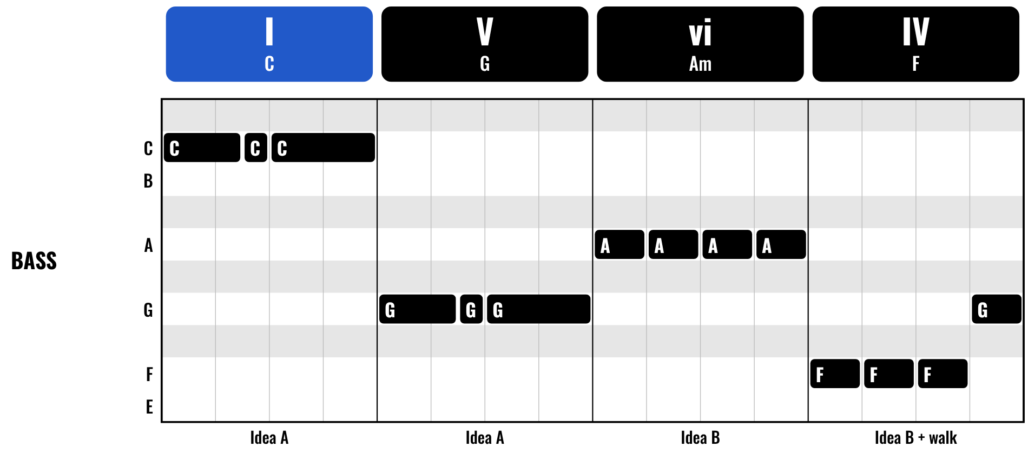
HUDSON BEAT
DAY 3
WORKED EXAMPLE: A BASSLINE
Root on beat 1 of every chord
Two rhythm ideas: A and B
One note at a time: no overlaps
The last note leans into the next chord
The plan: I – V – vi – IV in C major = C, G, Am, F
Bass & Melody Writing · Intro deck · © 2026 Brian Lotze · Hudson Beat
17
Notes:
One possible answer for the plan on the last slide, I–V–vi–IV in C major. Every measure starts on the chord's root. Measures 1 and 2 use one rhythm idea, measures 3 and 4 a second one, and the last note, G, leads back into the loop. One note at a time: no overlaps. It breathes: nothing busier than eighth notes.

Slide 18
HUDSON BEAT
DAY 3
WATCH ME: ROOTS FIRST, THEN RHYTHM
1
New file: build your four chords from the card
2
Bass track: one whole-note root per chord
3
Play the bass alone, then with the chords
4
Add rhythm: at least two ideas
5
Zoom in: no overlapping notes
Bass & Melody Writing · Intro deck · © 2026 Brian Lotze · Hudson Beat
18
Notes:
A short demo. Get the roots right first: place the root of each chord for the full duration of that chord before adding anything else. Then add rhythm. A bassline that is too busy is worse than one that is too simple. Any overlap in the bass track is an error.

Slide 19
HUDSON BEAT
DAY 3
BASSLINE: WHAT YOU TURN IN
Part 4 analysis in the packet done
Planning table: Roman numerals + roots
Monophonic: no overlapping notes
Root at every chord change
At least 2 rhythmic ideas + your why
MP3 + .zip, named Your Name — Building Blocks Part 4
Bass & Melody Writing · Intro deck · © 2026 Brian Lotze · Hudson Beat
19
Notes:
The Part 4 submission checklist, condensed. The written explanation of why students chose their progression is on the project sheet under the planning table. Students export and submit before the presentation day, the same way as the melody.

Slide 20
HUDSON BEAT
DAY 3
BASSLINE: HOW IT’S SCORED
BASSLINE CONSTRUCTION
5 = Monophonic, follows every chord change, clear rhythmic identity.
/ 5
HARMONIC INTENTION
5 = Clear emotional character, explained in Roman numeral language.
/ 5
DOCUMENTATION & PRESENTATION
5 = Named correctly, on time; presents chord choices with Roman numerals.
/ 5
SCORED 2 TO 5 · TOTAL / 15
Bass & Melody Writing · Intro deck · © 2026 Brian Lotze · Hudson Beat
20
Notes:
Three categories, each scored 2 to 5, for a total out of 15. Read the 5 column aloud: monophonic, following every chord change with a clear rhythmic identity; a progression with a clear emotional character explained in Roman numeral language; on time, named correctly, and chord choices presented with Roman numerals.

Slide 21
HUDSON BEAT
DAY 4
PRESENTATION DAY
Play your melody, then your bassline
What key? What Roman numerals?
What did you want it to feel like?
Respond to at least 2 classmates
Bass & Melody Writing · Intro deck · © 2026 Brian Lotze · Hudson Beat
21
Notes:
Day 4. Each student plays their melody, then their bassline over their chords, and answers the question that matters: why did you choose this progression, what did you want it to feel like? A student who answers in Roman numeral language has internalized the unit; one who says it sounded good has not yet.

Slide 22
HUDSON BEAT
DAY 4
ONE LAST THING…
You wrote a melody.
You built chords.
You wrote a bassline.
The foundation of every song.
Bass & Melody Writing · Intro deck · © 2026 Brian Lotze · Hudson Beat
22
Notes:
Close with the full picture from my teacher notes: in this unit you wrote a melody, built chords, and wrote a bassline. Those three things together are the foundation of every song ever written. Next unit, Song Form, arranges them into sections.

