Slide 1
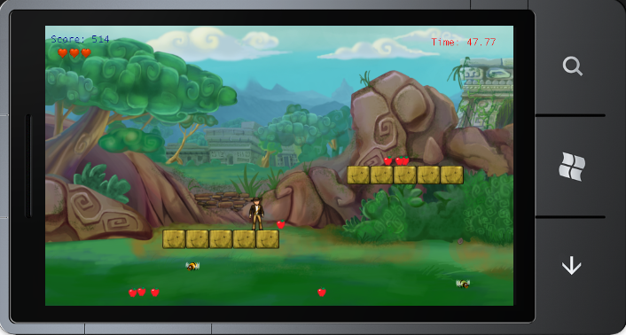
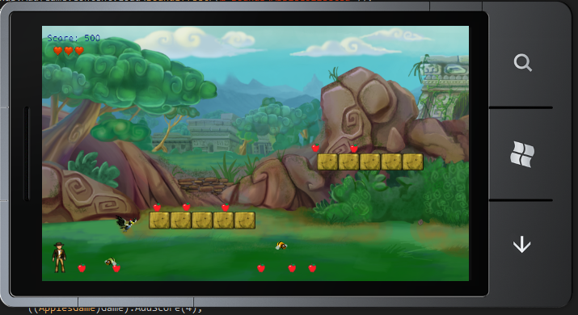
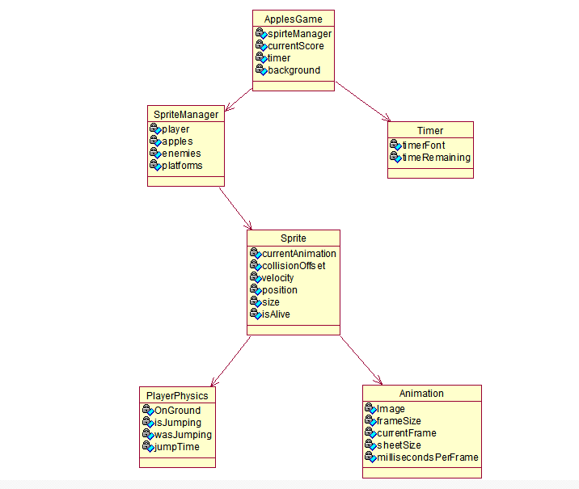
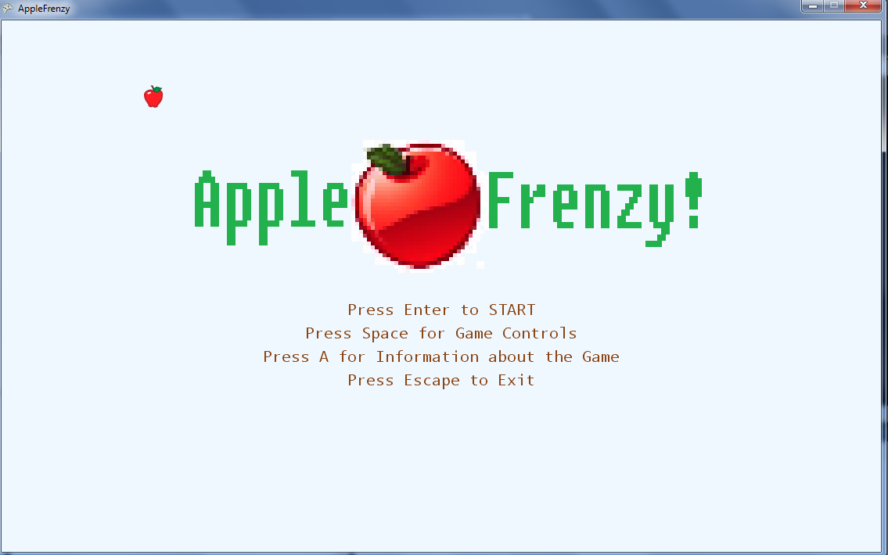
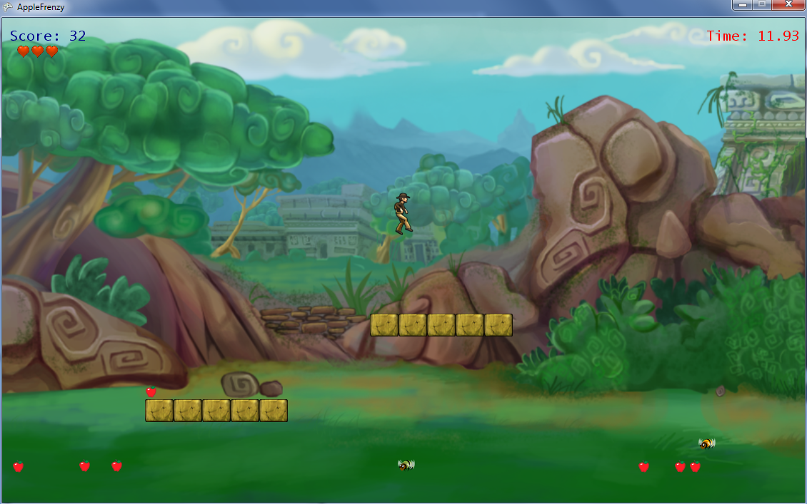
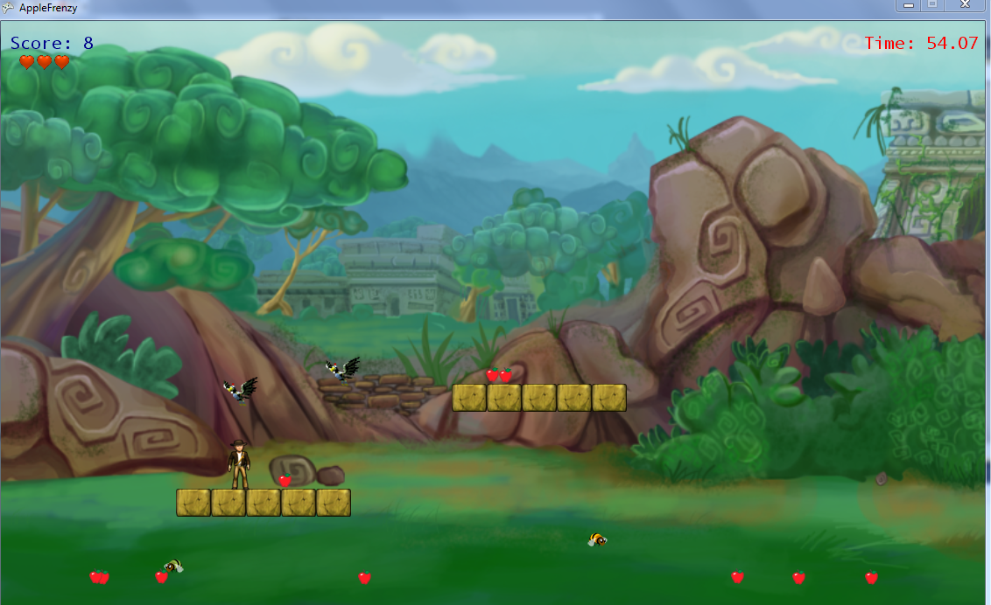
Apples Rain – A Windows Phone 7 Game
Ernesto Pavon, UNLV
Source Code @ http://github.com/Ernesto01/applesgame [PC Version]
ABSTRACT
METHODS
RESULT
CONCLUSIONS
This is a software project for the CS 441 class of UNLV. It consists of a 2-dimensional game for the PC, XBOX360 and Windows Phone.
Thanks to the XNA Framework provided by Microsoft, we can develop 2D and 3D interactive graphics for the Windows Phone, Xbox 360 systems and PCs. This project makes use of the XNA Framework to bring together a simple platforming game.
The goal of the game is to catch as many falling apples as possible in the limited amount of time without getting hit by bees and birds. Several huds in the game display the current status of the character’s health, score and remaining time.
The game can end by either of two reasons, either the timer runs out or the character’s number of lives reaches zero. In either case, the score will be displayed at the end screen and the player will have a chance to restart the game for another try.
This game can be played in the PC using the keyboard or an xbox 360 controller. It can also be played on the Windows Phone 7 using touch screen input.
In the PC, the player can move the character with the arrow keys. Left and right arrow move the character to the left and right respectively. The Up arrow key allows the player to jump.
The Windows Phone version functions similarly but with touch input. Touching to the left or right of the player moves the player either left or right. Touching any space in the phone screen above the character will make the character jump.
This game was programmed in C# using the XNA framework. As such , I made full use of C# object-oriented constructs such as abstract classes, virtual methods, inheritance and polymorphism.
The game starts by calling ApplesGame.cs file, which then spawn a Drawable Game Component which in XNA means that this object will be called every few milliseconds for updates and drawing. SpriteManager is in charge of handling sprites. SpriteManager will spawn several sprites, call their Update method and do game logic for interaction between certain sprites. For example, when a player runs into an enemy, SpriteManager knows to play a Sound file and update the sprites appropriately. ApplesGame also contains Timer which is in charge of keeping track of the time limit.
Sprite represents a visual entity in the screen. Sprite has an animation which consists of one or more frames through which the game cycles when the animation is to be played. Sprite also keeps track of its velocity, position, size and if applicable it keeps track of whether it’s alive or not. PlayerPhysics takes a character and applies physics logic to the sprite for each update call.
The project served as a good introduction to the world of XNA and C#. Having used C++/OpenGL for previous graphics projects, XNA had some advantages when building this type of project.
With XNA porting over code from any Windows based device and the xbox 360 console is very simple and can be done in very little time. XNA fully supports the Object-Oriented Paradigm which helps delegate tasks when building games and makes it easier to organize the project. Then we have the fact that C# is a managed language with its own garbage collector which means it’s easier to code for and the programmers need only worry about the game design and logic .
Game Running on Windows Phone:
The Start Screen:
While the project managed to achieve what it was set out to do, there are a few areas where I could improve it.
The game currently handles sprites collision by checking it’s position in Window coordinates. This system works well enough but it’s not very extensible since creating a game world bigger than the screen would require changes. Physics may also need to be re-adjusted for different level designs with different layout.
A way to fix this is to add a Camera and use a Tile engine where the screen is divided into a grid and sprites occupy a space in this grid. By so doing, we would be able to move the camera around the world and show it in the viewport. Using a tile base engine means we can add content without worrying about code changes for the physics system or any other part of the code.
REFERENCES
Objectives
http://create.msdn.com/en-US/
http://create.msdn.com/en-US/education/catalog/sample/platformer
http://create.msdn.com/en-US/education/catalog/lab/honeycomb_rush
http://www.wrox.com/WileyCDA/WroxTitle/productCd-0470126779,descCd-DOWNLOAD.html
The main objective was to become familiar with the software development practices for mobile devices.
The advent of mobile devices brings interesting new opportunities as well as new challenges. When developing for mobile devices we have to take into account the new interaction methods between the users and the devices. We have to make our applications feel natural for a device without buttons or keys.
We also have to take into account screen size. Our User Interface must be more direct in its presentation and waste no space. Another consideration is performance. We have to be mindful of memory and processor usage when developing for mobile devices, more so than when doing PC development.
ACKNOWLEDGMENTS
Title and End Screen were made by Corbin Benally.
Game was coded by Ernesto Pavon.
Sounds were use from: http://www.grsites.com/archive/sounds/
Graphics and Sounds were used from:
http://create.msdn.com/en-US/
Under Microsoft Permissive License.

