Slide 1
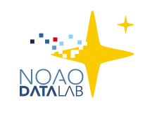
The NOAO Data Lab
Notes:
Add your title, name, and position
Add as much imagery as you want for “color”

Slide 2
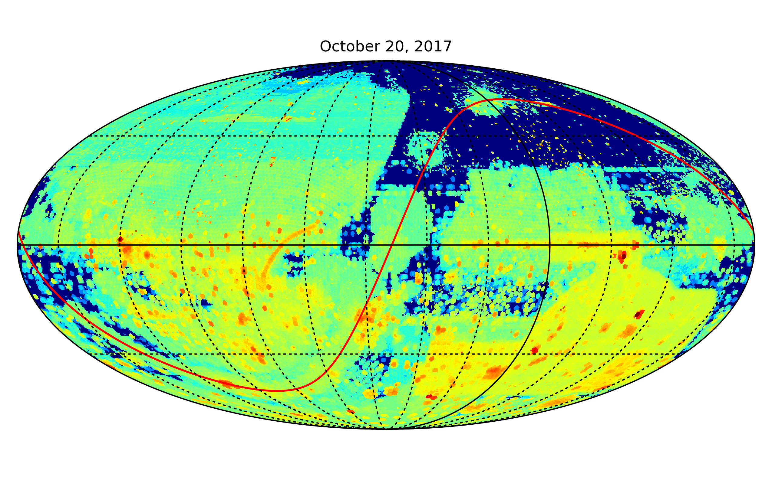
DECam/Mosaic Image Data at NOAO
Notes:
Use this for a giant graphic

Slide 3
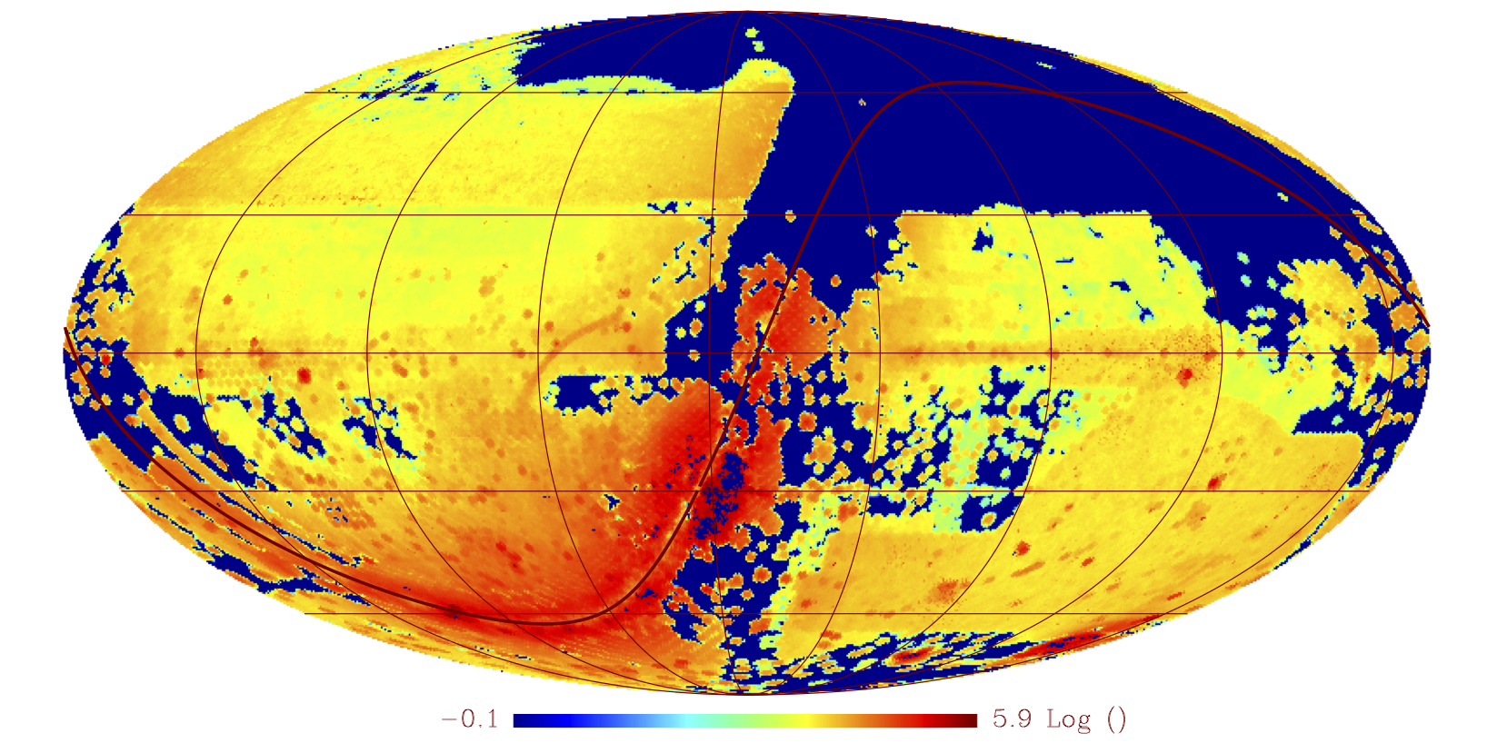
An NOAO All Sky Catalog
~2 billion objects, 20 billion measurements; basic aperture photometry (catalog cleaning in progress)
Availability planned for Fall 2017

Slide 4

NOAO Data Lab
Motivation:
Existing NOAO Science Archive entirely image/file-centric
No capability to serve or query catalog/spectral data
Goal:
Efficient exploration and analysis of large datasets with an emphasis on NOAO wide-field 4-m telescopes
Approach:
High-value catalogs from NOAO and external sources (e.g. SDSS, GAIA) and the NOAO-based images linked to catalog objects
Data discovery (web-based browsing)
Developing intuition through interaction with selected catalog and image set of known objects (Jupyter notebooks)
Automation of analysis to aid discovery of unknown objects (APIs)
NOAO UC, Tucson, Jun 16
4

Slide 5
NOAO Data Lab
A Few Design Principles:
Allow multiple entry points into the system
Web-based, notebooks, cmdline tools, APIs for scripting
Be language agnostic
Python Flask micro-services architecture, RESTful interfaces
Enable user-developed tools, don’t just supply them
Support legacy code in containers
Use established standards, but hide complexity
Astronomer-friendly interfaces
Know your limits
Provide access to external data/services vs. local ingest

Slide 6
Data Lab in a Nutshell
Large Catalogs – Data Lab will serve TB-scale tables and provide personal database storage (~25TB)
Pixel Data – Data Lab will connect users to images and spectra in NOAO Science Archive (~500TB)
Virtual Storage – ~1 TB per user to minimize data transfer
Visualization – Data Lab will enable data exploration
Compute Processing* – Data Lab will allow workflows to run close to the data
Additional features* – Access to published datasets and external data services, data publication, exportable workflows, distributable software
*Some limitations in current release

Slide 7
Summary of Functionality
Function | Method
Sky exploration | Image discovery tool Catalog overlay tool Catalog visualization tool (prototype)
Authentication | Web interface datalab command/python API
Catalog query | Web interface datalab command/python API TOPCAT + other TAP-aware clients
Image query | Simple Image Access (SIA) service
Query result storage | myDB user database Virtual storage (VOSpace+caps/views)
File transfer | datalab command and Virtual storage
Analysis | Jupyter notebook server Python API
Compute next to data (*coming soon) | Job Manager + Docker

Slide 8
Example Notebook
Star/galaxy/QSO separation
User logs in to Data Lab
1
3
Visualizes color-color diagrams by morphology type
Launches Jupyter Notebook
Queries database for DECaLS Tractor and AllWISE photometry
2

Slide 9
Example Notebook
Detecting a faint dwarf galaxy
User logs in to Data Lab
1
Queries database for blue stellar objects in SMASH DR1 Field
2
Launches Jupyter Notebook
Applies filter to spatial distribution
3
Runs automatic peak detection
4
9

Slide 10
Roles for the Data Lab in the LSST Era
Doing LSST pathfinder science today, e.g.
Exploring ways to perform star/galaxy separation, including application of machine learning techniques
Automated searches for dwarf galaxies and streams in all-sky data
Identifying variable sources in all-sky photometry, retrieving time series of variable stars, QSOs, etc.
Cross-matching large catalogs, e.g. LSST Stack-reduced crowded field vs. DAOPHOT/DoPHOT as part of Q.A.
Uploading table of moving objects, retrieving image cutouts from Archive, stacking and analyzing

Slide 11
Roles for the Data Lab in the LSST Era
As a complementary tool for LSST science
Data Lab will have some unique datasets for comparison with LSST, and will allow users to publish additional datasets
Scientists will be able to run legacy code close to Data Lab data, and upload personal data
We have some different technology on the backend, giving diversity of solutions, can be tuned to provide advantages for specific problems
Our goal of providing a user friendly platform for large data analysis is similar to LSST DAC; but aim to provide support for greater diversity of datasets, perhaps more focused and more customized in certain areas

Slide 12
Roles for the Data Lab in the LSST Era
As a testbed for LSST analysis
For complex analysis of LSST data (beyond just making queries of the database), the DAC will provide 10% of processing resources to general users, likely to be in high demand
Data Lab needs to be able to drop in code developed in DL to the LSST DAC
Data Lab should have running version of LSST Stack and access to LSST APIs
Data Lab could host a skinny version of LSST main catalog table (subset of columns, but all rows); plan to test feasibility of doing this with PanSTARRS and/or GAIA DR2

