Slide 1
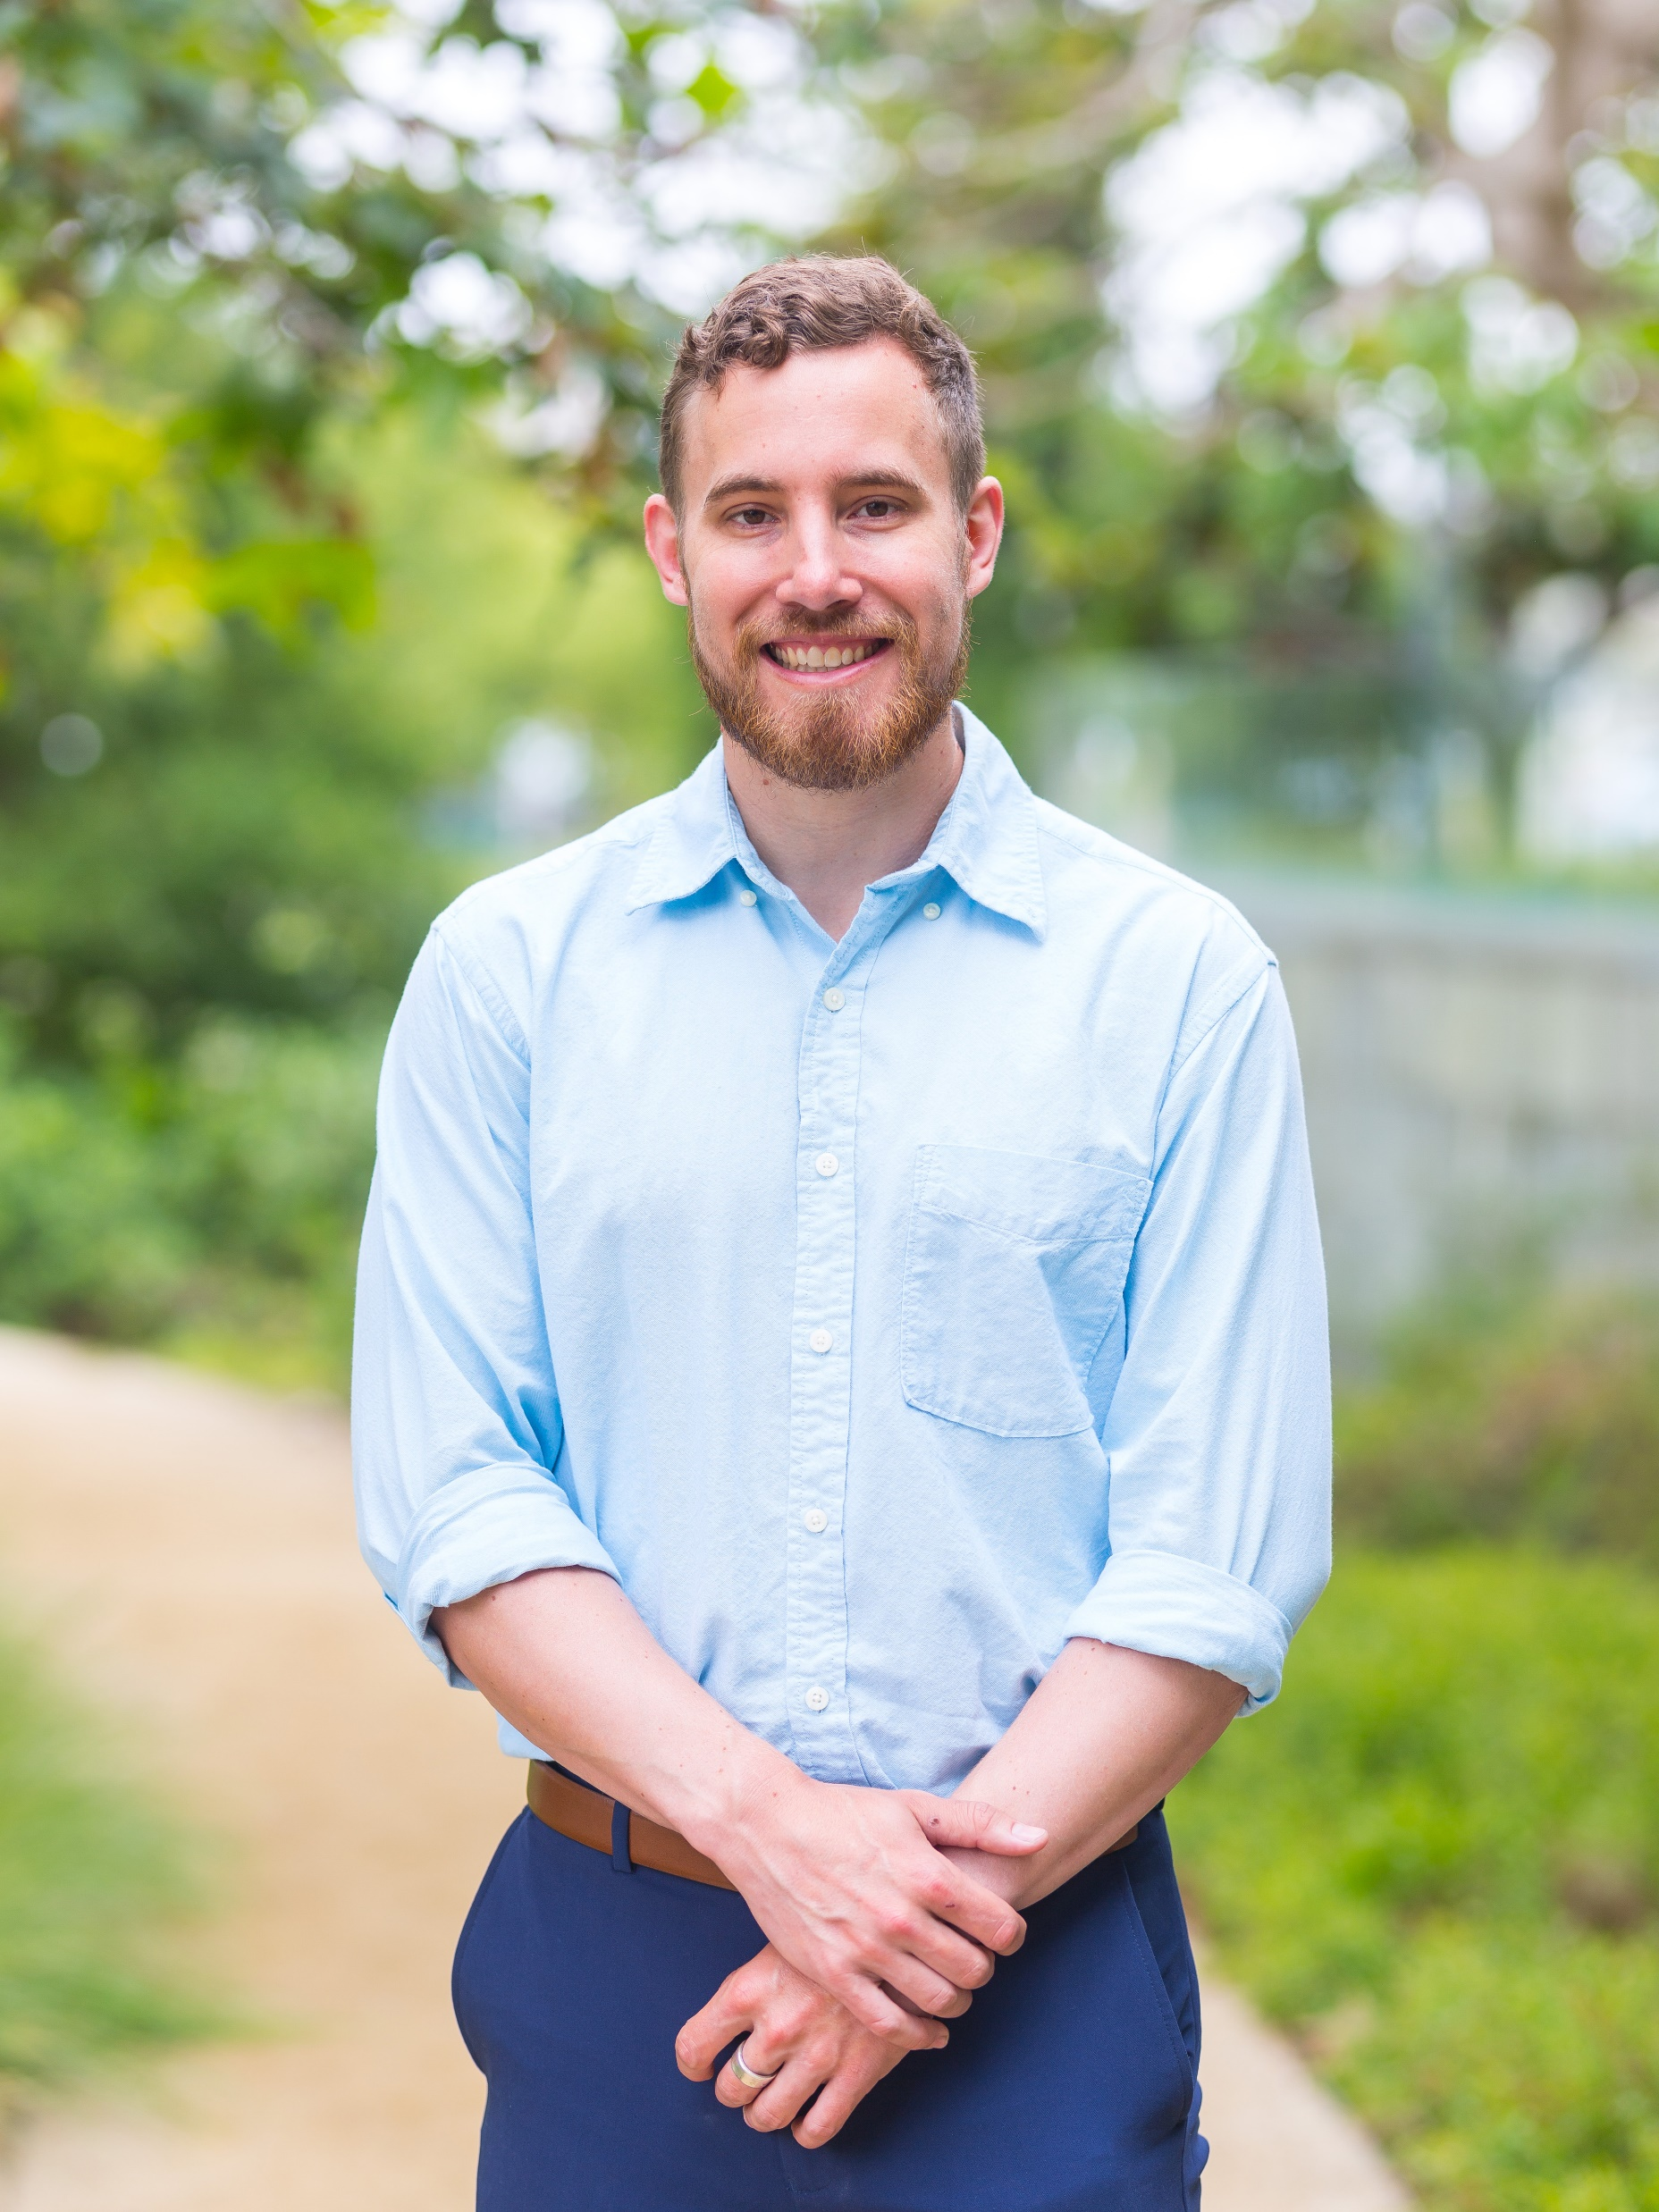


AI Basics: Making Tensorflow Work with Medicine
Brian Mark Anderson, PhD
October 20th, 2022
University of North Carolina Chapel Hill

Slide 2

How do to this workshop?
Don’t want to just talk
Want you to leave with something useful

Slide 3
Main takeaways
1) How do I convert DICOM into more wieldy format (Nifti)
Images and RT Structures
2) How do I create Tensorflow records?
From Nifti, toxicity scoring, anything
3) How do I make a generator from these records
For model training you need an example generator
4) How do I make a model!
That’s the whole goal isn’t it?

Slide 4
GitHub
(Almost) everything I make is publicly available.
This workshop is here: https://github.com/BrianMAnderson/2025.02.17_WIMP_Workshop
Want to run this with your own data? Great!
https://youtu.be/BfCbh96QfF4

