Slide 1
AI Basics: Making Tensorflow Work with Medicine
Brian Mark Anderson, PhD
Winter Institute of Medical Physics (WIMP)
February 24th, 2025
University of North Carolina Chapel Hill

Slide 2

How do to this workshop?
Don’t want to just talk
Want you to leave with something useful

Slide 3
Main takeaways
1) How do I convert DICOM into more wieldy format (Nifti)
Images and RT Structures
2) How do I create Tensorflow records?
From Nifti, toxicity scoring, anything
3) How do I make a generator from these records
For model training you need an example generator
4) How do I make a model!
That’s the whole goal isn’t it?

Slide 4
GitHub
(Almost) everything I make is publicly available.
This workshop is here: https://github.com/BrianMAnderson/2025.02.17_WIMP_Workshop
Want to run this with your own data? Great!
https://youtu.be/BfCbh96QfF4

Slide 5
Step 1: DICOM to Nifti

Slide 6
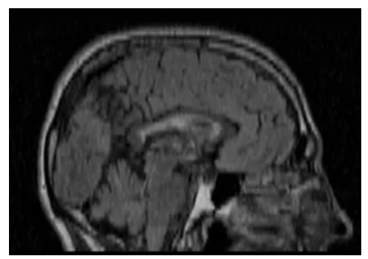


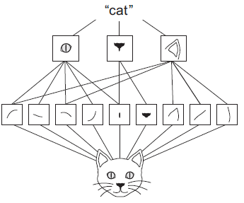
Why do we need to convert DICOM?
Slice thickness
Pixel Spacing
3mm slice thickness
NumPy array (60, 512, 512)
1mm slice thickness
NumPy array (60, 512, 512)
5x5 kernel
Very important in 3D UNets
Fur
Ears
Feet

Slide 7


Be wary of NumPy
That’s a bit aggressive…
Slice thickness
Pixel Spacing
Instead? Nifti files!
Makes resampling easy
Makes registration easy
Easy to convert back to NumPy when ready
3mm slice thickness
NumPy array (60, 512, 512)
1mm slice thickness
NumPy array (60, 512, 512)
Lets get some data!
Notes:
4 minutes

Slide 8


Organizing data
We have tons of data! All perfectly curated and ready for use!
Images
Plan
Registrations
RT Structures
Dose
Images
Plan
RT Structures
Dose
Registrations
Resident volumes
Auto-contour
Clinical contours

Slide 9
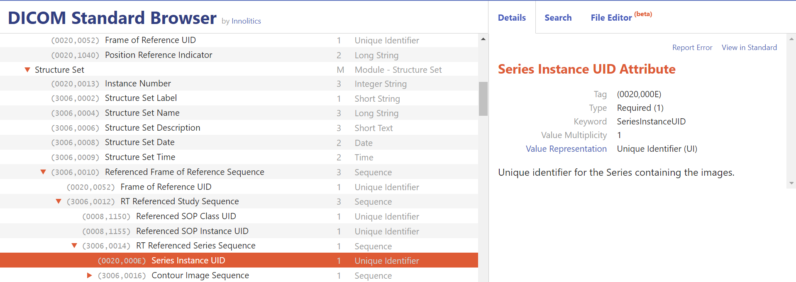
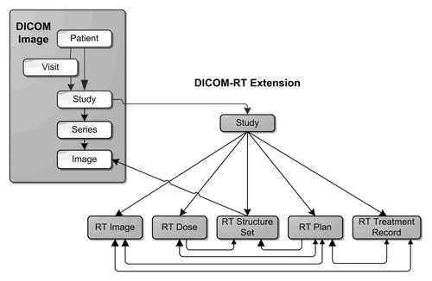

DICOM is wonderful…
*DICOM-RT and Its Utilization in Radiation Therapy
Maria Y. Law, Brent Liu
RSNA: RadioGraphics
https://pubs.rsna.org/doi/full/10.1148/rg.293075172
Just make it work…

Slide 10
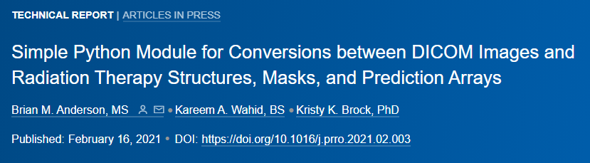
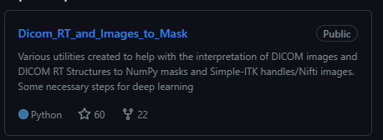

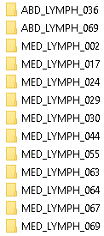
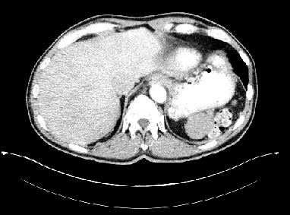
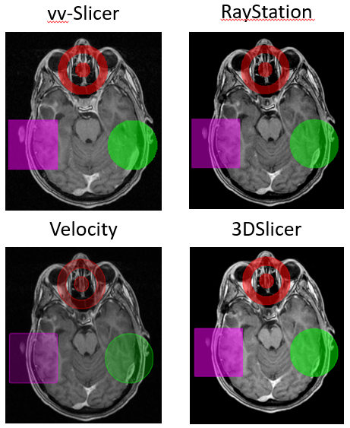

Tools to help
RT Structures
Masks
RT Structures
Characterize

Slide 11
Step 2: Nifti (and anything else) to tfrecords

