Slide 1
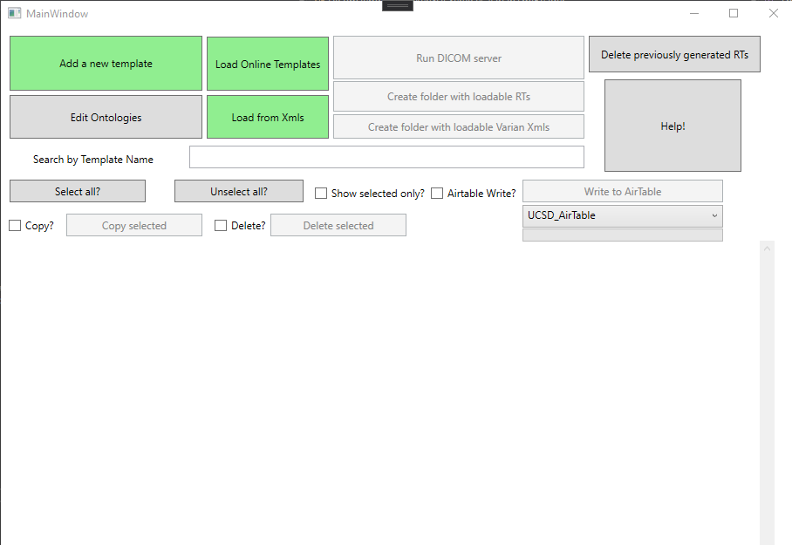
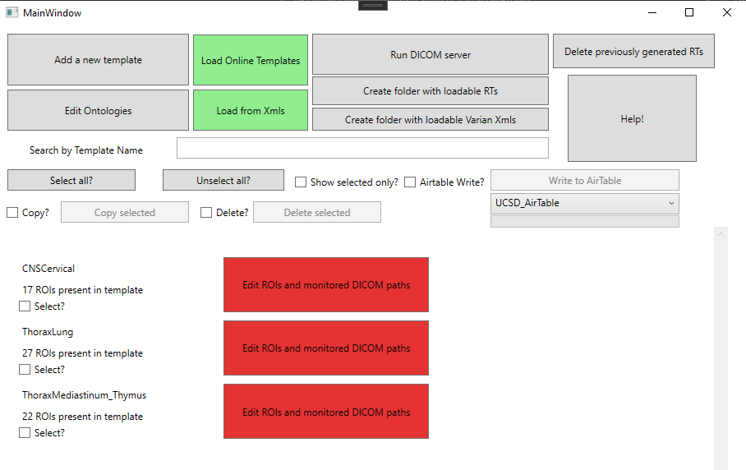
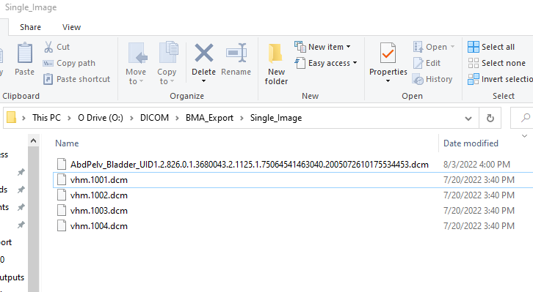
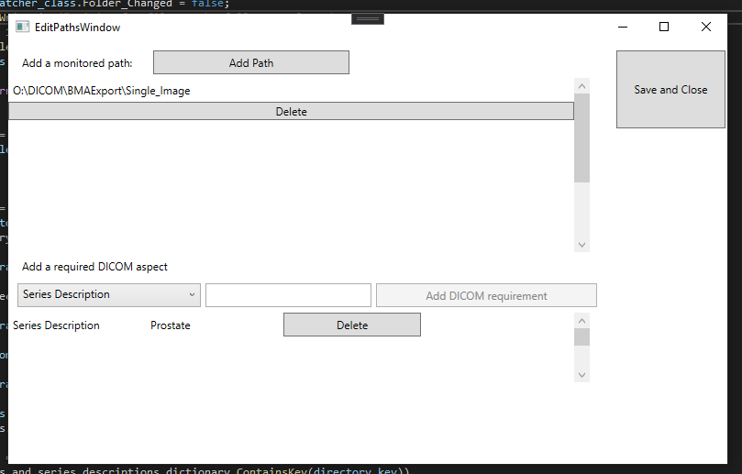
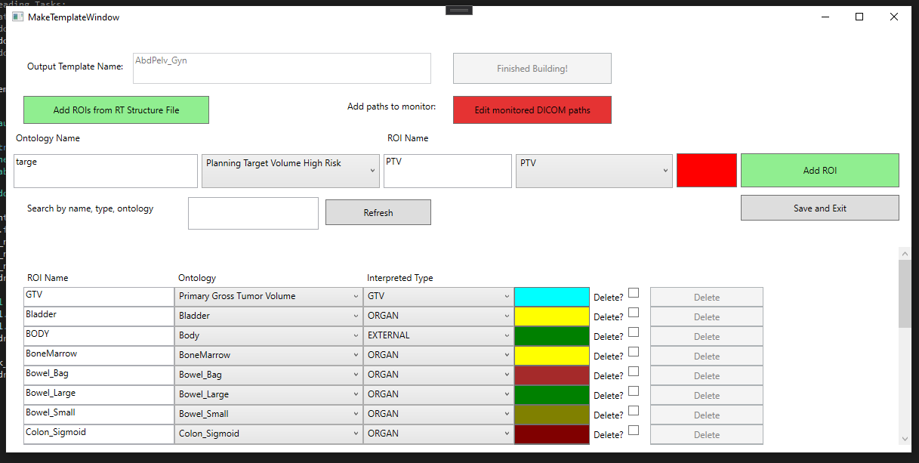
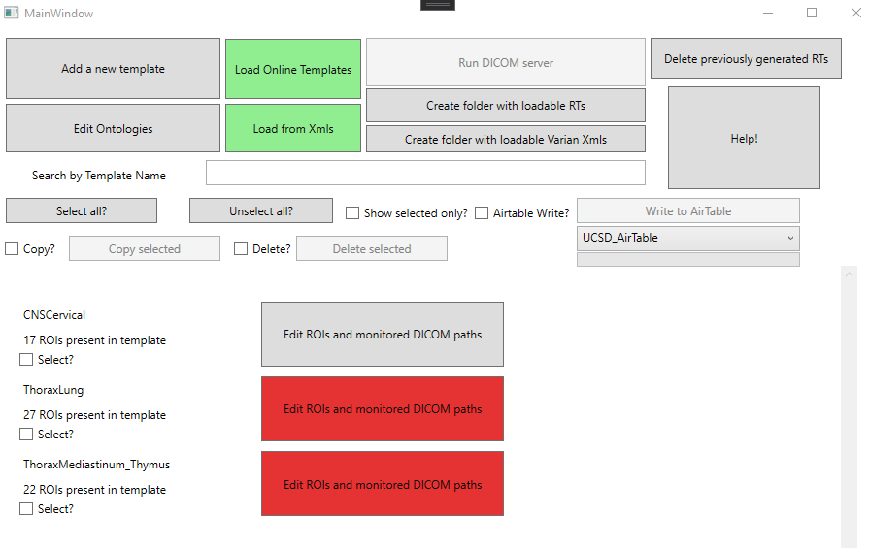
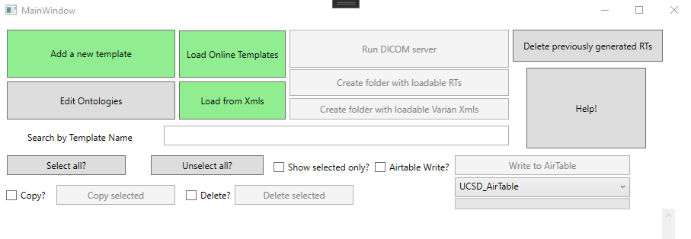
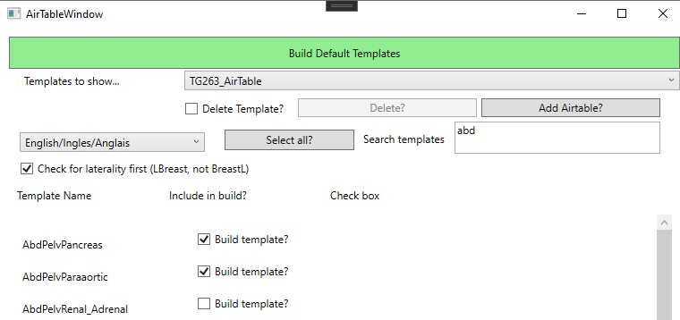
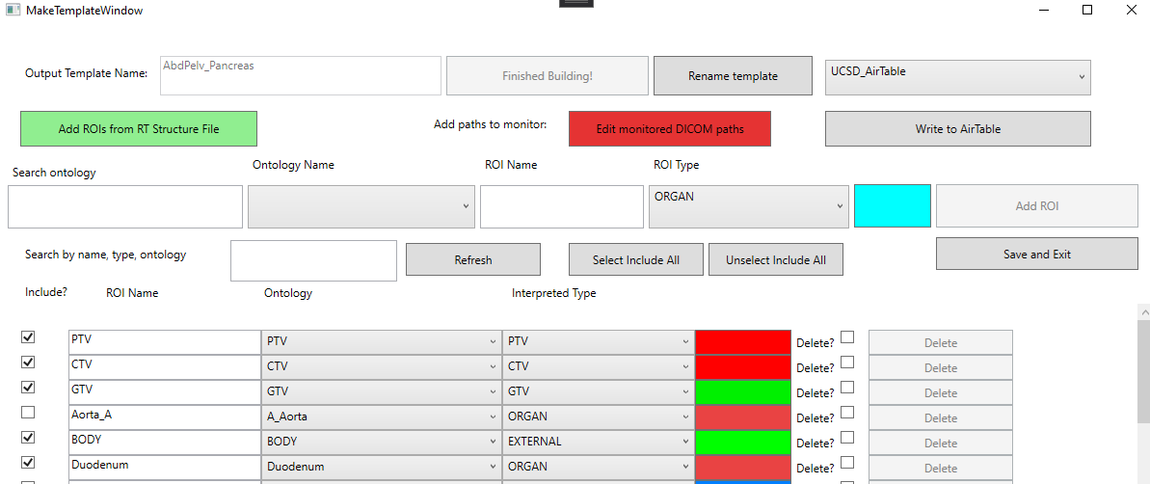
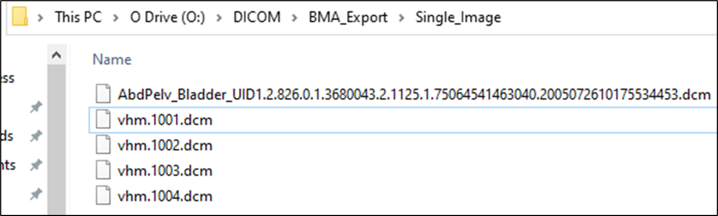
Start the program
Step 1
Add templates
Add ROIs, change colors and types
Step 2
Edit DICOM paths
Run DICOM server
Step 3
Create RT File
Example of the creation of an RT Structure file from the AbdPelv_Bladder template.
Example of the program after providing a path for the AbdPelvBladder template. Note that the ‘Run DICOM server’ button has been depressed.

Slide 2




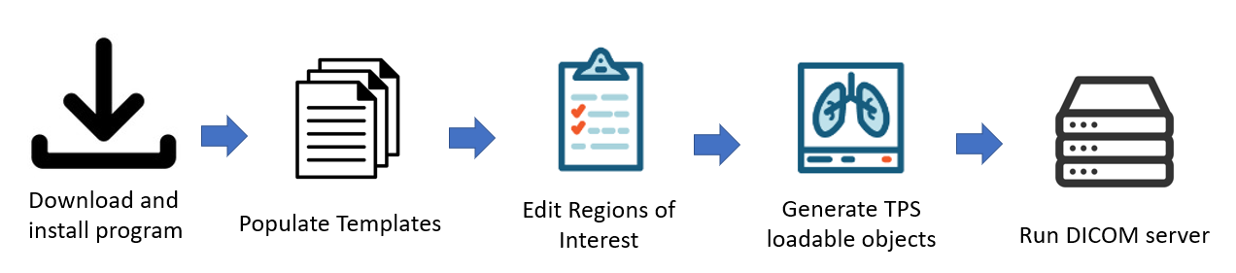


TG-263 Templates
Generate TPS
Loadable templates
Generate Patient-Specific
RT Structures

Slide 3
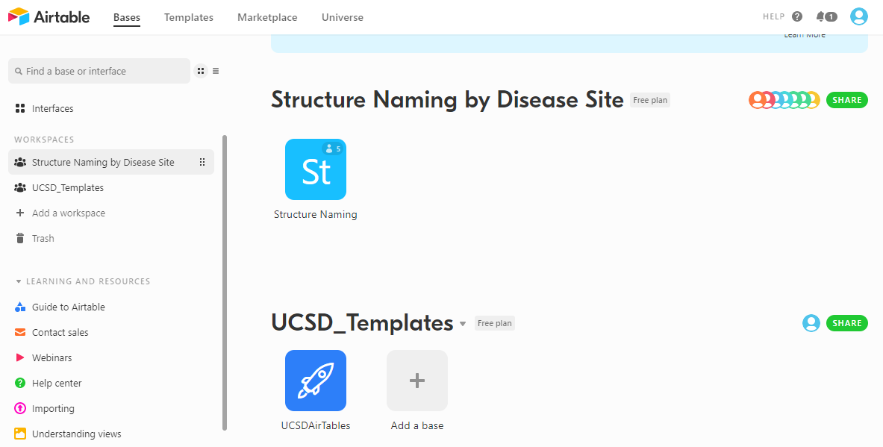
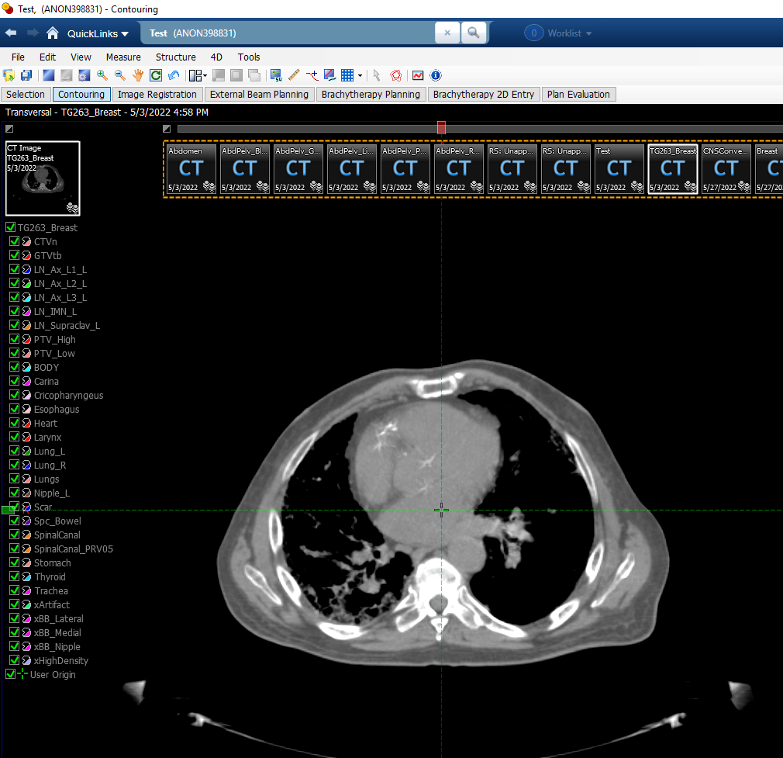
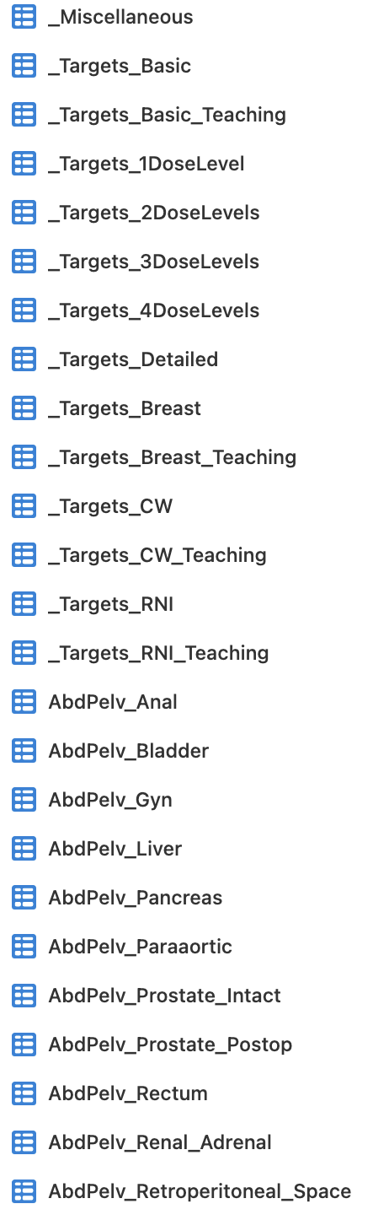
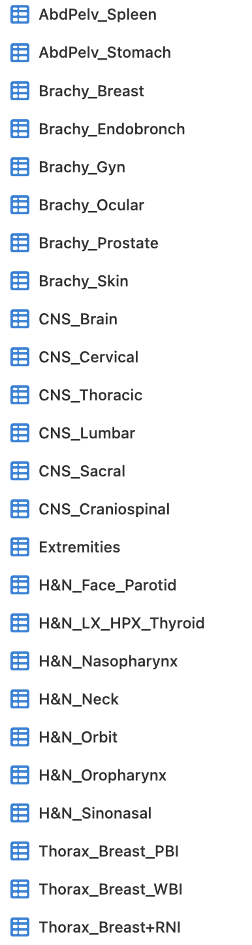
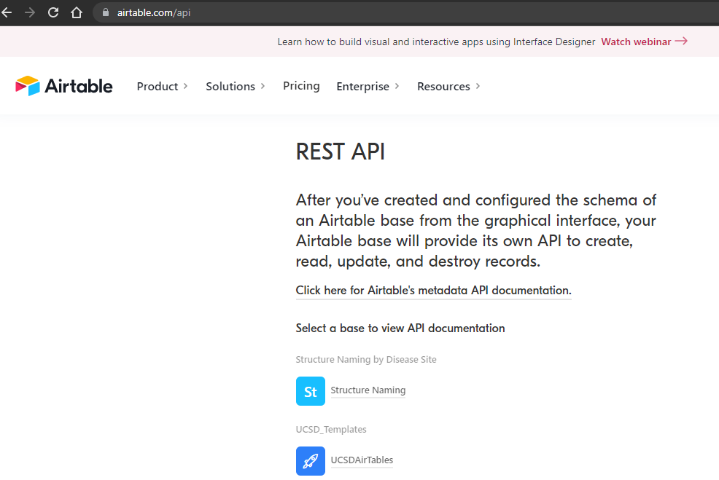
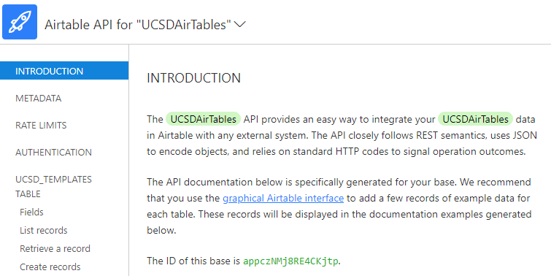
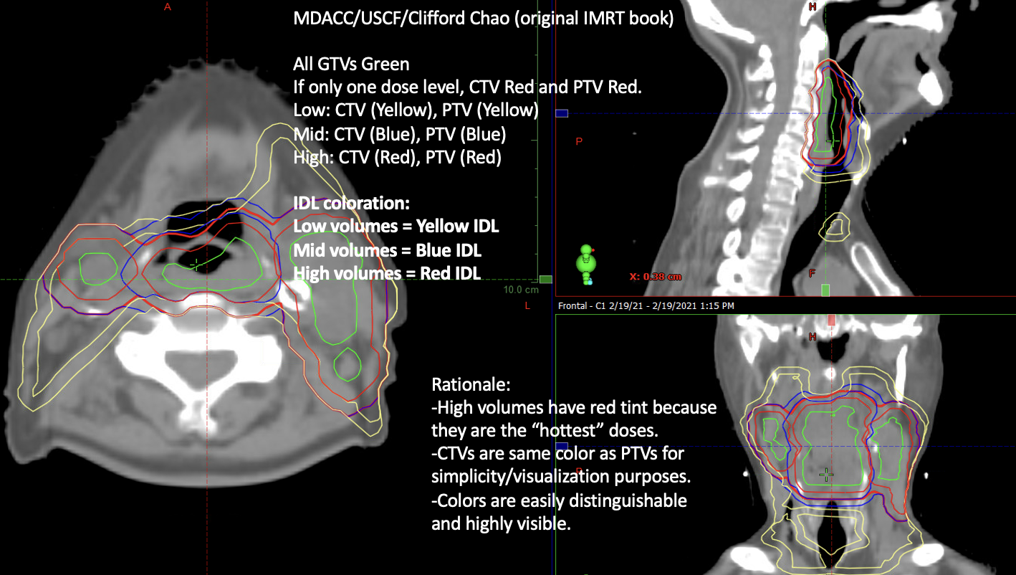
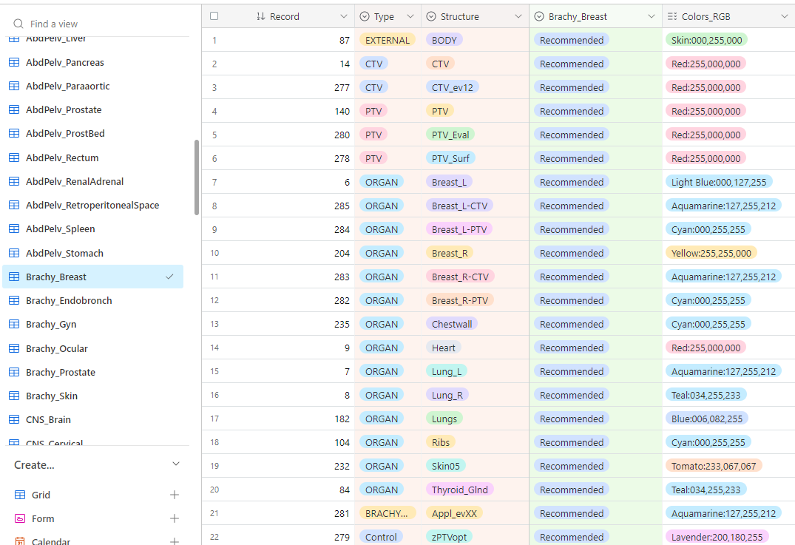
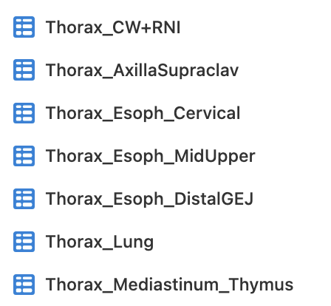
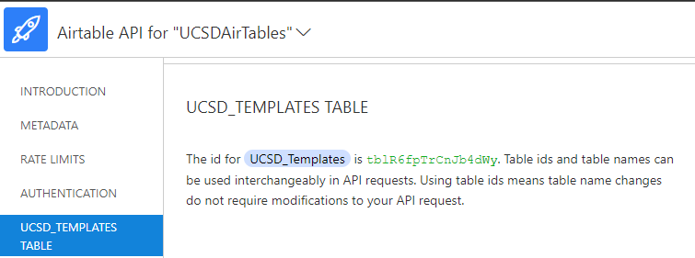
Evaluation of generated RT Structure ‘TG263_Breast’ after importation into anonymized patient
Structure Template Naming as of 09/20/2022

Slide 4
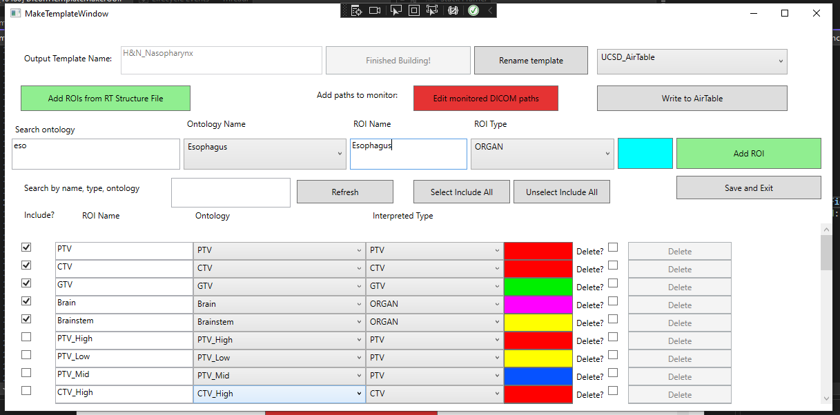
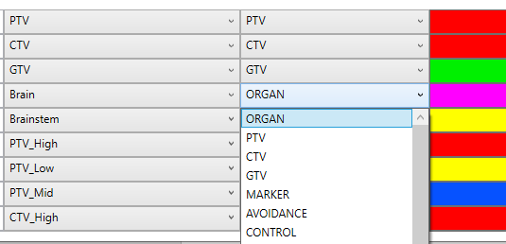
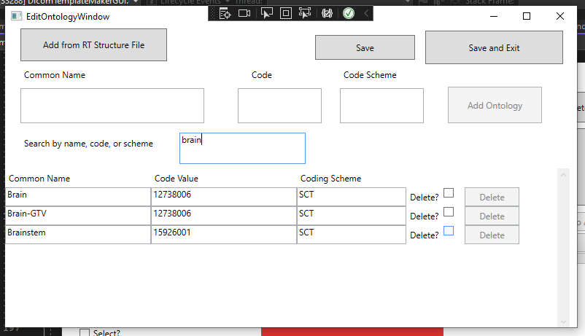

Slide 5
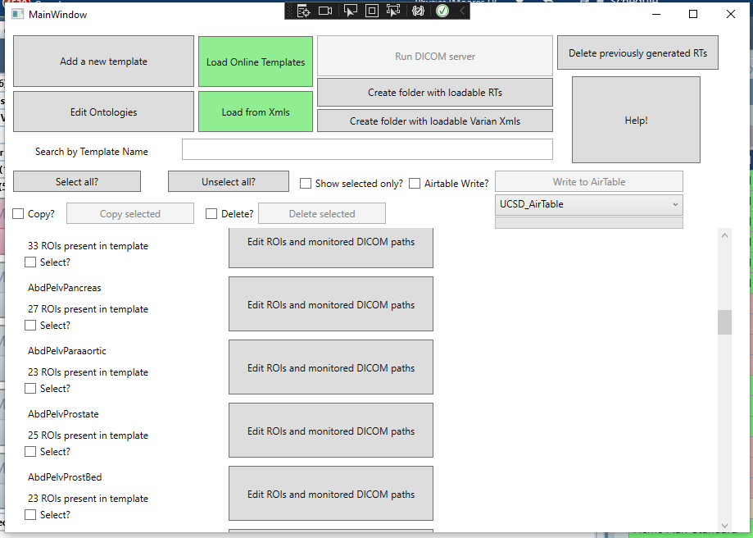
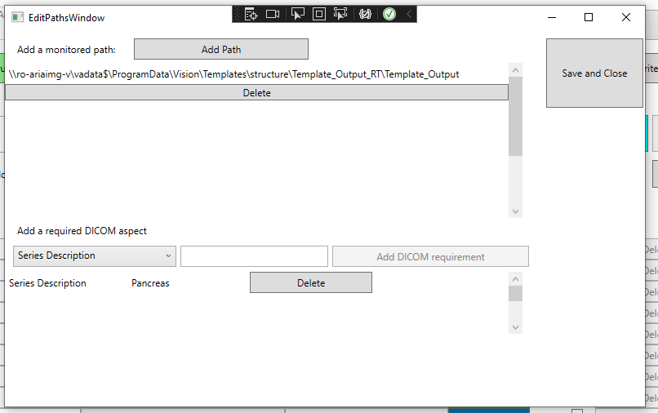
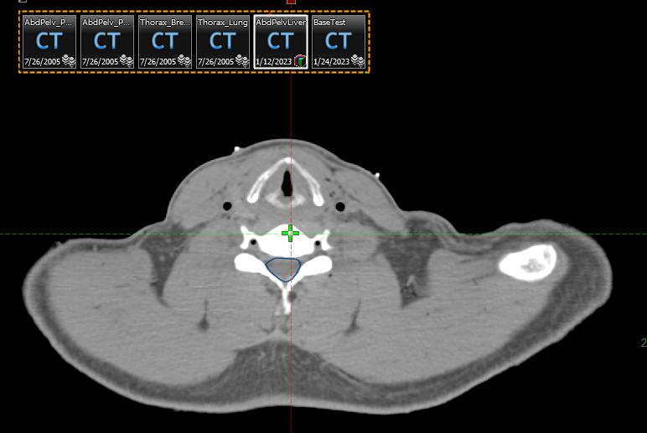
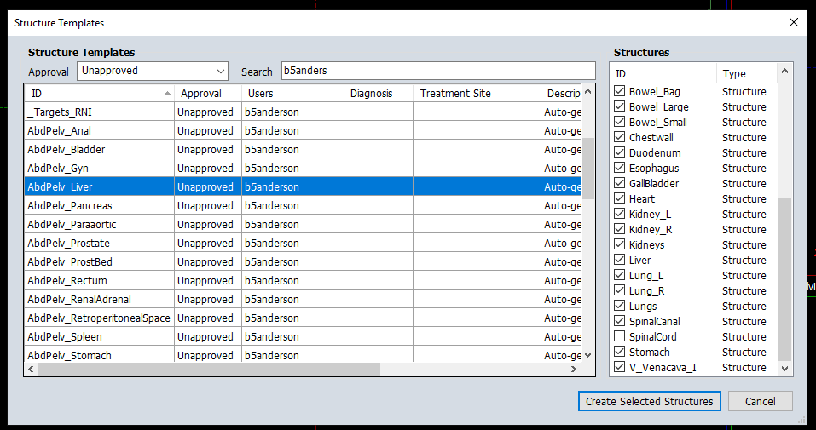
Populate Templates
Download TG-263 Templates
Downloaded templates are grouped based on their names. Each template is composed of ROIs relevant to that treated site.
A list of TG-263 compliant ROIs and templates are maintained and continually updated online
Installation of Program
Edit Regions of Interest
Program is installed from the publicly available website: https://github.com/brianmanderson/DicomTemplateMakerCSharp
Users can edit any ROI to match the preferences of their individual clinic. Including nomenclature/type/color/ontology
Run DICOM Server
Generate TPS Loadable Objects
Selecting ‘Run DICOM server’ will begin evaluating all templates and the paths listed in the previous step. Any DICOM files present will have a patient-specific RT structure generated.
Patient Specific RT Structure
RT Structures
Varian XML files
Users can create patient-specific RT Structures by defining locations where DICOM will be present and required Series/Study Descriptions
‘Create folder with loadable RTs’ will generate a folder with a loadable CT and a unique RT structure for each template.
‘Create folder with loadable Varian Xmls’ will generate a folder with a loadable .xml files. If this folder is the Varian XML folder, the templates will populate immediately!

Slide 6
Installation of Program
Edit Regions of Interest
Program is installed from the publicly available website: https://github.com/brianmanderson/DicomTemplateMakerCSharp
Users can edit any ROI to match the preferences of their individual clinic. Including nomenclature/type/color/ontology
Patient Specific RT Structure
Users can create patient-specific RT Structures by defining locations where DICOM will be present and required Series/Study Descriptions
Populate Templates
Run Server
Download TG-263 Templates
Downloaded templates are grouped based on their names. Each template is composed of ROIs relevant to that treated site.
Selecting ‘Run DICOM server’ will begin evaluating all templates and the paths listed in the previous step. Any DICOM files present will have a patient-specific RT structure generated.
A list of TG-263 compliant ROIs and templates are maintained and continually updated online
Generate TPS Loadable Objects
RT Structures
Varian XML files
‘Create folder with loadable RTs’ will generate a folder with a loadable CT and a unique RT structure for each template.
‘Create folder with loadable Varian Xmls’ will generate a folder with a loadable .xml files. If this folder is the Varian XML folder, the templates will populate immediately!

