Slide 1
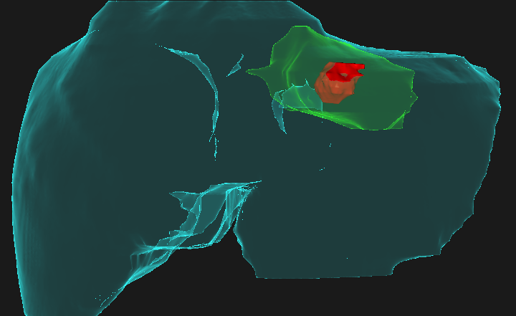
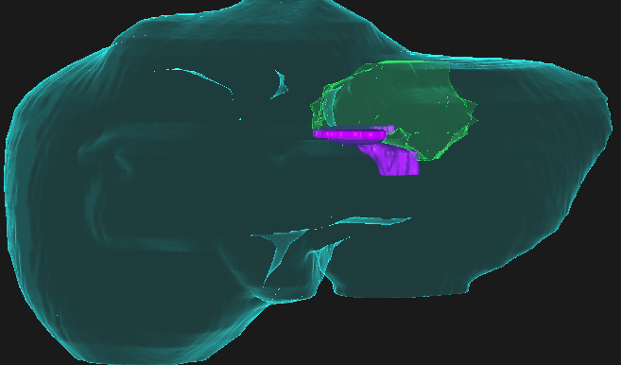
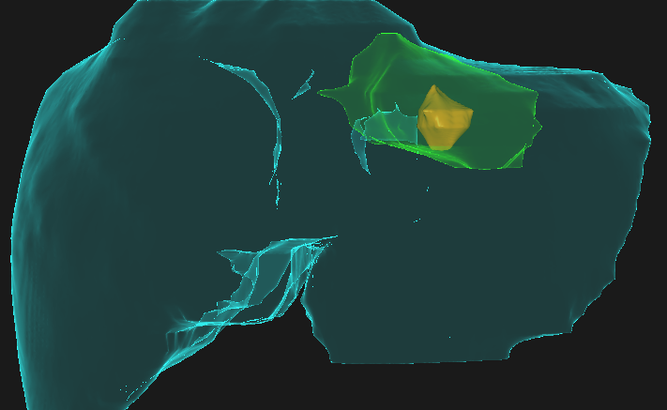
A
C
Ablation Zone
Progression
Rigid GTV
B
Deformed GTV
Post-Ablation CT
Progression CT
Rigid registration of the gross tumor volume (GTV, red) onto the post-ablation CT maps part of the tumor outside of the ablation zone (green), and gives a false sense of confidence in the delivered margin caudally
Deformable registration of the GTV (gold) onto the post-ablation CT indicates potentially insufficient ablation margin in caudal aspect
Development of disease progression (pink) in the caudal aspect of the recovered ablation zone (green) corresponds with insufficient margin in (B).

Slide 2
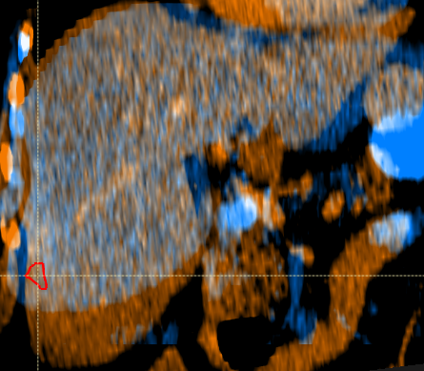
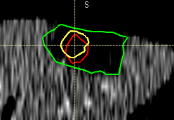
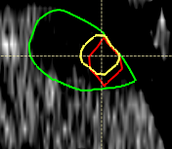
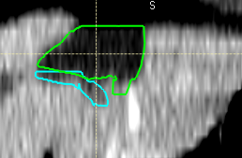
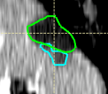
A
B
C
Ablation
Deformed GTV
Rigid GTV
LTP

Slide 3
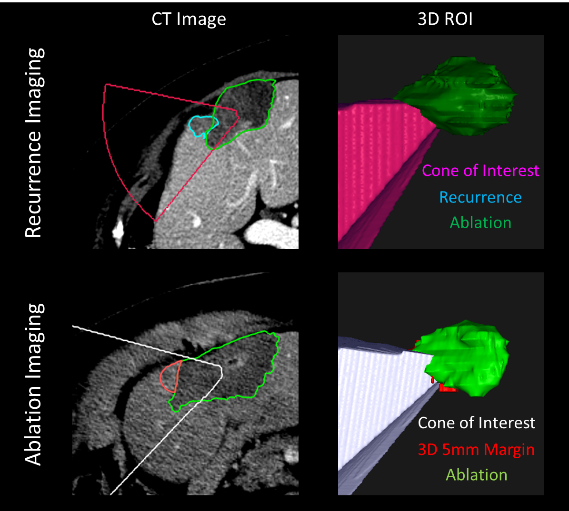


Slide 4
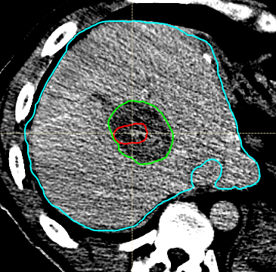
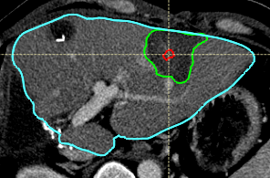

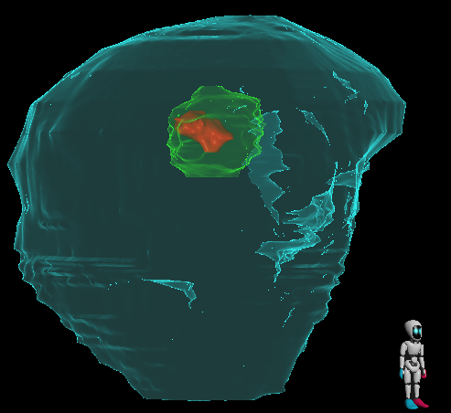
A
B

