Slide 1


Getting Started With GitHub/GitLab
Brian Mark Anderson, PhD
November 11th, 2021
Image Guided Cancer Therapy (IGCT) Research Program

Slide 2
Overview
Step 0 Necessary Software
Download ‘Git’ and make an account on GitHub or GitLab
Making a new repository
Adding existing code to that repository
Adding proper ignore files
Commit/push/pull and branching
Cloning a repository
Forking a repository

Slide 3
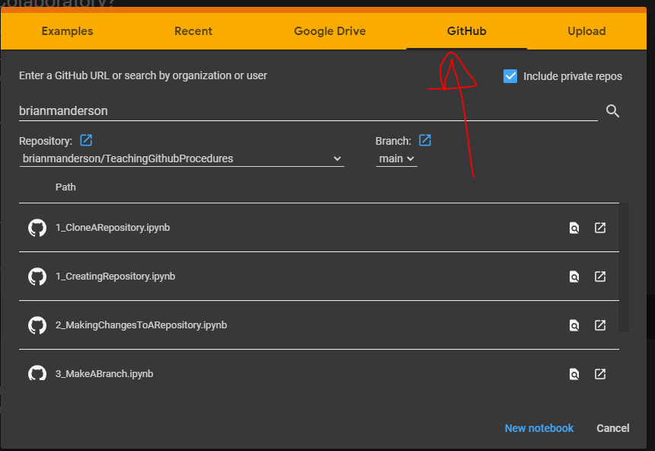
Google Colab
All notebooks are available to run as Jupyter Notebooks with google colab
Colab.research.google.com
GitHub -> brianmanderson
Repository: TeachingGithubProcedures

Slide 4
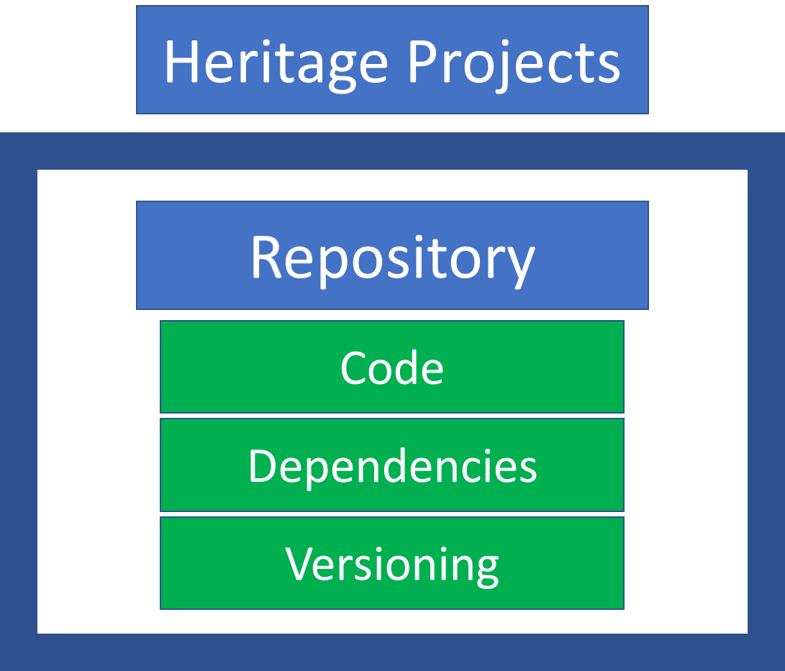
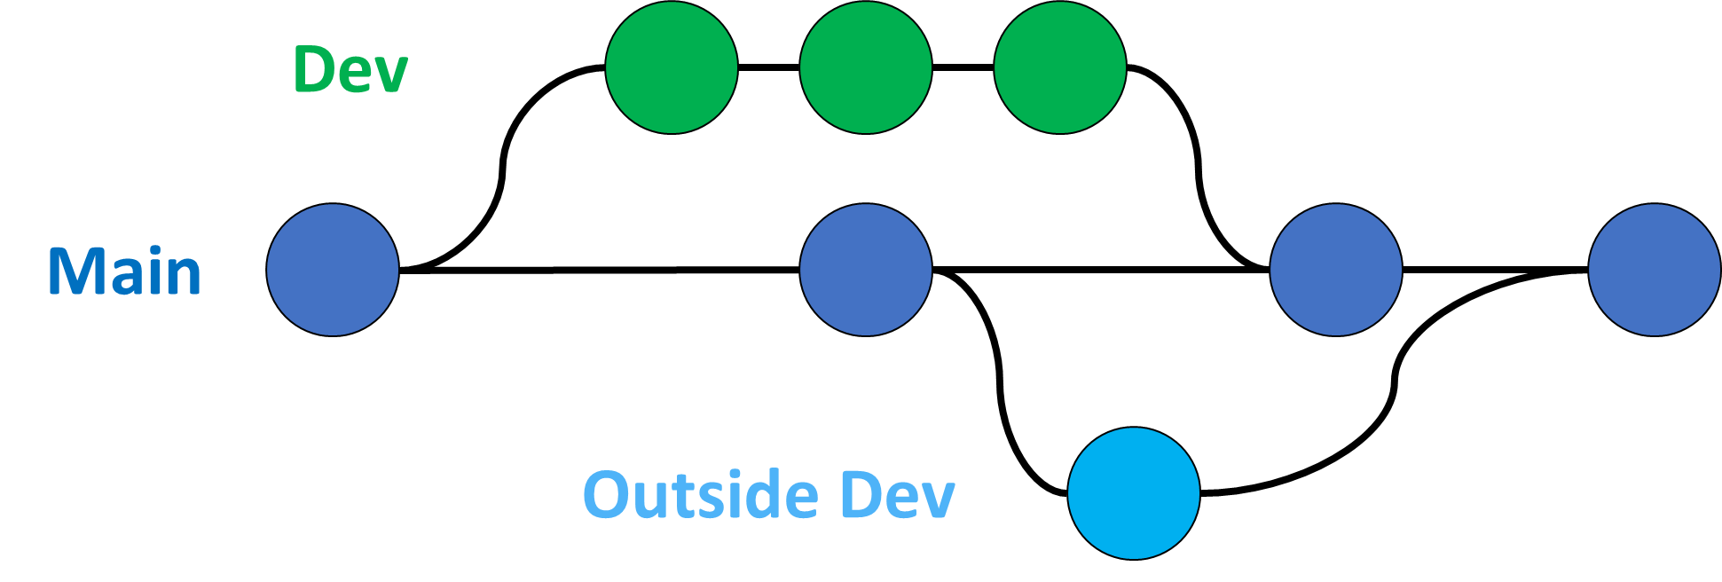
Why use GitHub/GitLab?
Code.py
Tracking changes: Commits
Code.py -> Code_New.py, Code_Old.py
Heritage projects: requirements.txt
Maintaining version control for packages
Collaboration/Experimenting
Code_New.py

Slide 5
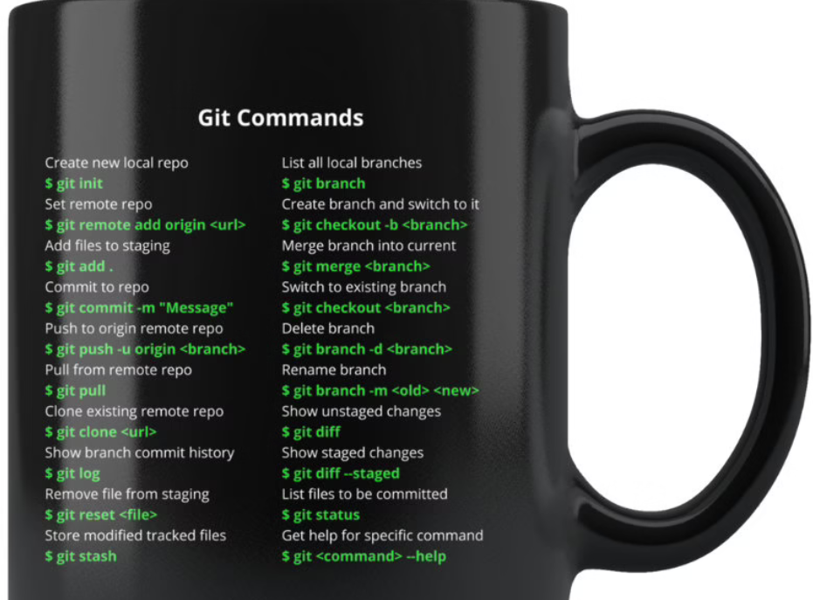
Basic Commands
git branch –M main

Slide 6
Things to cover: Commits
Adding .gitignore
Adding files/folders/dcm to ignore
Add, commit, push, pull
Git diff, git status
Cloning
Branching
requirements.txt

Slide 7
Things to cover: Heritage projects
requirements.txt
pip freeze > requirements.txt

Slide 8
Things to cover: Forking
Attempt clone, commit push

