Slide 1
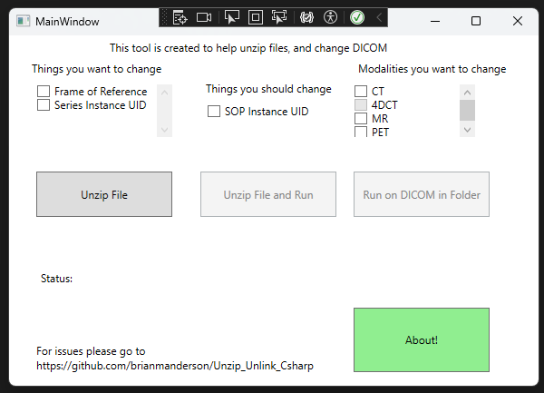
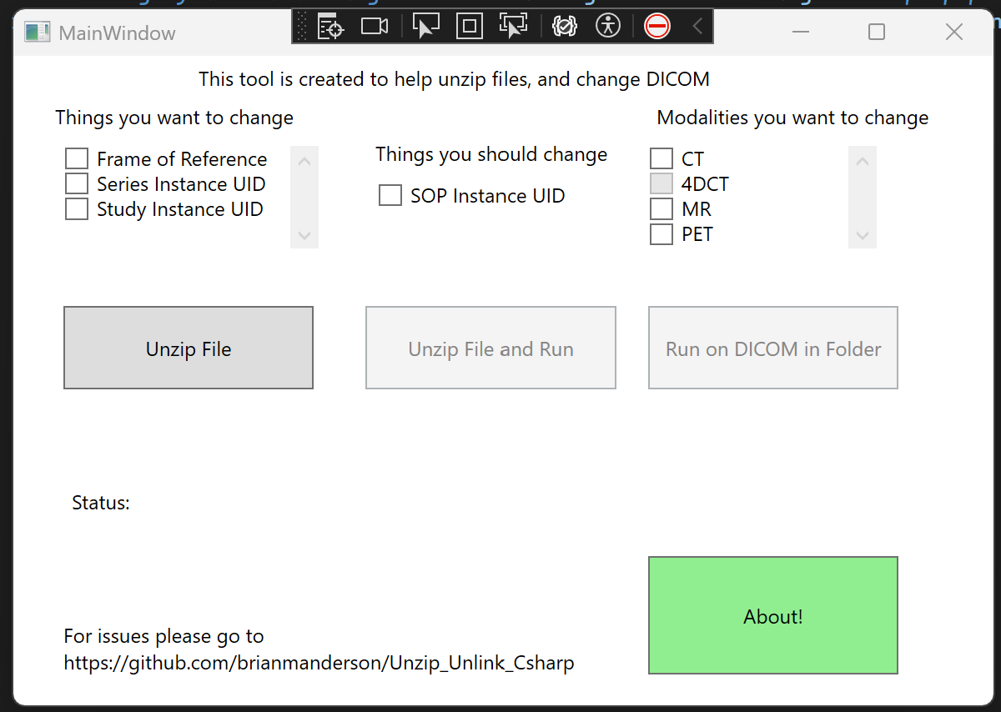
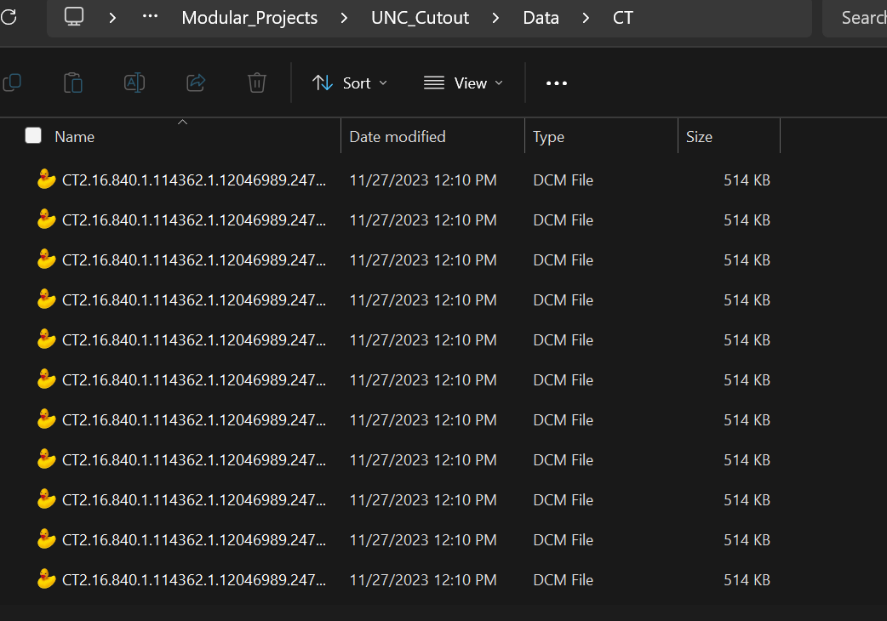
Selected folder with many DICOM images and modalities
Group images based on their unique series instance UID and modality
Based on selected attributes and modalities, each group is changed
CT : 2.16.840.1.114362…
Step 1: Characterize
MR : 1.11.40.1.1234122…
Step 2:
Change
…………………

