Slide 1


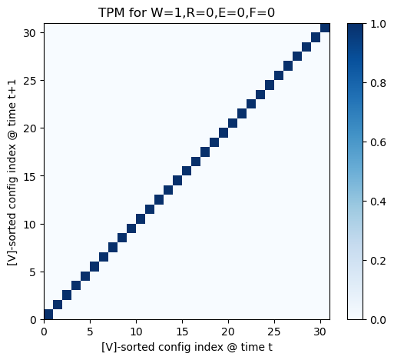
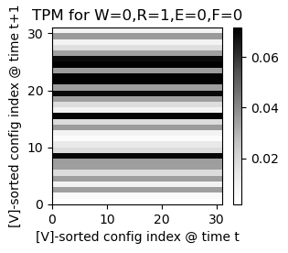
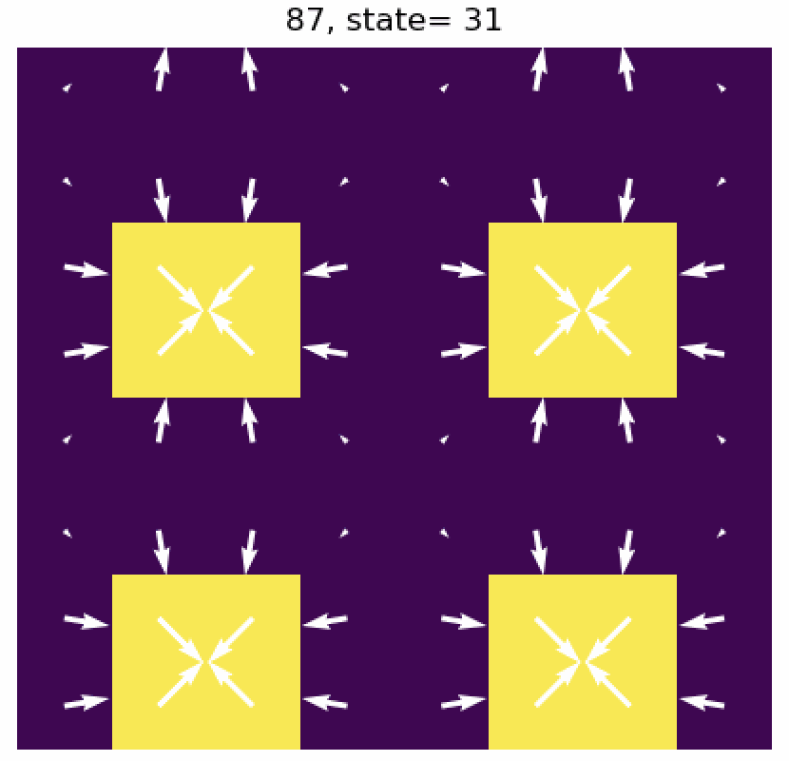
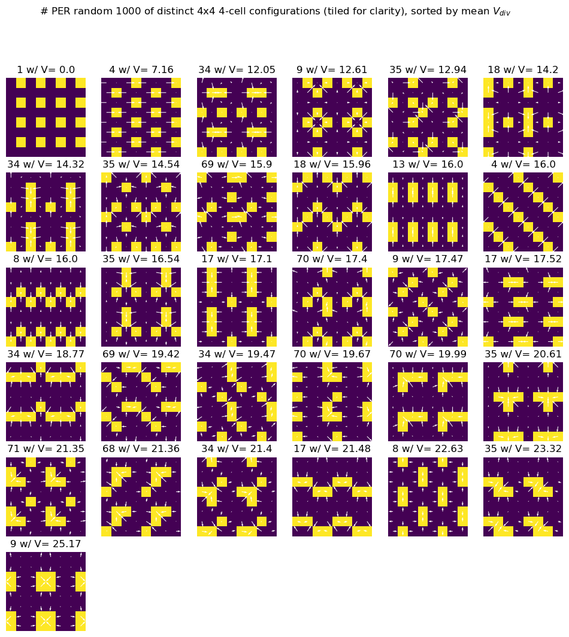
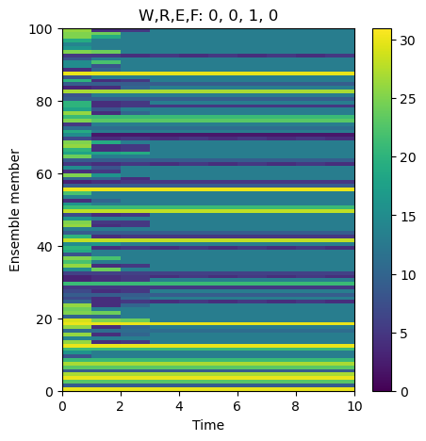
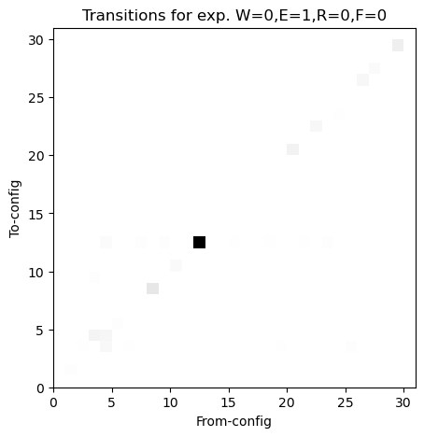
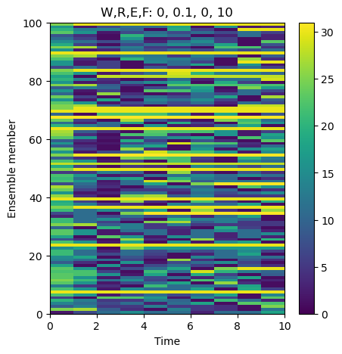
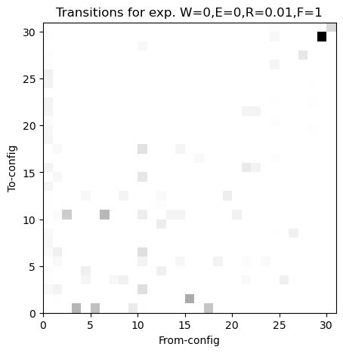
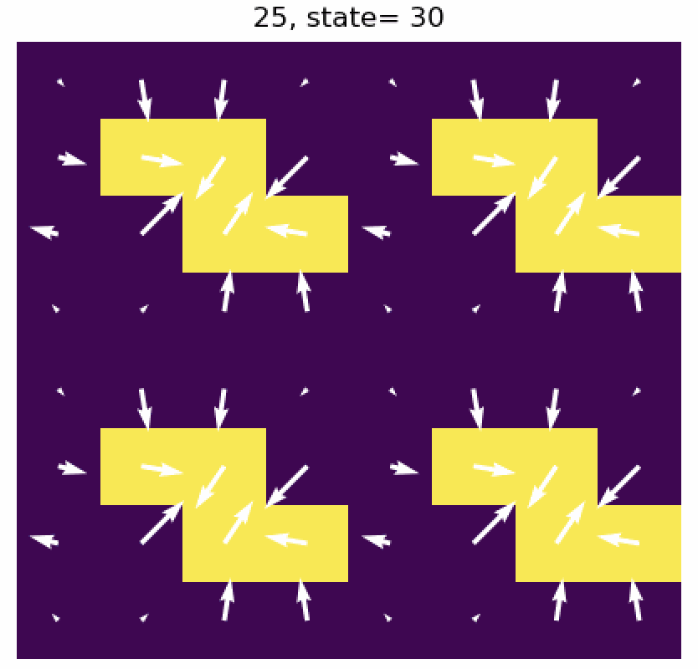
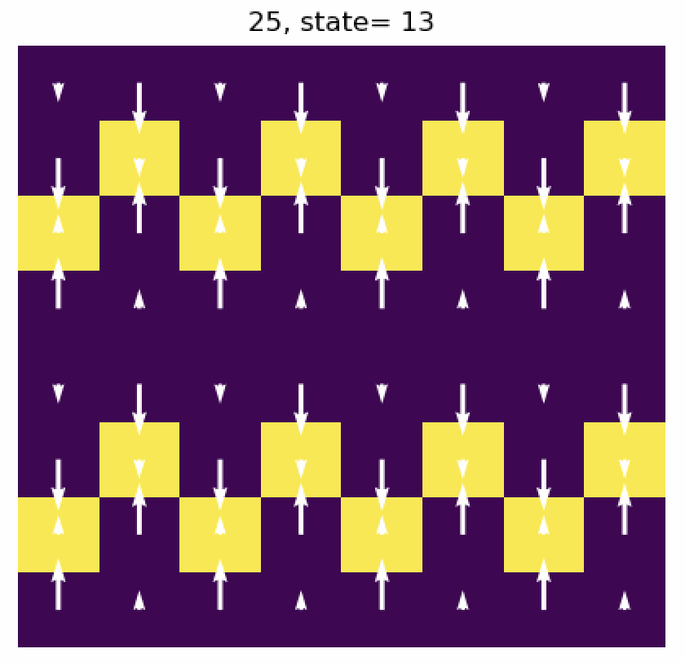
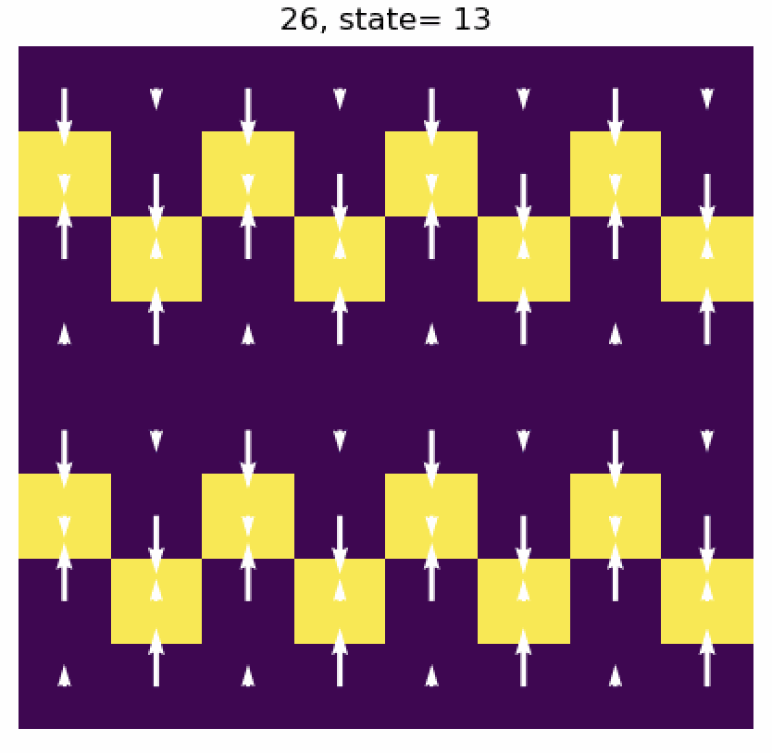
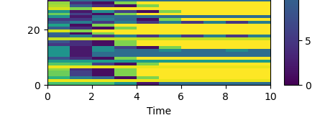
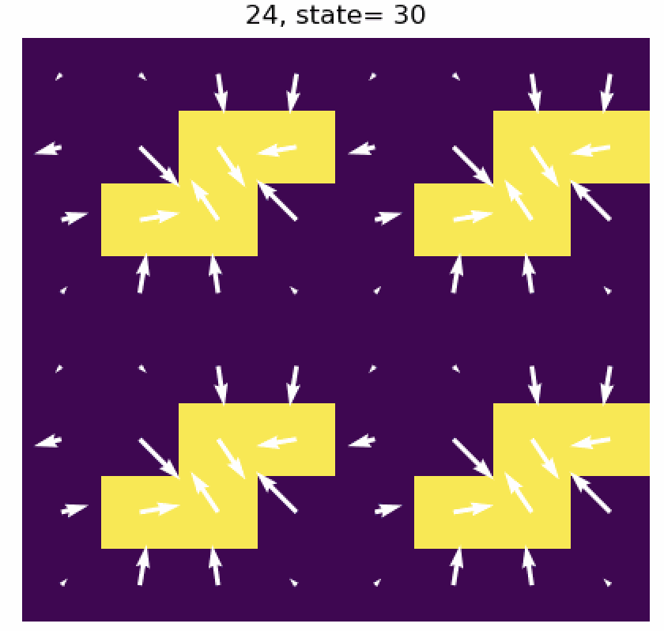
Evolution of mesoscales in a countable configuration space Brian E. Mapes, University of Miami mapes or bmapes @miami.edu
1. Introduction
3. Time evolution: a game with rules + randomness
1-timestep jumps → 31x31 transition probability matrix TPM
Probability for time t+1, based on configuration at time t:
P_{w}(x,y, t+1) = W w(x,y, t) + R Noise + E N_{4neigh}(x,y, t) + F |V(x,y, t)|
Parameter space: W,R,E,F
W governs persistence,
R governs random noise strength
E governs entrainment protection by neighbors
F governs |V|-dependent surface flux
QUESTION: How do unlikely but efficient mesoscale organizations of convection evolve from more likely but random configurations of convective updrafts, in a newly convecting fluid?
Evolutionary reasoning principles:
Consider an abstract space of possible configurations of convective cells (here, w=1 updrafts)
Vast majority of these are un-special; nearly redundant functionally
A few are ‘fitter’ at persistence and/or reproduction (propagating)
Hypothesis: Some config. adjacency defines a gradient of ‘fitness’ for evolution to climb
Numerical experiments: how fast can a system discover its ‘fitter’ = ‘organized’ configurations?
pure, sole
p=1 along
diag.
← 9/1000 rare ”block”
config is #31
pure, sole
numerosity within the 31 equivalency classes
2. Simplest, enumerable convection-like configuration space:
unconditional on t=t
* 4x4 periodic lattice, w/ 4 w=1 “updrafts” at every time. Enforce mean [w]=0.
* Velocity potential χ = ifft( fft(w)/k² ) for total wavenumber k. V = grad(χ).
simple numpy on unstaggered grid; V=0 for checkerboard w !
Randomly generate configurations: thousands 16*15*14*13 = 43680
Distinguish equivalencies by domain-mean [ |V| ], and [ N₄_neighbors² ]
2 things that shape Prob(w @t+1) pattern: F_{sfc} α |V|; Entrainment α (4-N₄)
E,F (nonlocal) most interesting for contingent evolution...
Construct P_{w}(x,y, t+1; W,R,E,F)
Initialize 4 w=1 cells randomly, iterate for NT time steps
Repeat step 2. NENS times to see I.C.-robustness of results
31: block,
most wind
# per random 1000 of 31 distinct 4x4 4-cell configs 2x2 tiled for clarity; sorted by [ |V| ]
E effect: P_{w} α N_{4neigh}
F effect: P_{w} α |V|
Simple combinatorics so far.
Interest begins with a temporal evolution law!
Define probability P_{w}(x,y, t+1).
Top 4 P_{w} locations get w=1.
Iterate.
Do ”winners” emerge?
How fast? By what pathways?
just a 1% contribution of R/F breaks 31 dominance
30:
alternating
←13: alternating
R=0, 31 rules
Discovered quickly, but frail
4. The evolutionary conceptual project
Even for 4 cells in a 4x4 periodic grid, configuration space is size 31. For 5 in 5x5, > 300, and on from there.
Welcome to combinatorics, and life! Pleiotropy. How can back-propagation of evo. selection work??
Absurdly many configurations (e.g., DNA) → several traits → binary fitness selection (survival, reproduction)
Unlikely but efficient configs can only discover themselves by pathways in vast config space. Can we map it?
In biology, key is meso GRNs (Gene Regulatory Networks).
In convection, meso state networks?
←Rare (about 9 per 1000), this configuration
has largest domain-mean windspeed
References:
Mapes (2025, ArXiv & JAS in press): Evolutionary theory of convective organization (but this work is not there!)

