Slide 1
Causal networks for evolution of organization

Slide 2
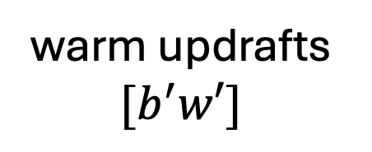
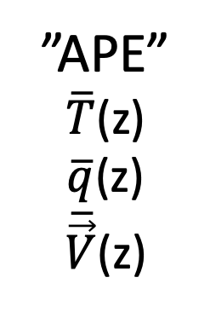


Causal network: energy only
-
-
Forcing:
Radiation,
Sfc. diseq→flux
warm updrafts
$${[b}^{′}w′]$$
wave
VKE of
convective motions
meso
$\overline{E′w′}$(“stabilization”)
neg. feedbacks
”APE”
$\overline{T}$(z)
$\overline{q}$(z)
$\overline{\vec{V}}$(z)
{
$${[b}^{′}w′]$$
cool downdrafts
LS motions

Slide 3

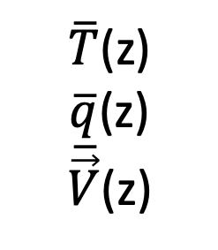

Energy only
Pattern feedbacks
Rad,
Flux
nonrandom
phase
$$\overline{b^{′}w′}$$
}
-
-
wave
VKE conv
meso
cloud
q_{c}(x,y,z)
{
shear
$\overline{T}$(z)
$\overline{q}$(z)
$\overline{\vec{V}}$(z)
Rolls,streets, waves (concentrated)
depth
auto: q_{c}q_{c}
collx: q_{p}q_{c}
}
$$\overline{b^{′}w′}$$
org. updrafts
precip
direct
wind
cold pools
net Q
vert. dipole

