Slide 1
A better 2D continuous wavelet? A modest proposal
Matlab Wavelet Toolbox crew call 2/18/2024
Brian Mapes and Mathieu Ratynski

Slide 2
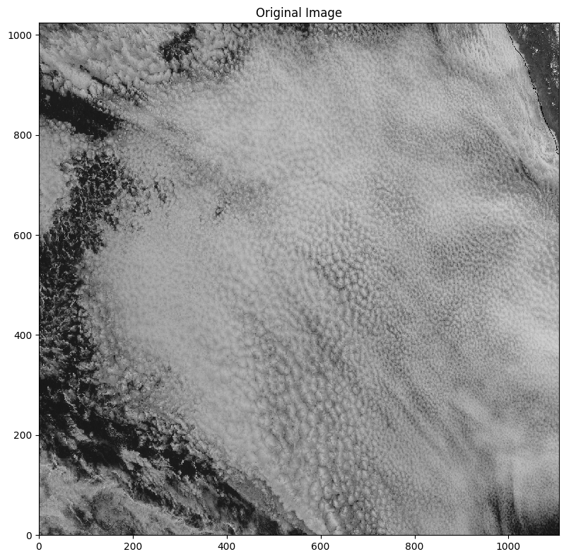
Example of our data
Peru
Wavy patterns are not the leading variance features… they need to be teased out. So we need the sharpest scalpels!
Better mother wavelet could help
--------------------
(This is just a snapshot – waves stand out better in animations. Really we use cross-coherence in time sequences of imagery.)
Packets are elongated. Could mother wavelet function be?

Slide 3
Example of our data
Peru
Packets are elongated.
Could mother wavelet function be?
Like this

Slide 4
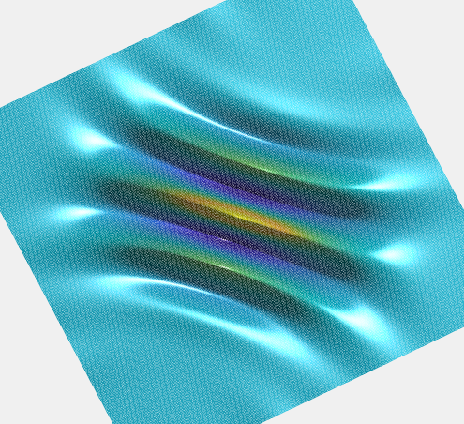
Cauchy wavelet: current
3-4 sinusoid crests and troughs:
HAPPY WITH THIS freq-location tradeoff
Times a circular Gaussian envelope: not ideal
Poor angle specificity
Unwanted proj. on random lumps
cwt of a delta function

Slide 5
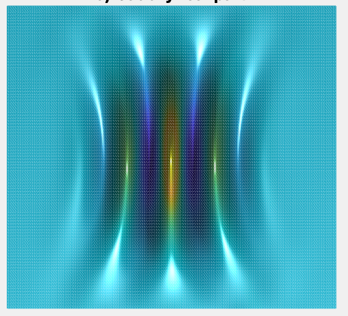
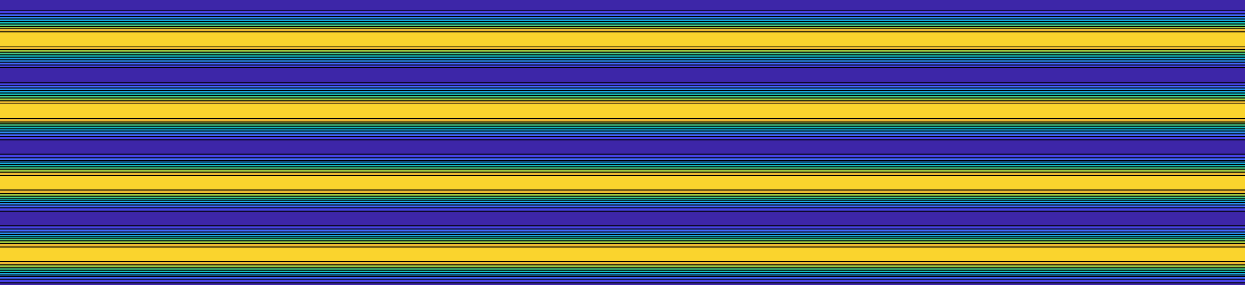
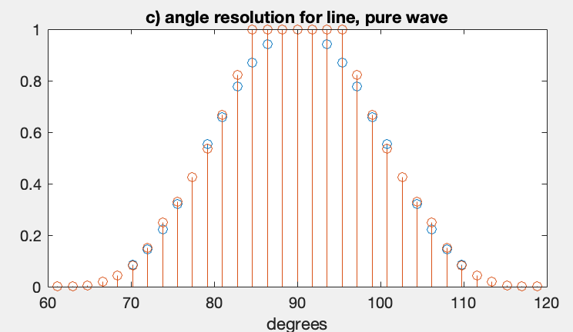
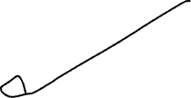
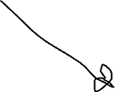
1. Poor angle specificity: ~20 deg ‘beam width’

Slide 6
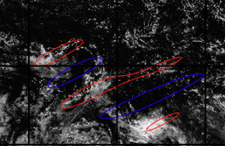
2. Random blobs project too easily on it

Slide 7
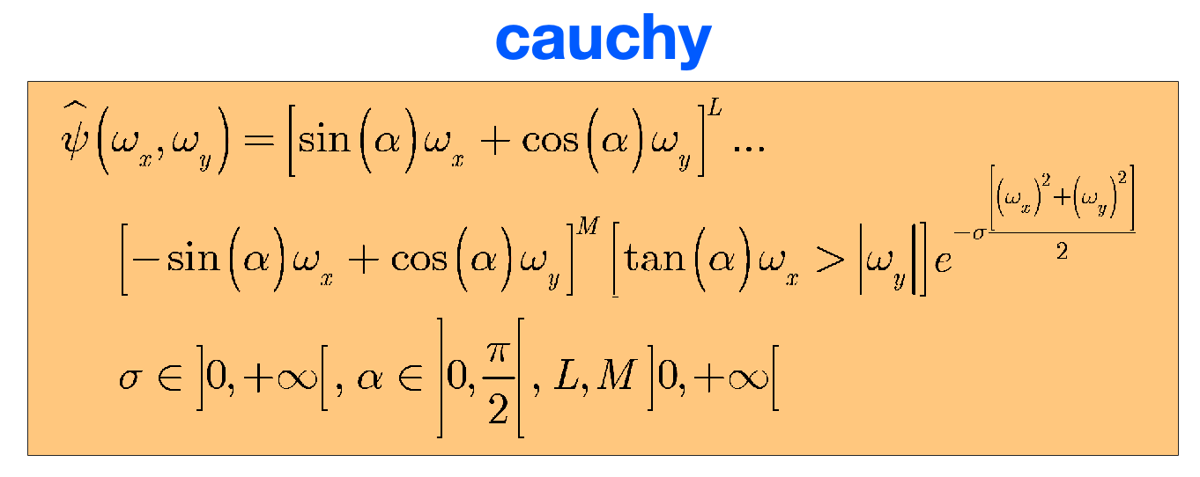
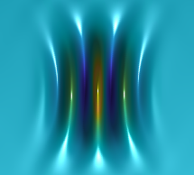


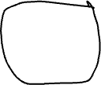
Cauchy wavelet: current
3-4 sinusoid crests and troughs:
HAPPY WITH THIS freq-location tradeoff
Times a circular envelope: not ideal
Poor angle specificity
Unwanted proj. on random lumps
Wanted: an oblong envelope, elongated along the same alpha as wave crest/trofs, like this →
Just one more parameter: env. elongation

Slide 8
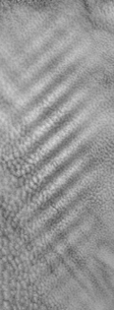
Cauchy wavelet: current
3-4 sinusoid crests and troughs:
HAPPY WITH THIS freq-location tradeoff
Times a circular envelope: not ideal
Poor angle specificity
Unwanted proj. on random lumps
TWO more params? elongation & separate angle of envelope function?
(excessive generality; not our focus)

