Slide 1


GAA Healthy Club Questionnaire
Annacurra
Survey Results

Slide 2
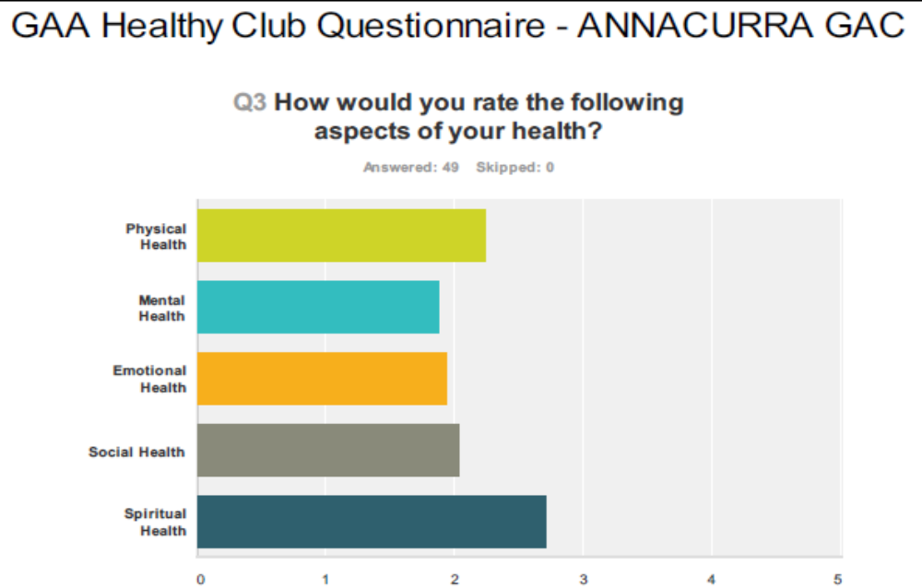

Slide 3
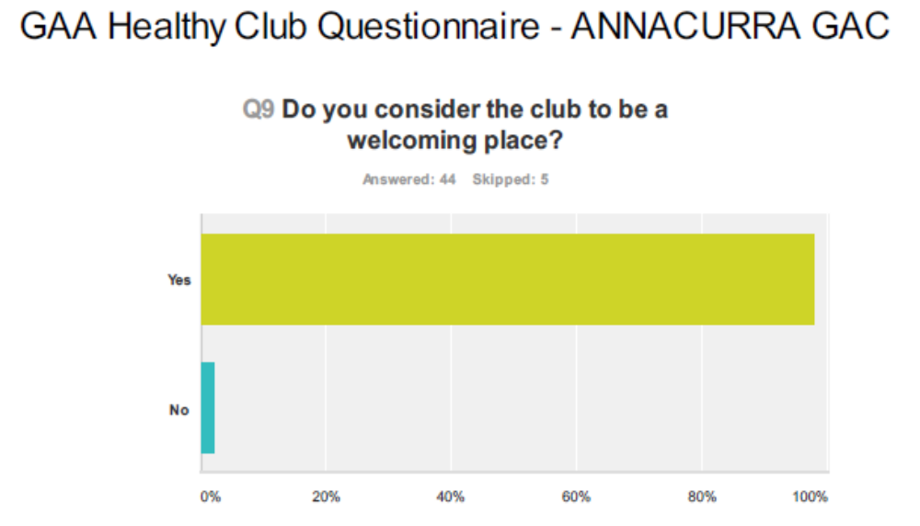

Slide 4
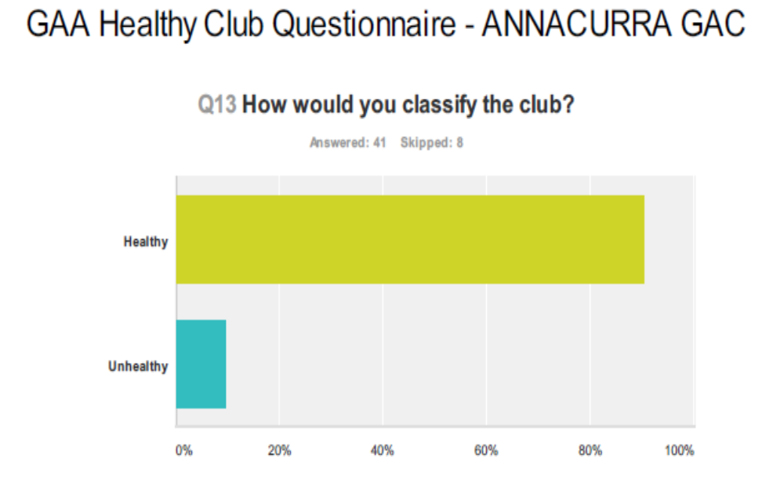

Slide 5
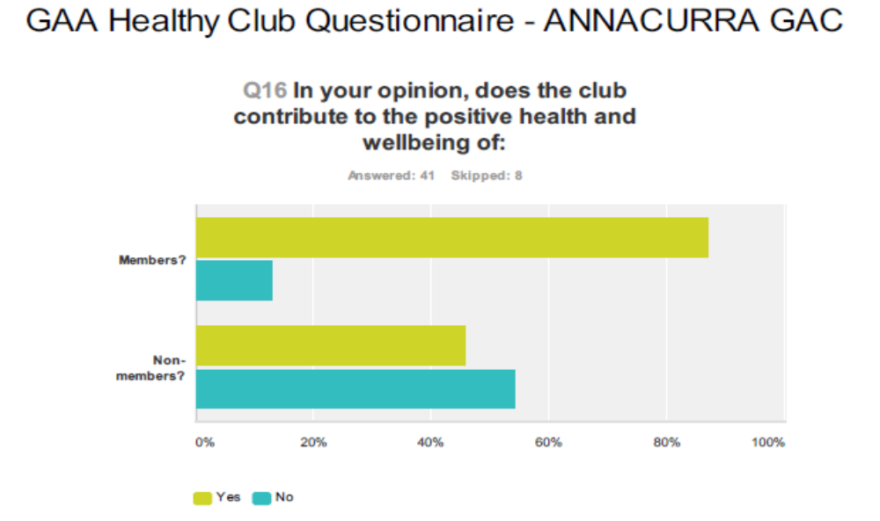

Slide 6
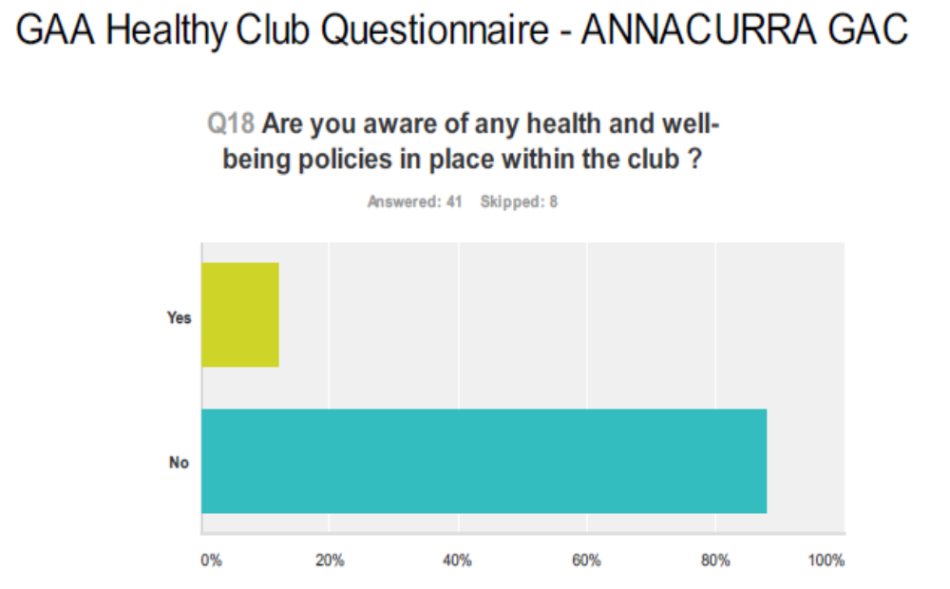

Slide 7
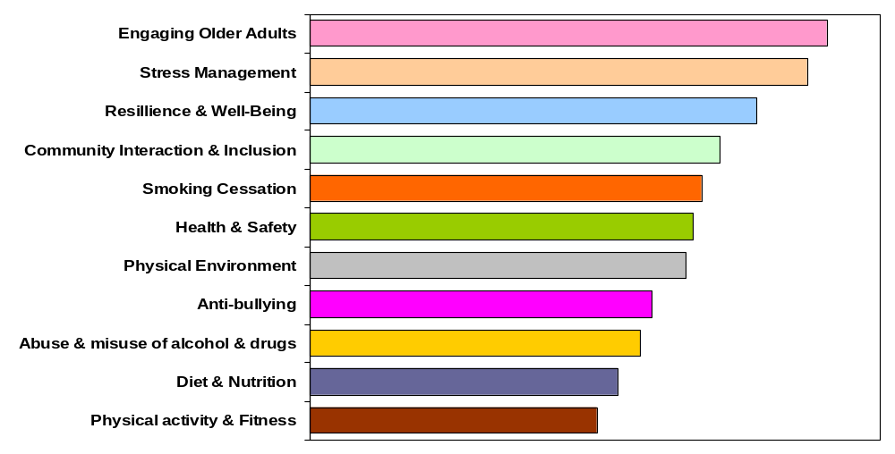
Ranking of programme options listed

Slide 9
GAA Healthy Club Project
Annacurra
Proposed Projects for 2013

Slide 10


Slide 11


Slide 12
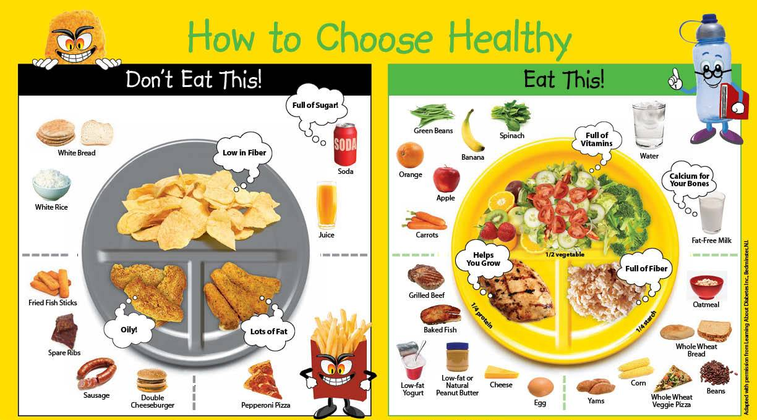
Nutrition & Healthy Eating

Slide 13


Slide 14


Slide 15
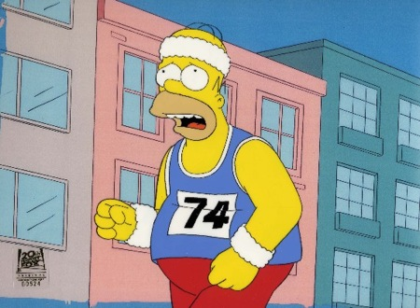
Past Player Fitness & Health

