Slide 1
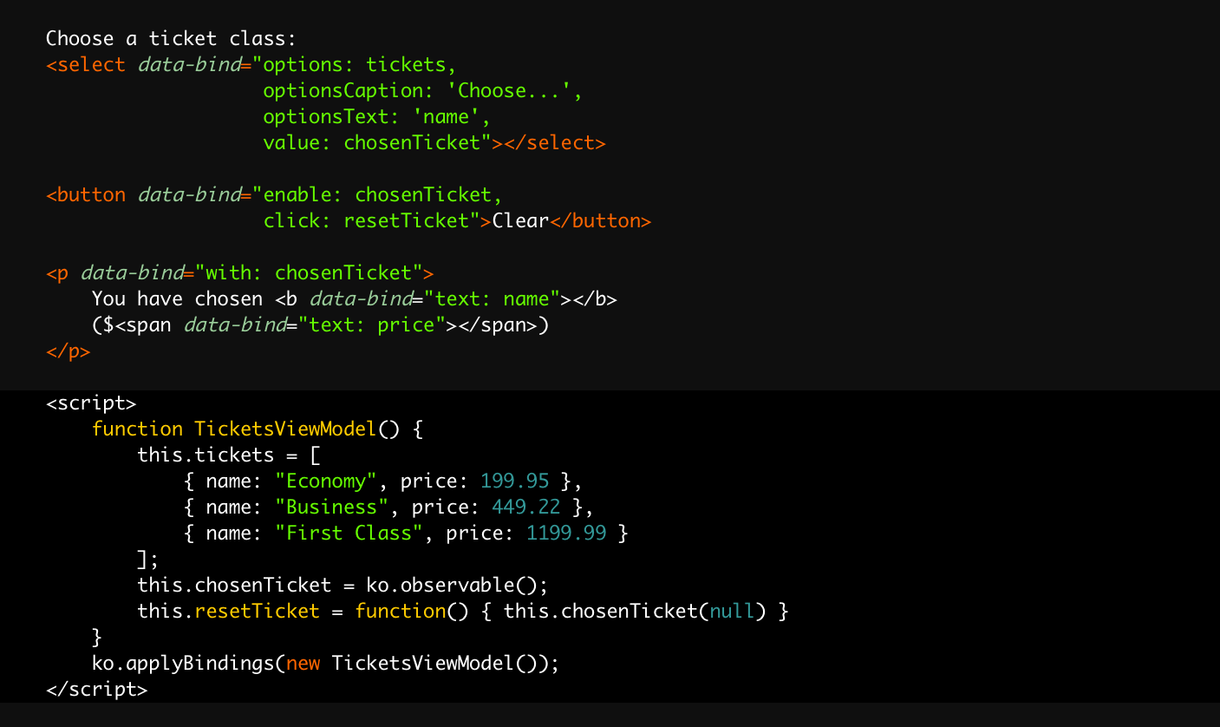
Binding attributes declaratively link DOM elements with model properties
Your view model holds the UI’s underlying data and behaviors
Activates Knockout

