Slide 1
WELCOME TO
DATA SCIENCE
Insert Instructor Name
Title, Company

Slide 2
LEARNING OBJECTIVES
WELCOME TO DATA SCIENCE
Describe the roles of GA staff and students to create a successful learning environment for data science
Define data science and the data science workflow
Apply data science workflow to get to know the class
Setup your data science development environment and review python basics

Slide 3
WELCOME TO DATA SCIENCE
PRE-WORK

Slide 4
PRE-WORK REVIEW
Define basic data types used in object-oriented programming
Recall the Python syntax for lists, dictionaries, and functions
Create files and navigate directories using the command line interface (for your specific environment)

Slide 5
WELCOME TO DATA SCIENCE
WELCOME TO GA!

Slide 6
WELCOME TO GA!
Welcome to GA!

Slide 7
WELCOME TO DATA SCIENCE
INTRODUCTION: WHAT IS DATA SCIENCE?

Slide 8
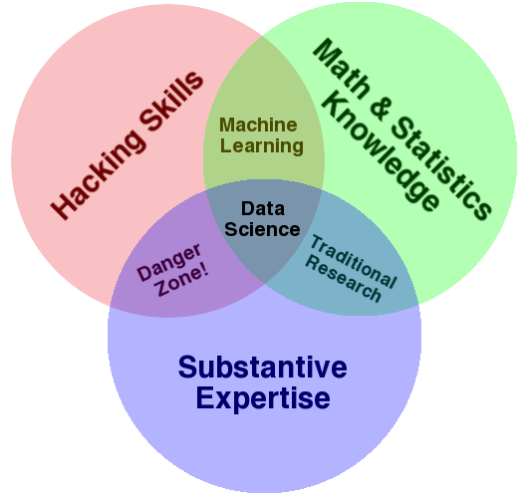
WHAT IS DATA SCIENCE?
A set of tools and techniques for data
Interdisciplinary problem-solving
Application of scientific techniques to practical problems

Slide 9





WHO USES DATA SCIENCE?
Can you think of others?

Slide 10
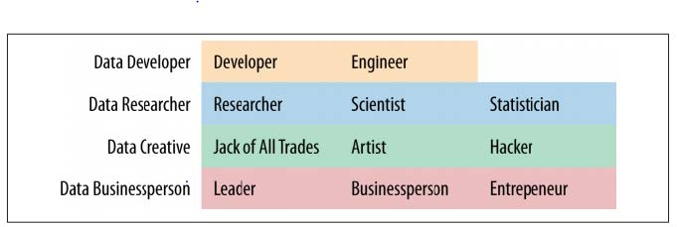
WHAT ARE THE ROLES IN DATA SCIENCE?
Data Science involves a variety of roles, not just one.

Slide 11
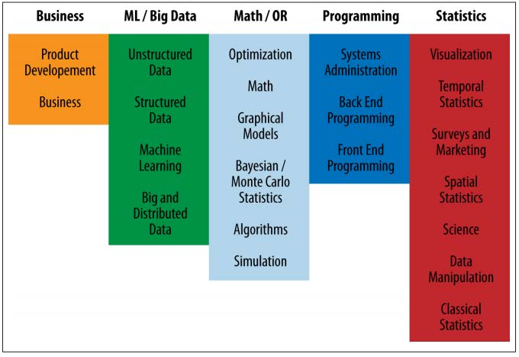
WHAT ARE THE ROLES IN DATA SCIENCE?
Data Science involves a variety of skill sets, not just one.

Slide 12
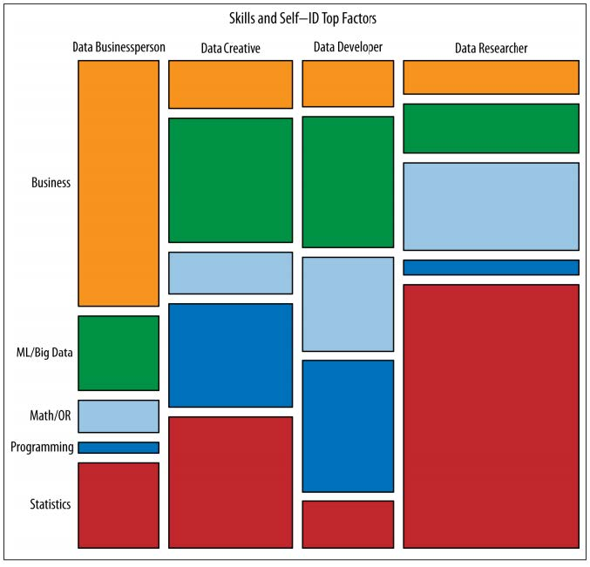
WHAT ARE THE ROLES IN DATA SCIENCE?
These roles prioritize different skill sets.
However, all roles involve some part of each skillset.
Where are your strengths and weaknesses?

Slide 13
QUIZ
DATA SCIENCE BASELINE

Slide 14

ACTIVITY: DATA SCIENCE BASELINE QUIZ
DIRECTIONS (10 minutes)
EXERCISE
Form groups of three.
Answer the following questions.
True or False: Gender (coded male=0, female=1) is a continuous variable.
According to this table, BMI is the _____
Outcome
Predictor
Covariate
Draw a normal distribution
True or False: Linear regression is an unsupervised learning algorithm.
What is a hypothesis test?

Slide 15
WELCOME TO DATA SCIENCE
INTRODUCTION: THE DATA SCIENCE WORKFLOW

Slide 16
OVERVIEW OF THE DATA SCIENCE WORKFLOW
A methodology to follow for doing Data Science
Similar to the scientific method
Helps produce reliable and reproducible results
Reliable: Accurate findings
Reproducible: Others can follow your steps and get the same results

Slide 17
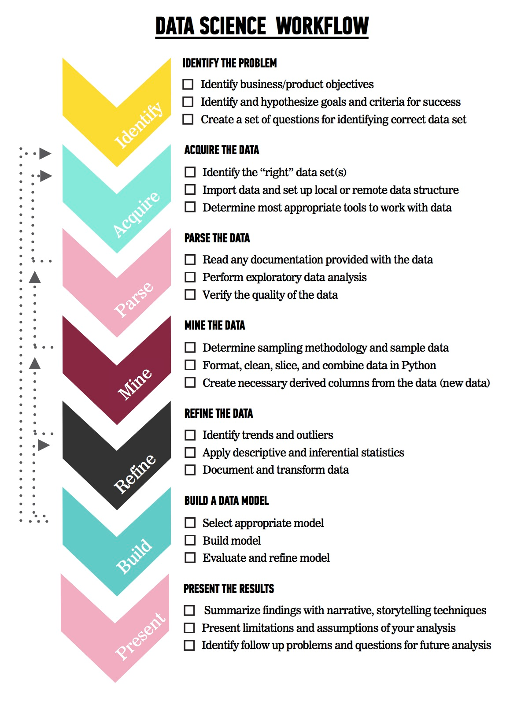
OVERVIEW OF THE DATA SCIENCE WORKFLOW
The steps:
Identify the problem
Acquire the data
Parse the data
Mine the data
Refine the data
Build a data model
Present the results

Slide 18

FUTURAMA EXAMPLE
Problem Statement: “Using Planet Express customer data from January 3001-3005, determine how likely previous customers are to request a repeat delivery using demographic information (profession, company size, location) and previous delivery data (days since last delivery, number of total deliveries).”
We can use the Data Science workflow to work through this problem.

Slide 19
FUTURAMA EXAMPLE: IDENTIFY THE PROBLEM
Identify the business/product objectives.
Identify and hypothesize goals and criteria for success.
Create a set of questions to help you identify the correct data set.

Slide 20
FUTURAMA EXAMPLE: ACQUIRE THE DATA
Ideal data vs. data that is available
Learn about limitations of the data.
What data is available for this example?
What kind of questions might we want to ask about the data?

Slide 21
FUTURAMA EXAMPLE: PARSE THE DATA
Secondary data (we didn’t directly collect it)
Example data dictionary
Variable | Description | Type of Variable
Profession | Title of the account owner | Categorical
Company Size | 1- small, 2- medium, 3- large | Categorical
Location | Planet of the company | Categorical
Days Since Last Delivery | Integer | Continuous
Number of Deliveries | Integer | Continuous

Slide 22
FUTURAMA EXAMPLE: MINE THE DATA
Think about sampling
Get to know the data
Explore outliers
Address missing values
Derive new variables (i.e. columns)

Slide 23
FUTURAMA EXAMPLE: REFINE THE DATA
Use statistics and visualization to identify trends
Example of basic statistics
Variable | Mean (STD) or Frequency (%)
Number of Deliveries | 50.0 (10)
Earth | 50 (10%)
Amphibios 9 | 100 (20%)
Bogad | 100 (20%)
Colgate 8 | 100 (20%)
Other | 150 (30%)

Slide 24
FUTURAMA EXAMPLE: CREATE A DATA MODEL
Select a model based upon the outcome
Example model statement: “We completed a logistic regression using Statsmodels v. XX. We calculated the probability of a customer placing another order with Planet Express.”
Steps for model building

Slide 25
FUTURAMA EXAMPLE: PRESENT THE RESULTS
You have to effectively communicate your results for them to matter!
Ranges from a simple email to a complex web graphic.
Make sure to consider your audience.
Key factors of a good presentation.

Slide 26
WELCOME TO DATA SCIENCE
GUIDED PRACTICE: DATA SCIENCE WORK FLOW

Slide 27
ACTIVITY: DATA SCIENCE WORKFLOW
DIRECTIONS (25 minutes)
EXERCISE
Divide into 4 groups, each located at a whiteboard.
IDENTIFY: Each group should develop 1 research question they would like to know about their classmates. Create a hypothesis to your question. (5 minutes)
NOTE: Don’t share your question yet!
ACQUIRE: Rotate from group to group to collect data for your hypothesis. Have other students write or tally their answers on the whiteboard. (10 minutes)
PRESENT: Communicate the results of your analysis to the class. (10 minutes)
Create a narrative to summarize your findings.
Provide a basic visualization for easy comprehension.
Choose one student to present for the group.
DELIVERABLE
Presentation of the results

Slide 28
WELCOME TO DATA SCIENCE
DEMO: DEV ENVIRONMENT SETUP

Slide 29
DEV ENVIRONMENT SETUP
Brief intro of tools
Environment setup
iPython Notebook test
Python Review

Slide 30
WELCOME TO DATA SCIENCE
CONCLUSION

Slide 31
CONCLUSION
You should be able to answer the following questions:
What is Data Science?
What is the Data Science workflow?
How can you have a successful learning experience at GA?

Slide 32
TITLE
BEFORE NEXT CLASS

Slide 33
DUE DATE
BEFORE NEXT CLASS
Homework:
Pre-Work:
Project: Project 1

Slide 34
TITLE
Q & A

Slide 35
TITLE
EXIT TICKET
DON’T FORGET TO FILL OUT YOUR EXIT TICKET

