Slide 1
Interpretable machine learning with shap
Brianna Frederick
General Mills
brianna.frederick56@gmail.com

Slide 2
Agenda
What is ML Model Explainability?
Why is it important?
SHAP Intro
LIME Intro
SHAP/LIME Comparison
Example Output
Python Examples
Q&A
Python code and data available at: https://github.com/briannafrederick/interpretable_ml_shap

Slide 3
About me
My Work
General Mills (~4 yrs)
Data Science Manager, Enterprise Data Capabilities
Senior Data Scientist, Enterprise Data Capabilities
Data Scientist, Global Consumer Insights
Hamline University, Course Instructor
MSBA Practicum
Forecasting and Modeling
My Life
Daughter, Jane (21 months)
Husband, JP
2 Good Pups, Robin and Baron and 1 Good Cat, Karl

Slide 4
What is ML Model Explainability?

Slide 5
Why is model explainability important?
In machine learning models, complexity often increases with accuracy
High complexity can lead to low interpretability
We want to allow our stakeholders to understand and use results in the proper way
Many applications require that we understand how individual model inputs impact the output
Black boxes can miss the most important part of the story!
Complexity
Accuracy
Interpretablity

Slide 6
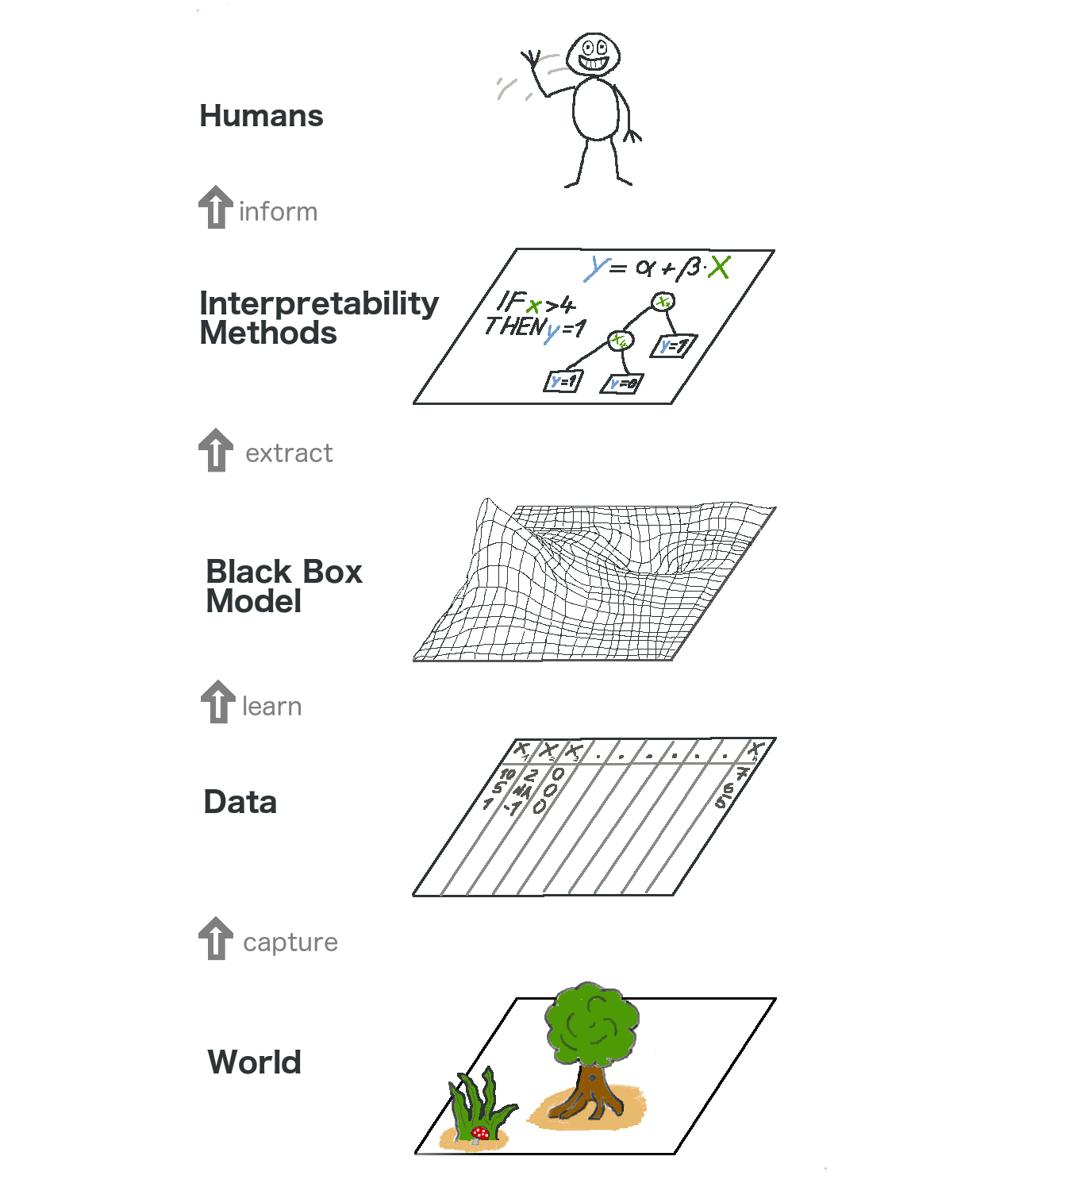
Interpretable models are more:
Informative
Trustworthy
Conducive to decision-making
https://towardsdatascience.com/interpretable-machine-learning-1dec0f2f3e6b

Slide 7
Is this just feature importance?
Feature importance is the relative importance of the features in a model
Typically uses the sum or average improvement in model fit when a feature is added
SHAP and LIME values measure the influence of a feature
Compares model predictions with and without a feature

Slide 8
SHAP Intro

Slide 9
background
SHAP (SHapley Additive exPlanations)
Shapley values – used in game theory to determine how much each player has contributed to success/failure in a cooperative game
Game: model, player: feature or collection of features
Average marginal contribution of a feature value over all possible coalitions
Fairly distribute both gains and losses to several players working in a coalition - in the case of machine learning, the model features are the players
Considers the effects of features on individual datapoints, then aggregates the results
Created by Scott Lundberg and Su-In Lee from the University of Washington¹

Slide 10
Example from game theory
Game: Paying for a pitcher of beer
Players: A, B, C
Payoff: Maximum quantity of beer the group can buy by pooling their money
Principles:
What everyone pays should equal the total bill (what everyone contributes should equal total reward)
If two people pay the same amount, they should receive the same amount of beer (equal value contributed = equal reward)
If someone pays nothing, they should drink no beer ☹
The group can have multiple rounds (rewards are additive)

Slide 11





Example from game theory
$4
B = (30, 50, 70), P = ($4, $6, $9)
A few possible outcomes*:
A and B contribute:
$15 120oz (A: 64oz, B: 56oz)
Only B contributes:
$6 50oz (B: 50oz)
All contribute:
$19 150oz (A: 63.2oz, B: 55.3oz, C: 31.6oz)
A: $8
30oz
$6
B: $7
50oz
C: $12
$9
70oz
*There are three players, so 2³=8 possible outcomes in a single round

Slide 12
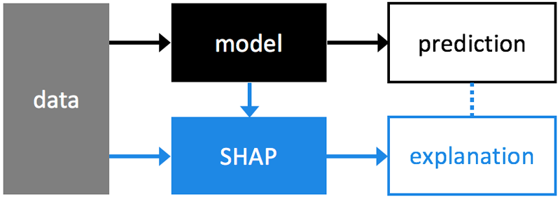
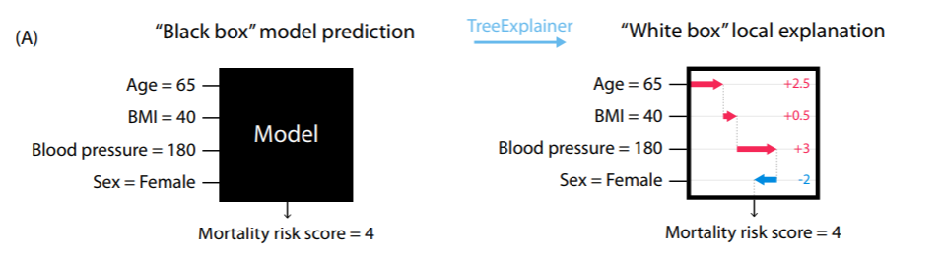
SHAP Under the hood
https://shap.readthedocs.io/en/latest/#

Slide 13
Shap advantages/shortcomings
Advantages
Shortcomings
Allows calculation of global contributions
Shapley values consider all possible predictions for an instance using all possible combinations of inputs
Local accuracy and consistency are guaranteed (consistency in that sampling is not done to calculate contributions)
Sensitive to high correlations among features
Important to do feature selection prior to modeling
Can be computationally expensive
SHAP will always use all of the features in the data to explain the output (not for sparse explanations)

Slide 14
LIME Intro

Slide 15
Lime intro
LIME (Local Interpretable Model-Agnostic Explanations)
Uses local surrogate models to approximate individual predictions
Intuition is that it is easier to approximate complex models locally (near the prediction that we want to explain)
Surrogate models generate explanations by approximating the underlying model with an interpretable one (for example, as a linear model)
Considers the effects of features on individual data points
Created by Marco Ribeiro, Sameer Singh, and Carlos Guestrin from the University of Washington2

Slide 16
lime advantages/shortcomings
Advantages
Shortcomings
Faster and less computationally expensive than SHAP
Only allows for local approximations of contributions
Single observation explanations only
Subset of SHAP without accuracy and consistency guarantee

Slide 17
SHAP/LIME Comparison

Slide 18
Shap or lime
SHAP
LIME
Produces globally consistent explanations
Estimates the effect of all features on all data points
To calculate exactly would be very computationally expensive
The values add up to the true prediction of the model
High accuracy and reliability
Produces local explanations (given a specific sample)
Gives contributions at a single data point of interest
Faster, but less accurate
Doesn’t work on all model types
Namely, XGBoost
LIME can be thought of as a subset of SHAP

Slide 19
My recommendation
Use SHAP unless the computational costs are
too high, in which case, use LIME

Slide 20
SHAP Examples

Slide 21
Data
Data on secondary student achievement in mathematics at two Portuguese schools. The data attributes include student grades, demographic, social and school related features. Data was by using school reports and questionnaires.
Classification example: Predict whether a student will pass their final math course
Data source: https://archive.ics.uci.edu/ml/datasets/Student+Performance
*Example code will use SHAP TreeExplainer, which is ideal for trees and ensembles of trees

Slide 22
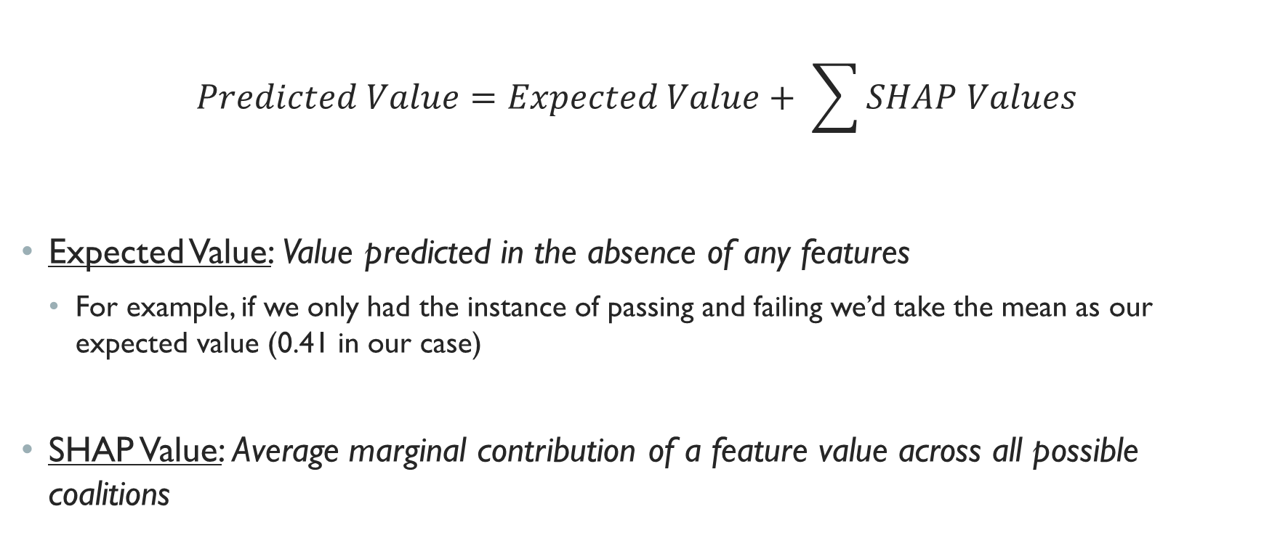
Data
$$Predicted Value=Expected Value+ \sum{SHAP Values}$$
Expected Value: Value predicted in the absence of any features
For example, if we only had the instance of passing and failing we’d take the mean as our expected value (0.41 in our case)
SHAP Value: Average marginal contribution of a feature value across all possible coalitions

Slide 23
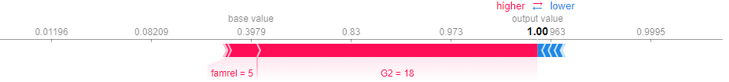
Force plot: explain single prediction
Force plots allow us to visualize individual model predictions. The “base value” is the model’s average prediction over the training data set. The “output value” is the predicted value for this observation - the probability that a student will pass their final math course.
The prediction is the probability that a student will pass their final math course.
Red arrows represent feature effects (SHAP values) that drive the prediction higher
Blue arrows are effects that drive the prediction value lower.
Each arrow’s size represents the magnitude of the corresponding feature’s effect

Slide 24
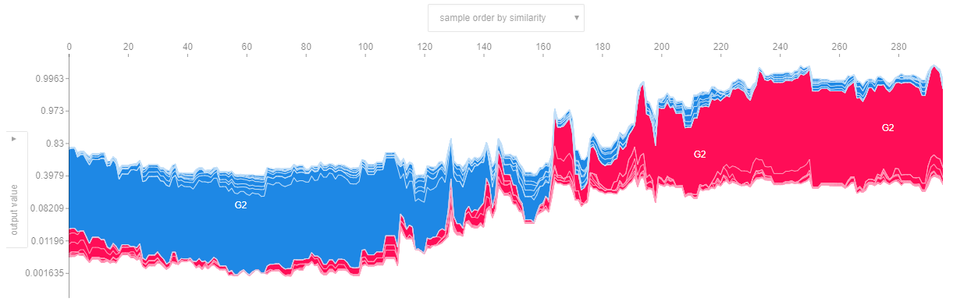
Force plot: explain all predictions
Force plots can also allow us to visualize all model predictions at once. Think of this as individual force plots rotated vertically and stacked horizontally.

Slide 25
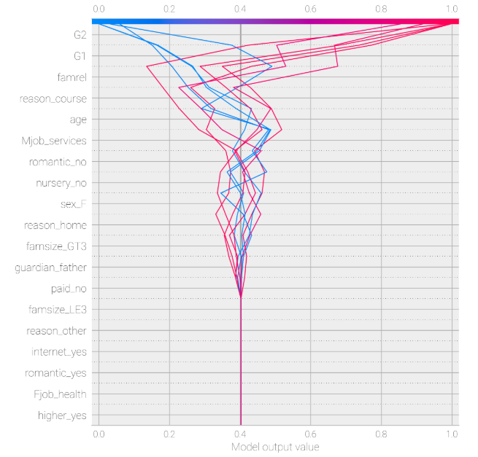
Decision plot: explain path to prediction
Decision plots show how complex models arrive at their predictions (i.e., how models make decisions). Below we see the decision path for the first 10 predictions.
The x-axis represents the model's output. In this case, the units are probabilities.
The y-axis lists the model's features. By default, the features are ordered by descending importance. The importance is calculated over the observations plotted. (This will typically differ from the importance ordering for the entire dataset.
Each observation's prediction is represented by a colored line. At the top of the plot, each line strikes the x-axis at its corresponding observation's predicted value. This value determines the color of the line on a spectrum.
Moving from the bottom of the plot to the top, SHAP values for each feature are added to the model's base value. This shows how each feature contributes to the overall prediction.
At the bottom of the plot, the observations converge at expected value.

Slide 26
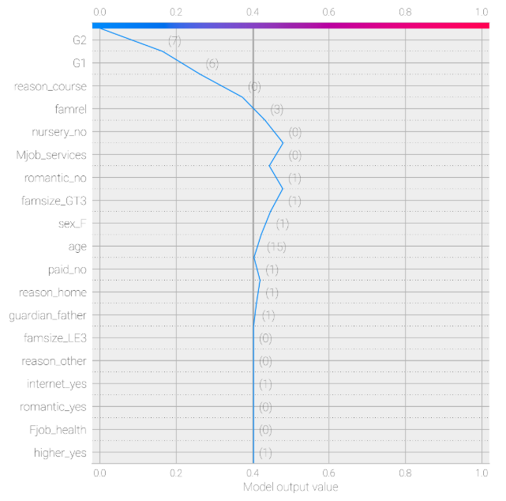
Decision plot: explain path to prediction
Decision plots show how complex models arrive at their predictions (i.e., how models make decisions). Below we see the decision path for a single prediction.
For this observation, it is predicted that the student will fail their final math course (notice that the model output value is 0)
You can follow the vertical path from the bottom at 0.4 (the expected value) to see how each feature positively or negatively impacts the prediction
G2 (grade in second math course) is the most impactful feature, and in this impacts the prediction negatively in this case.

Slide 27
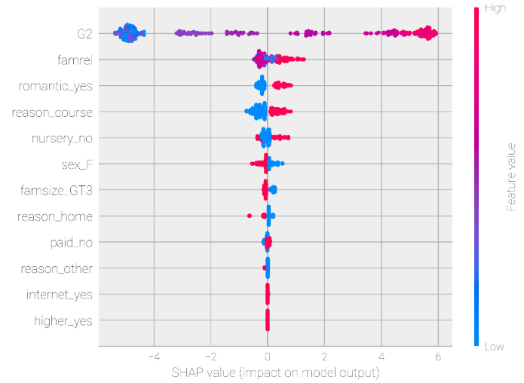
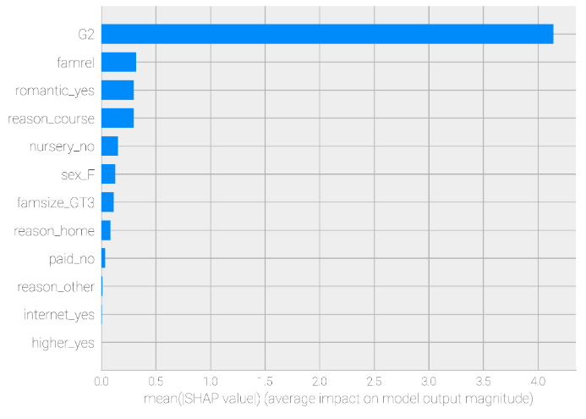
Summary plot
A summary plot is an extension of a traditional feature importance plot. It details both feature importance AND feature effects. Each point on the plot is a Shapley value for a feature and an instance. In this case, G2 (grade in second math course) is the most important feature.
The position on the y-axis is determined by the feature and on the x-axis by the Shapley value. The color represents the value of the feature from low to high. Overlapping points are jittered in y-axis direction, so we get a sense of the distribution of the Shapley values per feature.

Slide 28
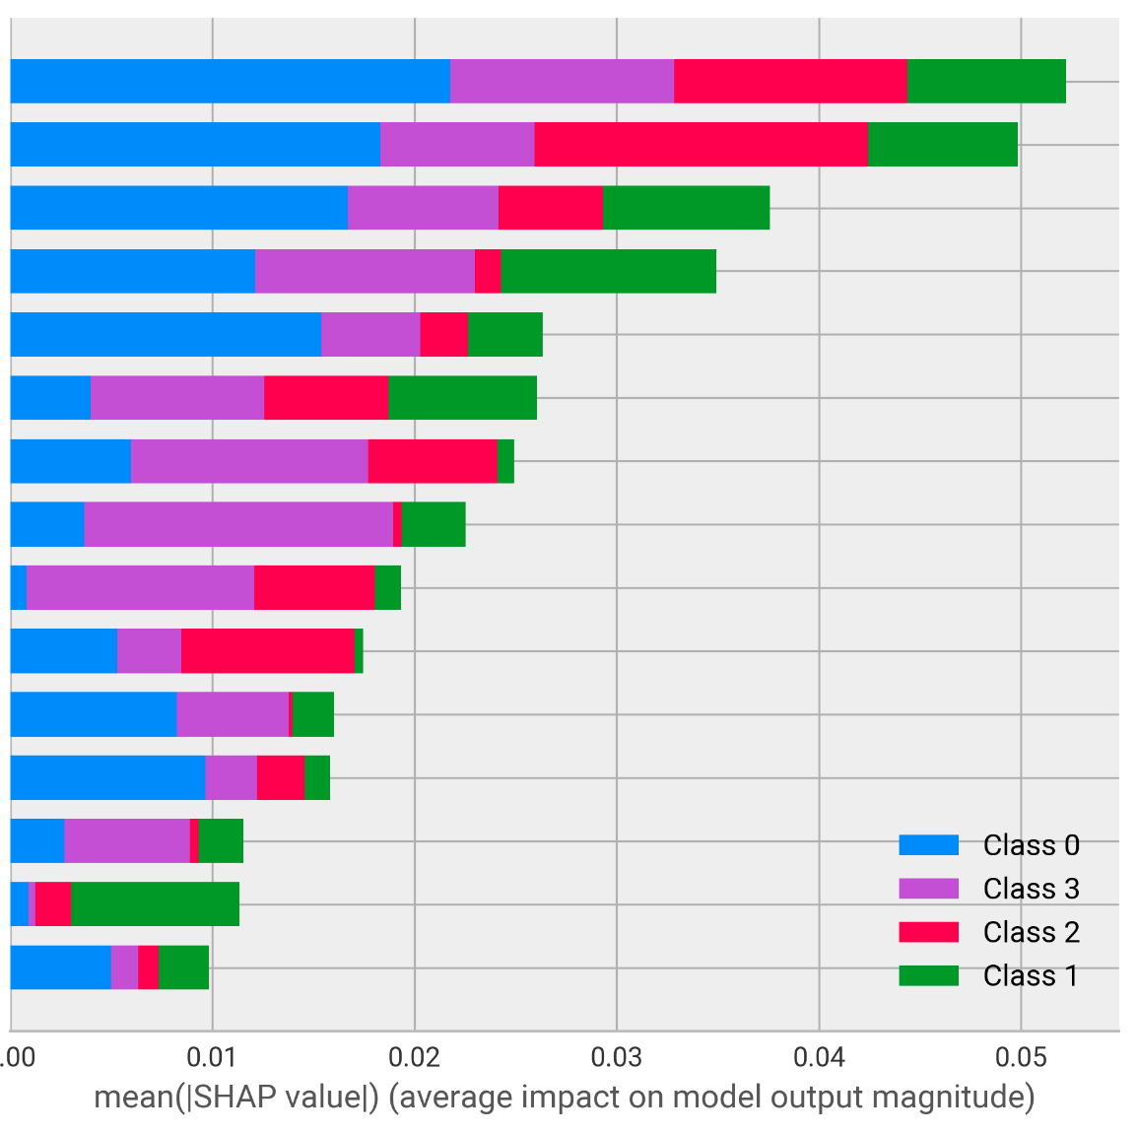
summary plot (multiclass classification)
A summary plot for multiclass classification (used post-clustering in this instance) allows us to understand which features are most prevalent in the clusters
Features
*This is just a visual example and is not using the education data

Slide 29
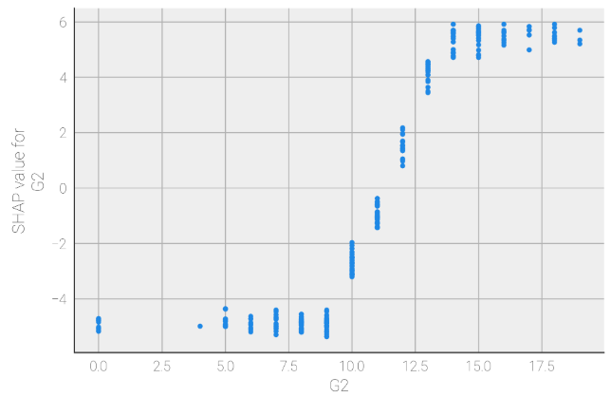
Dependence plot
A dependence plot is a scatter plot that shows the effect a single feature has on the predictions made by the model. In this example the log-odds of a passing grade increases noticeably for G2 = 10.
Each dot is a single prediction (row) from the dataset.
The x-axis is the value of the feature (from the X matrix).
The y-axis is the SHAP value for that feature, which represents how much knowing that feature's value changes the output of the model for that sample's prediction. For this model the units are log-odds of passing.

Slide 30
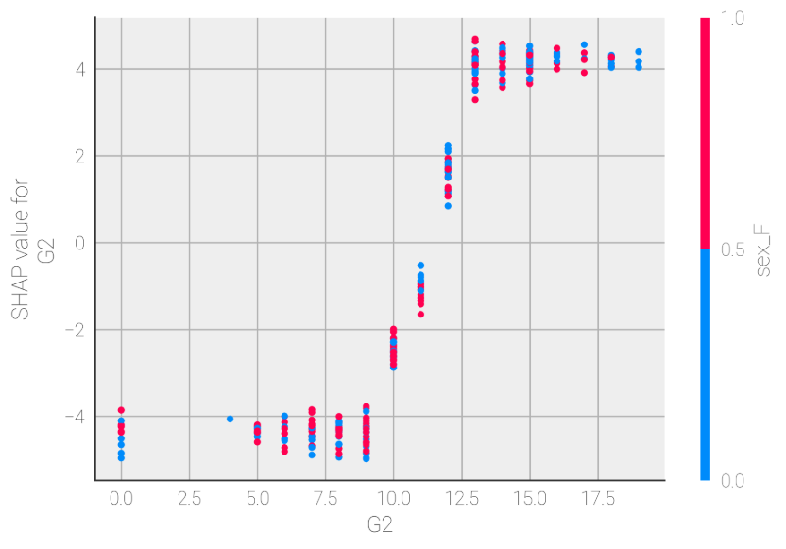
Dependence plot
The color corresponds to a second feature that may have an interaction effect with the feature we are plotting. If an interaction effect is present between this other feature and the feature we are plotting it will show up as a distinct vertical pattern of coloring.

Slide 31
Q & A

Slide 32
Thank you
Please remember to provide feedback!
https://gmisurvey.generalmills.com/Survey.aspx?sid=ac76cec8-6f88-4964-86af-ff137c0fdbb3

Slide 33
Appendix

Slide 34
Example from game theory: potential outcomes
B = (30, 50, 70), P = ($4, $6, $9)
Coalition | Potential Contribution | Total Contribution | Individual Contribution | Total Reward | Individual Rewards
None | $0 | $0 | $0 | 0oz | 0oz
A Only | $8 | $6 | $6 | 50oz | 50oz
B Only | $7 | $6 | $6 | 50oz | 50oz
C Only | $12 | $10 | $10 | 80oz | 80oz
A & B | $15 | $15 | A:$8, B:$7 | 120oz | A:64oz, B:56oz
A & C | $20 | $19 | A:$8, C:$11 | 150oz | A:63.2oz, C:86.8oz
B & C | $19 | $19 | B:$7, C:$12 | 150oz | B:55.3oz, C:94.7oz
All | $27 | $19 | A:$8, B:$7, C:$4 | 150oz | A:63.2oz, B:55.3oz, C:31.6oz

Slide 35
Other types of explainers
Kernel Explainer
Output of any function
Linear Explainer
Linear models with independent features
Gradient Explainer
Deep learning
Deep Explainer
Deep learning (fast, but approximate)

Slide 36
Helpful resources
Interpretable Machine Learning
SHAP Paper
SHAP Documentation
SHAP for Python (Github)
SHAP for R (Github)
LIME Paper
LIME Documentation
LIME for Python (Github)
LIME for R (Github)
Less common interpretability packages:
ELI5
Skater

