Slide 1
AC209B · MILESTONE 2
Does anyone write down
where they go home to?
Housing documentation in discharge summaries
for patients with serious mental illness
PROJECT
TEAM
#63 · Data Processing & EDA
Matlin Gilman · Brianna Grissom

Slide 2
INTRODUCTION
Why this project
When patients with serious mental illness leave the hospital, whether they have stable housing plays a huge role in whether they stay healthy or end up back in the hospital.
RESEARCH QUESTION
Is housing mentioned in SMI discharge summaries — and do documentation rates differ by race, gender, or insurance?
WHY IT MATTERS
▪ Unstable housing drives medication non-adherence and missed follow-ups
▪ Clinical guidelines say housing should be in the discharge plan
▪ Without it, discharge plans can fail before the patient leaves the hospital
THE STARTING OBSERVATION
Housing Documentation in SMI Discharge Summaries
02 / 17

Slide 3
DATA
Three datasets, three jobs
1
2
3
MIMIC-IV
MIMIC-IV-Note
MIMIC-III-SDOH
Structured tables
Clinical free text
Validation set
▪ admissions, patients, diagnoses_icd
▪ Demographics, insurance, ICD codes
▪ 546,028 admissions
▪ Discharge summaries (7 CSV files)
▪ Linked to admissions by hadm_id
▪ 331,793 notes
▪ Hand-labeled clinical sentences
▪ Used to test our keyword search
▪ 1,800 labeled sentences
Housing Documentation in SMI Discharge Summaries
03 / 17

Slide 4
DATA
Building the cohort
1
Merge
6
Exclude
MIMIC-IV admissions + patients on subject_id
Drop transfers, against-advice, in-hospital deaths
2
Categorize
7
Attach text
Race (4), insurance (4), gender — simplified groups
Merge MIMIC-IV-Note discharge summaries by hadm_id
3
Outcomes
8
Clean
30-day readmission flag (~20%); in-hospital death flag
Strip the administrative “Discharge Disposition” line
4
Diagnose
9
Search
Attach first-listed ICD code per admission
Apply the validated 20-keyword housing search
5
Filter
Keep only schizophrenia, bipolar, severe/recurrent MDD
Housing Documentation in SMI Discharge Summaries
04 / 17

Slide 5
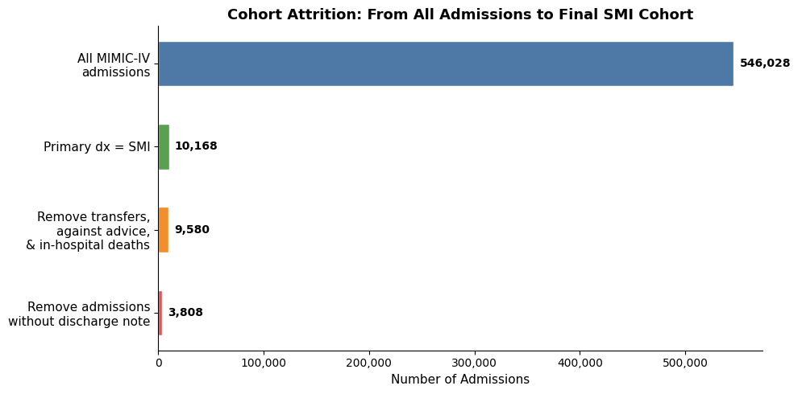
DATA
From 546,028 admissions to 3,808
3,808
FINAL ADMISSIONS
after exclusions and note matching
2,859
UNIQUE PATIENTS
some patients have multiple stays
0.7%
RETENTION RATE
of all MIMIC-IV admissions
Housing Documentation in SMI Discharge Summaries
05 / 17

Slide 6
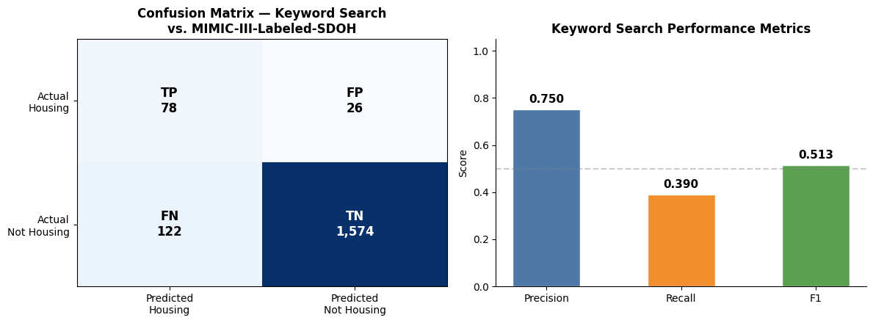
VALIDATION
How good is keyword search, really?
0.75
PRECISION
0.39
RECALL
0.51
F1 SCORE
When we flag housing we're usually right — but we miss 6 in 10 real mentions. Keyword search is a floor, not a ceiling. Motivates ClinicalBERT in Milestone 3.
Housing Documentation in SMI Discharge Summaries
06 / 17

Slide 7
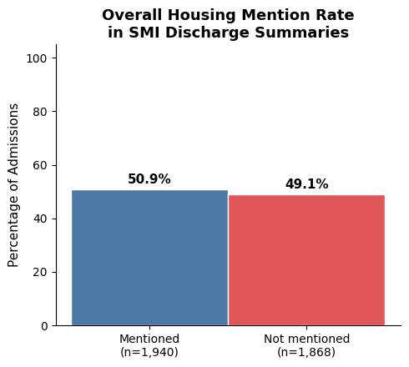
FINDINGS
Half the notes mention housing
50.9%
of SMI discharge summaries contain a keyword housing mention
▪ 1,940 of 3,808 admissions flagged
▪ Likely an undercount given recall of 0.39
▪ Any gap is clinically concerning here
Housing Documentation in SMI Discharge Summaries
07 / 17

Slide 8
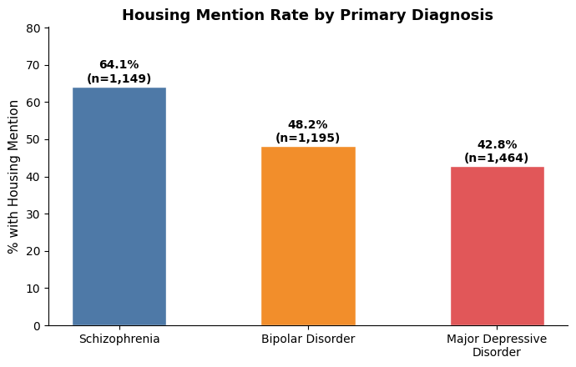
FINDINGS
Schizophrenia leads by 20+ points
64.1%
SCHIZOPHRENIA
48.2%
BIPOLAR DISORDER
42.8%
MAJOR DEPRESSIVE DISORDER
Consistent with clinicians asking about living situation more routinely for patients with severe functional impairment.
Housing Documentation in SMI Discharge Summaries
08 / 17

Slide 9
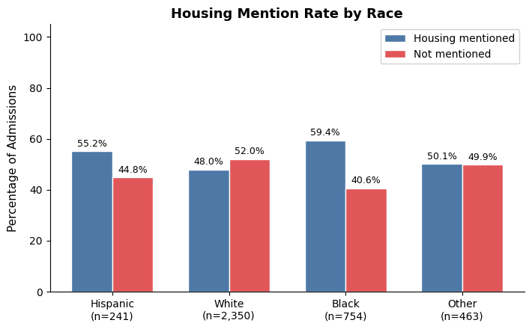
FINDINGS
Disparities by race
WHAT THIS COULD MEAN
▪ Black (59.4%) and Hispanic (55.2%) higher than White (48.0%)
▪ Could reflect real differences in housing instability
▪ Could reflect clinician attentiveness to social risk
▪ White patients may be assumed housing-stable and go unasked
Housing Documentation in SMI Discharge Summaries
09 / 17

Slide 10
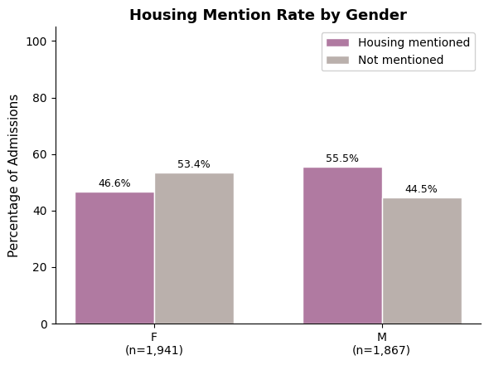
FINDINGS
Disparities by gender
THE 9-POINT GAP
Male 55.5% vs Female 46.6%
▪ Men are more likely to have housing documented
▪ But schizophrenia is more common in men — and schizophrenia has the highest mention rate (64%)
▪ The gender gap may be driven by diagnosis mix, not gendered documentation
Housing Documentation in SMI Discharge Summaries
10 / 17

Slide 11
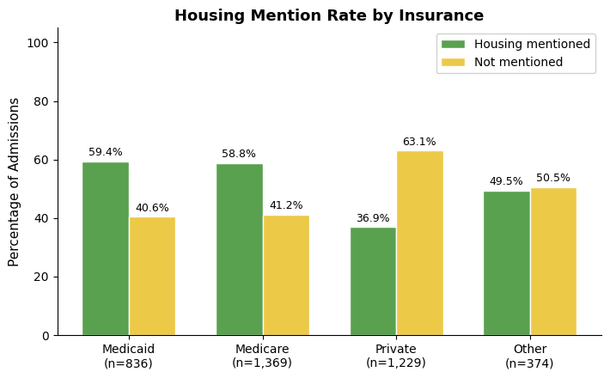
FINDINGS
The biggest gap is by insurance
THE 22-POINT GAP
Medicaid 59% vs Private 37%
▪ Medicaid is income-based — itself a marker of housing vulnerability
▪ Clinicians may anchor on insurance type when deciding to ask
▪ Open question: appropriate risk-based attention, or stereotype?
Housing Documentation in SMI Discharge Summaries
11 / 17

Slide 12
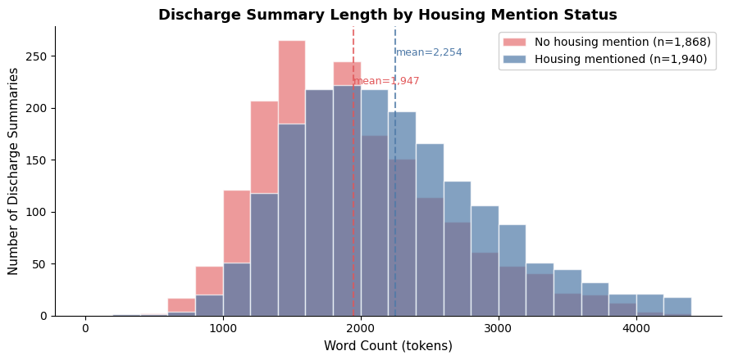
FINDINGS
Notes that mention housing run longer
MEAN WORD COUNT
2,254
Housing mentioned
1,947
No mention
A ~300-word gap. Notes that mention housing tend to be more thorough overall — likely capturing more of the patient's social context.
Housing Documentation in SMI Discharge Summaries
12 / 17

Slide 13
SYNTHESIS
Five things we learned
01
Half the notes mention housing
And keyword recall of 0.39 means the true rate is likely higher.
02
Diagnosis matters more than expected
Schizophrenia 64% vs MDD 43% — a 21-point gap.
03
Documentation is unequal across groups
Black & Hispanic > White; Medicaid & Medicare > Private.
04
Longer notes mention housing more
Notes that mention housing tend to be longer — likely because they're more thorough overall
05
The keyword baseline gives us a floor, not a ceiling
With recall at 0.39, every rate we report is a lower bound on the true documentation rate
Housing Documentation in SMI Discharge Summaries
13 / 17

Slide 14
RESCOPING
What changed since Milestone 1
M1 — ORIGINAL
M2 — REFINED
How much can a fine-tuned clinical language model improve on keyword rules for detecting social determinants of health?
Is housing documented in SMI discharge summaries, and do documentation rates differ by race, insurance, or gender?
▪ Multiple social determinants of health (housing, food, substance use, isolation)
▪ All discharge summaries in MIMIC-IV-Note
▪ Hand-label 200–300 notes for evaluation
▪ Method-focused: keywords vs. ClinicalBERT comparison
▪ Narrowed from all SDOH to housing specifically
▪ Narrowed from all admissions to the SMI cohort
▪ Validation set: MIMIC-III-SDOH (1,800 pre-labeled sentences) instead of hand-labeling
▪ Question-focused: documentation patterns and equity, with the model as the tool to answer it
Housing Documentation in SMI Discharge Summaries
14 / 17

Slide 15
NEXT STEPS
What happens in Milestone 3
01
02
03
04
Fine-tune
Apply
Compare
Re-analyze
ClinicalBERT on MIMIC-III-SDOH housing labels
Inference on MIMIC-IV-Note SMI discharge summaries
Model vs. keyword baseline; error analysis
Disparity analysis with model labels
Matlin and Brianna will collaborate on every step.
Housing Documentation in SMI Discharge Summaries
15 / 17

Slide 16
LOOKING AHEAD
Future considerations
WHAT WE'RE PLANNING
WHAT’S ON OUR MINDS
WE'D LOVE YOUR INPUT
Approach
Potential Challenges
For our TF
▪ ClinicalBERT, fine-tuned on MIMIC-III-SDOH
▪ Keyword search retained as baseline
▪ Evaluation against held-out MIMIC-III-SDOH sentences
▪ Domain shift: training on isolated sentences, applying to full multi-page discharge notes
▪ How to aggregate sentence-level predictions into a note-level yes/no
▪ We're both 209B students, so we need to incorporate an approach or method not covered in class
▪ Any approaches or methods you'd recommend?
Housing Documentation in SMI Discharge Summaries
16 / 17

Slide 17
THANK YOU
Questions?
Matlin Gilman · Brianna Grissom
Project #63 · AC209B · Milestone 2

