Slide 1
AC209B · MILESTONE 3
Three baselines, three answers
Modeling housing mentions in SMI discharge summaries
Baselines · Inference · What we trust
PROJECT
TEAM
#63 · Baseline Modeling & Inference
Matlin Gilman · Brianna Grissom

Slide 2
RESEARCH QUESTION
How consistently is housing mentioned
in discharge summaries for patients
hospitalized with serious mental illness?
WHY
WHO
HOW
Clinical guidelines
SMI cohort
Sentence-level classifier
Housing should be assessed and documented at discharge for patients with serious mental illness.
3,808 admissions with a primary SMI diagnosis (schizophrenia, bipolar, severe MDD).
Train on labeled sentences, apply to full discharge notes, aggregate to a per-note flag.
Housing Documentation in SMI Discharge Summaries
2 / 14

Slide 3
DATA
Training data: MIMIC-III labeled SDOH
WHAT IT IS
1,800
MIMIC-III-SDOH
A hand-labeled set of 1,800 clinical sentences released alongside MIMIC-III, each tagged for the social determinant of health (SDOH) it discusses — housing, food, employment, isolation, etc.
We use it as our supervised training set: it gives us ground-truth housing labels at the sentence level.
labeled sentences
80 / 20 stratified split for train / val
11.1%
of sentences mention housing
highly imbalanced — minority class
MIMIC-III
source database
publicly available, hand-labeled
Housing Documentation in SMI Discharge Summaries
3 / 14

Slide 4
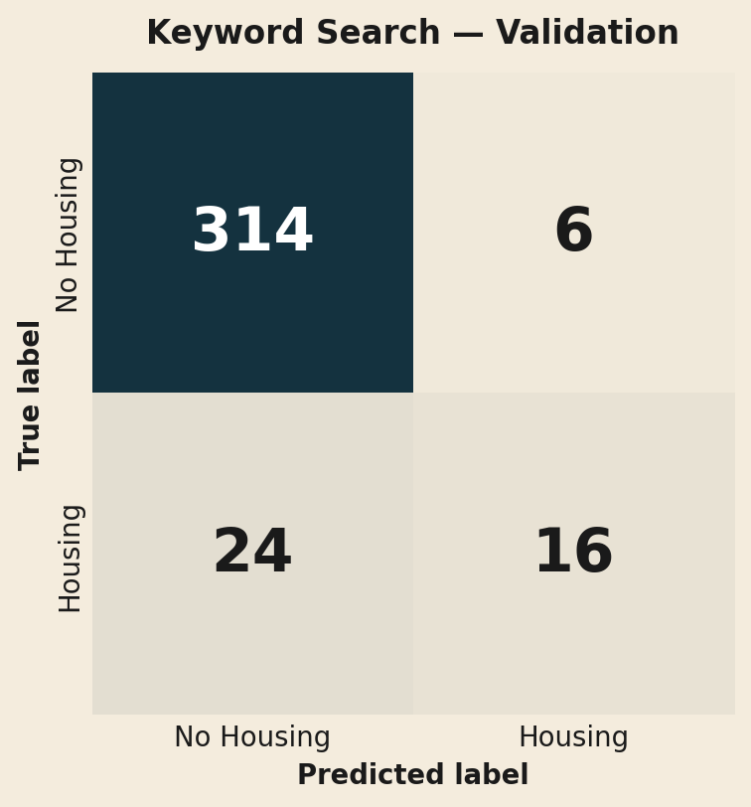
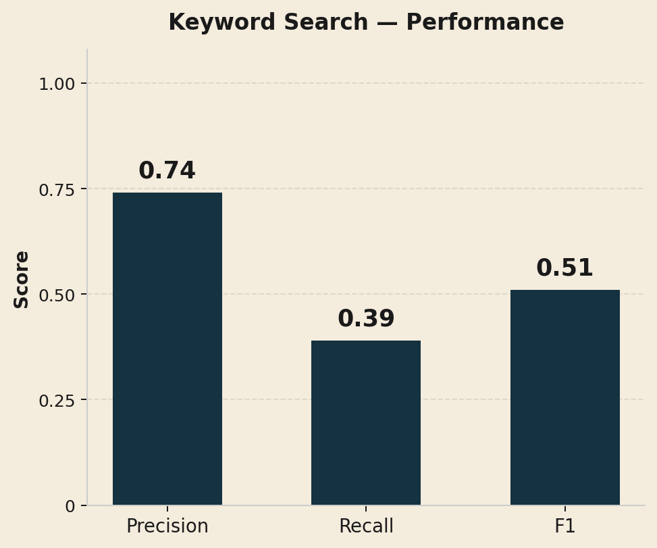
BASELINE 1
Baseline 1 — Keyword search
WHAT IT IS
Regex match on a curated list of 23 housing-related terms.
WHY A BASELINE
Simple, transparent, no training data needed. The natural floor for any ML model to beat.
KEYWORDS
homeless · shelter · street · evicted · housing instability · couch surfing · doubled up · unsheltered · …
RESULT — VALIDATION SET
Catches the obvious cases — but misses 6 in 10 real housing mentions.
A floor, not a ceiling. ML should beat this.
Housing Documentation in SMI Discharge Summaries
4 / 14

Slide 5
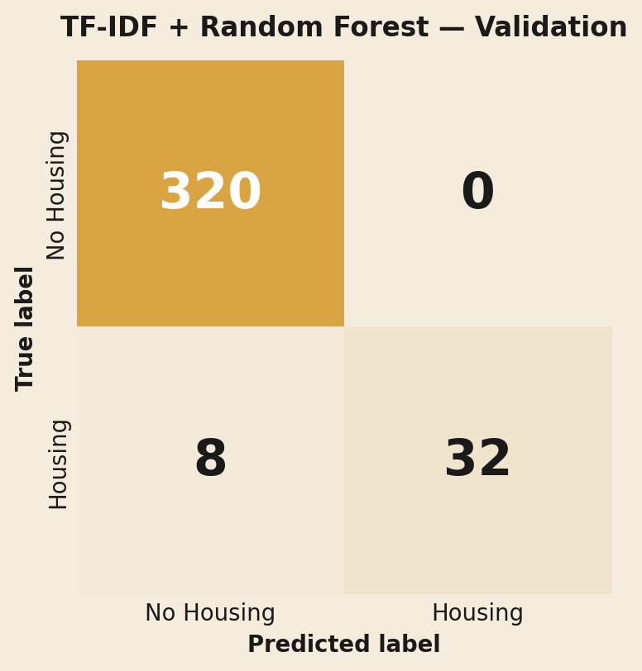
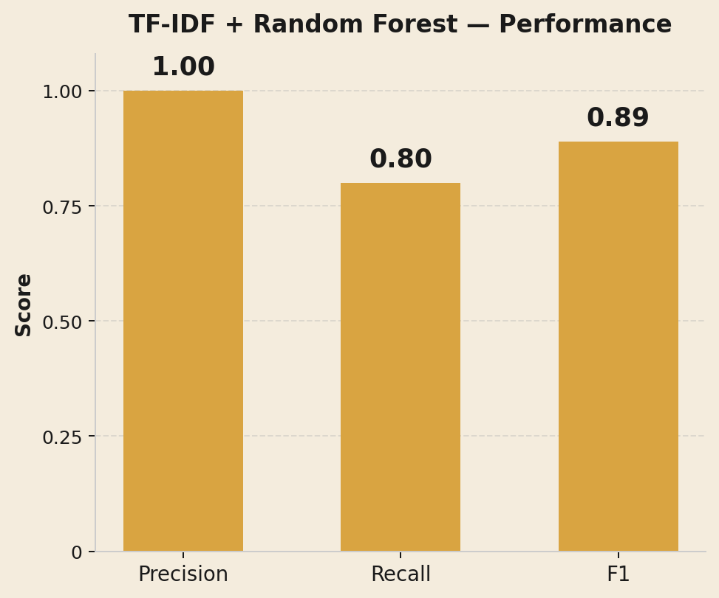
BASELINE 2
Baseline 2 — TF-IDF + Random Forest
WHAT IT IS
Sparse word-frequency vectors (unigrams + bigrams) fed to a tuned Random Forest classifier.
WHY A BASELINE
The simplest non-trivial way to turn text into vectors. Class-weighted to handle the 11% positive rate.
FEATURES
RESULT — VALIDATION SET
TF-IDF, max 5,000 features, n-grams (1,2), English stop-words removed.
Big jump on the validation set — recall 0.80, F1 0.89.
Beats the keyword recall floor of 0.39 by 2x.
Housing Documentation in SMI Discharge Summaries
5 / 14

Slide 6
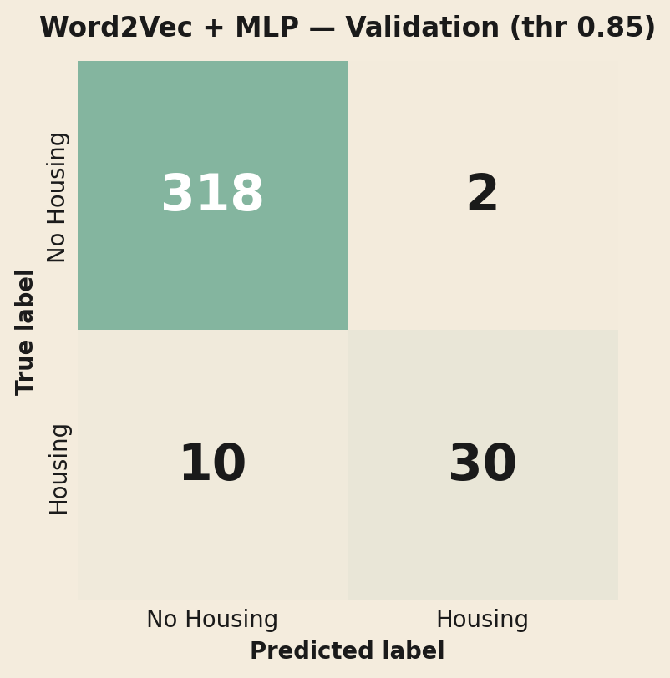
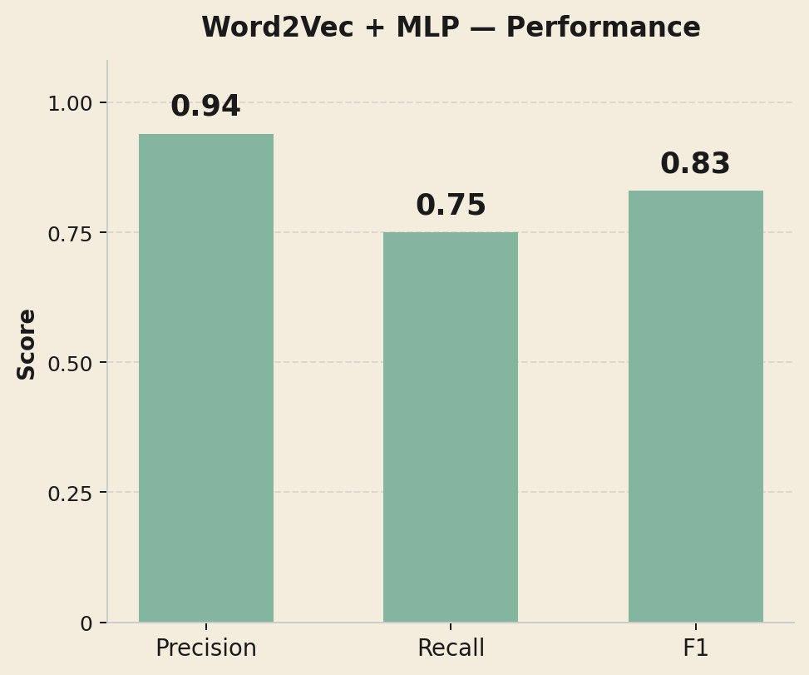
BASELINE 3
Baseline 3 — Word2Vec + MLP
WHAT IT IS
Custom Word2Vec embeddings (trained on our SMI notes), averaged per sentence, classified by an MLP.
WHY A BASELINE
Moves from word counts to semantic embeddings — words like "shelter" and "motel" land near each other in vector space.
RESULT — VALIDATION SET
FEATURES
Strong validation performance — F1 0.83 at the tuned threshold.
Slightly lower precision than RF, but better at semantic generalization.
100-d Word2Vec → mean pool → MLP (100, 50). Threshold tuned on validation to 0.85.
Housing Documentation in SMI Discharge Summaries
6 / 14

Slide 7
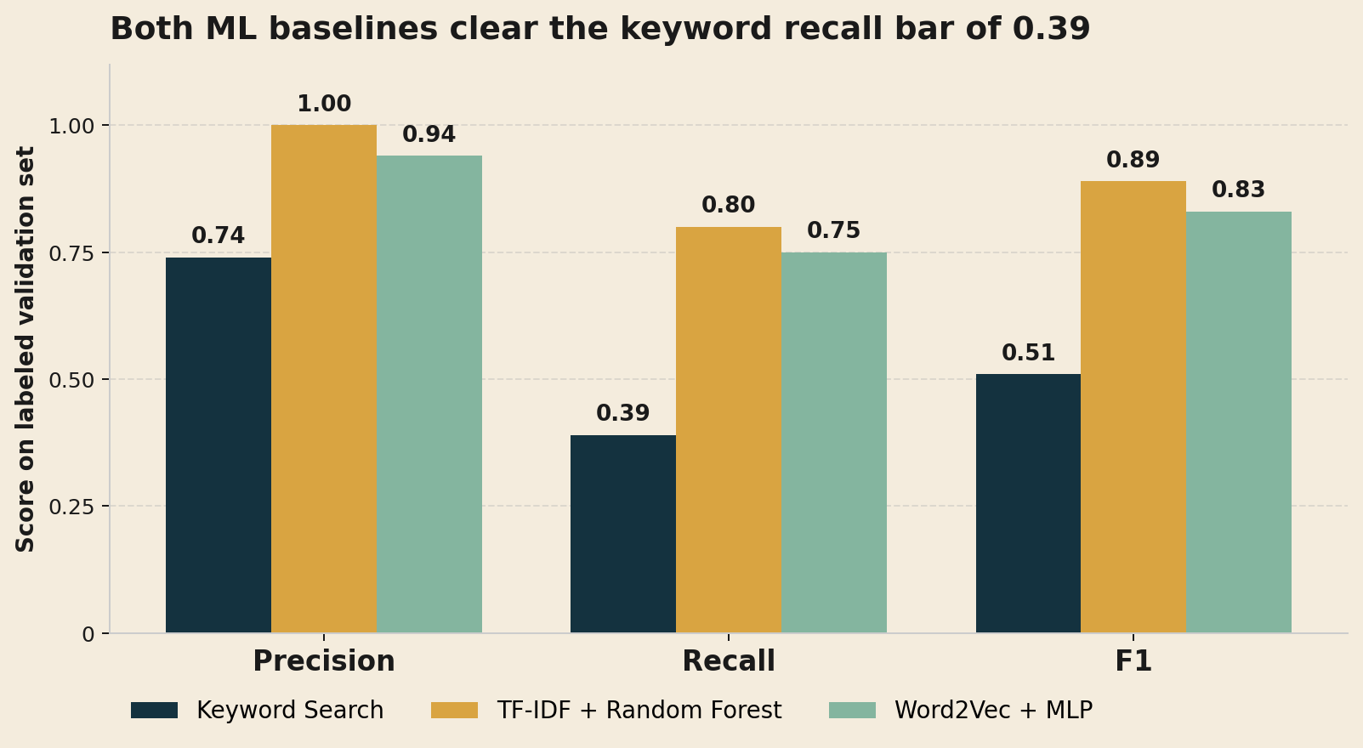
COMPARISON
All three models, side by side
BEST ON VALIDATION
TF-IDF + RF
F1 = 0.89
Highest precision (1.00) and the highest F1 in the held-out validation split.
But validation performance ≠ generalization. The next slides test that.
Housing Documentation in SMI Discharge Summaries
7 / 14

Slide 8
INFERENCE DATA
Inference data: the MIMIC-IV SMI cohort
WHAT
3,808
MIMIC-IV
Newer, larger critical-care database (~546k admissions). Discharge notes from MIMIC-IV-Note. The cohort: admissions whose primary diagnosis is schizophrenia, bipolar disorder, or severe / recurrent MDD.
admissions in our SMI cohort
PREPROCESSING
1
Split notes into sentences
WHY
Clinical guidelines say housing should be assessed and documented at discharge for SMI patients. We want to measure how often it actually is. This is our inference data — and it is unlabeled.
2
Drop non-narrative sections (labs, meds, vitals, identifiers)
3
Keep narrative sections (HPI, Brief Hospital Course, Social Hx)
4
Aggregate sentence-level predictions to a per-note flag
Housing Documentation in SMI Discharge Summaries
8 / 14

Slide 9
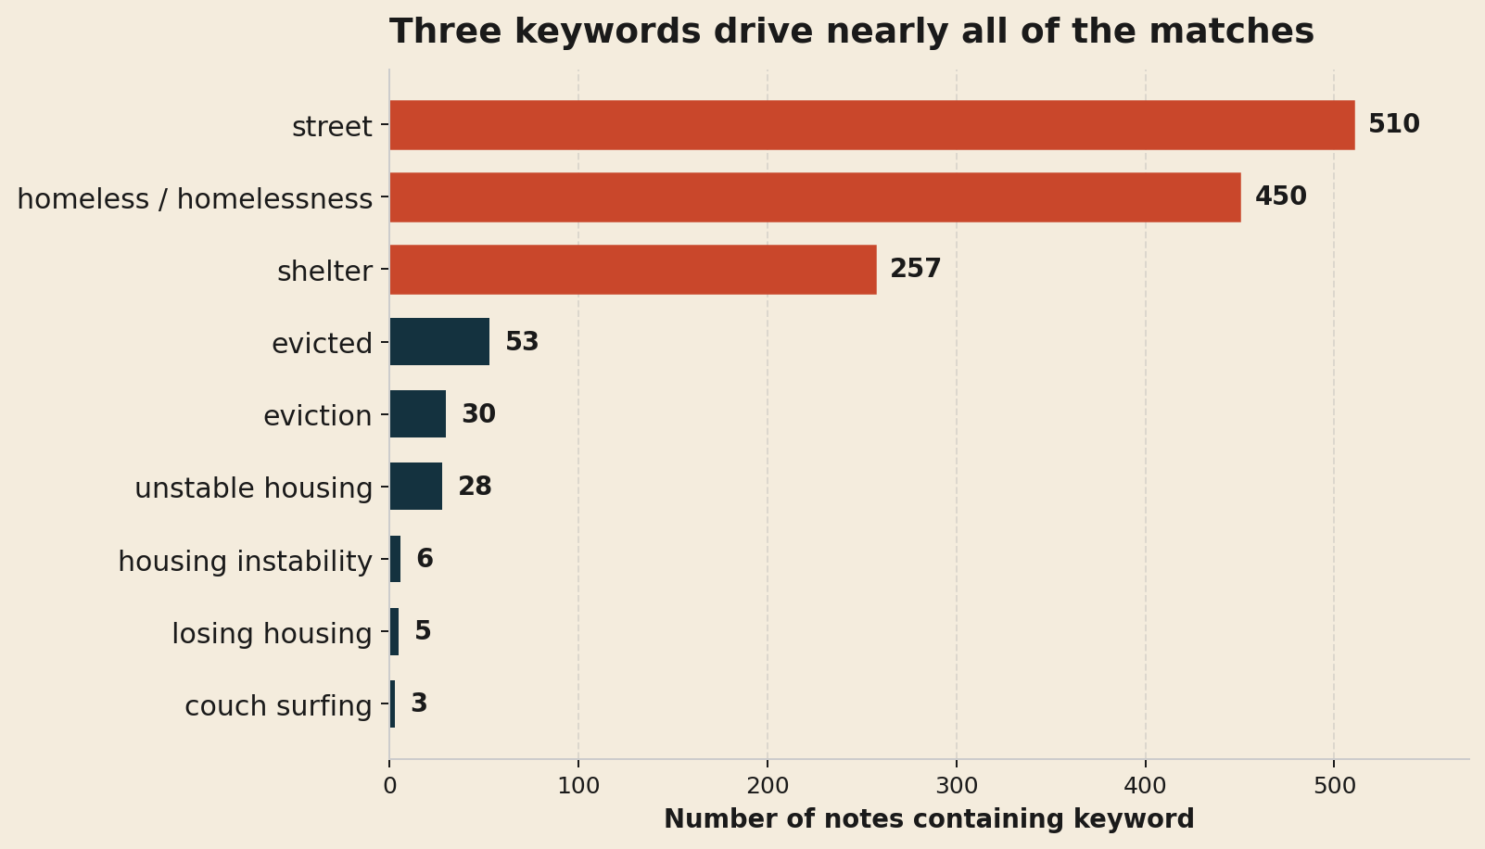
INFERENCE · BASELINE 1
Keyword search on the SMI cohort
OF NOTES FLAGGED
50.9%
of SMI discharge summaries contain a regex-matched housing keyword.
THE CONCERN
Likely overcounts via false positives: "street" can mean street clothes, "shelter" can be metaphorical.
Housing Documentation in SMI Discharge Summaries
9 / 14

Slide 10
INFERENCE · BASELINE 2
TF-IDF + Random Forest on the SMI cohort
OF NOTES FLAGGED
THE PROBLEM
1.2%
Implausibly low — and disagrees with the regex on 1,897 / 3,808 notes.
WHY IT FAILS TO GENERALIZE
Bag-of-words, not semantics.
TF-IDF vectors aren't semantic — a synonym the regex never saw is a different feature, not a similar one.
Distribution mismatch.
MIMIC-III-SDOH sentences are short and synthetic; MIMIC-IV discharge sentences are messy, abbreviated, and variable in length.
of SMI discharge summaries flagged by the validation-best model.
AGREEMENT WITH KEYWORD SEARCH
Disagrees with the regex on roughly half the cohort (1,897 notes).
Housing Documentation in SMI Discharge Summaries
10 / 14

Slide 11
INFERENCE · BASELINE 3
Word2Vec + MLP on the SMI cohort
OF NOTES FLAGGED
ASSESSMENT
83.2%
Generalizes better than RF — but probably over-flags.
WHY
Better representation.
Semantic embeddings let the model see synonyms the regex misses.
But not state-of-the-art.
Sentence vector = mean of word vectors, so "the" weighs as much as "homeless." Motivates ClinicalBERT, where attention learns which tokens matter.
at the F1-tuned threshold of 0.85 — far above the keyword 50.9%.
DISTRIBUTION SHIFT
MIMIC-III training sentences look very different from MIMIC-IV discharge sentences — model is operating off-distribution.
Housing Documentation in SMI Discharge Summaries
11 / 14

Slide 12
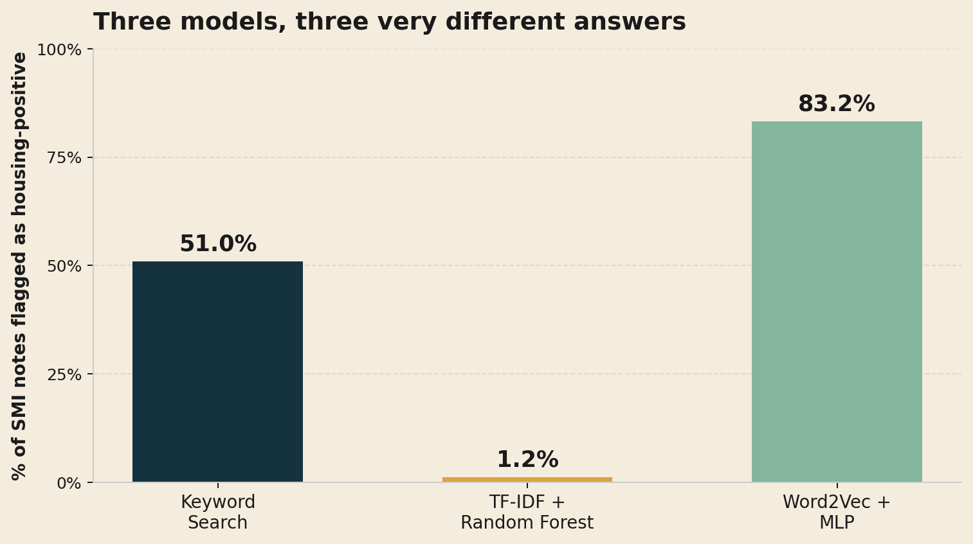
INFERENCE COMPARISON
Three models, three different answers
THE PUZZLE
Same 3,808 notes.
Very different answers.
RF barely flags anything (1.2%).
MLP flags almost everything (83.2%).
Both are out-of-distribution. Neither is fully trustworthy on this cohort.
Housing Documentation in SMI Discharge Summaries
12 / 14

Slide 13
SYNTHESIS
Main takeaways
01
Keyword search is the most trustworthy baseline.
04
The training imbalance compounds the problem.
Recall is low, but its 50.9% rate is the most defensible estimate we have today.
11% positive class. Oversampling and class-weighted loss help on validation, but don't fix off-distribution behavior.
02
TF-IDF + RF doesn't generalize from MIMIC-III to MIMIC-IV.
05
These limits motivate ClinicalBERT next.
Strong on validation (F1 0.89), but flags only 1.2% of the cohort — bag-of-words can't bridge the vocabulary gap.
Token-level attention + pretrained clinical text — the right tool for sentences this messy.
03
Word2Vec + MLP over-flags despite a tuned threshold.
Even at 0.85 (vs default 0.5), the model fires on 83.2% of notes. Mean-pooled embeddings + class imbalance + distribution shift.
Housing Documentation in SMI Discharge Summaries
13 / 14

Slide 14
NEXT STEPS
Where Milestone 4 goes
01
02
03
Fine-tune ClinicalBERT
Re-run subgroup analysis
Compare ClinicalBERT vs baseline models
Class-weighted loss, F1-tuned threshold.
Mirror the MS2 breakdowns (race, insurance, gender, diagnosis).
Compare models on the same notes
THANK YOU
Questions?
Matlin Gilman · Brianna Grissom | Project #63 · AC209B · Milestone 3
Housing Documentation in SMI Discharge Summaries
14 / 14

