Slide 1
Research, evaluation and data insights team

Slide 2
SQL Training
WEEK 1: General information about SQL

Slide 3
Course goals
General information about databases and database management
General information about SQL
Basic coding
Practical examples
Space to ask questions
Brainstorm solutions
Best practices

Slide 4
About us
Laura Tomedi
Epidemiologist
PhD in Epidemiology, MS in Public Health
SQL – accidentally used through SAS:
Data definition language
Data querying
Inese Bērziņa
Data Manager
PhD in Mathematics
SQL:
Data querying for analysis and data warehouse solutions
Data definition language (within SAS)
Brianna Mulligan
Programmer Analyst
MSc in Computer Science
SQL:
Database creation
Data maintenance
Data querying
Scott Gunn
REDI Data Team Lead
MS in Anthropology
SQL:
Data infrastructure architect
Database creation
Data maintenance
Data querying

Slide 5
References
[Book] H.Garcia-Molina, J.Ullman, and J.Widom, “Database Systems: The Complete Book”, 2nd Edition, Pearson, 2008.
First two chapters available: http://infolab.stanford.edu/~ullman/dscb.html
[IBM1] https://www.ibm.com/docs/en/zos-basic-skills?topic=zos-what-is-database-management-system
[IBM2] “What is a relational database?”,
https://www.ibm.com/topics/relational-databases#:~:text=the%20next%20step-,What%20is%20a%20relational%20database%3F,key%20or%20a%20foreign%20key.
[MongoDB] https://www.mongodb.com/basics/acid-transactions
[Wiki] https://en.wikiversity.org/wiki/Database_Examples/Northwind

Slide 6
What is a “database”?
“In essence a database is nothing more than a collection of information that exists over a long period of time, often many years.” [Book, Ch.1]
“In common parlance, the term database refers to a collection of data that is managed by database management system.” [Book, Ch.1]

Slide 7
Database Management Systems
Database Management System (DBMS) is a specialized software system for manipulation of data in database or management of database structure itself. [IBM1]
DBMS is expected to:
Allow users to create new DBs and specify their schemas [..]
Give users the ability to query data and modify the data
Support storage of very large amounts of data over long period of time
Enable durability – recovery of the database
Control access to data from many users at once
[Book, Ch.1]

Slide 8


DBMS
DBMS
Data Storage
Software application
Data Management
Database
Data Security
Queries
Administration
REDI Data infrastructure
MariaDB
Amazon Web Services
Business Intelligence Application
User

Slide 9
Transaction – one or more database operations that is considered as unit of a work.
A
ATOMICITY
All-or-nothing
C
CONSISTENCY
Data is in a consistent state when a transaction starts and when it ends.
I
ISOLATION
The intermediate state of a transaction is invisible to other transactions.
D
DURABILITY
If transaction successfully completes, the effect on DB must never be lost
Notes:
Relational databases are also typically associated with transactional databases, which execute commands, or transactions, collectively. [IBM]
DBMS is important to have these 4 components.
DBMS helps to insure that data is access in a consistent and structured way.
Helps to avoid data formatting issues.
Brie will provide some examples.

Slide 10
ACID
Example
Transaction 1 (T1): Transfer 250$ from Account 1 to Account 2
Power Failure
System Online
Start Transaction
Subtract Money
Success
Add
Money
Success
Commit Transaction
{_id: 1, bal:250 if T1 committed or
500 if T1 was aborted}
{_id: 2, bal:250 if T1 committed or
0 if T1 was aborted}
{_id: 1, bal: 500}
{_id: 2 bal: 0}
Bal < 0
Error
Error
{_id: 1, bal: 250}
{_id: 2, bal: 250}
Abort Transaction
Waits for T1 to Finish
Transaction 2: Transfer 100$ from Account 1 to Account 2
Start Transaction
Subtract Money
Success
Add
Money
Success
Commit Transaction
{_id: 1, bal: dependent on T1}
{_id: 2 bal: dependent on T1}
Bal < 0
Error
Error
{_id: 1, bal: 250}
{_id: 2, bal: 250}
Abort Transaction
Source: [MongoDB]

Slide 11
DBMS Types
DBMSs are categorized according to their data structures or types:
Hierarchical DBMS
Relational DBMS (RDBMS)
Network DBMS
Object oriented DBMS (OODBMS)
NoSQL DBMS
In-Memory DBMS
Columnar DBMS
This is a SQL course – we will be focusing on relational DBMSs only.

Slide 12
Relational DBMS
Relational DBMS – Relational database – Relational data model
Relational data model:
Relation – two-dimensional table
Attributes – columns
Schema – set of attributes
(Relational) database schema – set of schemas for the relations
Tuple – a row of a relation (table)
A tuple has one component for each attribute of the relation
Domain – data type associated with each attribute of a relation
[Book, Ch2]
COL1 | COL2 | COL3 | COL4
A1 | A2 | A3 | A4
B1 | B2 | B3 | B4
C1 | C2 | C3 | C4
Table 1

Slide 13
Example – relation “Categories”
CategoryID | CategoryName | Description | Picture
1 | Beverages | Soft drinks, coffees, teas, beers, and ales | beverages.gif
2 | Condiments | Sweet and savory sauces, relishes, spreads, and seasonings | condiments.gif
3 | Confections | Desserts, candies, and sweet breads | confections.gif
4 | Dairy Products | Cheeses | dairy.gif
5 | Grains/Cereals | Breads, crackers, pasta, and cereal | cereals.gif
6 | Meat/Poultry | Prepared meats | meat.gif
7 | Produce | Dried fruit and bean curd | produce.gif
8 | Seafood | Seaweed and fish | seafood.gif
Categories(CategoryID, CategoryName, Description, Picture) – schema
Categories(CategoryID:integer, CategoryName:text, Description:text, Picture:blob) – with domain

Slide 14
Keys of Relation
“A set for attributes forms a key for a relation if we do not allow two tuples in a relation instance to have the same values in all the attributes of the key.” [Book, Ch.2]
Unique key:
unique identifier of a row
Primary key:
Unique identifier of a row
Non-empty – cannot be NULL
There can be several unique keys in a relation, but only one primary key.
Foreign key:
a link/reference to a primary key of another existing relation

Slide 15
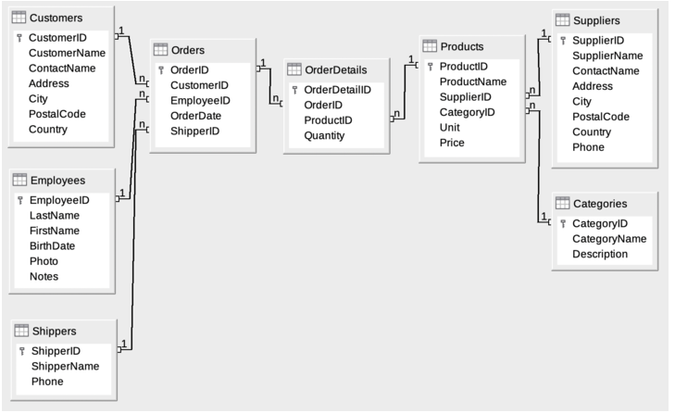
Northwind Database
Source: [Wiki]
Notes:
Relational schema diagram.

Slide 16
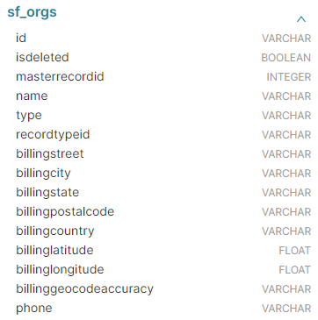
Examples – Superset: sf_orgs
sf_orgs – Salesforce organizations
ID – serves as a primary key
What else could serve as primary key?
Name
Name + billingcountry
Name + billingcountry + billingstate
…
Is there a foreign key?

Slide 17
Structured Query Language (SQL)
“Structured Query Language (SQL) is the standard programming language for interacting with relational database management systems, allowing database administrator to add, update, or delete rows of data easily.” [IBM2]
Brief history of SQL: [IBM2]

Slide 18
Defining a Relation Schema in SQL
SQL (pronounced “sequel”) is the principal language used to describe and manipulate relational databases. [Book, Ch. 2]
Current standard for SQL is called SQL:2023.
Most commercial database management systems implement something similar, but not identical to, the standard, There are two aspects to SQL:
1. The Data-Definition sublanguage for declaring database schemas and
2. The Data-Manipulation sublanguage for querying (asking questions about) databases and for modifying the database.
[Book, Ch. 2]

Slide 19
Relations in SQL
SQL makes a distinction between three kinds of relations:
Tables – stored relations. These are the kind of relation we deal with ordinarily– a relation that exists in the database and that can be modified by changing its tuples, as well as queried.
Views – relations defined by a computation. These relations are not stored, but are constructed, in whole or in part, when needed.
Temporary tables – constructed by the SQL language processor when it performs its job of executing queries and data modifications. These relations are then thrown away and not stored.
[Book, Ch. 2]

Slide 20
RDBMS
Data Storage
SQL
Software application
Data Management
Database
Data Security
Queries
Administration

Slide 21
SQL Commands
DDL
Data Definition Language
DML
Data Manipulation Language
TCL
Transaction Control Language
DQL
Data Query Language
DCL
Data Control Language
CREATE
INSERT
COMMIT
SELECT
GRANT
ALTER
UPDATE
SAVEPOINT
REVOKE
TRUNCATE
DELETE
ROLLBACK
DROP
CALL
SET TRANSACTION
EXPLAIN CALL
SET CONSTRAINT
LOCK

Slide 22
Northwind
Link: https://sqliteonline.com/#urldb=https://raw.githubusercontent.com/jpwhite3/northwind-SQLite3/master/dist/northwind.db

Slide 23
Other Materials
List will be updated during the course:
https://github.com/briannamulligan/SQlTrainingDOH

