Slide 1
Research, evaluation and data insights team

Slide 2
SQL Training
WEEK 3:joining tables in SQL, Nested Queries

Slide 3
About us
Laura Tomedi
Epidemiologist
PhD in Epidemiology, MS in Public Health
SQL – accidentally used through SAS:
Data definition language
Data querying
Inese Bērziņa
Data Manager
PhD in Mathematics
SQL:
Data querying for analysis and data warehouse solutions
Data definition language (within SAS)
Brianna Mulligan
Programmer Analyst
MSc in Computer Science
SQL:
Database creation
Data maintenance
Data querying
Scott Gunn
REDI Data Team Lead
MS in Anthropology
SQL:
Data infrastructure architect
Database creation
Data maintenance
Data querying

Slide 4
Agenda
Week 3:
Review of homework
Aliasing and Casting
Joining Tables in SQL
Merges
Inner Joins
Left Joins
Right Joins
Full Joins
Self Joins
Nested Queries
SQL in R
Practice

Slide 5
References
[Book] H.Garcia-Molina, J.Ullman, and J.Widom, “Database Systems: The Complete Book”, 2nd Edition, Pearson, 2008.
First two chapters available: http://infolab.stanford.edu/~ullman/dscb.html
[SQLiteonline] https://sqliteonline.com/#urldb=https://raw.githubusercontent.com/jpwhite3/northwind-SQLite3/master/dist/northwind.db
[Wiki] https://en.wikiversity.org/wiki/Database_Examples/Northwind
[Time math] https://www.sqlite.org/lang_datefunc.html
[Get R ] https://www.stat.colostate.edu/~jah/talks_public_html/isec2020/installRStudio.html

Slide 6
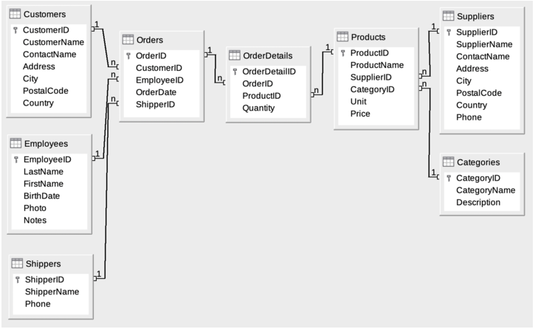
Northwind Database Model
Source: [Wiki]
Notes:
Relational schema diagram.

Slide 7
Keywords and Functions for Week 2
Basic query: SELECT, FROM
Return N tuples from query: LIMIT N
Apply Filters: WHERE
Apply logic: AND, OR, NOT, IN, LIKE , BETWEEN
Apply logic by column: CASE, WHEN, THEN
Sort output: ORDER BY(ASC/DESC)
Aggregation functions: SUM, AVG, COUNT
Grouping: GROUP BY
Filter on aggregated expressions: HAVING

Slide 8
Keywords and Functions for Week 3
Uniqueness function: DISTINCT
Aliasing: AS
Casting: CAST
JOINs: INNER, LEFT, RIGHT, FULL, JOIN
Time math function: STRFTIME (more here: https://www.sqlite.org/lang_datefunc.html)

Slide 9
Practice (1-5)
Write a query to get Product name and quantity per unit.
Write a query to get current Product list (Product ID and name).
Write a query to get discontinued Product list (Product ID and name).
Write a query to get Product list (name and unit price) by most expense.
Write a query to get Product list (id, name, unit price) where current products cost less than $20.
[w3resource]

Slide 10
Practice (6-9)
Write a query to get Product list (id, name, unit price) where products cost between $15 and $25.
Write a query to get Product list (name, unit price) of ten most expensive products.
Write a query to count current and discontinued products.
Write a query to get Product list (name, units on order , units in stock) of stock is less than the quantity on order.
[w3resource]

Slide 11
Question 1
Write a query to get Product name and quantity per unit.
What columns will we need?
What table is that from?
Does any further filtering or aggregation need to occur?
ProductName and QuantityPerUnit
Products
No, just Product name and quant per unit
Bringing these together:
SELECT ProductName, QuantityPerUnit
FROM Products;

Slide 12
Question 2
Write a query to get current Product list (Product ID and name).
What columns will we need?
What table is that from?
Does any further filtering or aggregation need to occur?
What filtering?
ProductID, ProductName, Discontinued
Products
Yes
Query says “current”, so need to leverage “Discontinued” 0/1 to get things that are not discontinued (0)
Bringing these together:
SELECT ProductID, ProductName, Discontinued
FROM Products
WHERE Discontinued = ‘0’
ORDER BY ProductName;

Slide 13
Question 3
Write a query to get discontinued Product list (Product ID and name)
What columns will we need?
What table is that from?
Does any further filtering or aggregation need to occur?
What filtering?
ProductID, ProductName, Discontinued
Products
Yes
Query says “current”, so need to leverage “Discontinued” 0/1 to get things that are not discontinued (1)
Bringing these together:
SELECT ProductID, ProductName, Discontinued
FROM Products
WHERE Discontinued = ‘1’
ORDER BY ProductName;

Slide 14
Question 4
Write a query to get Product list (name and unit price) by most expense
What columns will we need?
What table is that from?
Does any further filtering, ordering, aggregation need to occur?
What filtering?
What ordering?
ProductName, UnitPrice
Products
Yes
No filtering
By expense, or UnitPrice
Bringing these together:
SELECT ProductName, UnitPrice
FROM Products
ORDER BY UnitPrice DESC;

Slide 15
Question 5
Write a query to get Product list (id, name, unit price) where current products cost less than $20
What columns will we need?
What table is that from?
Does any further filtering, ordering, aggregation need to occur?
What filtering?
ProductID, ProductName, UnitPrice ,Discontinued
Products
Yes
Yes, need to use UnitPrice to find less than 20 AND discontinued is False
Bringing these together:
SELECT ProductID, ProductName, UnitPrice ,Discontinued
FROM Products
WHERE (((UnitPrice)<20) AND ((Discontinued)=0))
ORDER BY UnitPrice DESC;

Slide 16
Question 6
Write a query to get Product list (id, name, unit price) where products cost between $15 and $25
What columns will we need?
What table is that from?
Does any further filtering, ordering, aggregation need to occur?
What filtering?
ProductID, ProductName, UnitPrice ,Discontinued
Products
Yes
Yes, need to use UnitPrice to find < 25,>15, discontinued is False
Bringing these together:
SELECT ProductName, UnitPrice ,discontinued
FROM Products
WHERE (((UnitPrice)>=15 AND (UnitPrice)<=25) AND ((Discontinued)=0))
ORDER BY Products.UnitPrice DESC;

Slide 17
Question 7
Write a query to get Product list (name, unit price) of ten most expensive products
What columns will we need?
What table is that from?
Does any further filtering, ordering, aggregation need to occur?
What filtering?
What ordering?
Is there a limit?
ProductName, UnitPrice
Products
Yes
No filtering
By expense, or UnitPrice
Yes: 10
Bringing these together:
SELECT ProductName, UnitPrice
FROM Products
ORDER BY UnitPrice DESC
LIMIT 10;

Slide 18
Question 8
Write a query to count current and discontinued products
What columns will we need?
What functions will we need to get our answer?
What table is that from?
Does any further filtering, ordering, aggregation need to occur?
What filtering?
What ordering?
Is there a limit?
ProductID
COUNT and DISTINCT
Products
None
None
None
Bringing these together:
SELECT COUNT(DISTINCT(ProductID))
FROM Products;

Slide 19
Question 9
Write a query to get Product list (name, units on order , units in stock) of stock is less than the quantity on order
What columns will we need?
What functions will we need to get our answer?
What table is that from?
Does any further filtering, ordering, aggregation need to occur?
What filtering?
What ordering?
Is there a limit?
ProductID, ProductName, UnitsinStock, UnitsOnOrder
None
Products
Need UnitsinStock<UnitsOnOrder
None
None
Bringing these together:
SELECT ProductID, ProductName, UnitsinStock, UnitsOnOrder
FROM Products
WHERE UnitsinStock<UnitsOnOrder;

Slide 20
Aliasing- AS
In SQL we can rename columns or tables for ease of understanding or use.
This has form:
SELECT ProductName AS expensiveProduct
FROM Products
ORDER BY UnitPrice DESC
LIMIT 10;
So that ProductName is renamed expensiceProduct without changing any aspect of the column but the name.
This can be used in nested queries for readability, which we’ll touch on later.

Slide 21
Casting- CAST
In SQL, if one needs to convert a column’s datatype to a different one, CAST is used with form:
SELECT CAST(Discontinued AS INT) AS Disc_int
FROM Products
This can be used to convert between INTs, decimals, strings, and other datatypes, which can help bring two datasets containing similar information together.

Slide 22
MERGING – JOINING TWO TABLES
Here is how one could most simply pull information from two tables at a time. This is an old notation that has fallen out of use since SQL-92, but this is the outcome and the steps one should take if using two tables in the FROM clause.
This form is just as efficient as modern syntax joins, but can be confusing because the terms for the join (in red) and the filtering condition (turquoise) both need to be in the WHERE clause.
SELECT "Orders".orderdate
,"Orders".orderid
,"Orders".customerid
,"Order Details".productid
FROM "Orders", "Order Details"
WHERE ("Orders".orderid= "Order Details".orderid) AND strftime('%Y',orderdate)>='2017'
Notes:
https://learnsql.com/blog/joins-vs-multiple-tables-in-from/

Slide 23
JOIN TYPES
A JOIN clause is used to combine rows from two or more tables, based on a related column between them.
(INNER) JOIN – Returns records that have matching values in both tables
LEFT JOIN – Returns all records from the left table, and the matched records from the right table
RIGHT JOIN - Returns all records from the right table, and the matched records from the left table
FULL (OUTER) JOIN – Returns all records when there is a match in either left or right table
SELF JOIN
INNER JOIN
LEFT JOIN
RIGHT JOIN
FULL JOIN

Slide 24
INNER JOIN
SELECT Orders.orderdate
,Orders.orderid
,Orders.customerid
,"Order Details".productid
FROM "Orders"
INNER JOIN "Order Details"
ON "Orders".orderid= "Order Details".orderid
WHERE strftime('%Y',orderdate)>='2017'
ORDER BY "Orders".orderdate
, "Orders".orderid
SELECT o.orderdate
,o.orderid
,o.customerid
,od.productid
FROM "Orders" AS o
INNER JOIN "Order Details" AS od
ON o.orderid= od.orderid
WHERE strftime('%Y',o.orderdate)>='2017'
ORDER BY o.orderdate
, od.orderid

Slide 25
LEFT JOIN
SELECT o.orderdate
,o.orderid
,o.customerid
,od.productid
FROM "Orders" AS o
LEFT JOIN "Order Details" AS od
ON o.orderid= od.orderid
WHERE strftime('%Y',o.orderdate)>='2017'
ORDER BY o.orderdate
, od.orderid
SELECT o.orderdate
,o.orderid
,o.customerid
,od.productid
FROM "Orders" AS o
LEFT JOIN "Order Details" AS od
ON o.orderid= od.orderid
AND strftime('%Y',o.orderdate)>='2017'
ORDER BY o.orderdate
, od.orderid
Q: Whats the difference?

Slide 26
LEFT JOIN (2)
SELECT c.customerid
,c.companyname
,o.orderdate
,o.orderid
,o.shippeddate
FROM Customers AS c
LEFT JOIN Orders AS o
ON c.customerid= o.customerid
WHERE strftime('%Y',o.orderdate)>='2017'
SELECT c.customerid
,c.companyname
,o.orderdate
,o.orderid
,o.shippeddate
FROM Customers AS c
LEFT JOIN Orders AS o
ON c.customerid= o.customerid
AND strftime('%Y',o.orderdate)>='2017'
Q: Whats the difference?

Slide 27
RIGHT JOIN
SELECT c.customerid
,c.companyname
,o.orderdate
,o.orderid
,o.shippeddate
FROM Customers AS c
RIGHT JOIN Orders AS o
ON c.customerid= o.customerid
WHERE strftime('%Y',o.orderdate)>='2017'
SELECT c.customerid
,c.companyname
,o.orderdate
,o.orderid
,o.shippeddate
FROM Customers AS c
RIGHTJOIN Orders AS o
ON c.customerid= o.customerid
AND strftime('%Y',o.orderdate)>='2017'
Q: Whats the difference?

Slide 28
FULL JOIN
SELECT c.customerid
,c.companyname
,o.orderdate
,o.orderid
,o.shippeddate
FROM Customers AS c
FULL JOIN Orders AS o
ON c.customerid= o.customerid

Slide 29
SELF JOIN
SELECT c1.customerid
,c1.companyname
,c1.country
,c2.customerid AS customerid2
,c2.companyname AS companyname2
,c2.country AS country2
FROM Customers AS c1
(INNER/LEFT) JOIN Customers AS c2
ON c1.customerid<> c2.customerid AND c1.country= c2.country

Slide 30

Subqueries/ Nested Queries
In SQL one query can be used in evaluation of another.
Subquery – a query that is part of another query.
There are number of ways that subqueries can be used:
Return single constant, which can be compared with another value in WHERE clause.
Return relations that can be used in WHERE clause.
Subqueries can have their relations appear in FROM clause, just like any stored relation can.
[Book]
https://jackdawliving.com/cdn/shop/products/VintageRussianNestingDolls-JackdawLiving_800x.jpg?v=1589638754

Slide 31
Single Constant
Select all products having unit price above average unit price of all products:
SELECT *
FROM Products
WHERE unitprice >
(SELECT AVG(unitprice) FROM Products)

Slide 32
Returns Relation (WHERE Clause)
Select all discounted orders (there is at least one discounted product):
SELECT count(*)
FROM Orders
WHERE orderid IN
(SELECT DISTINCT orderid
FROM "Order Details" as od
WHERE discount>0
)

Slide 33
Returns Relation (FROM Clause)
Calculate final price (apply discounts) per product, order
Then return final sum per order
SELECT orderid
,SUM(Final_sum) AS Total_order_sum
FROM (
SELECT *
,unitprice*quantity*(1-Discount) as Final_price
FROM "Order Details"
ORDER BY Final_sum
) AS od
GROUP BY orderid

Slide 34
Query Outputs used in Joins
SELECT o.*
FROM ORDERS AS o
JOIN
(SELECT
CustomerId
,MAX(orderdate) as latest_order_date_customer
FROM ORDERS
GROUP BY CustomerId
) as lo
ON o.CustomerId=o.CustomerId AND O.orderdate=lo.latest_order_date_customer

Slide 35
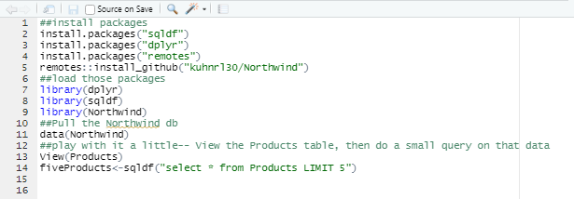
SQLite in R
If you don’t have R and/or RStudio on your computer, here’s a great resource: https://www.stat.colostate.edu/~jah/talks_public_html/isec2020/installRStudio.html
Once in RStudio, try:

Slide 36
R Text
##install packages
install.packages("sqldf")
install.packages("dplyr")
install.packages("remotes")
remotes::install_github("kuhnrl30/Northwind")
##load those packages
library(dplyr)
library(sqldf)
library(Northwind)
##Pull the Northwind db
data(Northwind)
##play with it a little-- View the Products table, then do a small query on that data
View(Products)
fiveProducts<-sqldf("select * from Products LIMIT 5")

Slide 37
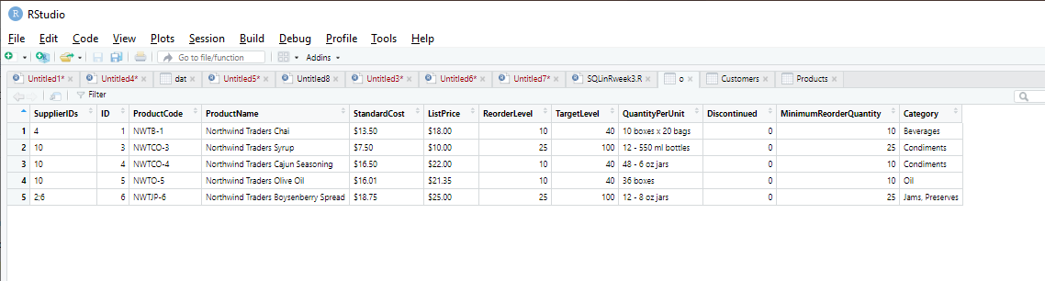
R Outcomes:
fiveProducts<-sqldf("select * from Products LIMIT 5")
View(fiveProducts)

Slide 38
Practice
All together: Provide total quantity, total sum of ordered stuff (with applied discounts) per customer, showing also amounts per category + showing flag if customer has both anything for particular category
If time or as homework:
List all Suppliers with all Products (ID, Name) they offer
Number of Orders by Customer Country and Year
Count of how many employees are associated with no orders, one order, or more than one order

