Slide 1
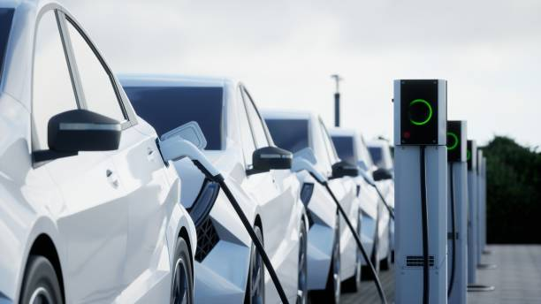
⚡
EV INDONESIA · PORTFOLIO CASE STUDY
Indonesia Electric
Vehicle Analysis
Market Landscape, Vehicle Performance & Budget Opportunity
[Brian Naufal]
Data Analyst | Business Intelligence
Tools: Power BI • DAX • Power Query
Notes:
Opening slide. Introduce yourself as a Data Analyst and frame this as an end-to-end BI project: from raw, messy EV specification data to an interactive decision-support dashboard built in Power BI. Keep this to ~20 seconds — name, role, and one line: 'I analyzed 60 EV models sold in the Indonesian market to help buyers and stakeholders compare price, performance and value.' Replace [Your Name] before presenting.

Slide 2
01 — BUSINESS CONTEXT
A Fragmented Market Is Hard to Compare
The Indonesian EV market spans dozens of brands with wide variation in price, driving range, battery capacity, motor power and charging time. When these specs live in raw, disconnected tables, stakeholders struggle to compare vehicles or match options to a real budget.
📊
💰
⚖️
Scattered Specifications
No Budget-Fit View
“Value” Is Guesswork
Price, range, battery, power and charging time sit in separate raw fields — there is no single view to compare trade-offs.
Buyers and planners cannot easily see which vehicles are realistically within a specific price ceiling.
Without a consistent value metric, choosing the best price-to-performance option relies on gut feel, not data.
THE BUSINESS QUESTION
“Which EV models offer the best balance between price, range and performance — and which options fit a given budget?”
Business Context
Indonesia EV Analysis | 2
Notes:
Main message: raw EV specs are too fragmented for stakeholders to compare confidently. Walk through the 3 problem cards briefly, then land on the business question banner — this is the single question the rest of the deck (and dashboard) answers. Observation vs interpretation: the fragmentation is an observed data condition; 'hard to compare' and 'guesswork' are the interpreted business pain points.

Slide 3
02 — OBJECTIVES
Four Questions Guide the Analysis
Each analytical question maps directly to a page in the Power BI dashboard.
What does the EV market landscape look like?
1
Market Analysis
Which EV models offer the best value?
2
Vehicle Analysis
How are price, battery, power and driving range related?
3
Vehicle Analysis
Which EV models fit a selected budget?
4
Budget Simulator
Business Insights consolidates all four analyses into decision-ready recommendations →
Objectives & Analytical Questions
Indonesia EV Analysis | 3
Notes:
Frame the dashboard as an answer engine: each analytical question routes to a specific page. This slide sets audience expectations for what they'll see in slides 5–8, mirroring the dashboard's own navigation.

Slide 4
03 — DATASET & PREPARATION
From Raw Specs to Analysis-Ready Data
Raw Data
60
↓
Power Query
EV MODELS IN THE CATALOG
↓
Data Cleaning
Vehicle Name • Brand • Price • Driving Range • Battery Capacity • Motor Power • Charging Time • Seating Capacity
↓
Data Validation
↓
DAX Measures & Calculated Columns
↓
Power BI Dashboard
⚠
12 vehicle models were flagged for invalid price values and excluded from price-based analysis. Other attributes — such as driving range and battery capacity — were not necessarily affected, so these models still appear in performance-based comparisons.
Dataset & Data Preparation
Indonesia EV Analysis | 4
Notes:
Dataset: 60 EV models scraped/compiled with 8 core attributes. Walk the workflow top to bottom — emphasize Data Validation as the step that caught the price issue. On the flagged-price callout: be precise — 12 of 60 models (20%) have a placeholder price value (29.1 Juta, identical across all 12), so they were excluded ONLY from price/value/budget analysis. Their range and battery specs remained valid and reusable, which is why 2 of them still appear later in the Top-5 Longest Range ranking (slide 7).

Slide 5

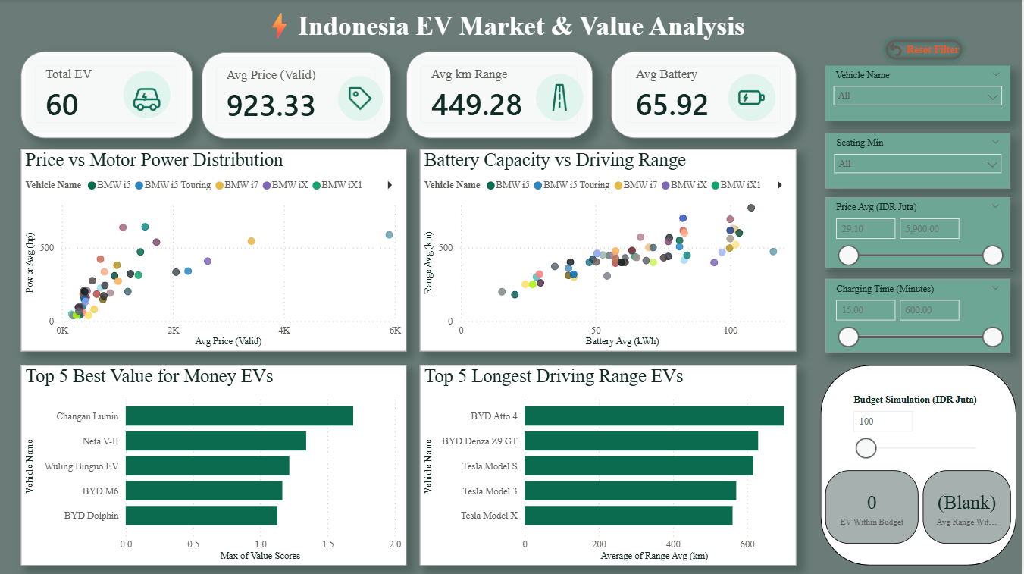
04 — DASHBOARD WALKTHROUGH
Executive Overview
DASHBOARD ELEMENTS
①
KPI Summary
②
Price vs Motor Power
📸 SCREENSHOT PLACEHOLDER
Dashboard / Executive Overview page
Recommended size: 8.3" x 4.15" @ 150 dpi, full-page capture
③
Battery vs Driving Range
④
Top 5 Value for Money
⑤
Top 5 Driving Range
⑥
Interactive Filters
⑦
Budget Simulation
KEY TAKEAWAYS
● The catalog covers 60 EV models across 30 brands; 48 carry validated pricing used in value and budget analysis.
● Average driving range is ~449 km and average battery capacity ~66 kWh — most catalog EVs already exceed typical daily commuting needs.
● Changan Lumin leads the Best-Value ranking (score 1.69) while Mercedes-Benz EQS leads Longest Range (770 km) — the two rankings favor different vehicles, showing price and range don’t scale together.
Dashboard Walkthrough — Executive Overview
Indonesia EV Analysis | 5
Notes:
Insert the actual Executive Overview screenshot in the placeholder before presenting. Use the numbered legend to orient the audience quickly instead of narrating every visual. All three takeaways are grounded in the dataset: 60 models / 30 brands / 48 validly priced; avg range 449 km, avg battery 66 kWh (unfiltered, all 60 models); Changan Lumin (Value Score 1.69) vs Mercedes-Benz EQS (770 km range) as the two 'winners' of different rankings — a good hook for 'best value ≠ best spec'.

Slide 6
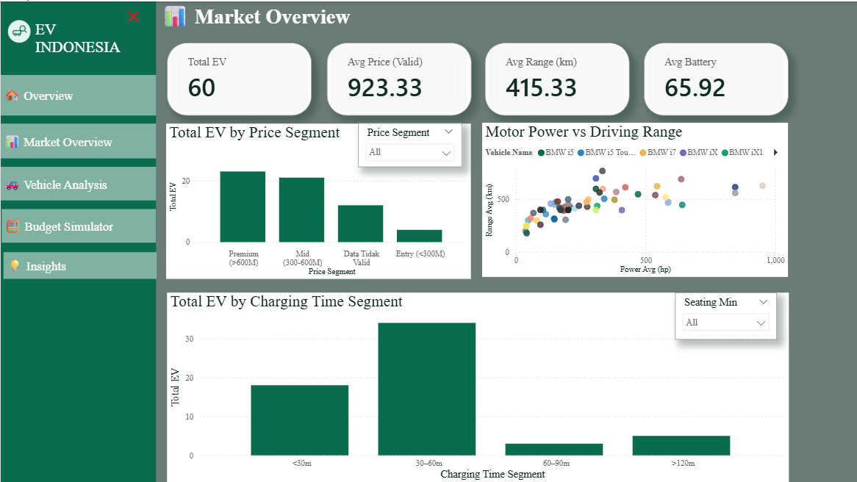
05 — MARKET ANALYSIS
What Does the EV Market Landscape Look Like?
📸 SCREENSHOT PLACEHOLDER
Market Analysis page
Recommended size: 5.7" x 3.1" @ 150 dpi
FINDING EV models cluster into three price tiers, skewed toward Premium.
Evidence: Premium (>600M): 23 models (48%) · Mid (300–600M): 21 (44%) · Entry (<300M): 4 (8%) — of 48 validly priced models. Implication: The catalog is currently dominated by upper-tier imports; affordable options remain scarce for mass-market adoption.
FINDING Charging speed varies widely across the catalog.
Evidence: 34 models charge in 30–60 min, 18 in under 30 min — but 5 models take over 120 minutes (up to 600 min). Implication: Charging time is a major differentiator and should be treated as a primary comparison filter, not a secondary spec.
Market Analysis
Indonesia EV Analysis | 6
Notes:
Answers: 'What does the EV market landscape look like?' All figures are computed directly from the dataset (48 models with validated pricing; segment thresholds: Entry <300M, Mid 300–600M, Premium >600M IDR Juta). Charging time distribution is computed across all 60 models (charging time isn't affected by the price flag). Emphasize the 'so what': premium skew = market entry opportunity for affordable EVs; wide charging spread = a real product differentiator.

Slide 7
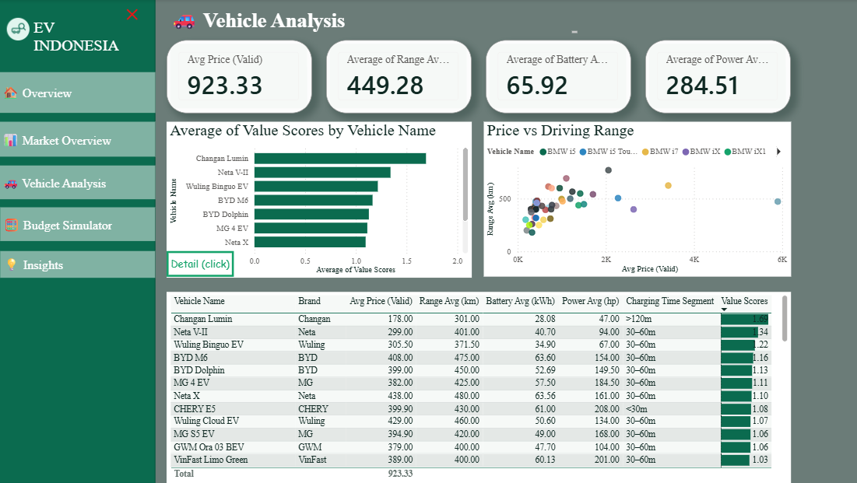
06 — VEHICLE ANALYSIS
Which EV Models Stand Out?
📸 SCREENSHOT PLACEHOLDER
Vehicle Analysis page
Recommended size: 5.7" x 3.3" @ 150 dpi
Top Value: Changan Lumin
Top Range: Mercedes-Benz EQS
Power ↔ Range Relationship
Data-Quality Note
Value Score 1.69 — priced at Rp178 Juta with 301 km range, the highest range-per-rupiah in the catalog. Entry-tier price does not mean low value.
770 km range, the longest in the catalog — but at a premium price (Rp2,057 Juta). Range leadership currently sits in the premium tier.
Motor power and driving range show a moderate-to-strong correlation (r = 0.68) across all 60 models — higher-power EVs tend to also offer longer range.
2 of the Top-5 longest-range vehicles (BYD Atto 4, BYD Denza Z9 GT) carry flagged price data — usable for range comparison, excluded from value/budget analysis until verified.
Vehicle Analysis
Indonesia EV Analysis | 7
Notes:
All numbers come directly from the EV_Data table: Changan Lumin (Value Score 1.69, price 178, range 301) is the top Value Score in the full 60-row dataset; Mercedes-Benz EQS (770 km) is the longest range. Power-vs-range Pearson correlation computed across all 60 models = 0.68. The data-quality note is important — it shows you handle imperfect data honestly rather than silently dropping flagged rows from every chart.

Slide 8
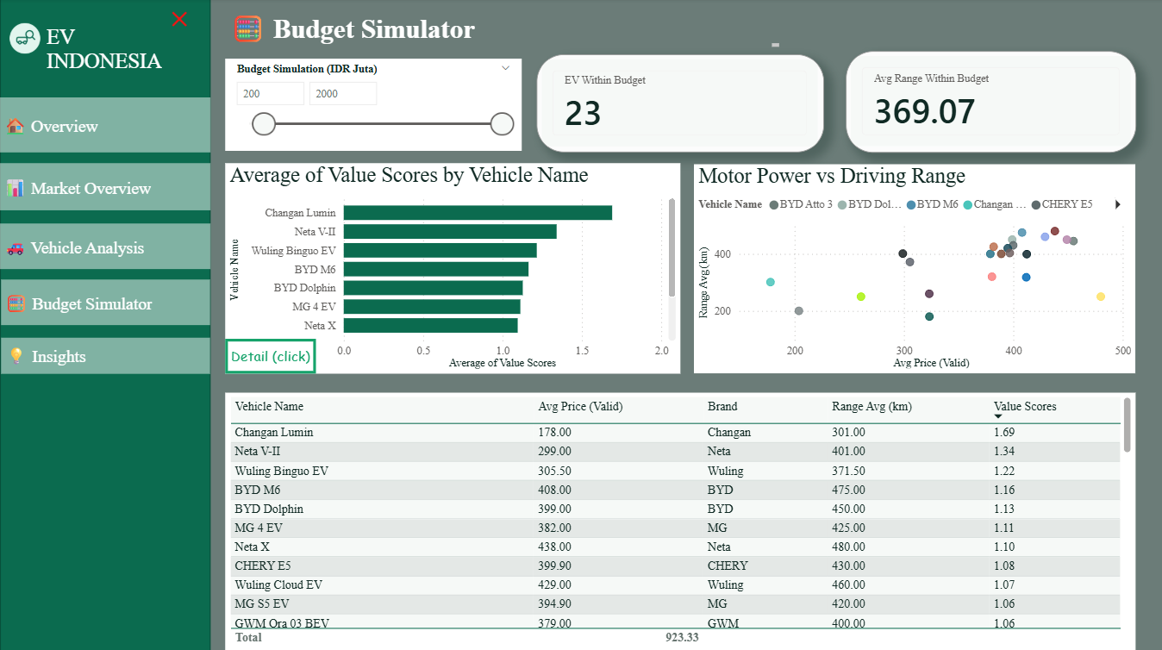
07 — BUDGET SIMULATOR
Which EV Models Fit a Selected Budget?
Selected
Budget
Filter Eligible
EV Models
EV Within
Budget
Avg. Range
Within Budget
Best Value
Within Budget
→
→
→
→
📸 SCREENSHOT PLACEHOLDER
Budget Simulator page
Recommended size: 5.7" x 2.55" @ 150 dpi
Example — Budget = IDR 500 Juta: 23 of 48 validly priced models qualify, with an average driving range of 369 km. Changan Lumin remains the best-value pick.
So what: raising the budget from 300→800 Juta (+167%) unlocks 8x more eligible models, but average range improves only ~34% — a higher budget mainly buys brand and feature variety, not dramatically more range.
Budget Simulator
Indonesia EV Analysis | 8
Notes:
The simulator uses a Power BI What-if Parameter to drive three linked measures dynamically. Numbers shown (300/500/800 Juta → 4/23/32 eligible models; avg range 288/369/387 km) are computed directly from the dataset using the same filter logic as the dashboard's DAX measures, so they'll match what the audience sees live. This is one of the strongest slides for a hiring manager — it shows you can translate an interactive feature into a clear, quantified business insight instead of just describing the UI.

Slide 9
08 — SYNTHESIS
Key Insights
Structured the same way as the dashboard’s Business Insights page.
01
Portfolio Position
02
Performance Pattern
INSIGHT The Premium segment leads the validly priced catalog.
EVIDENCE Premium (>600M) accounts for 23 of 48 validly priced models (48%) — the largest single tier, ahead of Mid 300–600M (44%) and Entry <300M (8%).
IMPLICATION The Indonesian EV catalog currently leans toward the upper price tier.
INSIGHT Power and range move together.
EVIDENCE Motor Power and Driving Range correlate at r = 0.68 across all 60 models.
IMPLICATION Higher-powered EVs tend to also deliver longer range — useful for performance-tier positioning.
03
Charging Landscape
04
Budget Opportunity
INSIGHT Charging speed varies enormously across the catalog.
EVIDENCE Fastest: 5 models tie at 15 minutes (incl. ZEEKR 7X, GAC Aion Hyptec HT). Slowest: Wuling E200 (600 minutes).
IMPLICATION The charging-time gap between models is very wide — a strong basis for a headline comparison filter.
INSIGHT The budget simulator reveals options invisible from price alone.
EVIDENCE At a budget of Rp500 Juta, 23 of 48 models qualify, averaging 369 km range; Changan Lumin remains the best-value pick.
IMPLICATION A dynamic simulator surfaces smarter recommendations than a static price list.
EXECUTIVE TAKEAWAY Use price, driving range, charging time and value score together — no single metric tells the full story.
Key Insights
Indonesia EV Analysis | 9
Notes:
This slide is intentionally structured to match the dashboard's own Business Insights page — same 4 categories, same order — so the audience recognizes it immediately when you switch to the live dashboard. Data-integrity note for presenter: the live dashboard's 'Portfolio Position' card currently displays '48 of 48 models' due to a DAX context bug in the Dominant Segment Count measure (an explicit CALCULATE filter on Price Segment overrides the row-context filter from the iterator, so every segment counts all 48 valid rows instead of just its own). This deck uses the statistically correct figure (23 of 48, 48%) instead — recommend fixing the measure before your next dashboard demo. Similarly, 'Charging Landscape' correctly shows no single fastest model because 5 vehicles tie at 15 minutes — SELECTEDVALUE returns blank on ties, which is why the live dashboard's fastest-model name appears empty. That is expected behavior, not a bug.

Slide 10
09 — RECOMMENDATIONS
From Findings to Action
👤
For Customers
🏭
For EV Sellers / Manufacturers
🎯
For Management / Decision Makers
● Prioritize the Value Score (range-per-rupiah), not price or range alone.
● Only 4 of 48 validly priced models sit in the Entry (<300M) segment — a clear whitespace for affordable EVs.
● Adopt budget-based segmentation instead of flat price tiers when profiling target customers.
● Use the Budget Simulator to compare realistic options at your exact price ceiling.
● Position performance-tier vehicles using Power + Range as a combined KPI.
● Treat charging time as a primary product-fit filter, not a secondary spec.
● Check charging time separately — it ranges from 15 to 600 minutes across the catalog.
● Verify and republish pricing for the 12 flagged models to unlock them for value comparisons.
● Establish a recurring data-validation step before specs reach decision-facing dashboards.
Recommendations
Indonesia EV Analysis | 11
Notes:
Every recommendation traces back to a specific finding: Entry-segment scarcity (4 of 48 models) → manufacturer whitespace; Power-Range correlation (r=0.68) → performance-tier KPI; the 12 flagged prices → data governance recommendation; budget non-linearity → segmentation strategy. Present column by column, audience by audience — recruiters and hiring managers respond well to seeing you translate analysis into role-specific action, not just charts.

Slide 11
CONCLUSION
From Fragmented Specs to Confident Decisions
Market
Understanding
Vehicle
Comparison
Budget
Simulation
Decision
Support
→
→
→
“The dashboard transforms fragmented EV specifications into an interactive decision-support tool, allowing users to evaluate market positioning, compare vehicle performance, and identify suitable EV options within a defined budget.”
Built end-to-end — from raw, imperfect specifications to an interactive Power BI experience — this project reflects how data analysis turns scattered numbers into confident, budget-aware decisions.
[Brian Naufal] • [brian.naufal5420@gmail.com] • brian naufal • https://briannaufal-portfolio.netlify.app/
Notes:
Close on the flow diagram: Market understanding → Vehicle comparison → Budget simulation → Decision support — this mirrors the four dashboard pages and the four analytical questions from slide 3, giving the deck a clean full-circle structure. End with the closing statement and your contact details. Replace the bracketed placeholders before sending/presenting.

Slide 12
APPENDIX A — DAX
DAX Measures
Core measures and calculated columns behind every KPI, chart, and simulator on the dashboard.
01
Core KPI Measures
02
Value & Segmentation
INSIGHT Baseline metrics reused across every page.
EVIDENCE Total EV, Avg Price (Valid), Avg Range, Avg Battery, Avg Power, Avg Charging Time — explicit DAX measures over EV_Data, not default field summarization.
IMPLICATION One reusable source of truth per KPI, instead of re-deriving the same aggregation in every card.
INSIGHT Turning raw specs into a comparable score.
EVIDENCE Value Score (column) = Range ÷ Valid Price. Price Segment (column) buckets each model into Entry / Mid / Premium / Data Tidak Valid.
IMPLICATION Enables Top-N ranking and price-tier analysis without repeating logic inside every visual.
03
Budget Simulator Logic
04
Insight & Correlation
INSIGHT Dynamic filtering driven by a What-if Parameter.
EVIDENCE EV Within Budget, Avg Range Within Budget, Best Value Within Budget — built with CALCULATE + SELECTEDVALUE against the Budget Simulation parameter.
IMPLICATION Every card on the Budget Simulation page reacts instantly to the slider — no manual filtering.
INSIGHT Text measures that narrate the data.
EVIDENCE Power Range Correlation (Pearson r via SUMX/AVERAGE), Dominant Segment Name/Count, Fastest/Slowest Charging Model feed the Business Insight page’s dynamic sentences.
IMPLICATION Insight text updates itself as data changes, instead of being hard-coded.
DAX DESIGN PRINCIPLE Every price-based measure explicitly excludes the 12 flagged invalid-price rows — accuracy is enforced once, in the model layer, not left to each visual.
DAX Measures
Indonesia EV Analysis | 13

Slide 13
APPENDIX B — DATA MODEL
Data Model
A single fact table, one disconnected parameter, and validation built into the columns.
01
Grain: One Row per Vehicle
02
Calculated Columns
INSIGHT EV_Data holds 60 rows — 1 row = 1 model, verified with no duplicates.
EVIDENCE e.g. “BMW i5” appears exactly once; Price, Range, Battery and Power all sit at the same vehicle-level grain.
IMPLICATION Row-level calculated columns behave predictably inside Table and Bar chart visuals.
INSIGHT Four columns layered on top of the raw fields.
EVIDENCE Brand (Power Query text split), Price Segment, Valid Price, and Value Score — all row-level DAX columns on EV_Data.
IMPLICATION Data-quality logic lives once in the model, instead of being repeated across 20+ visuals.
03
Budget Simulation Parameter
04
A Flat, Single-Table Model
INSIGHT A disconnected What-if numeric-range table.
EVIDENCE ‘Budget Simulation (IDR Juta)’ has no relationship to EV_Data — its selected value is read via SELECTEDVALUE inside measures.
IMPLICATION Standard pattern for slider-driven simulators that don’t require row-level filtering through relationships.
INSIGHT No date dimension or extra relationships needed.
EVIDENCE Every field lives directly on EV_Data — there is no time-series analysis requiring a calendar table here.
IMPLICATION Keeps the model simple and avoids relationship-management overhead.
MODEL DESIGN PRINCIPLE Data-quality flags (Price Segment = “Data Tidak Valid”) live in the model layer, so every page inherits one single definition of “invalid.”
Data Model
Indonesia EV Analysis | 14

Slide 14
APPENDIX C — INTERACTIVITY
Interactivity Features
How users explore the dashboard beyond static charts.
01
Slicers & Filters
02
Custom Tooltip Page
INSIGHT Four interactive filters on the Overview page.
EVIDENCE Vehicle Name, Seating Min, Price Avg (range slider), Charging Time (range slider).
IMPLICATION Any stakeholder can narrow the catalog to their own criteria without editing the report.
INSIGHT A dedicated mini-page shown on hover.
EVIDENCE ‘Tootlip Vehicle’ renders Vehicle Name plus 4 spec cards, triggered from both scatter charts via Format → Tooltip → Report page.
IMPLICATION Point-level detail on a 60-point scatter plot, without cluttering the chart with labels.
03
Drillthrough to Vehicle Detail
04
Sidebar Navigation
INSIGHT Right-click a bar to open a full spec page.
EVIDENCE ‘Vehicle Detail’ filters on Vehicle Name and includes a dynamic “Buka Sumber Data” button linking to each model’s source URL.
IMPLICATION Turns a ranking chart into a research tool for one model at a time.
INSIGHT Buttons and Page navigation across 5 pages.
EVIDENCE Every page carries an identical sidebar; the current page’s button is manually highlighted in dark green on that copy.
IMPLICATION Gives the dashboard an app-like navigation feel instead of relying on default page tabs.
INTERACTIVITY PRINCIPLE Every interactive element was re-tested after the invalid-price fix, so exploration never surfaces the 12 flagged rows as if they were valid.
Interactivity Features
Indonesia EV Analysis | 15

Slide 15
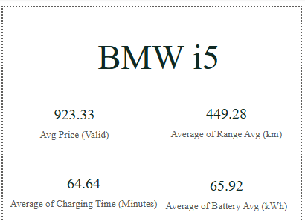
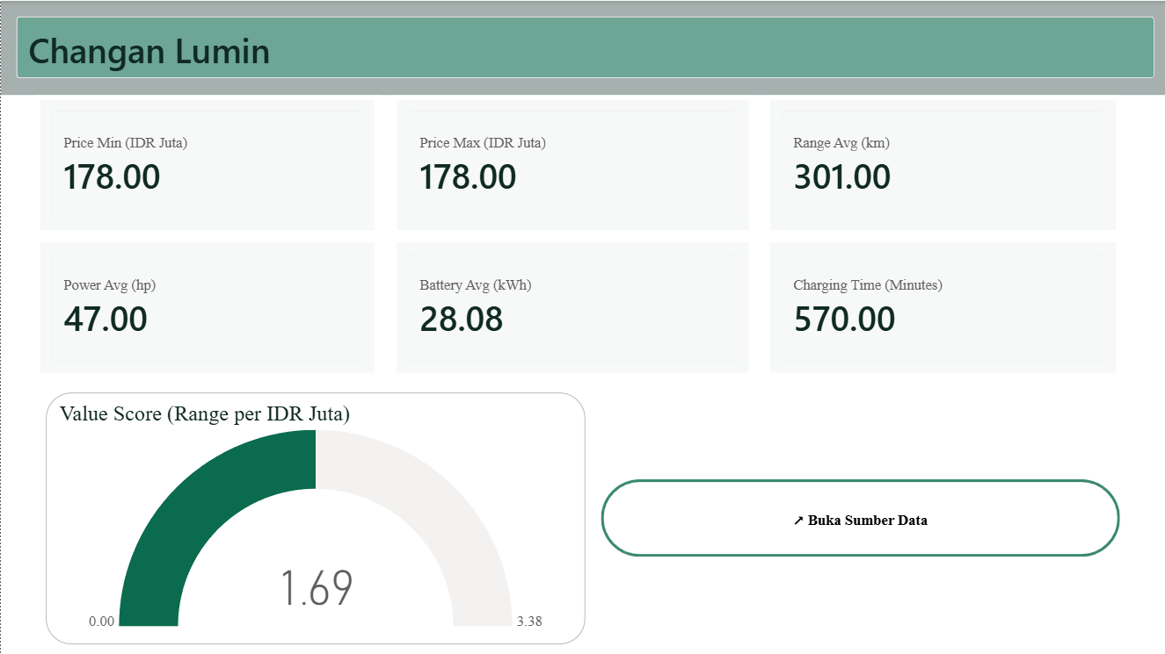
LIVE DASHBOARD SCREENSHOT
Tooltip & Drillthrough, Captured Live
The two interactive features from the previous slide, shown exactly as they appear while exploring the report.
02
Custom Tooltip Page
03
Drillthrough to Vehicle Detail
EVIDENCE Right-click a bar (e.g. in the Top-5 Value ranking) to drill through into this full spec page, including a live “Buka Sumber Data” source link.
EVIDENCE Hovering a point on either scatter chart reveals this mini page — vehicle name plus 4 spec cards.
Interactivity in Action
Indonesia EV Analysis | 16

Slide 16
APPENDIX D — PLATFORM FEATURES
Power BI Features Used
The full technical toolkit behind the five-page report.
01
Power Query
02
What-if Parameters & Bookmarks
INSIGHT Raw-to-clean transformation.
EVIDENCE Parsed text ranges (“Rp 345 - 419 Juta”) into numeric Min/Max/Avg columns; split Vehicle Name into Brand.
IMPLICATION Moved all text-cleaning logic upstream, before a single line of DAX was written.
INSIGHT Simulation and state control.
EVIDENCE ‘Budget Simulation (IDR Juta)’ numeric parameter; Bookmarks capture sidebar open/closed and reset-filter states.
IMPLICATION Adds interactivity that Power BI does not provide out of the box.
03
Conditional Formatting & Visibility
04
Custom Theme & Icons
INSIGHT Data bars and rule-based visibility.
EVIDENCE Data bars on Value Score in the comparison table; the price-warning card’s visibility is bound to ‘Is Price Flagged’ via conditional formatting.
IMPLICATION Surfaces data-quality context automatically — only when it is actually relevant.
INSIGHT A brand-consistent visual system.
EVIDENCE ‘EV Indonesia Modern Green’ JSON theme (dark green / teal / blue / yellow); custom PNG icons reused across KPI cards and this deck.
IMPLICATION One visual language across every dashboard page — and now across this presentation too.
PLATFORM PRINCIPLE No feature here is decorative — every button, tooltip, and parameter exists to answer one of the four analytical questions from Slide 3.
Power BI Features Used
Indonesia EV Analysis | 17

