Slide 1

PORTFOLIO CASE STUDY
Streaming Platform
Analytics Dashboard
User Engagement, Content Performance & Geographic Insights
Brian Naufal
Data Analyst / Business Intelligence
Built with Power BI • DAX • Power Query
Streaming Platform Analytics Dashboard — Portfolio Case Study
1 / 15
Notes:
MAIN MESSAGE: This is a portfolio case study: an end-to-end Power BI dashboard built from a raw streaming-activity dataset. WHAT TO SAY: This project turns raw streaming activity data into an interactive two-page Power BI dashboard covering engagement, content, geography and demographics, with a national-to-province drill-down. WHY IT MATTERS: Sets the frame that this is a full analytics workflow — data prep, modeling, DAX, and dashboard design — not just a pretty chart. POSSIBLE INTERVIEWER QUESTION: "What was the main purpose of this dashboard?" RECOMMENDED ANSWER: I wanted to give stakeholders one place to see how users engage with the platform — not just totals, but how that breaks down by region, content and device — and to let them drill from a national view into any single province in two clicks.

Slide 2



BUSINESS CONTEXT
Why This Dashboard Was Built
Metrics scattered across raw fields
Every streaming session generates a dozen raw attributes — user, device, province, content, package, timestamp — with no single view that connects them.
No unified source of insight
Stakeholders need one place to see engagement, content performance, geography and user behavior together, instead of pulling separate exports for each question.
No path from national to regional detail
A national summary alone can't tell a regional manager what is happening in their own province — there was no easy way to drill from an overview into one specific region.
BUSINESS QUESTION
How can streaming activity data be transformed into actionable insight on user engagement, content performance, and regional behavior — from a national overview down to province-level detail?
Business Context
2 / 15
Notes:
MAIN MESSAGE: The dashboard exists to solve a real analysis problem: fragmented raw data with no unified, drillable view. WHAT TO SAY: Streaming activity data has a lot of raw attributes, but no single view connected engagement, content, geography and behavior — and there was no way to go from a national number to what's happening in one province. WHY IT MATTERS: Shows the interviewer I think about the business problem before touching a chart. POSSIBLE INTERVIEWER QUESTION: "How did you decide what this dashboard needed to show?" RECOMMENDED ANSWER: I started from the questions stakeholders would actually ask — how big is the user base, where are they, what do they watch — and worked backward to the data needed to answer each one.

Slide 3

OBJECTIVES
Analytical Questions & Dashboard Scope
1
How large is the active user base, and how does activity move over time?
2
Which provinces contribute the most users at the national level?
3
Which content titles and package tiers drive the most engagement?
4
How does user behavior differ across age groups and devices?
5
How can a stakeholder move from a national view into one specific province?
Dashboard (Executive)
Detail Province (Drill-down)
National overview: KPIs, trend, map, content and package performance, demographic breakdown.
Regional detail: province KPI, trend, content ranking, package split, and a dynamic text insight.
Objectives & Analytical Questions
3 / 15
Notes:
MAIN MESSAGE: Five concrete analytical questions map directly onto the two dashboard pages. WHAT TO SAY: I translated the business question into five specific questions, then split them across two pages: Dashboard for the national view, Detail Province for regional drill-down. WHY IT MATTERS: Demonstrates structured thinking — questions first, visuals second — rather than starting from 'what chart looks nice'. POSSIBLE INTERVIEWER QUESTION: "Why two pages instead of one?" RECOMMENDED ANSWER: A single page can't hold both a clean national overview and a detailed regional breakdown without becoming cluttered — splitting them keeps each page focused and lets users drill down only when they need to.

Slide 4


DATA FOUNDATION
Dataset & Data Model
Fact_Streaming
10,000 rows • 20 columns
Dim_Calendar
Date dimension
One row per viewing activity: user ID, province/city, content name & type, package, device, age, gender, watch duration, date.
Date, Year, MonthName, Quarter — calculated columns enabling month-over-month comparisons.
Metric Selector
3-row parameter table
Ref_ProvinsiIndonesia
Reference list
A Power BI field-parameter table that lets one chart switch between Total Users, Streaming Hours and Avg Watch Time.
Standardized province name list used to clean and validate the raw Province field.
Raw Excel Data
▶
Data Preparation
(Power Query)
▶
Data Model
(4 core analytical tables + 1 supporting query entity)
▶
DAX Measures
(20 measures)
▶
Interactive
Dashboard (2 pages)
Verified data-preparation logic (from Power Query)
Timestamps are parsed and split into a clean datetime and a date-only field; watch duration is converted from milliseconds into minutes and hours; an outlier flag marks sessions longer than 6 hours; province text is standardized against a reference list to classify each record as Domestic or Overseas/Unmapped.
Dataset & Data Model
4 / 15
Notes:
MAIN MESSAGE: The model is a compact 4-table structure with real, verified Power Query transformation logic. WHAT TO SAY: The core fact table has 10,000 rows and 20 columns, one row per viewing activity. A calendar table supports time intelligence, and a field-parameter table lets one chart switch metrics dynamically. WHY IT MATTERS: Shows I can read and explain a real data model and its ETL logic, not just describe visuals. POSSIBLE INTERVIEWER QUESTION: "Walk me through your data model." RECOMMENDED ANSWER: Fact_Streaming holds the activity-level detail, Dim_Calendar supports month-over-month DAX calculations, and a small parameter table called Metric Selector lets the trend chart switch between three KPIs without duplicating visuals. Province names are also standardized against a reference list during data prep.

Slide 5
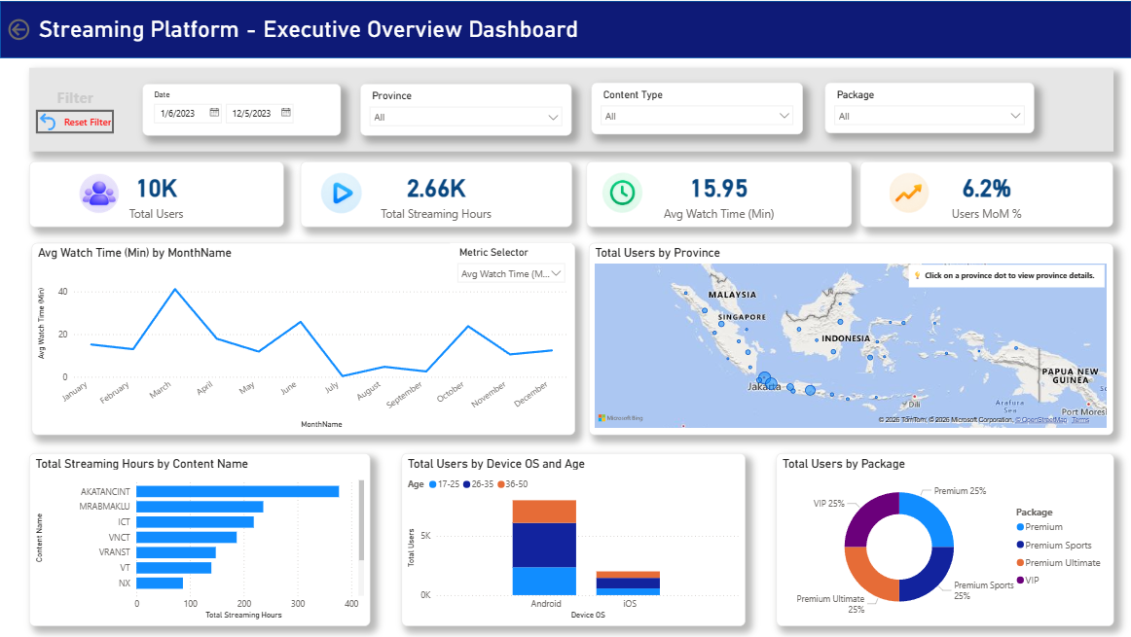

PAGE 1 OF 2 — DASHBOARD
Executive Overview
Screenshot needs to be captured from the live Power BI report — “Dashboard” page
Recommended capture: full page at 100% zoom, filters cleared. Highlight ① KPI row ② Monthly trend ③ Map ④ Content chart ⑤ Package donut ⑥ Age/Device chart ⑦ Slicer & Metric Selector row.
KEY FINDINGS FROM THIS PAGE
Activity is concentrated in two months, not a steady climb Evidence: May + June 2023 account for 8,054 of 10,000 users (80.5%); the other ten months average roughly 210 users each. → Read the monthly trend line as a concentration pattern, not organic growth, until the data owner confirms the cause.
Three provinces carry most of the national user base Evidence: Jakarta, West Java and East Java together represent 59.8% of all users, out of 79 provinces recorded. → Retention and acquisition budget can prioritize these three provinces first.
Two content formats drive almost all watch time Evidence: Channel Live (49.7%) and Series (48.1%) make up 97.7% of total streaming hours; Movie and Catchup are under 2.5% combined. → Content licensing and platform investment should weight Live and Series.
Executive Overview
5 / 15
Notes:
MAIN MESSAGE: The Dashboard page tells a national story, but the honest headline is a data concentration pattern, not smooth growth. WHAT TO SAY: Three findings stand out from the executive page: a two-month concentration in activity, three provinces carrying most of the user base, and two content formats driving nearly all watch time. WHY IT MATTERS: Shows I report what the data actually shows, including inconvenient patterns, instead of only flattering findings. POSSIBLE INTERVIEWER QUESTION: "What was the most interesting finding on this page?" RECOMMENDED ANSWER: Honestly, the monthly trend — 80% of users fall in just two months. Before I'd present that as growth, I'd want to confirm with the data owner whether that reflects a real usage spike or how the source data was collected.

Slide 6






ENGAGEMENT
User Engagement & Trend
10,000
2,659 hrs
15.95 min
Metric Selector switches this trend between Total Users, Streaming Hours and Avg Watch Time — no extra visuals needed.
Total Users
Total Streaming Hours
Avg Watch Time
80.5% of users fall in just 2 of 12 months
May (5,553) and June (2,501) dwarf every other month — worth confirming with the data owner before quoting a growth rate.
Nov → Dec users: –94 (–9.3%)
Comparing the last two populated months (642 → 582 users). The dashboard's “Users MoM %” card value depends on the active date-slicer selection — needs verification from the live visual.
User Engagement & Trend
6 / 15
Notes:
MAIN MESSAGE: Engagement headline numbers are solid, but the monthly trend needs a concentration caveat, not a growth narrative. WHAT TO SAY: Total Users, Streaming Hours and Avg Watch Time are all straightforward aggregates. The interesting part is the monthly pattern — a huge spike in May–June, and a small decline from November to December. WHY IT MATTERS: Shows comfort with time intelligence DAX (DATEADD) and honesty about what a card value depends on. POSSIBLE INTERVIEWER QUESTION: "How would you calculate month-over-month growth in DAX?" RECOMMENDED ANSWER: I'd use CALCULATE with DATEADD on the date table to shift the filter context back one month, then compare against the current period with DIVIDE to avoid divide-by-zero errors — that's exactly how the Users MoM% measure here is built.

Slide 7

PERFORMANCE
Content & Package Performance
Live + Series = 97.7% of all streaming hours. Movie and Catchup together are under 2.5%.
Each of the four tiers holds an identical 25% share (2,500 users). Tier alone doesn't explain engagement — cross it with watch time per tier for upsell targeting.
663 distinct content titles — a long tail, not one blockbuster
The single highest-hours title accounts for only 14.2% of total streaming hours, so engagement is spread across the catalog rather than concentrated in one hit.
Content & Package Performance
7 / 15
Notes:
MAIN MESSAGE: Content consumption is concentrated by format (Live + Series) but spread across many titles — two very different kinds of concentration. WHAT TO SAY: Live and Series make up 97.7% of hours, but no single title dominates — the top title is only 14.2% of hours out of 663 titles. Package tiers are evenly split at 25% each. WHY IT MATTERS: Shows I can tell the difference between concentration by category and concentration by individual item, and I don't over-read an even split as a finding by itself. POSSIBLE INTERVIEWER QUESTION: "Which package tier would you recommend the business invest in?" RECOMMENDED ANSWER: I can't answer that from this dashboard alone — the tiers are exactly even in user count, so I'd need watch-hours or revenue per tier before recommending where to invest.

Slide 8
GEOGRAPHY & BEHAVIOR
Who Are the Users, and Where Are They?
Jakarta + West Java + East Java = 59.8% of national users
Device OS split needs a caveat
The model shows Android 80% / iOS 20%, but the ETL logic assigns iOS to every 5th record by index — it is a placeholder rule, not captured device data. Do not use this split for a real device strategy.
Gender split (as recorded): Female 53.4% • Male 46.6%
Geographic & User Behavior
8 / 15
Notes:
MAIN MESSAGE: Geography is concentrated in 3 provinces; the device split needs an explicit data-quality caveat. WHAT TO SAY: Jakarta, West Java and East Java are almost 60% of the national user base. Age skews toward 26–35. The device OS split looks like Android dominance, but that's actually a placeholder rule in the ETL, not real device data. WHY IT MATTERS: Catching and disclosing the synthetic Device OS rule is exactly the kind of due diligence a hiring manager wants to see before trusting a number. POSSIBLE INTERVIEWER QUESTION: "I noticed the Android/iOS split — what would you do with that?" RECOMMENDED ANSWER: I'd flag it before using it. When I checked the Power Query logic, iOS was being assigned to every 5th record by index rather than captured from real device data, so I wouldn't use that split to justify a device strategy without going back to the source system.

Slide 9
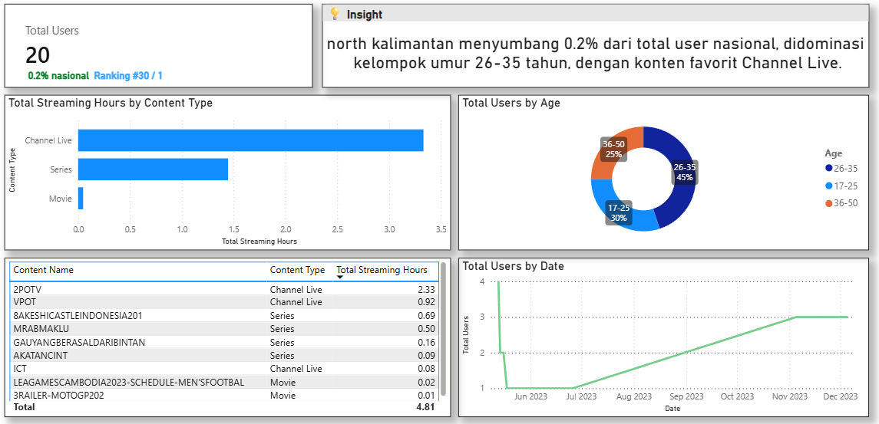


PAGE 2 OF 2 — DETAIL PROVINCE
Regional Drill-Down
WORKED EXAMPLE — JAKARTA (verified)
Rank
#1 of 79 provinces
Share of national users
23.9% (2,386 users)
Dominant age group
26–35
Screenshot needs to be captured from the live Power BI report — “Detail Province” page
Top content type
Series
Reached by clicking a province dot on the national map.
Dynamic “Province Insight” text measure
Auto-generates a one-sentence narrative per province, e.g.: “Jakarta menyumbang 23.9% dari total user nasional, didominasi kelompok umur 26-35 tahun, dengan konten favorit Series.”
National
Overview
▶
Click a
Province Dot
▶
Province
Detail Page
▶
Content / Package /
Trend Analysis
TOP 5 CONTENT IN JAKARTA (by streaming hours)
Content
Type
Hours
AKATANCINT
Series
85.3
A page filter carries the selected province from the map into every visual on this page — no manual filtering needed.
MRABMAKLU
Series
69.5
ICT
Channel Live
60.9
NX
Channel Live
60.3
National Geo (coded)
Channel Live
30.7
Regional Drill-Down
9 / 15
Notes:
MAIN MESSAGE: The Detail Province page turns a national number into a specific, actionable regional story in one click. WHAT TO SAY: Selecting a province on the national map carries the province context into the Detail Province page, which shows rank, share of national users, dominant age group, top content, and an auto-generated narrative sentence. WHY IT MATTERS: This is the clearest demonstration of interactivity and DAX text-generation in the whole report — good for a live demo. POSSIBLE INTERVIEWER QUESTION: "How does the province filter get passed between pages?" RECOMMENDED ANSWER: The Detail Province page carries a page-level filter on Province, driven by the selection made on the national map — so selecting Jakarta on the map carries the Jakarta province context to this page, where the visuals and narrative text update together.

Slide 10



SYNTHESIS
Key Insights
ENGAGEMENT
Activity is a two-month spike, not steady growth
Evidence: May + June 2023 = 80.5% of all users (8,054 of 10,000). → Treat the monthly trend as a concentration pattern until confirmed with the data owner — don't quote it as a growth rate.
CONTENT
Live TV and Series carry the platform, not Movies
Evidence: Channel Live + Series = 97.7% of total streaming hours. → Content licensing and catalog investment should prioritize these two formats.
GEOGRAPHY
3 of 79 provinces hold 60% of the user base
Evidence: Jakarta, West Java, East Java = 59.8% of national users. → Prioritize these three for retention while piloting acquisition in smaller provinces.
PACKAGE
Package tiers show no usage skew — yet
Evidence: All four tiers sit at an identical 25% share (2,500 users each). → Tier alone isn't a differentiator; pair with watch-hours per tier before making pricing or upsell decisions.
DEMOGRAPHIC
The core user is 26–35, and the Android figure needs a caveat
Evidence: 26–35 is the largest age group (46.3%); the 80/20 Android/iOS split is an ETL placeholder rule, not observed device data. → Design around the 26–35 segment with confidence; verify device data at the source before acting on the OS split.
Key Insights
10 / 15
Notes:
MAIN MESSAGE: Five insights, each traceable to a specific number in the dataset — no generic filler. WHAT TO SAY: These five insights summarize the whole dashboard: a data-collection pattern to verify, a content format story, a geographic concentration, an even package split, and a demographic core with one caveat attached. WHY IT MATTERS: Every insight follows Finding → Evidence → Implication, which is the structure a hiring manager wants to see in a real analyst's output. POSSIBLE INTERVIEWER QUESTION: "If you had to pick one insight to act on first, which would it be?" RECOMMENDED ANSWER: The geographic one — three provinces already representing 60% of users is something a marketing or retention team could act on immediately, whereas the monthly spike and package-tier findings both need one more round of verification first.

Slide 11

RECOMMENDATIONS
Recommendations & Conclusion
Product / Platform Team
Investigate the May–Jun 2023 spike (data quality vs. real growth) before using MoM trend as a KPI target; verify Device OS at the source before any Android-first decision.
Content Team
Prioritize Live + Series investment (97.7% of hours); use the 663-title catalog list to review underperforming long-tail titles.
Marketing / Customer Team
Focus acquisition and retention on Jakarta, West Java, East Java (59.8% of users); pilot lower-cost campaigns in the remaining provinces.
Management
Commission a watch-hours-per-package study before any tier-pricing decision — the current 25/25/25/25 split shows no usage-based signal yet.
User
Monitoring
→
Engagement
Analysis
→
Content & Package
Optimization
→
Regional
Drill-down
→
Decision
Support
This flow is how the dashboard supports better decisions: it takes a stakeholder from a raw number to a specific, regional, evidence-backed action in a few clicks.
Recommendations & Conclusion
11 / 15
Notes:
MAIN MESSAGE: Recommendations are split by team and each traces back to a specific, verified finding — nothing generic. WHAT TO SAY: Each team gets one clear, evidence-linked action: product investigates the spike and device data, content prioritizes Live and Series, marketing focuses on three provinces, and management holds off on tier pricing until usage data is available. WHY IT MATTERS: Shows the ability to turn analysis into role-specific next steps, which is what separates a dashboard demo from a business deliverable. POSSIBLE INTERVIEWER QUESTION: "How does this dashboard support better decision-making, concretely?" RECOMMENDED ANSWER: It moves a stakeholder from a single national number to a specific, regional, evidence-backed action in a few clicks — for example, from 'we have 10,000 users' to 'Jakarta is 24% of them, mostly aged 26–35, favoring Series' to 'here's what our content team should prioritize there.'

Slide 12
APPENDIX A
Key DAX Measures
Measure | Table | Business Purpose
Total Users | Fact_Streaming | Counts distinct viewers (DISTINCTCOUNT) — the headline user figure.
Users MoM % | Fact_Streaming | Month-over-month change via DATEADD — needs a single-month filter context to return a value.
Total Users with Trend | Fact_Streaming | Formats the user count with a ▲/▼ arrow and the MoM% into one display string.
% of National Users | Fact_Streaming | A province's users ÷ all provinces (ALL) — powers the province-share card.
Province Rank | Fact_Streaming | RANKX of provinces by Total Users — feeds the “Rank #X / 79” label.
Rank Label / Percent Label | Fact_Streaming | Dynamic text measures that assemble the rank and share strings on Detail Province.
Top Age Group / Top Content Type | Fact_Streaming | TOPN over a virtual table finds the dominant age bracket / content type in context.
Province Insight | Fact_Streaming | Concatenates the measures above into one Indonesian sentence per province.
Total Users PM / User Growth MoM % | Dim_Calendar | A parallel-period pair mirrored from Fact_Streaming for card conditional-formatting arrows.
5 calculated columns live on Dim_Calendar (Year, MonthName, MonthNumber, Quarter, QuarterSort). Power BI also auto-built 3 hidden date tables — one per date column not explicitly linked to Dim_Calendar — a cleanup opportunity: marking Dim_Calendar as the official date table would remove the duplicates.
Appendix A — Key DAX
12 / 15

Slide 13


APPENDIX B
Data Model — Relationships & Structure
Fact_Streaming ↔ Dim_Calendar
Many-to-one
Metric Selector
Disconnected
Tanggal (Fact) relates to Date (Dim_Calendar) — required for the DATEADD time-intelligence measures to work. Direct relationship metadata wasn't exposed by this audit's extraction tool; verify cardinality and direction in Power BI's Model view.
Not related to any table — this is Power BI's native Field Parameter feature. Its 3 rows carry field references that the visual switches between.
Ref_ProvinsiIndonesia
Lookup only
Auto Date Tables (×3)
Hidden ×3
38 standardized province names used during Power Query cleaning to fix text inconsistencies — not connected in the live model.
Power BI's default behavior when a date column isn't linked through the official date table — each adds hidden Year/Month/Quarter columns duplicating Dim_Calendar's.
A note on this audit's limits
The extraction tool used for this audit could read every DAX measure, calculated column, and table row, but not the relationship graph itself. The relationship above is inferred from the fact that MoM measures using DATEADD actually work — treat it as highly likely, not directly confirmed.
Appendix B — Data Model
13 / 15

Slide 14


APPENDIX C
Interactivity
MULTI-FIELD SLICERS
Five slicers on the Dashboard page
Date (Dim_Calendar), Province, Content Type, Package, and the Metric Selector field parameter.
METRIC SELECTOR
One chart, three switchable metrics
A field-parameter slicer lets the same line chart display Total Users, Streaming Hours, or Avg Watch Time without duplicating visuals.
MAP-DRIVEN NAVIGATION
Click a province dot to drill down
Clicking a province on the national map carries a page-level Province filter into Detail Province — the on-page tip literally instructs users to click.
BACK & RESET BUTTONS
One-click return to a clean state
A native Back button plus a Reset Filter button clear slicer selections without leaving the page.
DYNAMIC NARRATIVE TEXT
Sentences that update with the filter
Province Insight, Rank Label and Percent Label rewrite themselves live as the province selection changes — no static commentary.
Appendix C — Interactivity
14 / 15

Slide 15

APPENDIX D
Power BI Features Used
FIELD PARAMETERS
Metric Selector, built natively
Created via Power BI's “New parameter → Fields” — not a manual SWITCH measure.
TIME-INTELLIGENCE DAX
DATEADD-based MoM measures
Mirrored on both Fact_Streaming and Dim_Calendar to support card conditional-formatting arrows.
RANKX & TOPN
Live ranking and dominant-category lookups
Province Rank, Top Age Group and Top Content Type are computed fresh in the current filter context, not hardcoded.
DYNAMIC TEXT MEASURES
Four sentence-building measures
Total Users with Trend, Rank Label, Percent Label and Province Insight turn live numbers into readable Indonesian sentences.
DATA-QUALITY FLAG & CLEANUP NOTE
Is Outlier column + 3 duplicate date tables
Power Query flags sessions over 6 hours; the model would benefit from marking Dim_Calendar as the official date table to remove the auto-generated duplicates.
Appendix D — Power BI Features
15 / 15

