Slide 1
Reference Genome Sequences 4/03
Done Mycoplasma ~ 400 genes
Done E. coli + 100 4.6 Mb ~ 4,300
Done Yeast 12.5 Mb ~ 6,300
S. cerevesiae + 5 related species
Done Mustard weed 120 Mb ~ 26,000
Done Worm 1 &2 97 Mb ~ 17,000
Done Fruitfly 120 Mb ~ 13,000
Done Mouse & rat 3,000 Mb ~30,000
“high draft”
Done Human 3,300 Mb ~23,000 (prot coding)
“finished”
First draft Chimp 3,300 Mb

Slide 2
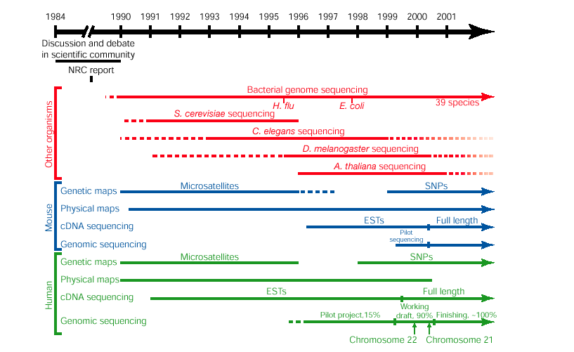
Genome Project History

Slide 3
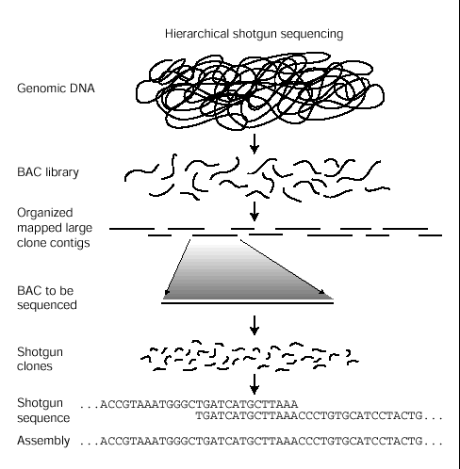
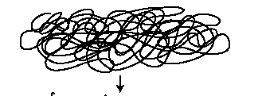
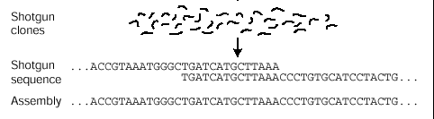
How human genome first draft was done (twice)
“Public” strategy
“Private” (Celera)
Now believe a mix of
These strategies is optimal
For an entirely “new” genome

Slide 4
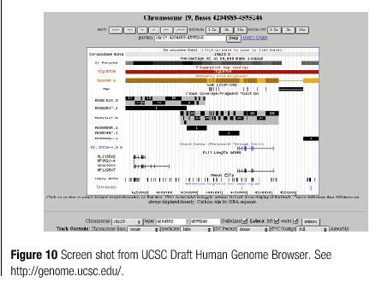
Go to this site, learn to use it!

Slide 5
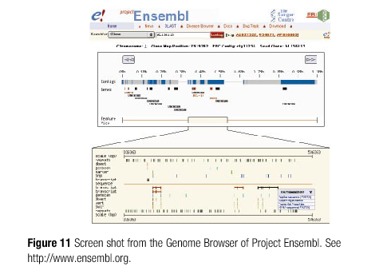
Go to this genome browser also.

Slide 6
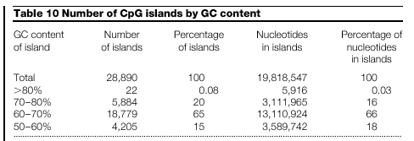
Global CpG island survey:
Normally counter-selected (conversion to TpG) & 5x under-represented
Of interest due to high frequency near 5’ ends of genes
(remember lecture 1 on clues from global base composition)
Coincidence with estimated gene number interesting,
How do we prove functional significance?

Slide 7
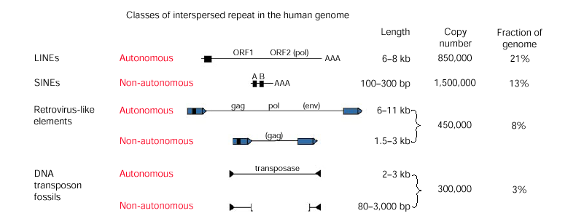
Human genome: <3% of sequence is proetein coding
Yeast genome: >70% is protein coding
> 45% of Human genome is repeated sequence due to
families of transposable elements.
Mainly now inactive for transposition

Slide 8
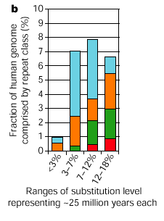
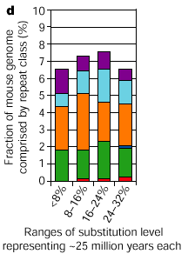
Most human elements are now dead or quiet
Mouse genome generating events fast as ever

Slide 9
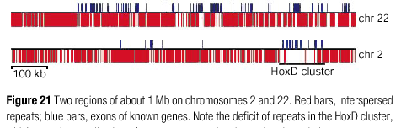
Using repeat incidence to identify functionally “special”
regions of the genome: where repeats cannot go
HOX clusters and their integrated, interdigtated
regulatory elements

Slide 10
Paralogous genes = Highly similar genes within a
genome derived from a common ancestral gene
Orthologous genes = the “same” gene in two different
genomes. Consider how to distinguish a true ortholog from
frome paralogs where there has been gene loss or
rearrangement - the power of chromosomal position
to arbitrate - same neighbors = ortholog
Homologous =
“100%” similarity
“% homology” used loosely to mean % similarity
(some object strenuously to this use of “homology”)

Slide 11
Reminder: Gene anatomy for typical metazoan
exon
intron
exon
OFF
Enhancer
RNA Coding Sequence
Regulatory proteins
RNA polymerase
hnRNA
mRNA
ON

Slide 12
Biggest human gene known: dystrophin = 2.4MB hnRNA
Mutated in DMD= Duchenne Muscular Dystrophy
Many alleles -> huge target -> X-linked, thus
males are affected
Compare with “average” human gene (note context -
regulatory sequences not included in this usage of
“gene”)
mRNA ~1600bases
Average ORF 450aa residues = 1350 bases
Average genomic extent 30,000 bp
11.1 genes per megabase average density (high variance)

Slide 13
Complex gene anatomy - distant and multiple
regulatory elements
~ 100kb
GENE X
MRF4
myf5
E. 9.5 Mouse embryo
Different elements can direct
expression in different
spatiotemporal domains
in response to diverse signals
Can “select” different promoters
preferentially
Myf5 regulator

Slide 14
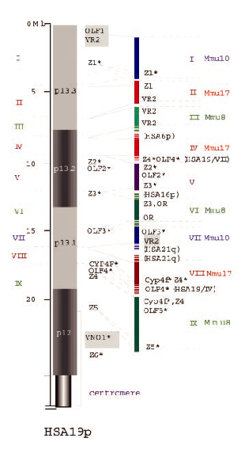
Chromosome scale
Comparative genomics
Mouse Human H19
&
15 segments of mouse
Similar to Human 19
Stubbs and colleagues
Dehal et al., Science: 293, pp 104
XXX

Slide 15
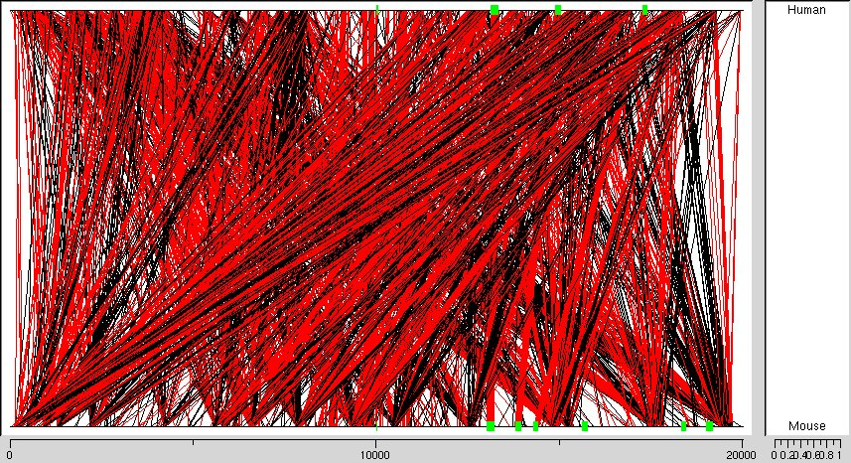
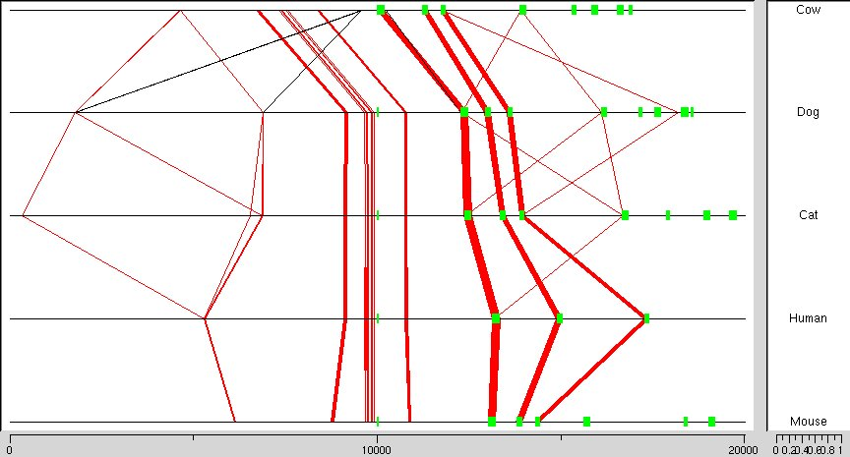
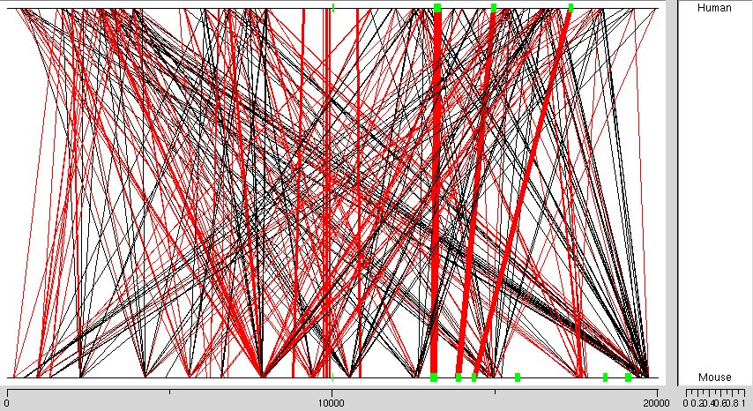
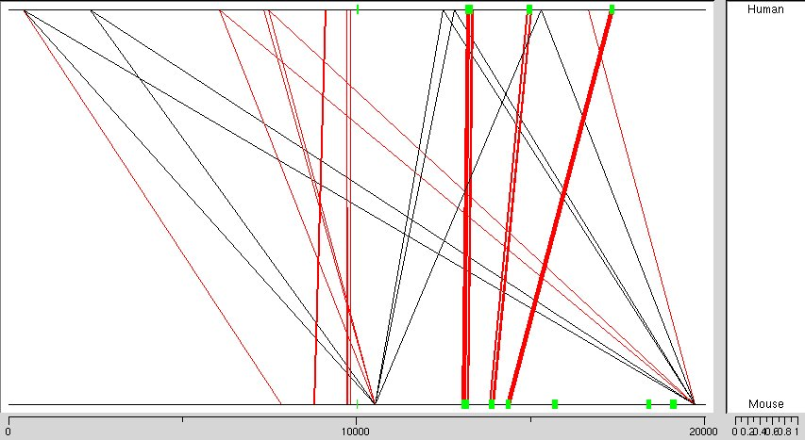
What can be detected with 2 vs 5 mammals for a “simple” gene?
Mouse/ Human Mouse, human, cat, dog, cow 70%
human
70%
mouse
80%
90%
? ?
30BP sliding window across a 30 KB region of MCK “simple” gene
Simple sequence repeats (only) masked
Notes:
Need a new version of this very old slide that has been
1.repeat masked, so it is comparable to the rest that they will see from Mussa
2. It should be run at 30bp window over 30 KB for direct comparison with the multigenome slide
[3. Would like to compare 50bp window used here with 30bp window for my interest and as a backup
graphic.]
Is that upstream gap part of craziness from incorrect or duplicated stuff in celera assembly? If so, has it now been corrected in Celera?

Slide 16
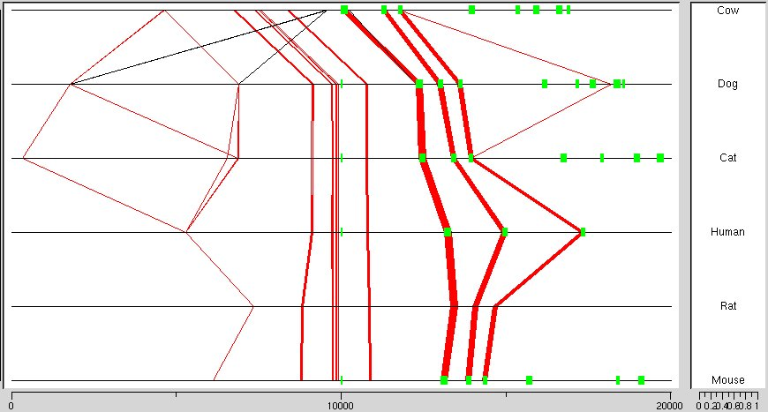
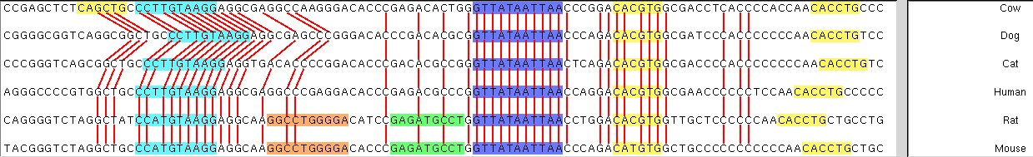
Three main views from Mussa
Cow
Dog
Cat
Hum
Rat
Mouse
Cow
Dog
Cat
Hum
Rat
Mouse

Slide 17
MRF4 / Myf5 complex locus: Integrates diverse signals in
Different spatiotemporal domains throughout development
and adulthood
~ 60kb
MRF4
myf5
E. 9.5 Mouse embryo
> 9 Distinct elements for
Spatiotemporal domains =
different signals
How can we pinpoint candidate elements computationally
Myf5 regulator
Notes:
Replace deleted cartoon above with best current map of domains of function (broad boxes justified by functional data)

Slide 18
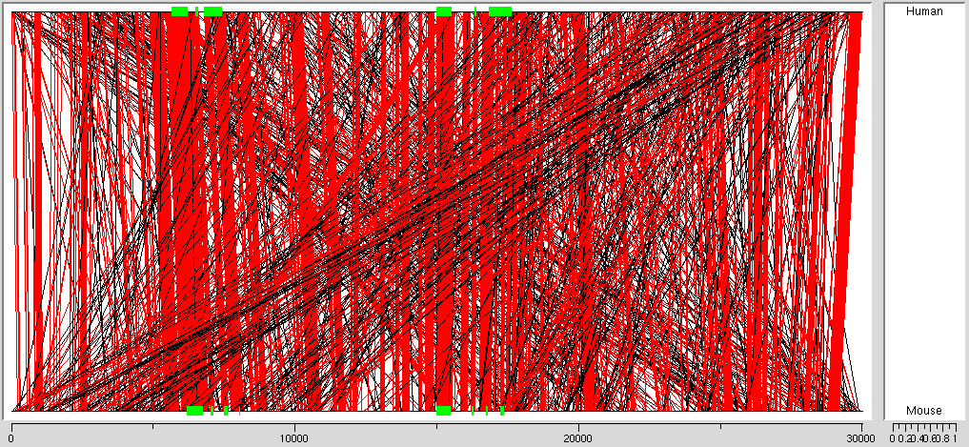
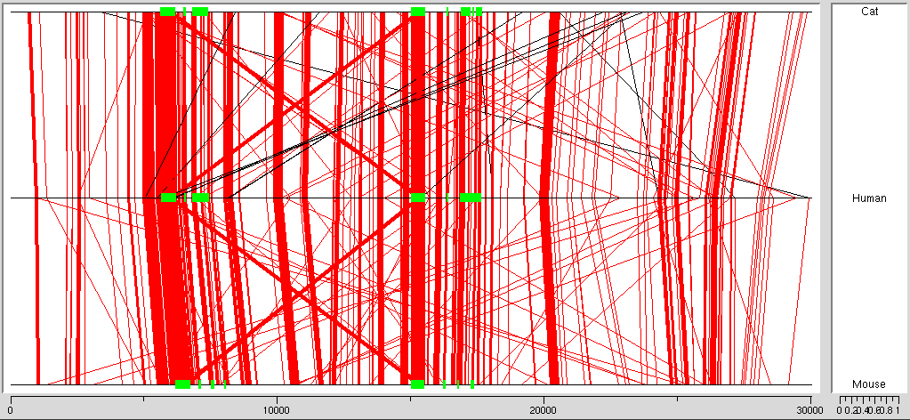
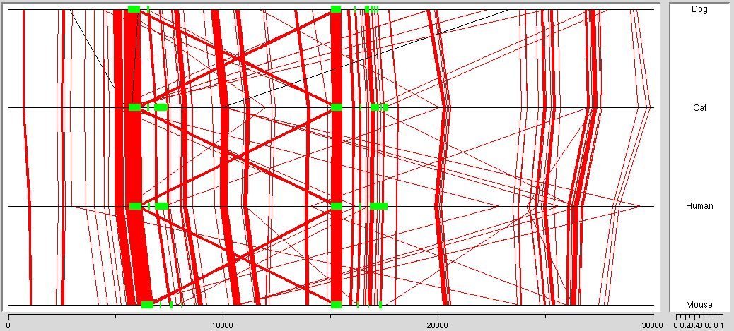
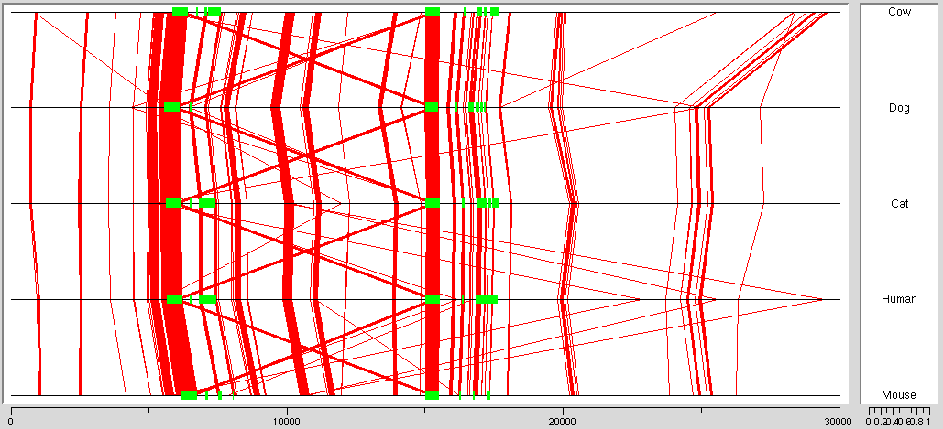
Incremental resolution for “complex locus”
2
3
4
5
Sequence data: Eric Green & colleagues
Notes:
Want this kind of compendium for MCK from 2 - 5 (skip rat for now). Need to capture the graphics so they can be sized here, but without loosing all the lines we are loosing here. For now, JPEG may do it fine.
Important: Make certain that the window size and repeat masking for the pariwise version matches MUSSA conditions

Slide 19
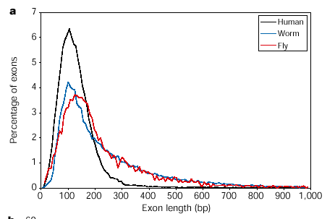
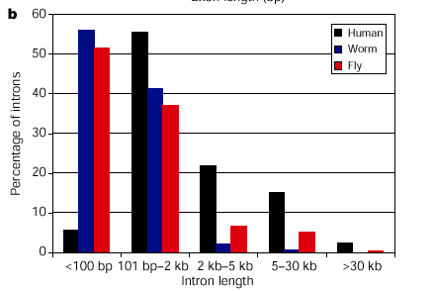
What protein coding genes look like in 3 diverse genomes
Exons (bp)
Introns (bp)
Human genes are going in direction of big introns + narrower
distribution of relatively short exons. Is there meaning in this
for domain shuffling?

Slide 20
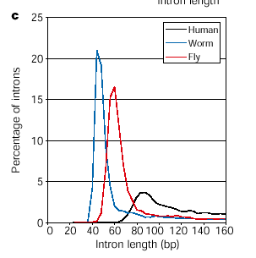
Human is also relatively low on very short introns
compared with worm and fly
[Majority of genes in yeast are not spliced at all, though
some important ones are]

Slide 21
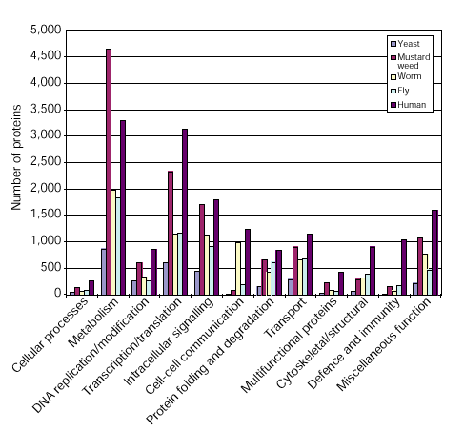
Functional group distribution for protein coding genes

Slide 22
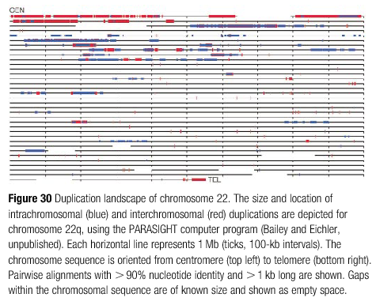
Recent duplications: inter(red) and intra (blue)-chrmosomal duplications
Positive positional bias for centromere and telomere…….why?
Consequences? CharcotMarieTooth1A Syndrome,
Smith/Magenis Syndrome
PraderWilli syndrome and others

Slide 23
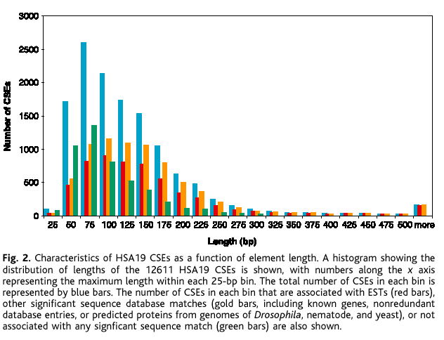
Conserved sequence elements between mouse & human 19
Blue bars are total
Gold are known genes
Green = mysteries

Slide 24
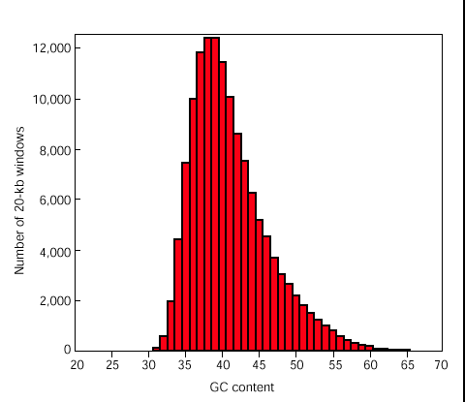
Global Genome Character: GC content in 20kb windows
Over entire human genome (minus centromeres/telomeres)

Slide 25
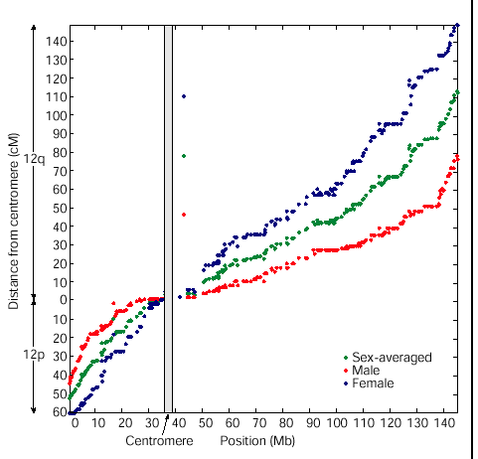
Genetic Map versus physical map from DNA sequence
Note shifts in slope at telomeres (recom rate higher)
and centromere (recombination rate lower)

Slide 26
Introduction to gene families: Paralogy groups
Olfactory receptors (true nose)
VNO (vomeronasal receptors)
Globin gene family
Protocadherin family
Zinc finger Transcription factors

Slide 27
Evolution of VNO Receptor Genes
(vomeronasal organ - pheromones in mouse,cat, etc)
Human
Mouse
Hypothesis: Contraction of human receptor family
Occurred as dependence
on pheromones decreased

Slide 28
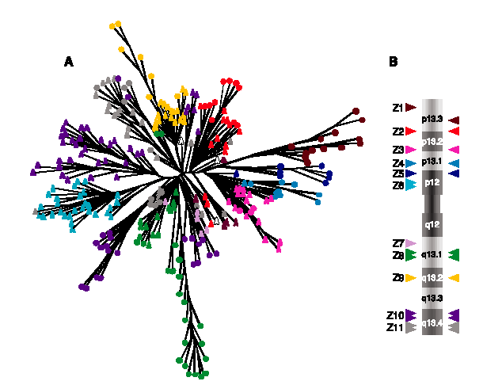
Back to possible reasons that realtively low gene
number can give great organismic complexity massive, rapid
changes in some transcription factor families
Example: Explosion of zinc finger transcription factor family
Fingers changing fast; domains of expression changing fast

Slide 29
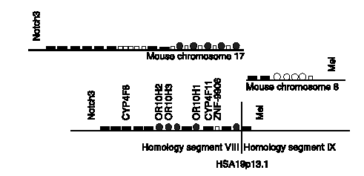
Strange goings-on at breaks of similarity segments
“Ortholog - schmortholog”………...

Slide 30
Consider new ways in which whole genomes can
be exploited experimentally: the power of “completeness”
or , at least, comprehensivity
Welcome to the “omes”
1. In model organisms - Best Example - All possible loss of function
mutations coupled WITH “bar- coding” in yeast
many possible RNAi responses through library of bacteria
that worms will eat
2. Transcriptome Large scale expression studies -
unbounded dataset - mainly a hypothesis generator
3. Proteome - This is where the bio-action is - chemistry more
challenging for ways to handle all proteins in uniform
formats

Slide 31
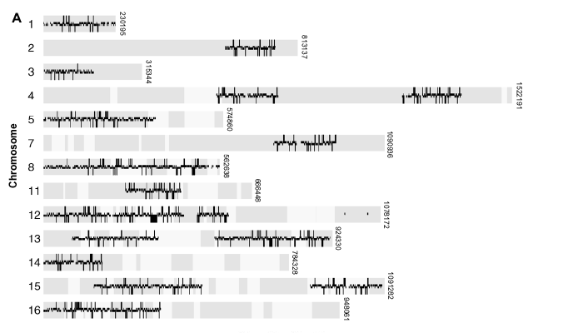
4,627 (of possible 6200) bar-coded null strains of yeast
2 20bp unique sequence tags per deletion
Assay w. barcode microarrays (consider other uses of barcodes…)

Slide 32
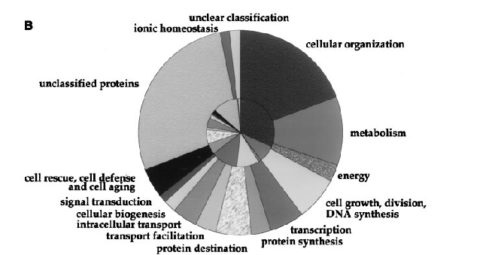

Slide 33
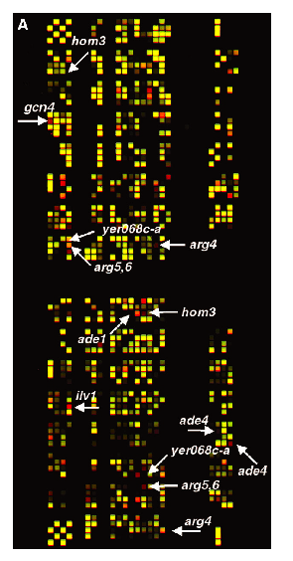
Barcode microarrays
Note false color
0 vs 6 hrs in minimal medium
Arrows = growth defect
In minimal but not rich medium

Slide 34
