Slide 1
Anticipation = increasing severity with progression of generations
19th century popular concept in inheritance
Re-interpreted by Penrose and others post-rediscovery
of Mendel =
ascertainment bias based on identification
of severely affected children whose parent must
have been less severely affected for transmission to have
occurred
Re-interpreted again with triplet repeat expansions for some
diseases - see Table
Myotonic Dystrophy
Huntingtin

Slide 2
Molecular origins - putative replication slippage of repeats
[apparent relation with microsatellite instability]
Asymmetry of triplet expansion vs. contraction favors
expansion.
G-rich triplets seem to dominate in disease
perfect repeat strings seem important- perhaps for mitotic
and meiotic recombinational contributions to expsansion
Instability thought to occur in both mitotic and meiotic processes -
Putative meiotic inferred from parent/child comparison
Mitotic determined from DNA analysis of B-cells -
DNA blot evidence - data predictions

Slide 3
Some Members of triplet repeat family of diseases
Coding sequence = polyglutamine = Huntingtin
5’UTR = Fragile X1
3’ UTR = Myotonic Dystrophy (DM1 locus on H-19)
Repeat number that is “normal” vs pathological differs by disease
Normally 5- 38 repeats in myotonic dystrophy
39-100 = milder disease alleles
Disease alleles up to 2000 are most severe
DMPK = serine/threonine kinase gene
containing expandable repeats that
are CUG in the RNA
Overall lower expression level of DMPK is a primary
molecular phenotype

Slide 4
Myotonic Dystrophy phenotype and inheritance
Most common muscular dystrophy of adulthood
Myotonia (hyperexcitability)
Muscle degeneration (myopathy))
Cardiac conductance defect
Cataracts
Mental retardation (sometimes)
Dementia (sometimes)
Highly variable age of onset and severity
Autosomal dominant
Imprinting effect: males do not transmit alleles > 1000)
but females do

Slide 5
For myotonic dystrophy - 4 current (nonexclusive) hypotheses
1. RNA processing defect leads to defective protein
and/or less protein
2. Repeat structure alters local chromatin structure
affecting nearby genes and their expression
3. CUG repeats interact with RNA-binding proteins
to alter normal activity of RNA binding proteins
(gumming-the-works notion). i.e. toxic
gain of function
4. CUG repeats in RNA might serve as binding sites for a subset
of DNA binding proteins that include specific
transcription factors

Slide 6
Experimental approaches to test these possibilities
1. Altered splicing: Detected by transcript mapping - Retention
and accumulation of incorrectly spliced forms within nucleus
Result is less mRNA at steady state in cytoplasm to be translated
Therefore less wild-type protein: Raises question of dosage
So, ask what does mouse het vs homozygous deletion look like?
Results: 1. heterozygous mouse has no muscle phenotype
2. homozygotes
A. mild skeletal myopathy in adults
B. no cataracts
C. good phenocopy of cardiac conductance deficit
So - partial recapitulation of human - at best - and only in
homozygotes

Slide 7
2. Neighborhood position effect variegation (through chromatin
alterations perhaps)
Is there a specific candidate gene in the chromatin neighborhood?
Factor SIX5 is known to regulate genes involved in muscle - notably sodium ion homeostasis
Altered sodium ion is part of phenotype of myotonic dystrophy patients
Experiment = knockout mouse for the SIX5 transcription
factor gene which located 3’ to DMPK

Slide 8
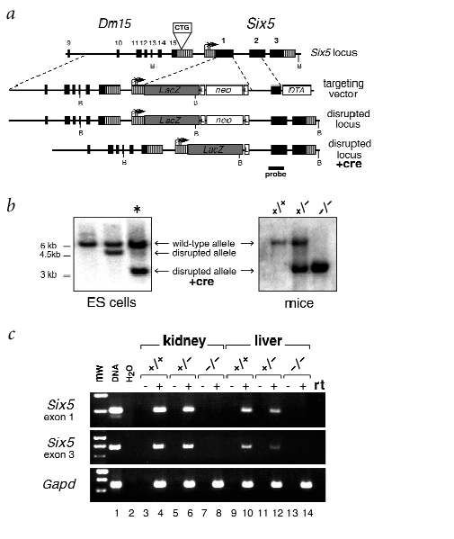
Note good
knock-in
Design with cre-
mediated excision
of selection cassette
(see “Know your
Neighbors” review
On the hazards of
Unintended position
effects)

Slide 9
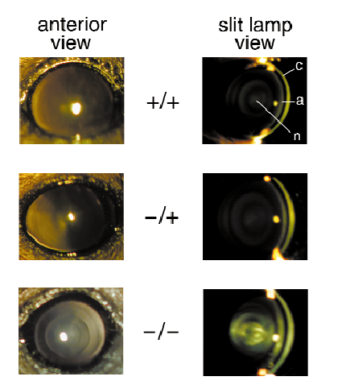
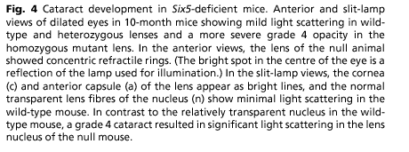
Main Results -
a. No significant muscle phenotype
b. Recapitulation of cataract phenotype in
both heterozygotes and homozygotes

Slide 10
3. Toxic gain of function: Experimental tests
Mouse model is a transgenic carrying gene encoding RNA
with a high copy (~250) CUG repeat motif. Put initially on a
wild-type background.
Design so that repeats embedded in an actin RNA -
not a DMPK RNA, so this separates effects on DMPK
itself from toxic GOF effects of a high CUG RNA
Result: Myotonia and myopathy phenocopy of human disease

Slide 11
Supporting evidence from cultured cell studies
A. High CUG repeat transcripts tend to accumulate in foci within
the nucleus of transfected cells
B. High CUG repeat RNAs inhibit muscle differentiation
C. A protein that preferentially binds to CUG RNA (CUG-BP1)
is implicated in RNA processing
D. A hairpin structure formed by high CUG RNA activates a
double stranded RNA dependent kinase called PKR
(its targets are presently unknown).

Slide 12
So - All four hypotheses may be correct in some degree -
Leads to an “additive” mechanistic model of Myotonic Dystrophy.
1. Cardiac conductance phenotype from reduced/altered DMPK activity
2. Cataract phenotype from position effect operating on nearby SIX5
gene
3. Myotonic myopathy phenotype from toxic gain of function transcript
radiating to targets in RNA metabolism
4. DMWD gene is normally high in brain and may explain cognitive
disturbances in manner of SIX5 on eye phenotype

Slide 13
However….
Consider DM2 locus on chromosome 3
Has diverse features of DM phenotype
Turns out to be triplet repeat in first intron of a zinc finger factor

Slide 14
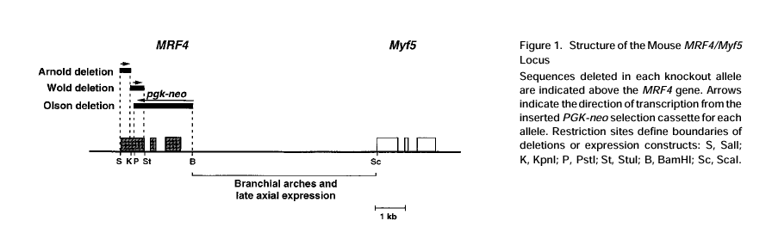
Position effects in knock-outs and knock-ins
A major issue of interpretation and a lesson in mammalian
position effects

Slide 15
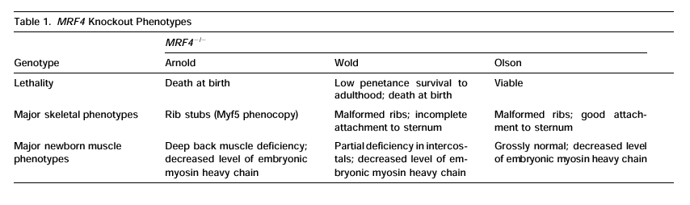

Slide 16
Huntington Disease
Again, autosomal dominant, fully penetrant toxic
gain of function alleles with anticipation
Here expansion through the male parent is most severe
Review polyglutamine expansion phenotype - underlying
Neurodegenerative phenotypes from errant protein folding
DNA level testing available long enough to have studies on
implications. Extreme case because of penetrance.

Slide 17
ELSI (ethical legal and social implications)
Insurance - DNA knowledge versus family history
current law - group versus individual health plans
Who wants to be tested?
Implications of 20 year old child being tested for
40 year old parent who does not want to know
Responses to testing negative
Responses to testing positive
Responses to errors in testing

