Slide 1
Beta thalassemia gene therapy:
A very old goal
“The stable introduction of a functional b-globin gene in
haematopoietic stem cells could be a powerful approach
to treat beta-thalassaemia¹ and sickle-cell disease².”
Ref 1 from 1981 review based on work from 1979
A very old goal not yet realized -
How close are we?
What is so difficult??

Slide 2
Challenges aplenty
Getting the therapeutic gene into relevant cells
a. hematopoetic lineages represent a uniquely favorable
target
b. target - stem cells - marrow transplant technologies
well worked out - although still dangerous
Getting gene expressed in physiological amounts in right cells,
but not in other cells
a. for globins, acute problems of complex locus structure
and its relationship to high-level expression
b. position effects from integration sites
c. unwanted effects of viral vector sequences on intended cis-
regulatory elements
1. Ectopic expression
2. Silencing over time (methylation )

Slide 3
Challenges, continued…
Insertional mutagenesis - some vectoring methods more
problematical then others
specific target sites as with Adeno Associated Virus
believed less dangerous
random site vectors such as lentiviral vectors more
dangerous
selective pressure for transformation may encourage
faster growing cells carrying damaged growth
control genes
Specific example: Two SCID gene tharapy patients with
integrations in newly arising

Slide 4
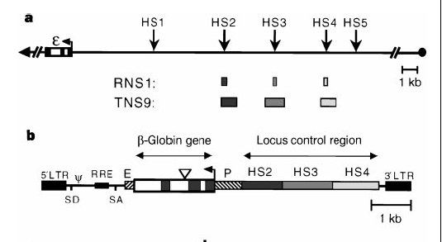
Lentiviral vectoring with LCR regulatory elements: mouse model

Slide 5
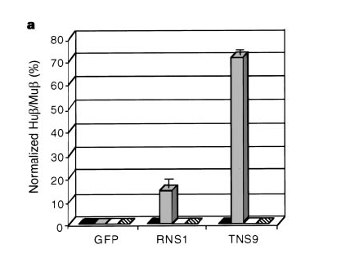
Hematopoetic cell type specificity test of lentiviral human beta globin vectors
Grey bars = induced MEL cells
(red cell model)
Black = uninduced MEL cells
White, hatched
Bars are non-red
Cell line models - eg monocytic
HL60,
Jurkat T cells

Slide 6
Autologous “ex-vivo” transfection of marrow followed by transplant into irradiated host: mouse experiments verify with secondary transplants

Slide 7
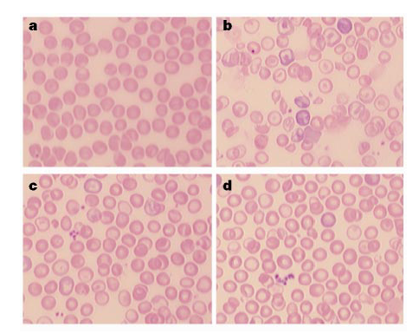
Blood smear assays from RN9 transduced mouse marrow
a = control
GFP-lenti
In Wildtype
marrow
b= GFPlenti
Into beta-thal
marrow
c and d =
2 different
Globin-lenti
Marrow
Transduced
Beta-thal mice

Slide 8
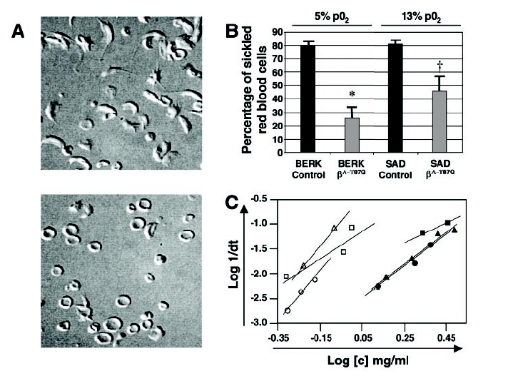
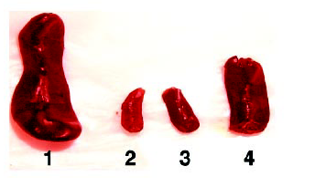
Sickle cell mice: engineered beta globin variant in lentiviral vector
Beta globin residue 87 bchanged from threonine to glutamine
to imitate strong antiscikling character of fetal globin

Slide 9
Gene therapy mediated insertional mutagenesic hazard: First clear cases
Human trial: SCIDX1
Gene - gamma-c cytokine receptor subunit
common chain in recpetors for IL2,4, 7,9,15
needed for survival, growth, differentiation of early
immune progenitors
Human trial with murine maloney retroviral vector expressing
gamma-c cDNA - target cells = cd34+ ex vivo marrow
Early endpoint assay at 10 months:

Slide 10
SCIDX1 initial trial: 2 patients
11 and 8 months old
1. Remove marrow; isolate CD34+ cells (~5 million cells)
2. Stimulate cells to divide in culture (this is a retrovirus)
3. Infect repeatedly for 3 days with gamma-C Moloney virus
4. Infuse ~2 X 10⁷ cells per KG body weight
> Note: No irradiation or other myeloablative treatment
of host. Expect growth advantage to the gamma-c positive cells

Slide 11
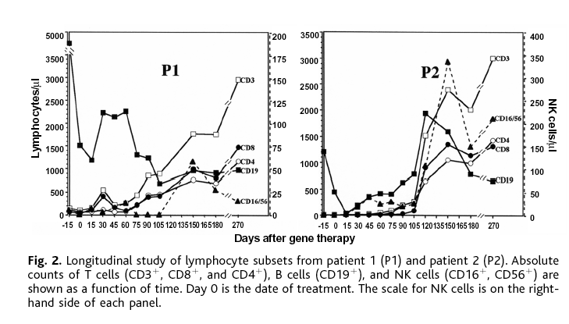
“It is presumed that the effect results from a strong positive selective pressure provided to the corrected lymphoid progenitors.”

Slide 12
Acute lymphoblastoid Luekemia:
2 instances in SCIDX1 trial
Both cases show upregulation of the same cellular protoncogene
due to insertion of retrovirus (gene = LMO2)
LMO2 is transcription factor of progenitor cells
Not fast: three year latency
Preclinical mouse trials did not reveal the risk

Slide 13
Insertional sites, biases, consequences
Retroviruses insert at “random” sites (note other viral systems - notably
adeno associated viruses
- go into just a few specific sites, but they have other limitations
However, open chromatin domains - and explicitly promotor
regions often favored by retros. Pertinent to possible oncogene activation
9 patients = total of ~ 10⁸ independent insertion events
~ one insertion every 10 bases if evenly spaced (not likely)
Loose estimate (~200 cellular oncogenes) suggests range of 10⁻² - 10⁻³
Assume 10kb range for effect at insertion site
conclude a “risky” event once every 100,000 insertions.

