Slide 1
Bi188: Lab 3
Using Galaxy to process RNA-seq data
Say-Tar Goh, Peng He (Brian)
(adapted from Kelvin Zhang’s and Luz Orozco’s presentation slides)

Slide 2
Data: From Sequencer to Analysis
Sequencer
FASTQ: Raw Reads
FASTA: Genome, or pieces of it
Whole-genome assembly / Online Resources
Mapping
note revisions!
SAM/BAM: Alignments
Genome Browser
Input
Conversion
Wig/Bigwig: Continuous Signal
Output
Other analysis (reference gene list, DNase regions, ChIP regions etc.)
Bed: Signal
Delimited Text: Signal per defined section (Transcript, “regions”, etc.)
note revisions!
Custom Analysis: Peak-callers, Clustering, Python, Matlab, Excel(!) etc.

Slide 3
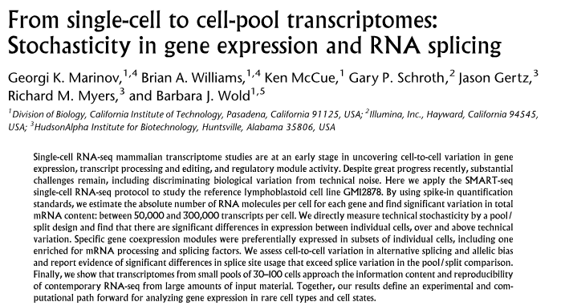
Today’s dataset
http://genome.cshlp.org/content/24/3/496.long

Slide 4
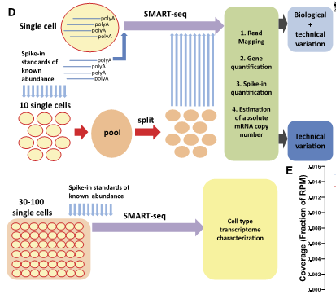

Slide 5
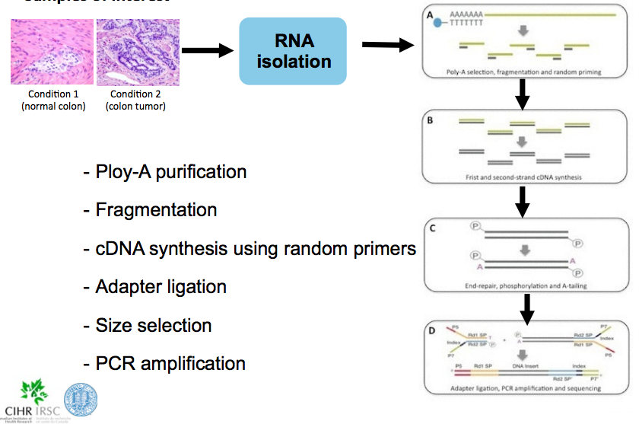
RNA-seq workflow

Slide 6
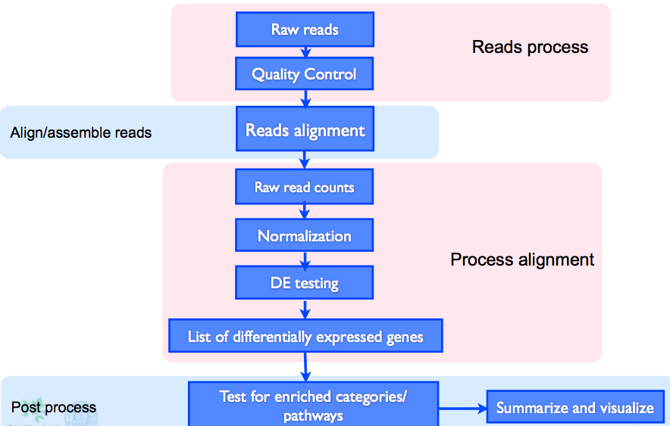
RNA-seq analysis workflow

Slide 7
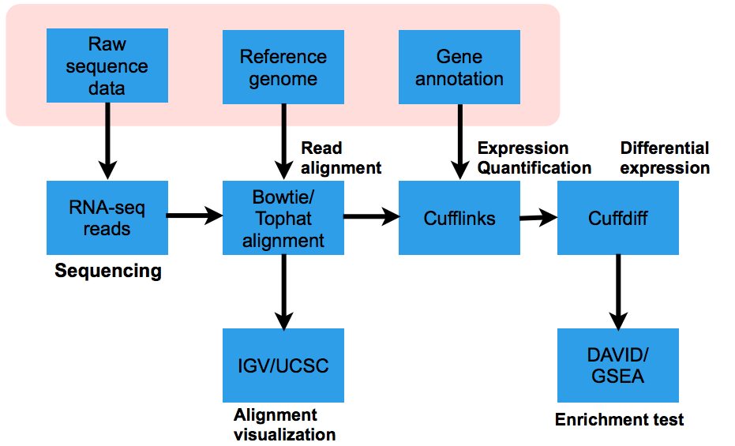
RNA-seq analysis workflow

Slide 8
fastq format
Read sequence
unique identifier/name
@12820-100mers-GM12878_208SRR764797.1 HWI-ST0787:114:D0PMDACXX:2:1101:1717:2186 length=100
CAGTTAGATTACAGTAGAAAAATCATCATTGTCTTATAAAAGACTCTTCAGCATAACAAATGACTCCAGAATCTACAGATTTGAAACAACGTGTATTTAT
+12820-100mers-GM12878_208SRR764797.1 HWI-ST0787:114:D0PMDACXX:2:1101:1717:2186 length=100
CCCFFFFFHHHHGIJJJJJJJJJIJJJJJJJJJIIIIIIJJJJJJJJJJJJJJJJJJJJJJJIJJJJJJIJJIJJEHIHIJJHHHHHFFFFADECFEFED
@12820-100mers-GM12878_208SRR764797.2 HWI-ST0787:114:D0PMDACXX:2:1101:2155:2165 length=100
TGNTTAAATTAAATTAACTATGGTGAAATTGTAGGAAAGAAAAATATATTGCTATTAAAACAATCTTAACTGAAATGGGAAATATTCAGGATGTAATAAT
+12820-100mers-GM12878_208SRR764797.2 HWI-ST0787:114:D0PMDACXX:2:1101:2155:2165 length=100
BB#4ADDFHHHHFIJGJJJIJJJEHHIJJJJGIIJJIJJJJJJJJJJJJJJJJJJJJJJJHIIJJJJJJJJIIJJCHIJHHHHHHFFFFFFEEEEEEEDD
@12820-100mers-GM12878_208SRR764797.3 HWI-ST0787:114:D0PMDACXX:2:1101:2196:2193 length=100
GTATCAACGCAGAGTACATGGGCTTTCCGGCGGTGACGACCTACGCACACGAGAACATGCCTCTCGCAAAGGATCTCCTTCATCCCTCTCCAGAAGAGGA
+12820-100mers-GM12878_208SRR764797.3 HWI-ST0787:114:D0PMDACXX:2:1101:2196:2193 length=100
@@@FDFFFHHGHHIEFGGIJJJHIIJIIIJIIIF@HHGDHF6@>ACBD8A?BDDDDDCDCACCCDBDBB;A9?A>>ACCDDDCCABDDDCC>C>?AC?A?
Quality string

Slide 9
Quality scores
aaacacYabK[`bdefK[RRa_e^JQQ`dI_ged^Ibfg]U_HWWXaSI^
These are coded quality scores. When you do QC, these get converted to a number (Phred score), that represents the probably of a base-calling error

Slide 10
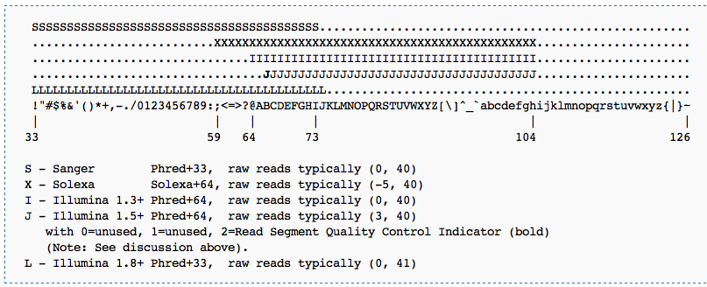
Quality scores
To add to this, some of the Illumina versions (all up to 1.8) encode the quality in a different range of ASCII code than the accepted Sanger……
Thus, you need to “groom” your data file if necessary (we’ll show you how)
http://en.wikipedia.org/wiki/FASTQ_format#Quality

Slide 11
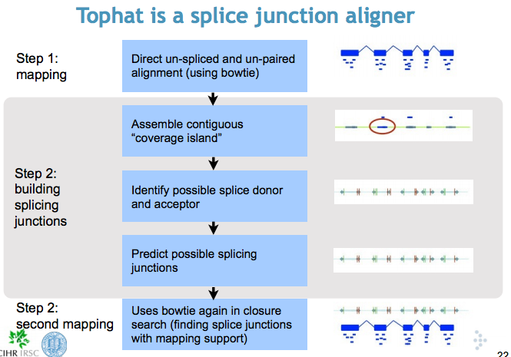
How Tophat maps reads

Slide 12
What is Galaxy
Galaxy is an open, web-based platform for biomedical data analysis
Some institutions have built their own local versions of Galaxy, e.g. UCLA, Rothenberg Lab, Cai Lab etc.

Slide 13
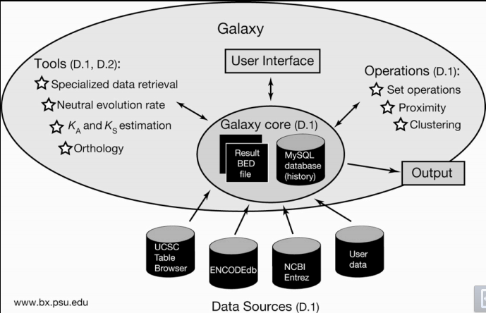
What is Galaxy

Slide 14
Your tasks
1. log on Galaxy
2. Upload .fastq files (“Get Data”)
3. Groom .fastq files (Fastq groomer)
4. Use tophat to align the reads in the .fastq files (convert BAM to Bedgraph, then to bigWig to upload on browser)
5. Use Cufflinks to get FPKM values from the alignment file accepted_hits.bam
6. Downstream analysis (cluster, visualization etc)
7. What are the differences between the “pooled” samples? Vs the single cells? Between the single cells? What more would you need to tell the difference you’re interested in?
Notes:
12819-100mers-GM12878_205SRR764796.fastq 20460064
12820-100mers-GM12878_208SRR764797.fastq 22878845
12821-100mers-GM12878_pool_split_5SRR1066622.fastq 20809512
12822-100mers-GM12878_pool_split_6SRR1066623.fastq 30936670
13290-100mers-GM12878-244SRR764812.fastq 16963441
13291-100mers-GM12878-245SRR764813.fastq 40845001
SRR1066641.1.fastq 426599
SRR1066641.2.fastq 42674
SRR1066641.fastq 42659924

Slide 15
Where are the files?
Main datasets: woldlab/bostau/data00/home/sgoh/fastq
Small test dataset:
woldlab/bostau/data00/home/sgoh/fastq_small

Slide 16
Miscellanous command line:
ftp/sftp (on bostau): server-to-server copying
mput/mget, !ls, ls

