Slide 1
Investigating chromatin accessibility using atac-seq
Peng (brian) He

Slide 2
Your task 1
cp /woldlab/castor/home/www/bi188/XunATACIl2ra.fastq ~/
/woldlab/castor/home/hamrhein/bin/bowtie /woldlab/castor/home/georgi/genomes/mm9/bowtie-indexes/mm9 -p 8 -m 1 -t --best --strata -q --sam XunATACIl2ra.fastq | /woldlab/castor/proj/genome/programs/samtools-0.1.8/samtools view -bT /woldlab/castor/home/georgi/genomes/mm9/sequence/mm9.fa - | /woldlab/castor/proj/programs/samtools-0.1.16/bin/samtools sort - XunATACIl2ra

Slide 3
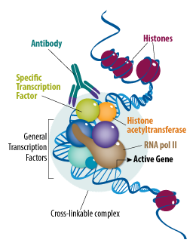
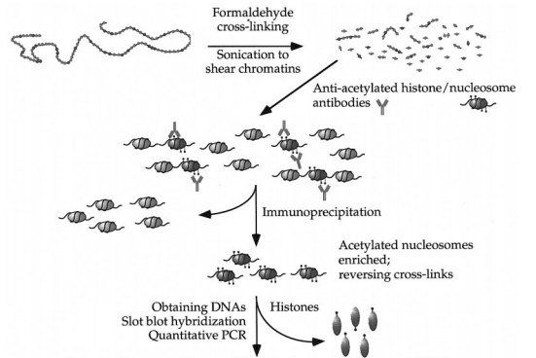
Warming up --- chip-seq

Slide 4
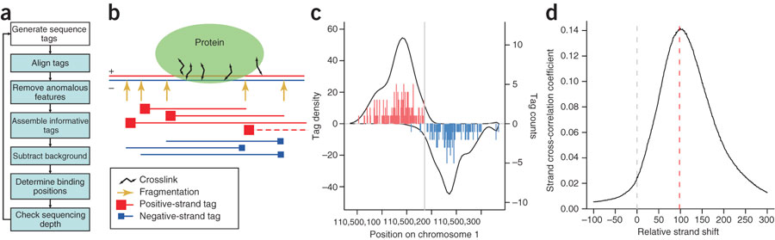
Warming up --- chip-seq
Kharchenko 2008

Slide 5
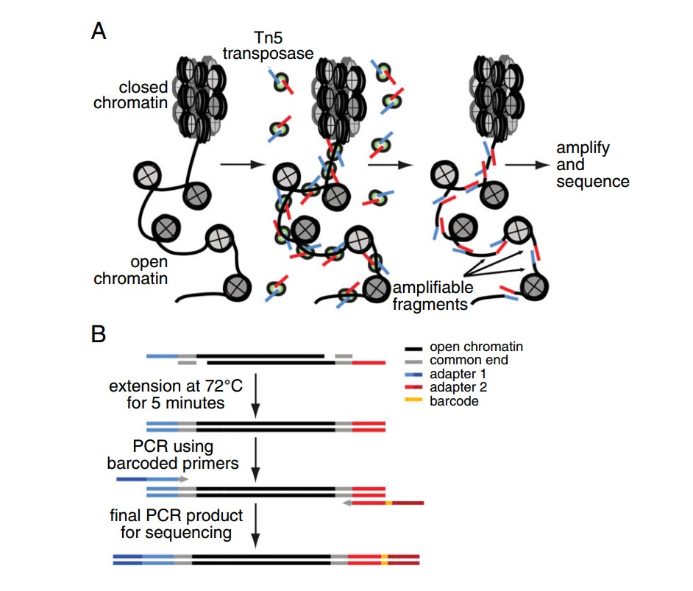
ATAC-seq principle
Jason D Buenrostro et al

Slide 6
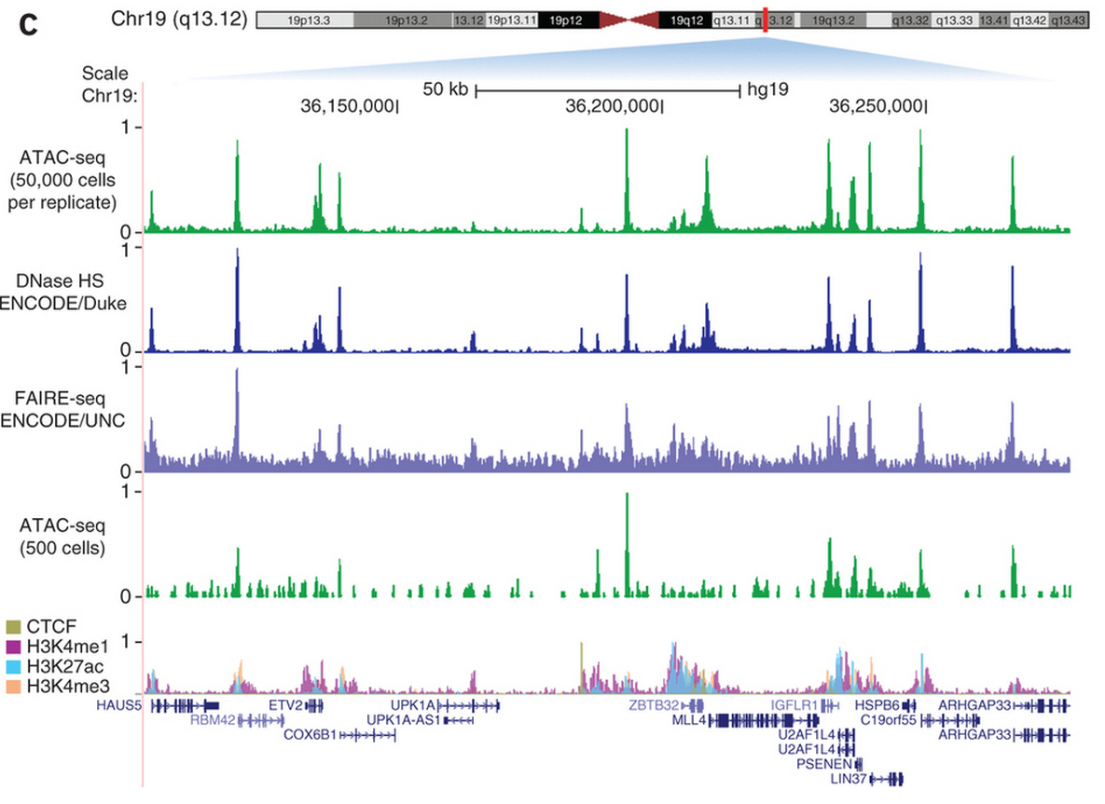
Jason D Buenrostro et al

Slide 7
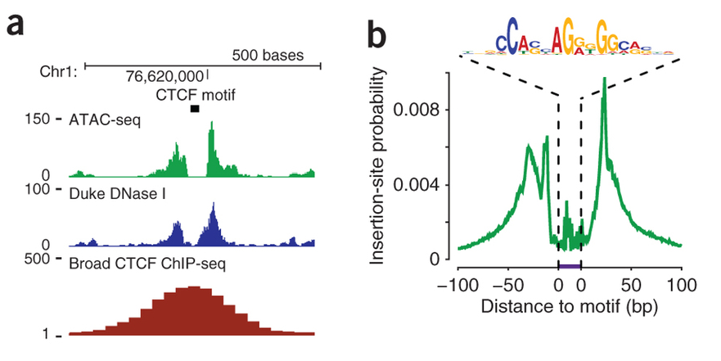

Slide 8
Linux command line: why linux
Unix is a command line interface, used by most large, powerful computers.
It is very popular, so it is easy to find informatIon and get help
Unix is very stable - computers running Unix almost never crash
Unix is very efficient
it can smoothly manage extremely huge amounts of data
Most new bioinformatIcs software is created for Unix - its easy for the programmers
(from Serghei Mangul’s slides)

Slide 9
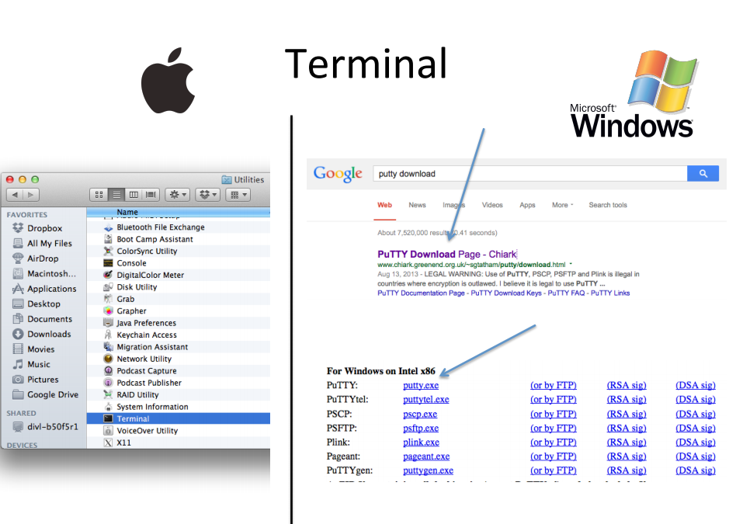
(from Serghei Mangul’s slides)

Slide 10
Get started (if you still remember how)
woldlab.caltech.edu/bi188/software.shtml
Get Putty (for Windows), open Terminal (for Mac/Linux)
Make sure you’re familiar with: ls, cd, cp, mv, general folder navigation
Your SFTP client of choice, or Filezilla
bostau.caltech.edu:22
ssh

Slide 11
Your task 2
1. map the data file using bowtie (you’ve already done it)
2. Convert the sam output to bam format
3. sort the bam file
4. index the bam file
5. convert bam file to bigwig
6. look at the data using the genome browser

Slide 12
hints
mv XunATACIl2ra.bam ~/public_html/XunATACIl2ra.bam
samtools index ~/public_html/XunATACIl2ra.bam
python /woldlab/castor/home/georgi/code/makewigglefromBAM-NH.py --- ~/public_html/XunATACIl2ra.bam /woldlab/castor/home/georgi/genomes/mm9/mm9.chrom.sizes ~/public_html/XunATACIl2ra.bam.wig -notitle –RPM
/woldlab/castor/proj/genome/programs/x86_64/wigToBigWig ~/public_html/XunATACIl2ra.bam.wig /woldlab/castor/home/georgi/genomes/mm9/mm9.chrom.sizes ~/public_html/XunATACIl2ra.bam.bigwig
It’s hypothesized that Notch regulates Il2ra. Where is it likely to bind?

Slide 13
Bonus task
Use different bowtie parameters and see how they will change the results

