Slide 1
Microservices
Resilient and Reliable Service Implementation Using Azure Service Fabric

Slide 2
Agenda for the day
Microservices
SOA and Microservices
Monolithic vs Microservice Architecture
Common Microservice design patterns
Azure Service Fabric
Introduction
Clusters and Nodes
Development, Testing and Deployment
.NET Core
Kestrel
NGINX
Demo
1
2
3

Slide 3
What are Microservices? Isn't SOA the same?

Slide 4
Service-Oriented Architecture
Defines a mechanism of how 2 application or services communicate via the network
Big applications are broken down into logical components
Service Request
Service Consumer
Service
Service Provider
Service Response

Slide 5
Microservices Architecture
Microservice architecture is a method of developing software applications as a suite of independently deployable, small, autonomous and modular services.
Each service runs a unique process.
Communicates through a well-defined, lightweight mechanism (API’s and Message Queues)
Why go for Microservices?
Technology Heterogeneity (.NET, Java, Node etc…)
Resilience
Scaling
Ease of Deployment
Organizational Alignment
Composability
SOA
Microservices

Slide 6
Monolithic vs Microservices
Monolithic
Microservices
User Interface
User Interface
Business Layer
Data Interface
Microservice
Microservice
Microservice

Slide 7
Does and Don’ts
TODO: Steel from the meetup

Slide 8
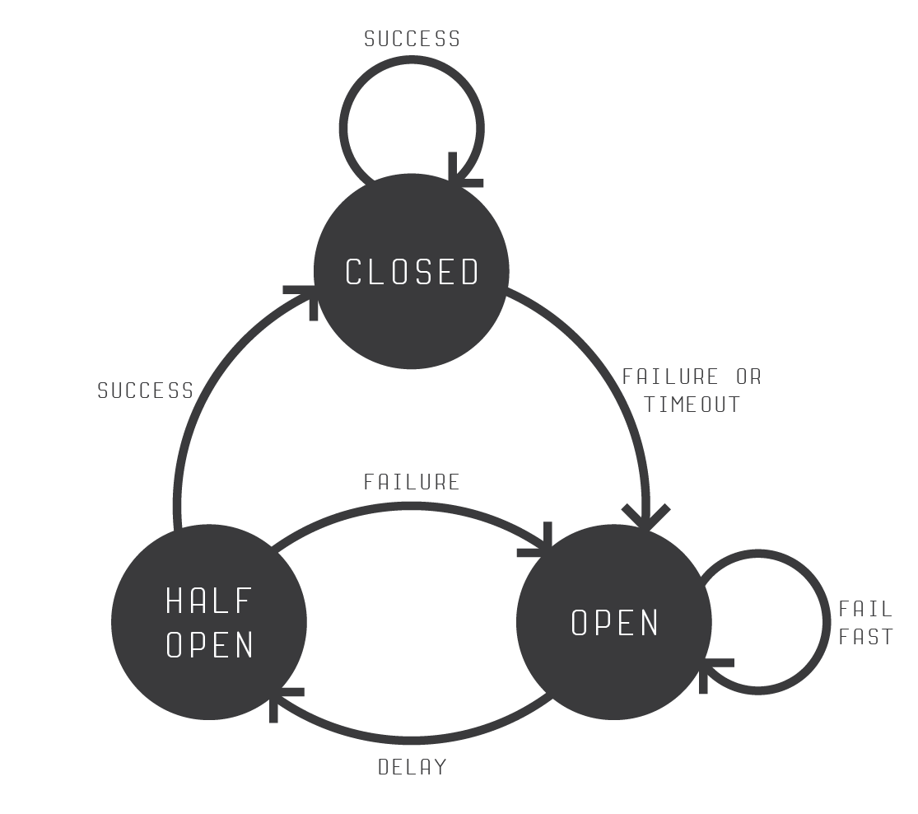
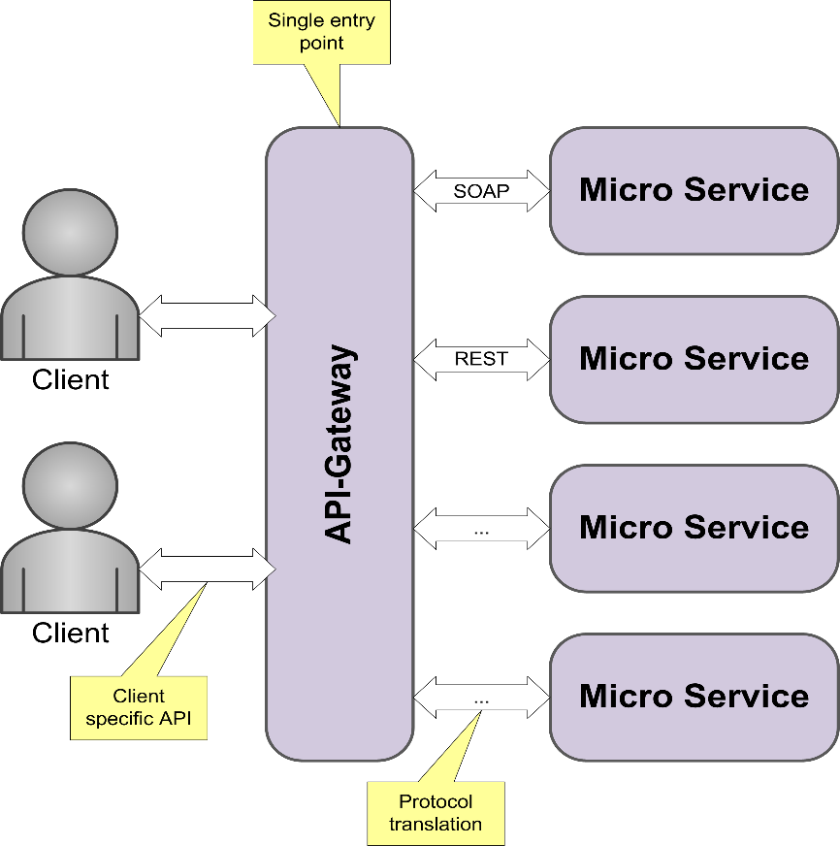
Common Microservices Design Patterns
Circuit Breaker Pattern
Handle faults that may take a variable amount of time to rectify when connecting to a remote service or resource. This pattern can improve the stability and resiliency of an application.
Api Gateway Pattern
The API Gateway pattern defines how clients access the services in a microservices architecture. Implements an API gateway that is the single entry point for all clients.

Slide 9
Honorable mentions….
Client-side Discovery and Server-side Discovery patterns
Used to route requests for a client to an available service instance
The Messaging and Remote Procedure Invocation patterns
Different ways that services can communicate.
Single Service per Host and Multiple Services per Host
Different deployment strategies.
Database per Service pattern
Describes how each service has its own database.
Microservice chassis pattern
Build micro services using a framework that handles cross-cutting concerns.

Slide 10



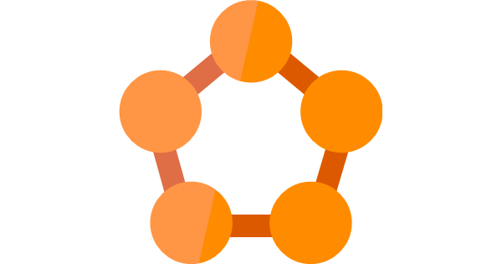


Microservices Chassis Frameworks
Microservices Framework for Java
Azure Service Fabric

Slide 11
Azure Service Fabric

Slide 12
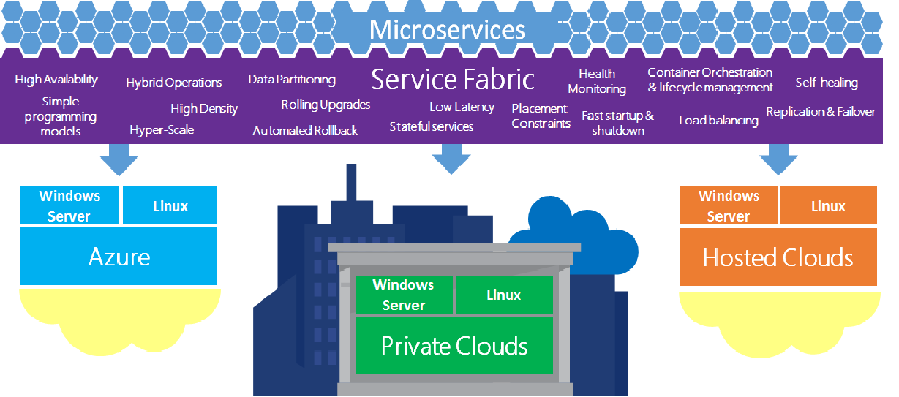

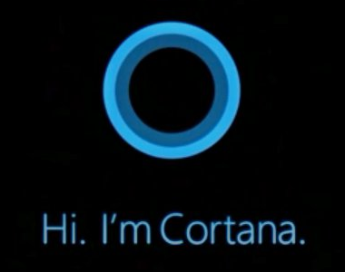
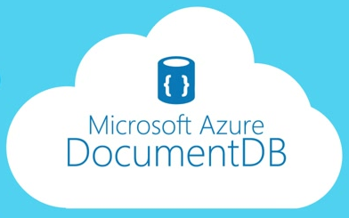
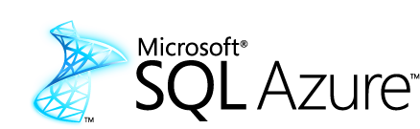
Azure Service Fabric
Application platform for distributed reliable, hyper scale, Microservice-based applications

Slide 13
Advantages of using Service Fabric
Develop massively scalable applications that are self-healing
Develop highly reliable stateless and stateful microservices
Deploy to Azure or to on-premises datacenters that run Windows or Linux with zero code changes. Write once, and then deploy anywhere to any Service Fabric cluster.
Deploy self hosted applications and service (Kestrel, OWIN host, NodeJs)
Develop applications that are composed of microservices by using the Service Fabric programming models (Reliable Actor, Reliable Services model).

Slide 14
Clusters and Nodes
Service Fabric Clusters
A cluster is logical group of machines which are referred to as nodes.
Service Fabric Nodes
A node is a Virtual Machine.
A node can be a Linux or Windows.
Service fabric can be configured to host 0 or any number services or applications on a single node. (Assuming that your node vertical scales accordingly)
Node1
Node 2
Node 3
Node 4
Node 5
Cluster

Slide 15
Development, Testing and Deployment
A service developer develops different types of services using the Reliable Actors or Reliable Services programming model.
The development environment in the SDK is identical to the production environment, and no emulators are involved. In other words, what runs on your local development cluster deploys to the same cluster in other environments.
Chaos Test Scenarios, application built to cause faults in the cluster for testing purpose of the service fabric.
Deploying an application on the service fabric combines the following steps into one simple operation:
Creating the application package
Uploading the application package to the image store
Registering the application type
Removing any running application instances
Creating a new application instance

Slide 16
.NET Core
What is .NET Core?
.NET Core is the latest moduler version of .NET.
It is a new open-source and cross-platform framework for building modern cloud based internet connected applications, such as web apps, IoT and mobile backends.
Allows you to separate out your host from the application.
Why use .NET Core?
.NET Core is cross platform, so you can run it on Windows, Linux, Docker and Mac
You don't need to install the .NET Framework to run it. Instead, you ship all the required dlls with your application.
You can use Visual Studio Code to develop your application, which is free and lightweight in comparison to Visual Studio. And you can use it on different platforms as well.
.`NET Core has a number of architectural changes that result in a much leaner and modular framework.

Slide 17
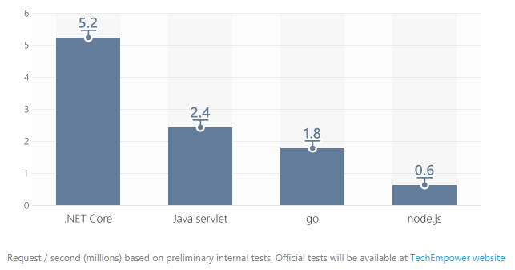
Kestrel
What is Kestrel?
.NET Core includes a managed cross-platform web server, called Kestrel.
Kestrel is the new cross platform .NET web server which runs on Linux, Mac and Windows 10 and will, eventually, run on Raspberry Pi.
Kestrel is way faster when compared to IIS. According to some measure it is about 20 times faster than IIS.

Slide 18
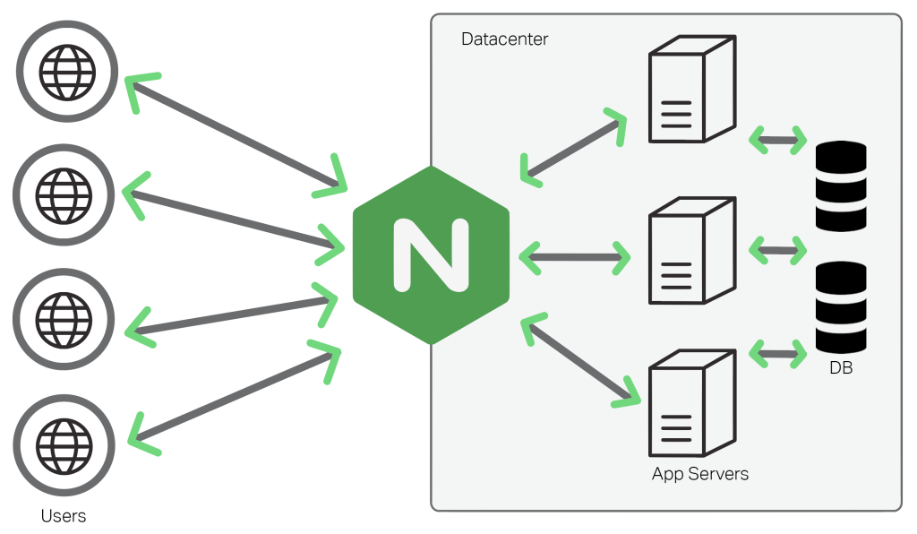
NGINX
What is NGINX?
NGINX (Pronounced as Engine-X) is an open source, lightweight, high-performance web server or proxy server.
Nginx can be used as a reverse proxy server for HTTP, HTTPS, SMTP, IMAP, POP3 protocols, on the other hand, it is also used for servers load balancing and HTTP Cache.
Why use NGINX?
Can be used as a proxy or a load balancer
Its super fast, light weight and more platform independent.

Slide 19
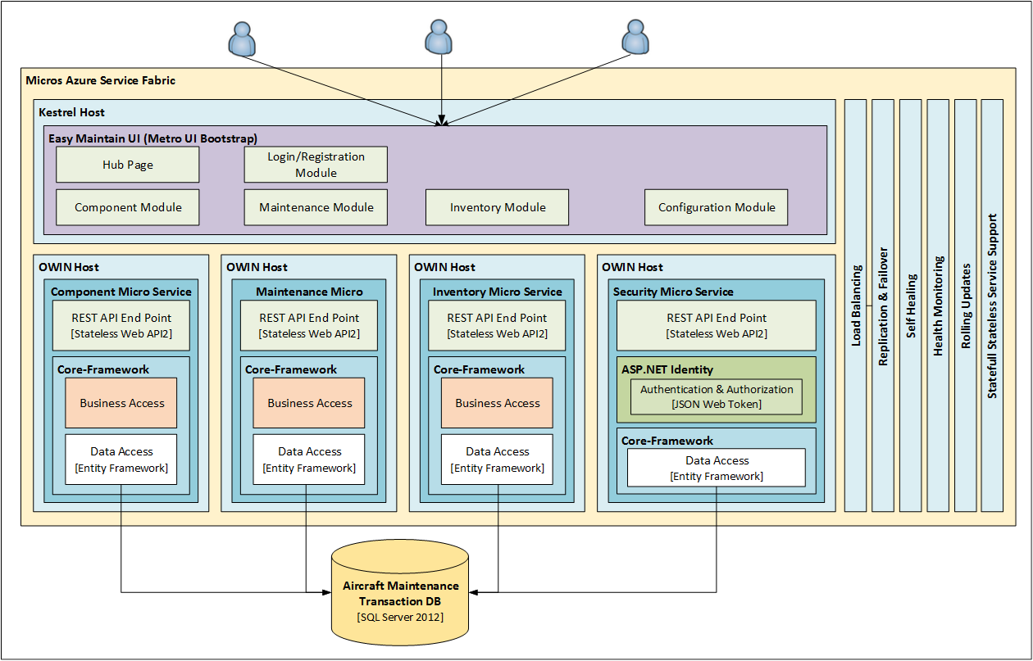
Proof of Concept

Slide 20
Questions?

Slide 21
Thank You

